Slide 1


Multi-Tiered Systems of Support in a Comprehensive Reading Program
Project created in partnership with
the Rhode Island Department of Education Literacy Ambassadors 2020

Slide 2

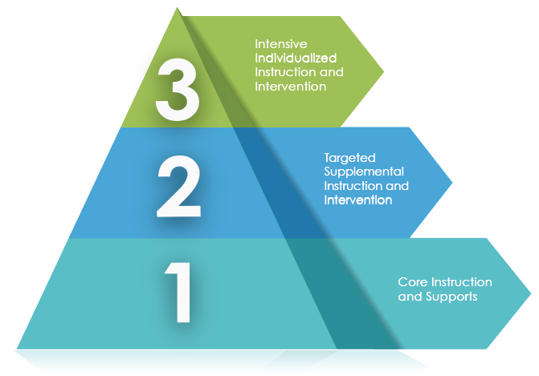



Slide 3


Comprehensive Reading Program

Slide 4
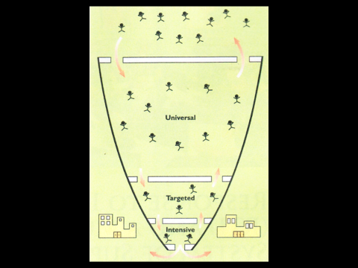
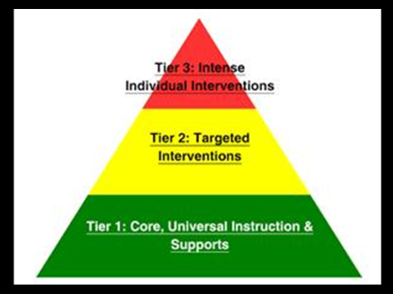
Response to Intervention/MTSS Overview
Cengage Learning, 2013

Slide 5
Sample Structure of a Literacy Block
Instruction | Time | Class Configuration | Instructional Examples
90 minutes Tier 1: Core Literacy Instruction | 25-45 minutes daily | Whole group | Teaching the core reading program and supplementing with materials to fill any gaps in foundational reading skills (e.g., phonemic awareness, encoding)
 | 45-65 minutes; approximately 15-20 minutes per small group daily | Small groups on a rotating basis | Reviewing phonics instruction, word building activities, reading decodable texts and moving to leveled when students can accurately read real and nonsense words of all syllable types.
 |  | Group 1: 15 minutes
 |  | Group 2: 15 minutes
 |  | Group 3: 15 minutes
Tier 2 Intervention | 15-25 minutes 3-5 times per week | Individual/small group | In addition to the core literacy instruction, address specific area of need on the literacy continuum.
Tier 3 Intervention | 30 minutes- 1 hour 3-5 times per week | Individual/small group with highly trained support personnel | Intensive, formal, structured literacy-based intervention delivered with fidelity still focusing on specific area of need.

Slide 6

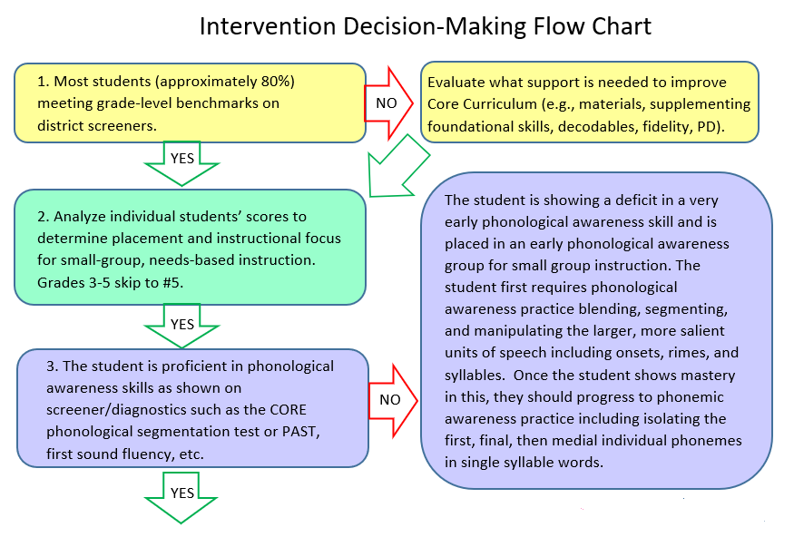

Slide 7

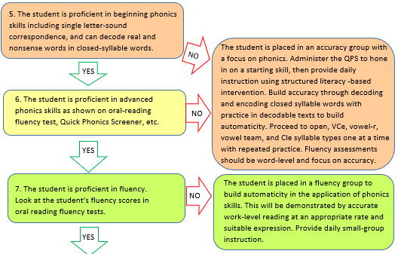

Slide 8

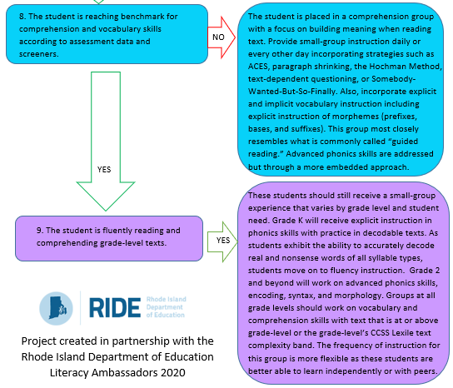

Slide 9

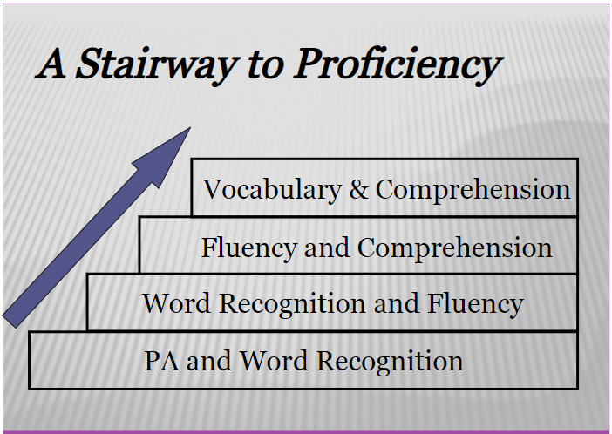
Continuum of
Literacy Skills

Slide 10

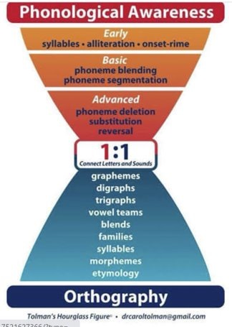

Slide 11
Response to Intervention/MTSS Overview
Cengage Learning, 2013

Slide 12

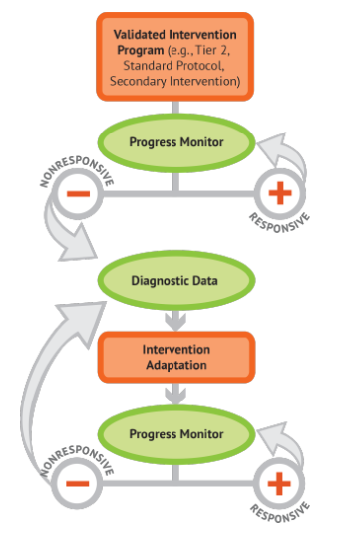
Data-Based Individualization: When Students are Non-Responsive to the Intervention
A specific way of implementing intensive intervention
Grounded in experimental teaching (Fuchs & Deno, 1982)
Evidence of effectiveness in many studies Schumaker et al., 2005; see Toste et al., 2018 for a review)
Currently championed by the OSERS-funded National Center on Intensive Intervention

Slide 13

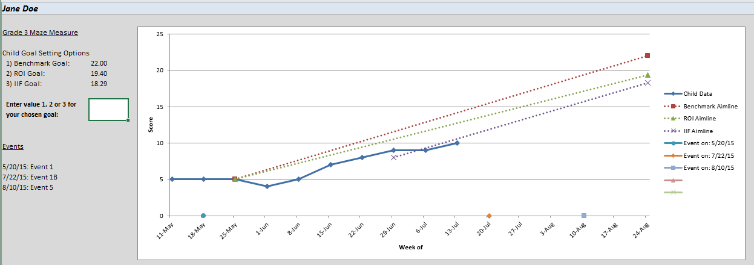
Progress Monitoring

Slide 14

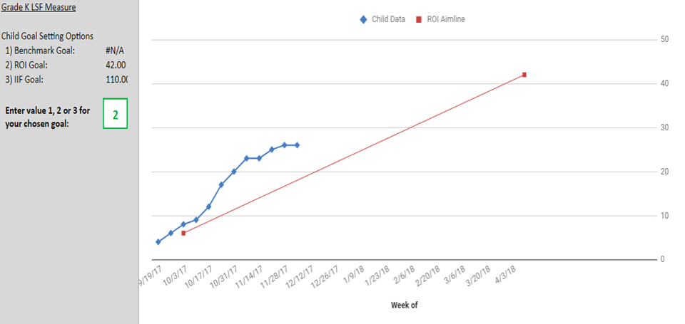
Progress monitoring template found at https://intensiveintervention.org/

Slide 15

Diagnosis

Slide 16


Further Resources

