Slide 1



Slide 2


EEP HIGHLIGHTS
Established in 1980
2nd largest and oldest program in New England
Founding member of NACEP
49 RIC courses available

Slide 3
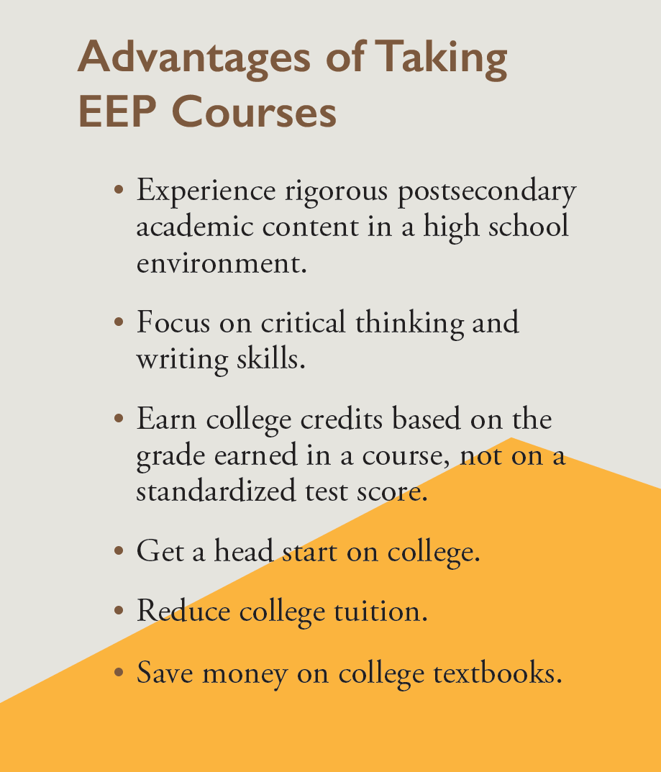
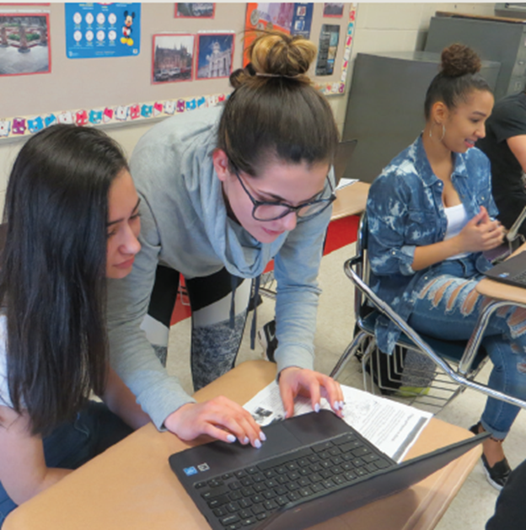


Slide 4
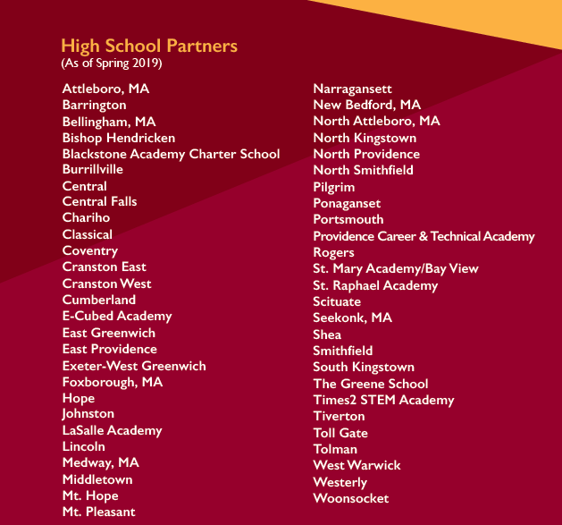

High School Partners 2021 – 2022
Partner Schools 2021-2022
42 RI public high schools
4 RI private high schools
7 MA public high schools

Slide 5
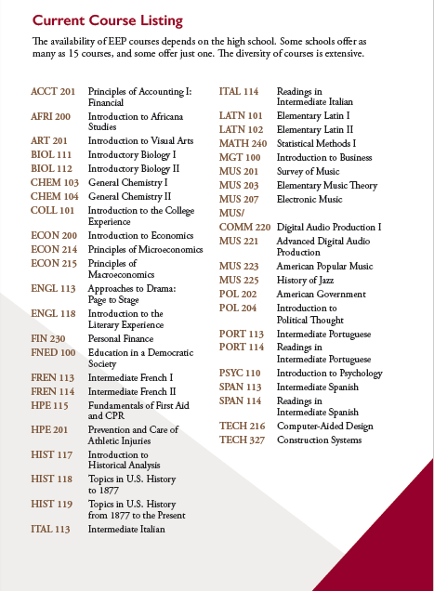

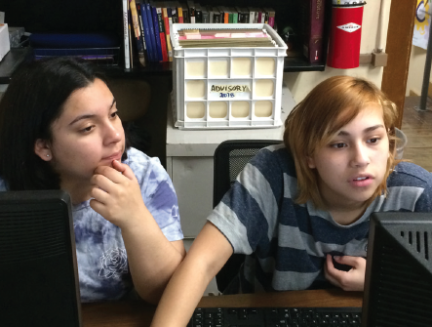
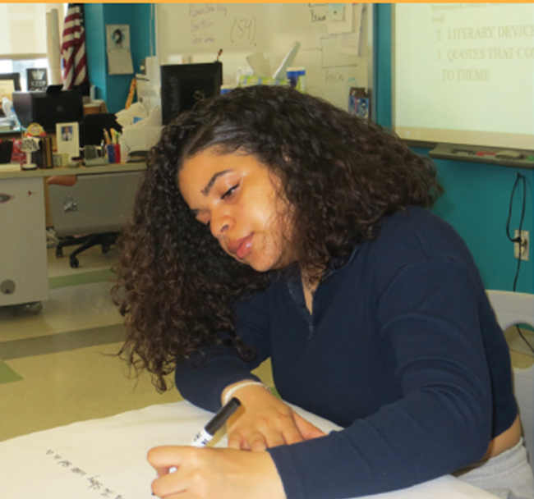

ǂACCT 201 Principles of Accounting I: Financial | *ITAL 114 Intermediate Italian II
*AFRI 200 Introduction to Africana Studies | _{LATN 101 Elementary Latin I.}
*ART 201 Introduction to Visual Arts | _{*LATN 102 Elementary Latin II}
*ǂBIOL 111 Introductory Biology I | *ǂMATH 240 Statistical Methods I
*ǂBIOL 112 Introductory Biology II | ǂMEDI 201 Orientation to Medical Imaging
_{*ǂCHEM 103 General Chemistry I} | ǂMEDI 255 Patient Care in Medical Imaging
*ǂCHEM 104 General Chemistry II | MGT 100 Introduction to Business
COLL 125 College Learning Strategies | _{*ǂMUS 207 Electronic Music}
*ECON 200 Introduction to Economics | *ǂMUS 220 Advanced Digital Audio Production I
ǂECON 214 Principles of Microeconomics | MUS 119 Advanced Digital Audio Production
ǂECON 215 Principles of Macroeconomics | _{*MUS 201 Survey of Music}
_{*ENGL 113 Approaches to Drama} | *MUS 203 Elementary Music Theory
*ENGL 118 Introduction to the Literary Experience | *MUS 223 American Popular Music
_{FIN 230 Personal Finance} | _{*ǂMUS 225 History of Jazz.}
ǂFNED 101 Introduction to Teaching and Learning | _{*ǂPOL 202 American Government}
ǂFNED 246 Schooling for Social Justice | *ǂPOL 204 Introduction to Political Thought
*FREN 113 Intermediate French I | *PORT 113 Intermediate Portuguese I
*FREN 114 Intermediate French II | *PORT 114 Intermediate Portuguese II
ǂHPE 115 Fundamentals of First Aid & CPR | *ǂPSYC 110 Introduction to Psychology
ǂHPE 201 Prevention & Care of Athletic Injuries | ǂSWRK 200 Introduction to Social Work
*HIST 107 Multiple Voices: The US in the World | *SPAN 113 Intermediate Spanish I
*HIST 117 Introduction to Historical Analysis | *SPAN 114 Intermediate Spanish II
_{*HIST 118 U.S. History I} | ǂTECH 216 Computer-Aided Design
_{*HIST 119 U.S. History II} | _{ǂTECH 327 Construction Systems}
*ITAL 113 Intermediate Italian I
* Satisfies a Gen Ed requirement at RIC
ǂ Counts in a major or a minor at RIC

Slide 6
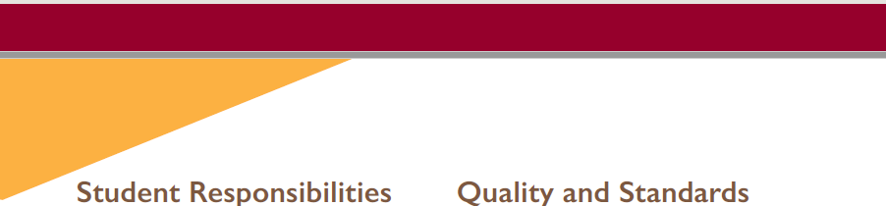
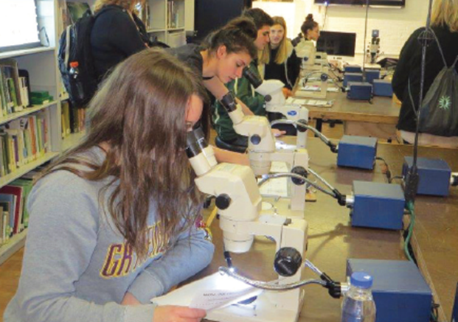

How EEP Courses Can Be Applied at RIC
90% of our 49 EEP courses count towards a
Gen Ed and/or a major or minor requirement
Gen Ed: 32 courses
Major or Minor: 23 courses
Elective Credit: 5 courses
First of its kind
New minor in Digital Media Production was strategically designed to include 2 EEP music courses.

Slide 7
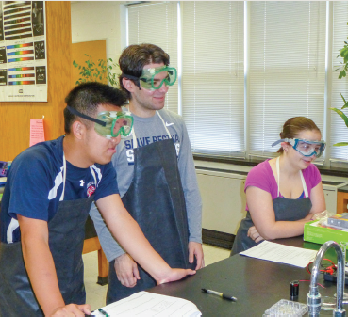

Newest Additions to EEP Offerings
COLL 125 College Learning Strategies
PCTA was the first high school to offer the course and it is co-taught by an English teacher and a school counselor.
FNED 101 and 246
The Feinstein School of Education & Human Development is now offering two courses required in our elementary education degree.

Slide 8
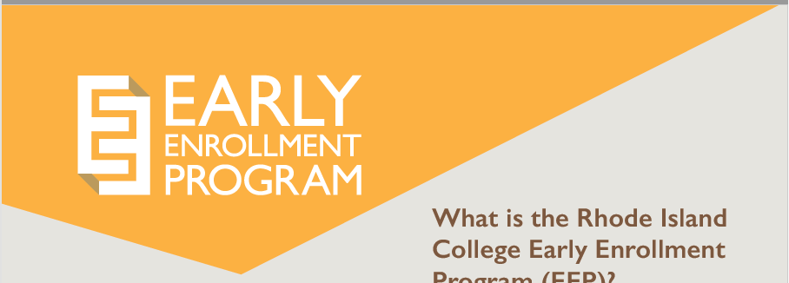
Interested in becoming an
EEP Instructor?
Contact the EEP staff at 456-8857 or email eep@ric.edu.
EEP staff can supply sample syllabi for prospective EEP Instructors and will outline the approval process.
Visit https://www.ric.edu/early-enrollment-program to and click on EEP Instructors & On-site Coordinators to learn more about requirements and qualifications needed.

Slide 9

QUESTIONS?
Contacts:
Early Enrollment Program (EEP)
http://www.ric.edu/eep/Pages/default.aspx
401-456-8857
Holly L. Shadoian, PhD
Vice Provost for Undergraduate Affairs
401-456-8884

