Slide 1
Spring Convening for LEAs Using a New Student Learning Option: Embedded Practice or Student Learning Goals 2019-20
Notes:
Thank you for taking the time to assemble your LEA team and for creating the space to attend to this important information.
This session is designed to be led by a district leader who is very knowledgeable with the RI Model Evaluation & Support System, its flexibility factors, and especially, the new model of student learning being implemented in your district: Embedded Practice or Student Learning Goals. It is recommended that the facilitator of this session print out the ‘Notes Pages’ version of this PowerPoint so that they can read the slides and direct participants, accordingly.
If not done already, please consult the Facilitator’s Guide (https://www.ride.ri.gov/Portals/0/Uploads/Documents/Teachers-and-Administrators-Excellent-Educators/Educator-Evaluation/2019-20_SpringConvening_FacilitatorGuide.pdf?ver=2020-04-29-123145-003) to ensure familiarity with the session objectives, that necessary materials have been printed in advance, and that there is a general level of comfort with the content and flow of this session.
Please reach out to EdEval@ride.ri.gov with any questions or concerns.

Slide 2
Guiding Principles
Notes:
As you know from having participated in the Fall Convening, these are the guiding principles that inform the backbone of these new student learning models. In the fall, we discussed how these were important principles to consider in operationalizing the models into practice. In this session, we’ll emphasize how evidence, strategies, and learning expectations come together in the scoring process through intentionally designed activities.

Slide 3
Essential Question
How do we measure student learning with accuracy and authenticity?
Notes:
During the two Student Learning Pilot years, our work in supporting LEAs with implementation was grounded in this essential question. We continue to see this question as relevant as you understand how measuring student learning through Embedded Practice/SLGs differs from the process of measuring through SLOs. So we invite you to reflect: How did you measure student learning through this model? Did it feel like a natural extension of they way you would normally determine how your students demonstrated their learning? How do you know if the process was an accurate representation of your students’ learning?
In thinking about the implementation process, we hope you have learned from this year’s work in an effort to continue to operationalize and improve upon the process for next year.

Slide 4
Intended Outcomes: Overview
Today’s intended outcomes are to:
Review the 3e Rubric & Scoring Guidance and understand how instructional processes lead to instructional outcomes
Reflect on implementation and plan for next year
Understand how a student learning score is calculated
Notes:
Here are today’s intended outcomes.

Slide 5
Intended Outcomes: Overview
Today’s intended outcomes are to:
Review the 3e Rubric & Scoring Guidance and understand how instructional processes lead to instructional outcomes
Reflect on implementation and plan for next year
Understand how a student learning score is calculated
Notes:
Let’s jump into our first item: (read screen)

Slide 6
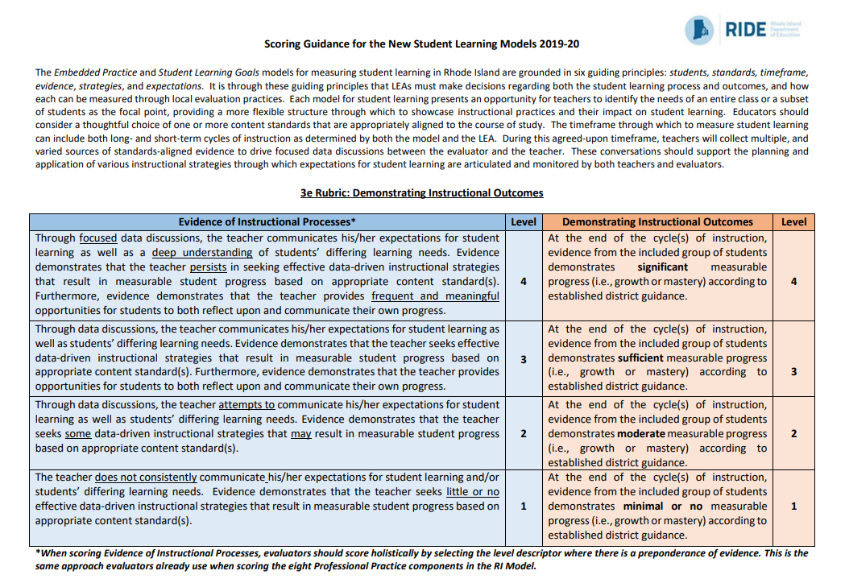
3e Rubric (RI Model)
Notes:
At this point, take out hard copies of your 3e rubric and guidance document.
Different from two SLO scores, teachers using these new models – Embedded Practice or SLGs – will be scored holistically on their overall instruction, the left side, which lead to student learning, the right side, no matter how many cycles of instruction were completed during that time. Now we’re going to reacquaint you to the “left” and “right” sides of the rubric.
This rubric was designed to recognize the instructional “inputs”, or purposeful teacher moves, that you make in order to impact student learning: the instructional outcomes – THE LEFT SIDE. Ideally, strong inputs should lead to strong outputs, but we know in context, this is not always the case – THE RIGHT SIDE. Thus, by design, there is more flexibility with this model. In a moment, you’ll participate in an activity to acquaint you with each side of the rubric, in an effort to more clearly define what each “looks like” in practice.

Slide 7
Activity: “Left Side” (30 min.)
(5 min.) Independently, read the rubric language first. Then, read the vignette and annotate. Finally, use the left side of the rubric to score the overall process on your organizer.
(15 min.) As a group, discuss each of your scores and come to a consensus on how this teacher would be scored, and any questions you still have about the score.
(10 min.) As a group, share out the questions and/or concerns that arose from engaging in this discussion.
Notes:
Now your team will engage in an activity to better understand the left side of the 3e rubric. We suggest, after reviewing the instructions and gathering the rubric, your model’s vignette, and graphic organizer, that you pause for approximately 30 minutes, or the time that is needed for your group to complete this activity. Please remember that the goal of this activity is to ultimately come to consensus on the scoring.
When completed, you’ll advance to the next slide.

Slide 8
Activity: “Right Side” (30 min.)
As a group:
(5 min.) Discuss the guidance your district developed for Demonstrating Instructional Outcomes.
(20 min.; 10 min. per set) Review and score each of the 2 artifact sets that the team brought. Calibrate as needed. Discuss how this evidence aligns with your local guidance.
(5 min.) Determine what, if anything, is still required to better clarify the scoring process.
Notes:
Now your team will engage in an activity to better understand the right side of the 3e rubric. Now, take out your two artifact sets that you were asked to bring for today, in addition to your LEA guidance that expands on scoring the “right” side of the rubric. Again we suggest, after reviewing the instructions and gathering the necessary materials we previously described, that you pause for approximately 30 minutes, or the time that is needed for your group to complete this activity. During the activity, evaluators and educators should engage with the decision making to ensure that there is a common understand of what each indicator means based on the artifacts provided.
Then, once the group has come to a shared understanding, you’ll advance to the next slide.

Slide 9
Intended Outcomes: Overview
Today’s intended outcomes are to:
Review the 3e Rubric & Scoring Guidance and understand how instructional processes lead to instructional outcomes
Reflect on implementation and plan for next year
Understand how a student learning score is calculated
Notes:
Now that you better understand the scoring process with the 3e rubric, you’ll take some time to reflect on the process thus far, and think ahead to what educators and evaluators will need to know for next year and beyond.

Slide 10
Activity: Reflect on Student Learning Processes (25 min.)
Where did data discussions take place? How often? With whom?
What evidence was used to set expectations for student learning?
How was data used to adjust instructional strategies?
How were expectations for student learning recorded? By whom?
What did student reflections look like? How did they show ownership of their learning?
Notes:
This activity will ask that the group count off by fives, and work independently, or in small groups, depending on how many are in your session today. Each group will rotate through the five questions above, spending about 2-3 minutes at each “station” which are designed to surface the key processes of implementing this new model for student learning: [read questions]. When the groups have arrived back at the question in which they started, review the additional thoughts from the group and take 1-2 minutes to share out the findings with the whole group. This way, everyone has a chance to hear about the whole group’s thoughts before moving to the next part of today’s presentation.

Slide 11
Intended Outcomes: Overview
Today’s intended outcomes are to:
Review the 3e Rubric & Scoring Guidance and understand how instructional processes lead to instructional outcomes
Reflect on implementation and plan for next year
Understand how a student learning score is calculated
Notes:
And finally, we want to share how student learning will be calculated with regard to the overall Final Effectiveness Rating.

Slide 12
Professional Practice Rubric: Element 3e
3e (New Component)
2a, 2b, 2c, & 2d
PR1-9
3a, 3b, 3c, & 3d
Notes:
Here we wanted to reference the overall evaluation scoring process to see where this new rubric element aligns in the bigger picture of the FER. We see that Domains 2 & 3 are still in their respective 25% of the FER, but we are calling the new rubric element “3e” as it is a result of instructional practices, i.e. Domain 3. With that said, we want to note that this one rubric will replace the two or more required SLOs, and will account for the 30% of Student Learning.

Slide 13
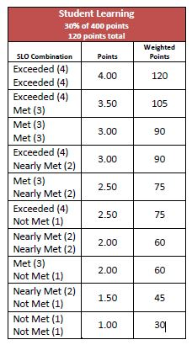
Student Learning Weighting & Points
Student Learning 30% of 400 points 120 points total
Evidence of Instructional Processes |  | Demonstrating Instructional Outcomes | Points | Weighted Points
Exceeded (4) | + | Exceeded (4) | 4.00 | 120
Exceeded (4) | + | Met (3) | 3.50 | 105
Met (3) | + | Met (3) | 3.00 | 90
Exceeded (4) | + | Nearly Met (2) | 3.00 | 90
Met (3) | + | Nearly Met (2) | 2.50 | 75
Exceeded (4) | + | Not Met (1) | 2.50 | 75
Nearly Met (2) | + | Nearly Met (2) | 2.50 | 60
Met (3) | + | Not Met (1) | 2.00 | 60
Nearly Met (2) | + | Not Met (1) | 1.50 | 45
Not Met (1) | + | Not Met (1) | 1.00 | 30
Notes:
Here we see the points and weight chart for SLO scoring that we have used traditionally in the RI Model. You’ll note that the new scoring process is virtually identical to the way you know it. Instead of getting 2 SLO scores, you’ll get two scores but one will be for Evidence of Instructional Processes and the other will be for Demonstrating Instructional Outcomes.

Slide 14
Closing
Resources:
https://www.ride.ri.gov/TeachersAdministrators/EducatorEvaluation/StudentLearning.aspx
Evaluation email: EdEval@ride.ri.gov
Notes:
In closing, we hope this spring convening module was helpful and engaging as you reflect on implementing Embedded Practice or SLGs. And, we want to thank you for your continued work to implement, improve, and evolve the process of measuring student learning.. Please don’t hesitate to reach out to us with your questions at EdEval@ride.ri.gov.

Slide 15
Optional Closing Activity: Reflection & Discussion
Based on your experiences with SLOs, what would you say was the biggest difference between implementing your model and SLOs?
What advice would you give to someone in the same role starting this process that you wish someone had given to you at the start of last year?
How would you improve upon the ways in which you organized the many aspects of student learning within the evaluation process (i.e. organization, expectations, data, students, etc.)?
Notes:
If you have time, and are so inclined after the previous activity, groups are encouraged to choose one or more of these questions to discuss with small group, whole group, or even as an exit ticket. Either way, it is important to consider how the learning you have shared from this year will help to improve upon the process for next year so that all educators in your district may benefit from your collective experiences.

