Slide 1
Building Capacity for a Collaborative ENL & General Education Model: A Five-Module Course for School-Based Teams Module 4 Integrating Supports for ENLs
Notes:
Narration:

Slide 2
Review of Course Modules
Module 1 – Introduction to the Standards-Based Lesson Tuning Protocol
Module 2 – Analyzing the Focus Standard of a Lesson
Module 3 –Tuning Lesson Elements
Module 4 – Integrating Supports for ENLs
Module 5 – Building Capacity for Routine Collaboration
Notes:
Edits:

Slide 3
Module 4 Intended Outcomes
By the end of Module 4, participants will:
Be able to apply knowledge of the following to provide targeted and thoughtful feedback to colleagues about their language objectives and lessons.
Key Uses and Language Domains of the ELDS
Can Do Descriptors
GoTo Strategies
Notes:
Explain readiness for engaging in protocol between Ms 1 and 2.

Slide 4
Module 4 Agenda
Pages
4-3
Review Group Norms
Debrief the 3rd Round of Collaborative Practice
Participate in the Text-Based Discussion
ENL Strategy Exploration Activity
Watch and Discuss Demonstration Video
Schedule 4th Round of Tuning Practice
Prepare for Module 5

Slide 5
Review Group Norms
Norms of Collaboration
Pay Attention to Self & Others
Pause
Paraphrase
Put Ideas on the Table
Provide Data
Probe
Place inquiry at the Center
Review the Norms of Collaboration or your group’s preset norms.
Select a norm to focus on for the day.

Slide 6
Reminder: We Welcome Your Feedback
As mentioned in Module 1, this course is a new resource being provided by the Rhode Island Department of Education. As you take this course, you may have ideas about how to improve it. We welcome all suggestions, big and small.
To expedite the giving of feedback, please use this link to access an electronic form where you can send us your thoughts.
https://goo.gl/2dst6a

Slide 7
Debriefing the Tuning Process
Reflection

Slide 8
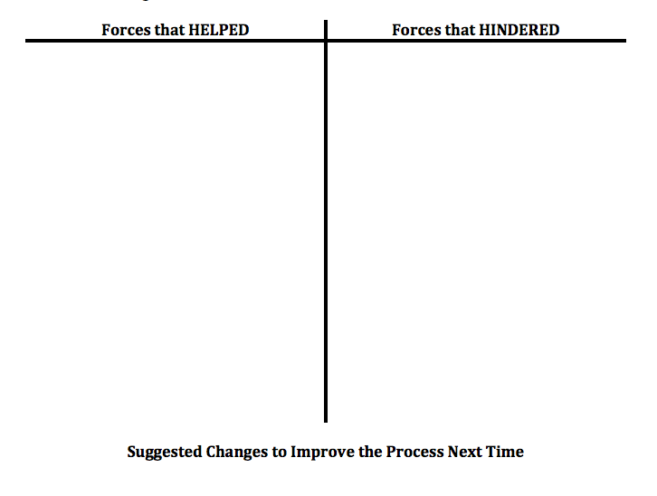
Debriefing the Tuning Process
Pages
4-5
Directions
Reflect
Use the Debriefing Tool to identify what HELPED or HINDERED the process
Share and discuss
Revise process for next time.
Record changes

Slide 9
Text-Based Discussions

Slide 10
Activity: Text-Based Discussion
Pages
4-2
As part of your pre-work for Module 4, you were asked to consider how specific features of the WIDA ELDS and the GoTo Strategies can help teachers support ENL students during content instruction. As a group, share the thoughts you recorded on the active reading organizer.
 | How it Helps
Key Uses
Language Domains
Features/Levels of Academic Language
Levels of Language Proficiency
Can Do Descriptors
The GoTo Strategies

Slide 11
ENL Strategy Exploration Jigsaw
Collaborative Activity

Slide 12
Activity: Strategy Exploration Jigsaw
Pages
4-6a-d
Directions
Identify an unfamiliar strategy for three different principles in the GO TO Strategies document. (3 total).
Read the description for each of the three strategies you identified.
Complete a Strategy Mapping Organizer (in your booklet) for each strategy.
When each person in the group has read and taken notes about the strategies they selected, take turns teaching the rest of the group about each strategy.

Slide 13
Activity: Text-Based Discussion
Discussion Prompt
Now that you are more familiar with the principles and strategies within the GO TO Strategies document, how can this resource be used during a tuning session to guide feedback for classroom teachers looking for thoughtful ideas about how to refine a lesson?

Slide 14
Discussing Strategies to Support ENLs
Video Demonstrations

Slide 15
Demonstration Video
Pages
4-7
Next, you will watch a video of teachers engaging in a discussion about how to enhance supports for ENLs in a content lesson.
As you watch the video, use the Video Observation Sheet to record the following:
Observations
Implications / Interpretations
Questions
Connections to Your Own Work
Be prepared to share and discuss your notes afterwards.

Slide 16
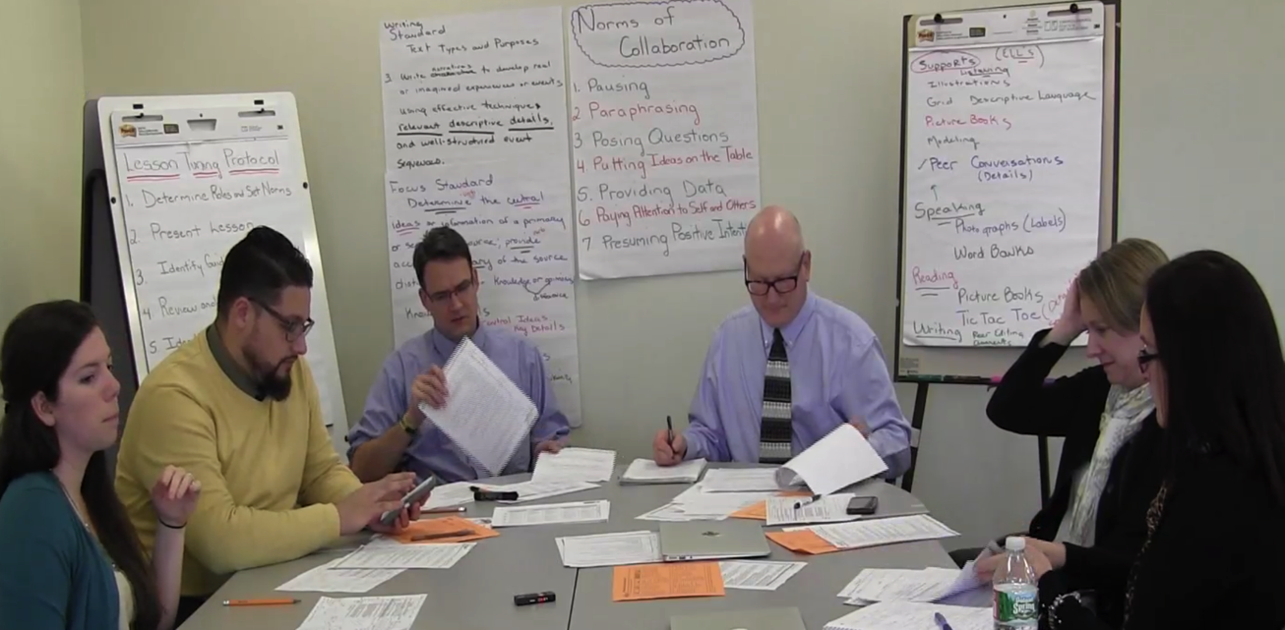
Step6d - Feedback on Supports for ENLs
Pages
4-7
Clicking on the video will take you directly to the Youtube channel video.

Slide 17
Demonstration Videos
Pages
4-7
Share and Discuss
Anything that stood out to you, and
Anything the left you wondering.

Slide 18
Wrapping Up Module 4

Slide 19
What was accomplished in Module 4
Review Group Norms
Debrief the 3rd Round of Collaborative Practice
Participate in the Text-Based Discussion
ENL Strategy Exploration Activity
Watch and Discuss Demonstration Video
Schedule 4th Round of Tuning Practice
Prepare for Module 5

Slide 20
Activity
Discuss the intended outcomes for Module 4. To what extent do you feel they were met?
By the end of Module 4, participants will:
Be able to apply knowledge of the following to provide targeted and thoughtful feedback to colleagues about their language objectives and lessons.
Key Uses and Language Domains of the WIDA ELDS
Can Do Descriptors
GoTo Strategies

Slide 21
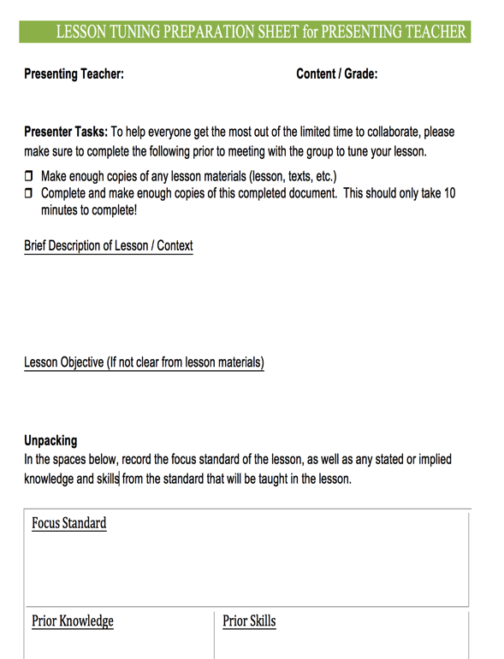
Preparing for Collaborative Practice – Round 4
Pages
4-8a
Clarify date and time for the collaborative practice.
Determine who the presenting teacher will be to bring a lesson to tune.
Determine who will volunteer to facilitate.
Have the presenting teacher complete the prep sheet for presenting teachers prior to meeting.

Slide 22
Preparing for Module 5
All
Complete reading assignments for Module 5.
Complete the Active Reading Organizer
Clarify Date, Time and Location
Collaborative Practice
Guided Workshop for Module 5
Materials to Bring
Course Booklet, notes from Round 4 of the collaborative tuning practice.

Slide 23
Summary Statement
The heart of Rhode Island Collaborative ENL and General Education model is for RIDE to provide districts and schools with resources to help build capacity to help all learners succeed – particularly including English Learners and students with disabilities.

