Slide 1
Student Learning Options: Embedded Practice & Student Learning Goals Fall Convening Module
Notes:
Facilitator’s Notes: Welcome & Introductions (as needed). This module is designed for teams of educators; we do not recommend using this training individually, as the activities have been specifically designed to foster discussion and the sharing of ideas. Additionally, it is important to note that this module is for the use of the Embedded Practice and Student Learning Goals models only, not the SLO Flex option. SLO Flex can be implemented locally using the flexibilities that are best suited to local policies and processes. In addition, the SLO & SLO Flex options use the traditional scoring approach, where the EP & SLG models use the new 3e rubric, Demonstrating Instructional Outcomes, which will be covered in this presentation, revisited from the summer information session presentation.

Slide 2
Did you know?
Over 98% of teachers who participated in the SY 17-18 and SY 18-19 Student Learning Pilots indicated they believed that, as compared to SLOs, each of the new student learning models was a more accurate and authentic way of measuring their impact on students’ learning.

Slide 3
Year-at-a-Glance: Student Learning Options
Fall Convening (Oct)
Mid-Year Resources (Jan)
Spring Convening Module (May)
Closure Activities (June)
Complete Evaluation Processes & Calculate Scores (May/June)
Info Session Module
Ongoing communication with participating educators
Notes:
Facilitator’s Notes: This is the suggested implementation plan for LEAs using one of the new student learning options. If you’re in the process of using this presentation, you would have already reviewed the Info Session presentation. This fall convening module is designed to support the decision-making process for using the 3e rubric, and codifying the practices and processes that will be most helpful in the implementation of the student learning model your LEA has chosen. From there, LEAs will be able to access the mid-year resources, which will include a sample BOY survey and discussion guides that LEAs can use to collect data and structure conversations about student learning. Finally, RIDE will provide a spring convening module that will support the scoring process using the 3e rubric, followed by additional EOY processes that will help to close out the year.

Slide 4
Guiding Principles
Notes:
Facilitator’s Notes: As you know, these are the guiding principles that are the backbone of the Embedded Practice & Student Learning Goals models. These are important principles to consider when operationalizing the model, as they outline how the new models were built. When educators attend to each of these principles, the new models can provide a more flexible method of measuring a teacher’s effectiveness against student outcomes.

Slide 5
Intended Outcomes: Overview
Today’s intended outcomes are to:
Review the features of your chosen model: Embedded Practice or Student Learning Goals
Understand how instructional processes lead to instructional outcomes using the 3e rubric and guidance
Plan for implementation
Notes:
Speaking Notes: The intended outcomes of this module are as follows: [Read Outcomes]

Slide 6
Intended Outcomes
Today’s intended outcomes are to:
Review the features of your chosen model: Embedded Practice or Student Learning Goals
Understand how instructional processes lead to instructional outcomes using the 3e rubric and guidance
Plan for implementation
Notes:
Facilitator’s Notes: The first part of this training will focus on the features of your chosen model.

Slide 7
Activity: Review Your Model (30 min.)
Navigate to the Student Learning Pilot webpage.
Review your model’s infographic & process graphic.
Then, read your model’s narrative scenario.
This is only one representation of the model in practice. It is designed to help you think about how your current practices align with your model, and what might need to be done differently from SLOs in years past.
Discuss with your group.
When compared to SLOs, what opportunities do you see in your model? Challenges?
What might you need to think about/do differently this year?
What questions do you still have about your model?
What areas might you want to talk about more?
Notes:
Facilitator’s Note: Walk through the activity that groups will go through to better understand their model through the resources on our website. The goal of this activity is to get you acquainted with your model’s framework, and how it might look similar or different to your past experiences with student learning, specifically using SLOs.
Handout:
Infographic, Scenario, & Process Graphic for group’s review prior to discussion.

Slide 8
Critical Discussion Questions for Local Teams
What data are available in your school through which to measure student learning? How are these examples of student learning?
What meetings will be considered ‘data discussions’ within your model?
How often will you meet to discuss data, and with whom? Do evaluators need to be present at all meetings? Explain.
How will you communicate and keep track of these discussions? What preparation is needed for these discussions? Will artifacts of student learning be encouraged, or required?
How will you capture/record expectations for student learning? If so, who will do this?
Notes:
Facilitator’s Note: Now that your team is more familiar with your chosen model, now is an opportune time to discuss these questions that really get at the heart of the models’ details. Therefore, it is suggested that you revisit the critical discussion questions from the information session presentation which your local team has already reviewed. These questions really provide a framework to draw out the authentic practices that are likely already in place from which to develop and evolve within this model. It is critical that all teachers who will be implementing a new model of student learning really know the answers – if there’s one thing learned from piloting districts it is that everyone needs to be on the same page. This is not an exhaustive list of the many questions that educators and evaluators will have in the beginning of this process. The intent is that through the purposeful design of these questions that your team will be better able to plan for, and communicate answers to these critical questions now that you’ve begun implementing the model.

Slide 9
Intended Outcomes
Today’s intended outcomes are to:
Review the features of your chosen model: Embedded Practice & Student Learning Goals
Understand how instructional processes lead to instructional outcomes using the 3e rubric and guidance
Plan for implementation
Notes:
Facilitator’s Note: Now you will dive deeper into the relationship between instructional processes and outcomes through the 3e rubric and guidance.

Slide 10
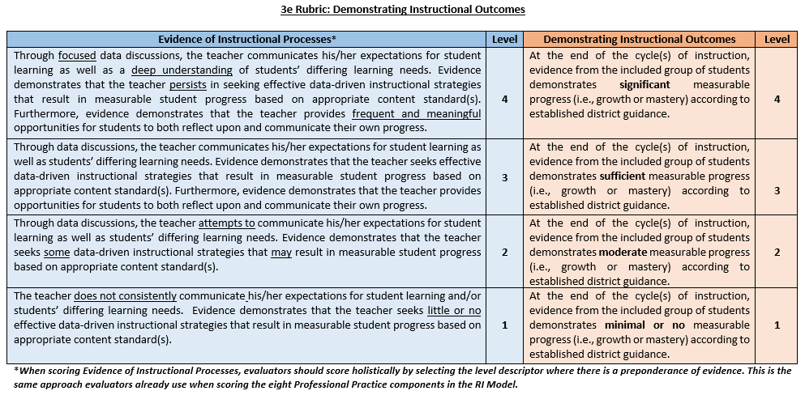
3e Rubric & Scoring Guidance
One score for each side of the 3e rubric
Scored holistically at the end of the year
Criteria for the “Left Side” should be discussed and calibrated
Qualifiers for the “Right Side” need to be defined and calibrated using sample artifacts of student learning
On-going support and communication with RIDE and the Collaborative Team
Notes:
Speaking Note: This is the first page of the new 3e rubric guidance. As already mentioned, those educators using either the Student Learning Goals or Embedded Practice models will use the new 3e rubric. We chose the component 3e because like the RI Model, these scores are a result of instructional practices, which “live” in the professional practice Domain 3. Here, you can see that in place of two separate SLO scores, the total 30% of student learning for the RI Model is split into two components. First, is Evidence of Instructional Processes, in blue, which captures the instructional moves that teachers make that lead to student learning. Second, is Demonstrating Instructional Outcomes, in orange, which captures the actual amount of student learning – the outcomes.
In addition to this first page, there are two supporting guidance pages that guide DECs and local teams in calibrating the qualifiers: significant, sufficient, moderate, and minimal. The process of moving away from the quantified SLO measure toward qualified measures of student learning are adaptive challenges that must be supported throughout the year, not just at the beginning or end. As such, we suggest that time be spent with teams early in the process, supported by the fall convening module, to discuss and calibrate the left side of the rubric, as well as defining and calibrating the qualifiers for the right side.

Slide 11
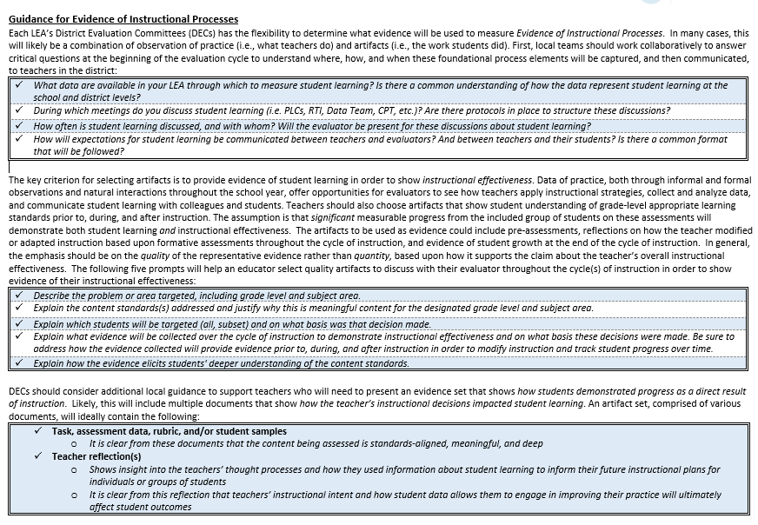
Notes:
Speaking Note: This second page of the rubric focuses on critical questions for DECs to answer, codify, and communicate with regard to guidance for discussing the Left Side – Evidence of Instructional Processes. Again, this Left Side of the rubric aims to capture the instructional moves that teachers make that lead to student learning. And so leadership teams should codify the What, When, and How of student-level data so that evaluators and teachers may communicate authentically about student learning. We know there is an intrinsic relationship between a teacher’s inputs and a student’s outcomes and so ensuring opportunities for relevant and available data to be discussed, and expectations to be communicated, is critical for capturing a teacher’s impact on student learning.
In support of observable data, we’ve developed prompts for educators to consider as they select quality artifacts that aim to show evidence of their overall instructional effectiveness. These artifacts will afford evaluators the opportunity – the evidence! – to see how their teachers applied instructional strategies in order to impact student learning.
If not done already, DECs should consider adding additional local guidance around artifact sets – that is, evidence at the end of the cycle of instruction that shows how students demonstrated progress as a direct result of instruction. Evaluators will find this useful as they make decisions about scoring the Left Side of the rubric later in the spring.

Slide 12
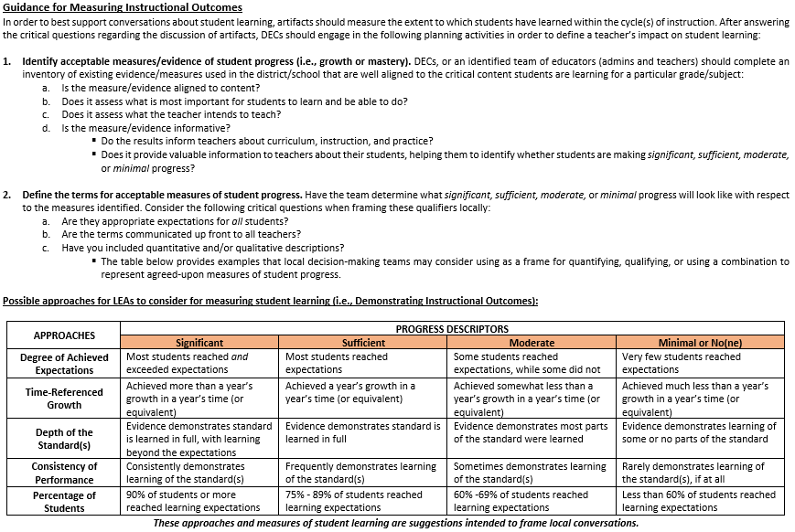
Notes:
Speaking Note: Next is Guidance for Measuring Instructional Outcomes. Here we identify some critical steps for DECs to determine acceptable measures or evidence of student progress that will define just how much learning students have made. Additionally, DECs must engage in the important task of first defining, and then communicating what significant, sufficient, moderate or minimal progress actually means. Unlike the scoring of SLOs, measuring a teacher’s impact on student learning using Embedded Practice or Student Learning Goals is entirely a local decision.
This third page of the 3e rubric guidance goes a step further to suggest possible approaches for further defining the qualifiers significant, sufficient, moderate, and minimal. If the district does not wish to pursue quantified measures like the SLO structure, we encourage DECs and local teams to determine which approaches, and their descriptors, will be most helpful in guiding a conversation with educators and evaluators about the way in which student learning will be measured in the “Right” side of the rubric for Demonstrating Instructional Outcomes. A district could choose one or more of these approaches as a way to better clarify how the outcomes will be measured against the descriptors. This is a marked shift from SLOs and as such, should be discussed and planned thoroughly as a school or district before the year begins. As is best practice, and affirmed by those in the pilot, these conversations and communications around measures of student learning should begin with the end in mind, and start as soon as these decisions to implement have been made. This way, educators and evaluators can begin to have data discussions using the terms that most closely align to the way in which learning will be measured.
As a point of clarification, unlike SLOs where teachers develop 2, Embedded Practice and SLGs only require one measure of student learning. So, whether a teacher engages in short cycles or long cycles of instruction, they will be holistically scored at the end of the year on the entire breadth of the amount of progress their students made over the course of the school year.

Slide 13
Activity: “Left Side” (30 min.)
Read the Level 3 Descriptor for Evidence of Instructional Processes.
With your group, discuss and record your answers to the following questions:
Where will data discussions take place? How often? With whom?
What evidence will be used to set expectations for student learning?
How will data be used to adjust instructional strategies?
How will expectations for student learning be recorded? By whom?
What will student reflections look like? How will they show ownership of their learning?
3. Now, read the Level 4 Descriptor for the ‘Left Side’.
In what ways do the practices of a “4” look different from a “3”?
What does a ‘focused’ data discussion look like? Deep understanding? Persistence? Frequent and meaningful? How are students part of this descriptor?
Notes:
Facilitator’s Note: Now that your team has reviewed the previous 3 slides on the 3e rubric, this activity will support the group by going deeper into the performance level descriptors, to understand what each one is comprised of, and what, if anything, needs to be more clearly defined at the local level. Ultimately, it is the descriptors/qualifiers that need to be understood at the local level to operationalize these processes.
Activity Set-up:
Depending on the number of educators in attendance, we suggest breaking up your group into small teams (2-4 individuals/team). Once broken up, allow these smaller teams to think, discuss, and then record answers to #2 . Before moving on to #3, allow time for each team to share out. As the facilitator, you may choose to chart answers with a marker on poster paper; alternatively, typing answers into a shared document such a Google Doc would also work well here. Next, provide time for these same small teams to answer questions from #3. Again, like with #2, facilitate a whole-group share out, using poster paper or a Google doc to record answers. This activity will be helpful as it will essentially codify your local guidance and best practices for the “Left Side.”

Slide 14
Activity: “Right Side” (20 min.)
Using your local guidance and the 3e rubric, read each level descriptor for Demonstrating Instructional Outcomes.
With the same small teams, discuss the following:
Are we focused on growth, proficiency, or mastery? How is it defined?
How is ‘significant’ different from ‘sufficient’, and so forth?
How will you use evidence to know, holistically, how much students have learned?
To help with this process, read the Guidance for Measuring Instructional Outcomes.
How can the various approaches be used to define the qualifiers? Which ones will your LEA choose, and why?
What guidance has already been developed in your school or district?
What else needs to be defined before starting/continuing the year?
Notes:
Speaking Notes: Now that we’ve focused on the left side, the day-to-day teaching & learning, the right side is more “fixed” in time because it is scored holistically at the end of the year. As a group, we’ll walk through the following activity to calibrate around our local guidance and clarify, and answer, some of these questions which will help us to refine our approach to evidence collection and scoring later this spring.
Facilitator’s Note: Once the activity is complete, take a moment to reflect with the group regarding any changes, or additional development work will be necessary to clarify the “right side” guidance. Attend to these during the final portion of this presentation during the “Next Steps” as needed.
Activity Set-up:
Like the previous activity on Slide 12, allow teams to think, discuss, and then record answers to #2 . Before moving on to #3, allow time for each team to share out. As the facilitator, you may choose to chart answers with a marker on poster paper; alternatively, typing answers into a shared document such a Google Doc would also work well here. Next, provide time for these same small teams to answer questions from #3. Again, like with #2, facilitate a whole-group share out, using poster paper or a Google doc to record answers. This activity will be helpful as it will essentially codify your local guidance and best practices for the “Right Side.”

Slide 15
Intended Outcomes
Today’s intended outcomes are to:
Review the features of your chosen model: Embedded Practice & Student Learning Goals
Understand how instructional processes lead to instructional outcomes using the 3e rubric and guidance
Plan for implementation
Notes:
Facilitator’s Note: Now your team will plan for implementation.

Slide 16
Year-at-a-Glance: Student Learning Options
Fall Convening (Oct)
Mid-Year Resources (Jan)
Spring Convening Module (May)
Closure Activities (June)
Complete Evaluation Processes & Calculate Scores (May/June)
Info Session Module
Ongoing communication with participating educators
Notes:
Facilitator’s Note: Now that your team has walked through the content of the fall module, consider what still needs to be determined, communicated, and completed in the coming months to ensure that this implementation year goes as smoothly as possible for your LEA.

Slide 17
Immediate District Next Steps
Answer critical questions to determine readiness for adopting a new model of student learning; involve as many participating teachers as possible
Communicate with participating teachers the decision points from the critical questions to ensure that all involved are informed on local guidance and decisions
Allocate time and resources to ongoing professional learning around these new models
This may include additional calibrations and discussions about student work samples
Notes:
Facilitator’s Note: It is assumed that your LEA has already begun the work to implement the models for student learning. Now is the time to consider your communication plan to ensure that educators are well aware of any changes from former SLO practices and how data will continue to be at the center of discussions about student learning in your schools. Moreover, your team should consider how and when there are professional learning opportunities for groups to collaborate around practices and processes to reflect on what is working, and what needs additional attention to yield the outcomes which you are seeking to achieve.

Slide 18
Closing
Contact:
Evaluation email: EdEval@ride.ri.gov
Resources:
RIDE website: https://www.ride.ri.gov/TeachersAdministrators/EducatorEvaluation/StudentLearning.aspx
Notes:
Facilitator’s Note: As you continue through the implementation process, we encourage LEA representatives to contact the RIDE team through the edeval@ride.ri.gov inbox as questions or concerns arise. All of our resources related to student learning will be updated, and available at the link provided here. We hope this has been a helpful resource for your team, and look forward to hearing how you continue to continuously improve your local evaluation system.

