Slide 1
Welcome!
The webinar will begin at 9:30am
Please rename yourself on Zoom to include
Name
LEA or School Name

Slide 2
Webinar: Resource Allocation Review
Office of School and District Improvement
Community Training & Assistance Center – CTAC
February 29, 2024
Notes:
KD will intro team …. and pass off to Cindy

Slide 3
Warm-Up Activity
Which animal describes how you feel when someone mentions Resource Allocation Reviews?
Notes:
Cindy

Slide 4
Objectives
By the end of today’s webinar, participants will:
Demonstrate understanding of the Resource Allocation Review requirements and tools
What is a Resource Allocation Review?
Who needs to do a Resource Allocation Review?
Why should I do a Resource Allocation Review?
Be prepared to engage in and/or facilitate a Resource Allocation Review
Notes:
Cindy

Slide 5
Community Agreements
What They Are:
A consensus on what every person in our group needs from each other and commits to each other in order to feel safe, supported, open, productive and trusting so that we can do our best work and serve our students.
*Source: National Equity Project
4
Notes:
Cindy

Slide 6
Why Community Agreements Matter
We are unable to achieve our goals in a hostile, disrespectful, or undermining group culture.
Some of the most critical conversations teams need to have are emotional, painful, and uncomfortable (e.g., equity issues, examining individual practice), but we will not engage or make ourselves vulnerable without emotional safety and trust.
Adult relationships shape group culture.
A healthy culture is key to personal sustainability in the challenging jobs of education. *Adapted from National Equity Project
Notes:
Cindy

Slide 7
Our Community Agreements
Stay engaged in the process
Speak your truth
Listen to understand
Challenge ideas, not people
Speak from your own experience
Be mindful of your talk time
Keep our students at the center
Notes:
Cindy (10-15 minutes, 9:45am) / Check-in with team for agreement, changes / Speak your truth = being honest and vulnerable
Pass back to KD

Slide 8
What is a Resource Allocation Review (RAR)?
A Resource Allocation Review is a team-based inquiry process for LEAs and schools to understand the current state of how their educational resources are being used as part of the continuous improvement process. This is a best practice for all LEAs and schools.
A federal requirement for LEAs that have school identified as CSI and/or with student subgroups identified as ATSI.
During the RAR, LEAs and schools will start by examining low performing subgroups
Listed as Student Subgroup Identifications on RIDE Report Card in the Accountability tab
Notes:
KD: Highlight Identifying Educational Resources handout

Slide 9
What the RAR is…is not…and could be…
Bowman, A., Taylor, T. (2022). ESSA Resource Allocation Reviews – Design Principles and Considerations for Conducting a Meaningful Resource Allocation Review. San Francisco, CA: Region 15 Comprehensive Center Network.
Notes:
KD

Slide 10
What educational resources should be considered for RAR?
Consider the following educational resources:
Human Resources
Schedule
Professional Learning
Equipment
Materials/Supplies
Programs/Services
Community Collaboration and Partnerships
Finance
Notes:
KD: Allison will drop the handout link in the chat
A few minutes to digest the resources terminology and examples

Slide 11
Who needs to do a RAR?
ESEA & ESSA set requirements for identifying & addressing resource inequities
SEA
Periodically conduct RAR in each LEA with significant number of schools identified for CSI, TSI, and ATSI.
LEA
Ensure schools identified as CSI and ATSI undertake a process to identify resource inequities that are addressed through an improvement plan.
School
CSI and ATSI schools must identify resource inequities that are addressed through an improvement plan.
Notes:
KD

Slide 12
Addressing ESSA Requirements
SEA
Periodically conduct RAR in each LEA with significant number of schools identified for CSI, TSI, and ATSI.
SY23-24: RIDE conducts Comprehensive RAR in LEAs with 2+ CSI schools
LEA
Ensure schools identified as CSI and ATSI undertake a process to identify resource inequities that are addressed through an improvement plan.
School
SY23-24: RIDE conducts Desktop RAR in LEAs with 80% or more schools identified as TSI/ATSI
CSI and ATSI schools must identify resource inequities that are addressed through an improvement plan.
Resource inequities and plan entered into CSIP/SIP within the SPS for superintendent approval
LEA with CSI schools completes LEA RAR Document (Google folder) and submits to RIDE for review
Reviews LEA RAR Document for all LEAs with CSI schools
RARs are best practice as part of needs assessment for ALL schools
CSI and ATSI schools enter resource inequities and plan into CSIP/SIP within the SPS
Recommend that TSI schools create plan to address the needs of identified subgroup(s)
Text in RED are ESSA requirements.

Slide 13
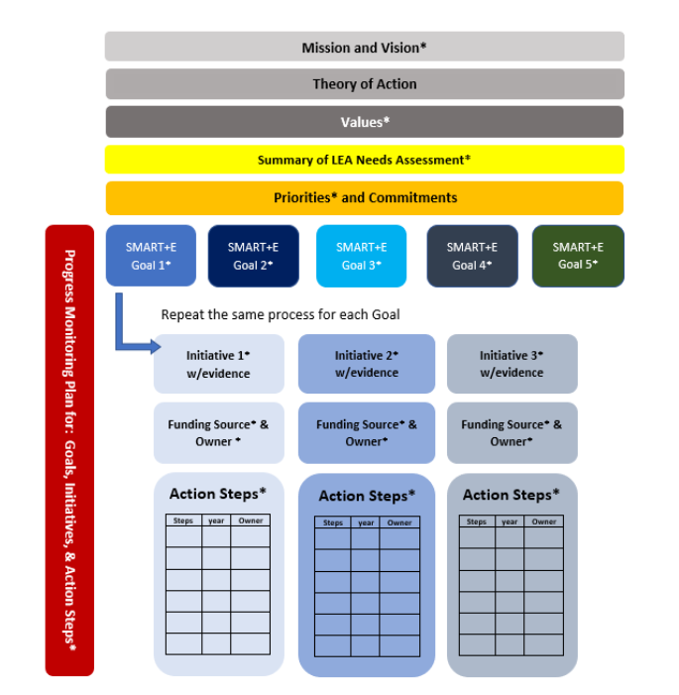
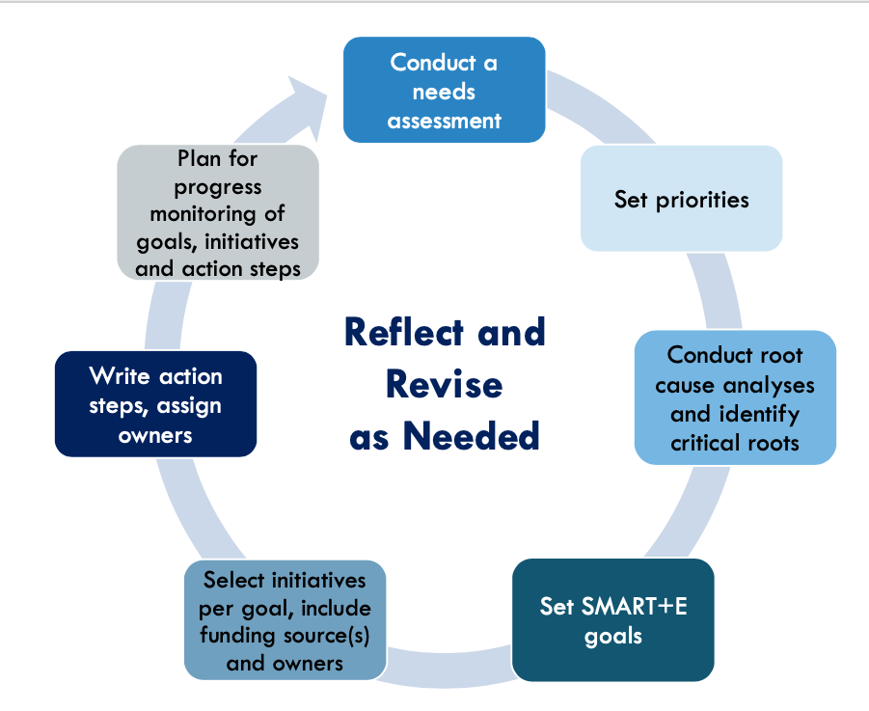
Why is this important?
Conducting an RAR provides schools and LEAs with data to inform improvement planning, especially targeted low-performing subgroups.
RAR is part of needs assessment. Results feed into goals, initiatives, and/or action steps.
Notes:
KD – note in SPS soon, field is in between needs assessment on school level plans.

Slide 14
Why is this important?
Per ESSA, any school identified as in need of ATSI with a low performing subgroup that has not met the exit criteria for four consecutive years will be identified as in need of comprehensive support and improvement.
4 Years Identified as ATSI
Identification of CSI
Notes:
KD

Slide 15
We all have a role in the RAR process
School
Examines how resources are allocated within the school, focusing specifically on low-performing subgroups and SIP
SEA
Examines resource inequities identified within LEAs
LEA
Examines resource inequities identified within schools & examines how resources are allocated between schools, specifically focusing on low-performing schools and student subgroups
Notes:
KD: 20 minutes (10:05am) - reminder to provide example of

Slide 16
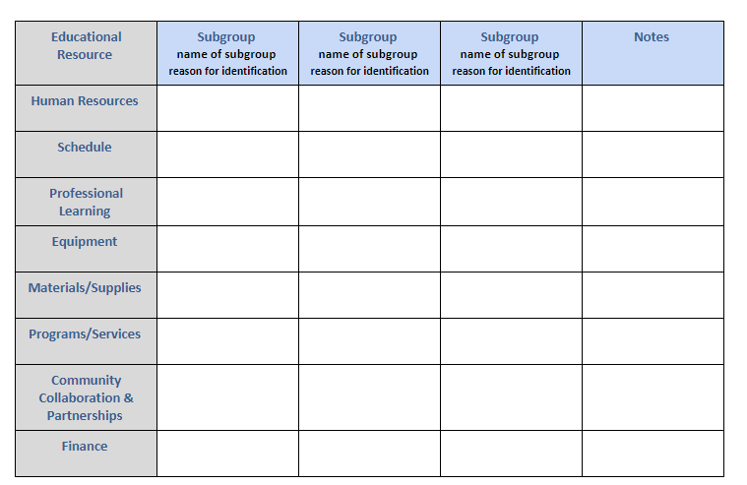
School Level Resource Allocation Reviews
To conduct an RAR, school leaders can use the “RAR: School Level Tool ”
Notes:
(Mike) This is a tool we have developed for you to use when conducting an RAR (which Allison will linik into the chat on our next slide)
This tool is optional, but we want to take you through it today.
Schoool leaders will want to staart with your report card data. Once you find your school you will be brought to the front page of the Rep[ort Card
You click the Accountability tab, which brings you to your school summary, Below the school summary to view the list of identified subgroups and the reason they are identified as ATSI
For this tool, we are going to ask you to think about what you have currently within the SIP/CSIP and in the building

Slide 17
School Level Activity
English Learners
Achievement & Growth, and Overall Low Performance
Use the RIDE Report Card to identify subgroups at your school that have been identified as TSI/ATSI
Consider your school's schedule OR community collaboration/partnerships
EL teachers are available to supports gr.8 during science block
Reflect on the following:
How does your schedule and/or community collaboration & partnerships impact the low-performing subgroup(s)?
After school supports for language development with local university
Notes:
(Mike)
Allison is dropping a link in the chat. Note that this is a read only file so when you want to use it, make a copy for your team.
Once you have identified TSI and ATSDI subgroups, you want to consider what resources you have or do not have. I am going to model an example considering schedule and community resources then we will ask you to do the same.
In this example, I am a Principal at a MS and my English Language Learners (EL students) were identiifed as ATSI for Achievment and growth and overall low performance.
I know that we are supporting our EL s with EL co-teachers in the science block
Our school also has connected with our local university to provide after school tutoring on a weekly basis.
I just provcided two assets, the tool can also be used to identify inequities for example, our current schedule does not allow opur EL teachers to plan with

Slide 18
School Level RAR Tool
What did you notice?
What did you wonder?
Based upon your review, what resource inequities have emerged?
What follow-up thoughts and/or questions do you have?
What opportunities have presented themselves based on your school building RAR?
Are there additional resources and/or SIP revisions (goal, initiative, action steps) that are needed to address the needs of the identified subgroup(s)?
17
Notes:
(Mike) - 1 minute
High level – connect the tool to these reflection questions to do with SIT, leadership team....
The Qs in red font will be in fields within the SPS as evidence of a RAR within the School Plan.
(10:20)

Slide 19
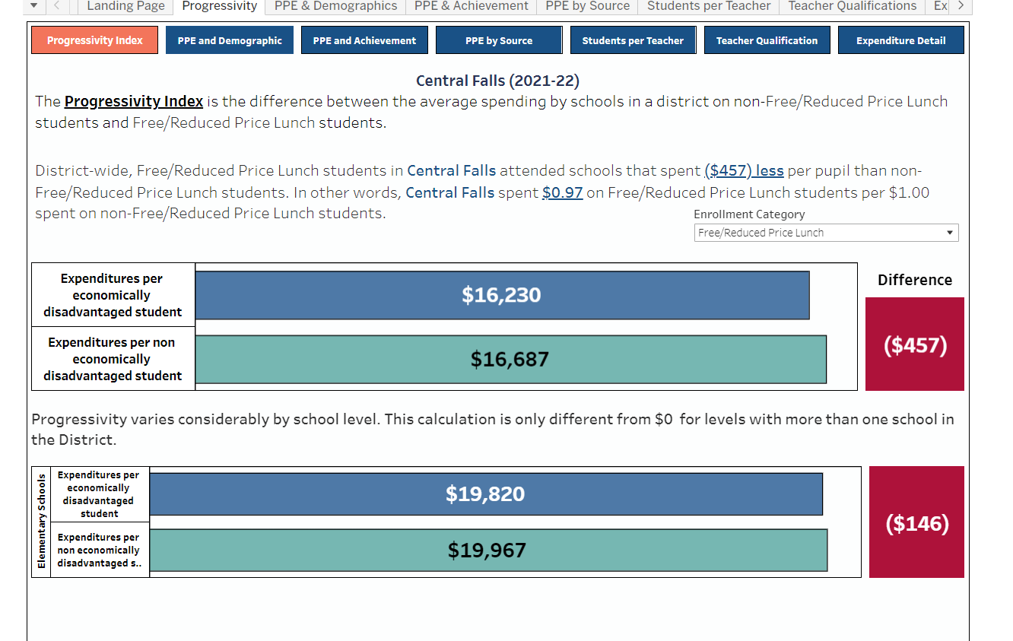
LEA Resource Allocation Reviews
LEAs can use the “UCOA Resource Allocation Review Dashboards”
Notes:
Lee will present the dashboard....and share his screen window....
Dashboard is developed by the Office of Statewide Efficiencies – name the 3 sources of data to develop the dashboards
Allison will drop the link the chat.
Shelley will provide the voice over
Model with dashboard 1; Put links in chat; note the change from "at risk" to "high need“: https://tableau.ride.ri.gov/t/Public/views/ResourceAllocationDashboards/LandingPage?%3Adisplay_count=n&%3Aembed=y&%3AisGuestRedirectFromVizportal=y&%3Aorigin=viz_share_link&%3AshowAppBanner=false&%3AshowVizHome=n
https://tableau.ride.ri.gov/t/Public/views/ResourceAllocationDashboards/LandingPage?%3Adisplay_count=n&%3Aembed=y&%3AisGuestRedirectFromVizportal=y&%3Aorigin=viz_share_link&%3AshowAppBanner=false&%3AshowVizHome=n

Slide 20
UCOA Resource Allocation Dashboard Activity (Demo)
Following the model of the UCOA Resource Allocation Dashboard
Use the link in the chat box to review the Dashboard for Cumberland
Reflect on the following:
(1) What school has the lowest proficiency?
(2) What school has the highest PPE?
Notes:
Demo the Dashboard using Cumberland (~2-3 minutes)

Slide 21
UCOA Resource Allocation Dashboard Activity
Using the same link, find your LEA within the UCOA Resource Allocation Dashboards
Select your LEA's Dashboard and explore the various tabs across the top
Reflect on the following:
(1) What stands out to you?
(2) What do you want to explore further?
Notes:
This is time for the participants to navigate the dashboard for their own LEA (~7-10 minutes)
Kristen will be the direct support for participants struggling with navigating the dashboard.
Have a few participants share out

Slide 22
UCOA Resource Allocation Review Dashboards
Reflection Questions
What did you notice?
What did you wonder?
What follow up thoughts and/or questions do you have?
Are there additional resources and/or LEA Strategic Plan revisions (goal, initiative, action steps) that are needed to address the resource inequities?
Notes:
If you use the LEA Dashboards, here are follow up Qs to use with your team. (10:45-10:50)

Slide 23
RAR Wrap-Up
Once a LEA and schools have completed the RAR, central office and school leaders will prepare for next steps
Given the discussion and the inequities that have emerged:
Consider how the distribution and use of resources have impacted student outcomes.
Consider what next steps could be implemented to address the inequities.
School level resource inequities need to be named and addressed in the CSIP/SIP at the goal, initiative, or action step level. This will be identified within the SPS (coming soon).
Notes:
KD

Slide 24
Resources
RIDE’s RAR Resources:
UCOA Resource Allocation Review Dashboard
Resource Allocation Review Process Guide – coming soon
LEA RAR Document (for LEAs with CSI Schools)*
School Level RAR Tool*
(*) available on website on 3/1
RAR Documents:
Rhode Island’s ESSA State Plan
Every Student Succeeds Act (ESSA)
Letter to Chief State School Officers regarding RARs
Notes:
KD – participants follow up email

Slide 25
Closing
Webinar Feedback
For questions,
contact the
Office of School and District Improvement
osdi@ride.ri.gov
LEA & School Colleagues CTAC Partners Lee Rutledge &
Shelley Nixon-Green
We appreciate your time and partnership!
Notes:
https://docs.google.com/forms/d/e/1FAIpQLSeYiKcejLUljR2V3kKm2xvp6z7riYQcEXl8sP2cCjBnVO_smg/viewform

