Slide 1
Title IV-A: Student Support and Academic Enrichment Grant CRP Rollout
March 21, 2023

Slide 2
Agenda
Program Overview
Equitable Services
CRP Application
Budget
Data Reporting
Resources to Share

Slide 3
Agenda
Program Overview
Equitable Services for Private School
Consolidated Resource Plan (CRP) Application
Budget and other fiscal requirements
End of the Year Expenditure Report
References & Resources
Notes:
Linda – New Slide

Slide 4
Program Overview

Slide 5
Agenda
Program Overview
Equitable Services for Private School
Consolidated Resource Plan (CRP) Application
Budget and other fiscal requirements
End of the Year Expenditure Report
References & Resources
Notes:
Linda – New slide

Slide 6
Title IV-A Student Support & Academic Enrichment Grant Program
The Elementary and Secondary Education Act (ESEA) was originally authorized in 1965.
ESEA was reauthorized in 2015, and is known as the Every Student Succeeds Act (ESSA).
Title IV-A was included for the first time.
It allows LEAs to tailor investments based on the needs of their unique student populations in three content areas: well-rounded education, safe and healthy students and effective use of technology.
USED encourages LEAs to coordinate the use of these funds with other ESEA programs whenever possible.
Searchable Title IV-A Statute

Slide 7
Purpose of Title IV-A To improve student academic achievement by:
Any LEA that received Title I-A funds in the previous year, receives Title IV-A funds.
Increasing
Access to a
Well-Rounded Education
Improving Conditions for Student Learning
Improving the Use of Technology

Slide 8
Supplemental Title IV-A activities may include:
Well-Rounded Education | Safe and Healthy Students | Effective Use of Technology
Arts Education Music Programs Civics and Government Foreign Language STEM/ STEAM Programs Social and Emotional Learning Advanced Learning AP Courses Environmental Education | School Guidance Counselors Restorative Justice Parent & Family Engagement Conscious Discipline PBIS Drop Out Prevention Physical Education & Wellness | Supports activities related to staff development in: STEM subjects Blended/ remote learning programs Use of student data to differentiate instruction.
Notes:
The SSAE program provides SEAs, LEAs, and schools the flexibility to tailor investments based on the needs of their unique student populations. Where possible, the Department encourages coordination and integration of the SSAE program with activities authorized under other sections of the law, as well as other federal programs to improve outcomes for students. The Department notes that ensuring all students have access to a holistic well-rounded education is central to the shared work across programs in ESSA.

Slide 9
Topics Areas
NEW
Check the allowable use of funds that best aligns to this activity.
Well-Rounded Education | Safe and Healthy Students | Effective Use of Technology
STEM courses and activities Accelerated learning programs, including AP and IB, dual or concurrent enrollment programs Mental health education, including SEL interventions College and career counseling Career and technical education Music and arts enrichment American history, civics, economics, geography, social studies, or government instruction Environmental education Foreign language instruction Volunteerism and community involvement programming Other allowable well-rounded activity. | Drug prevention/reduction programs Strategies to improve school climate, including schoolwide positive behavioral interventions and supports Family engagement strategies Establishing community partnerships Bullying and harassment prevention Mental health education, including SEL interventions Mentoring and school counseling Healthy, active lifestyle programs, School drop-out prevention School safety | Blended learning Personalized learning Digital learning opportunities for students Implement open educational resources (OERs) initiatives Support for discovering, adapting, and sharing of high-quality resources Digital learning opportunities in rural, remote and underserved areas Digital citizenship courses and trainings Technology infrastructure (devices, equipment, software applications, platforms and digital instructional resources, or one time IT purchases to support allowable TIV-A activities)
All areas allow for increasing access for multilingual learners or students with disabilities.

Slide 10
Technology Infrastructure
An LEA, or consortium of LEAs, may use up to 15 percent of the total funds set aside, then expended, for the effective use of technology to purchase technology infrastructure, which is defined as:
“planning activities, which may include development of new instructional models (including blended learning technology software and platforms), the purchase of digital instructional resources, initial professional development activities, and one-time information technology purchases, except that such expenditures may not include expenditures related to significant construction or renovation of facilities.”
“purchasing devices, equipment, and software applications in order to address readiness shortfalls” to support allowable Title IV-A activities."
Funds are for new supplemental services and not replacement costs.
ESEA 4109(a)(4)(A) and (a)(2)(B)

Slide 11
How are Title IV-A allocations calculated?
Title IV-A allocations are calculated by formula.
Calculations are based on your prior year Title I-A allocation.
Consortia Option
LEAs can apply for funds as part of a consortium. If interested, reach out to David Luther for assistance.
TIV-A Consortium Agreement
Notes:
How are Title IV-A Allocations calculated?
Title IV-A allocations for LEAs are calculated by formula, based on the proportion of those LEAs’ prior year’s Title I, Part A allocation. SEAs are further required to ensure no LEA receives an allocation less than $10,000 (minus any required Maintenance of Effort reductions), and must ratably reduce LEAs accordingly to ensure the minimum amount requirement is met.
To be eligible to receive an allocation under the Title IV-A Student Support & Academic Enrichment grant, a local educational agency (LEA) must have received Title I-A funding in the prior school year.
Consortiums
LEAs may choose to submit an application as part of a consortium. LEAs seeking to use this option must contact

Slide 12
Allocation Totals Matter
LEAs and consortia with an allocation of $30,000 or more after transfers must expend Title IV-A funds as follows:
Increasing
Access to a
Well-Rounded Education
Improving Conditions for Student Learning
Improving the Use of Technology
Remember
COVID waivers have ended
LEAs and consortia with an allocation less than $30,000 after transfers may choose to spend funds in one or more area.

Slide 13
Transferability
Transfer from:
Transfer to:
Title II-A
Title IV-A
Keep in mind:
LEAs must conduct a needs assessment and begin equitable services consultation before making any decisions about transfers.
Some or all funds may be transferred, depending on needs for improving student achievement.
Transferred funds must meet new program requirements, including equitable services.
Title IV-A
Title I-A
Title II-A
Title III

Slide 14
Program Planning
Needs Assessment
Stakeholder Input
Identifying Schools for Support

Slide 15
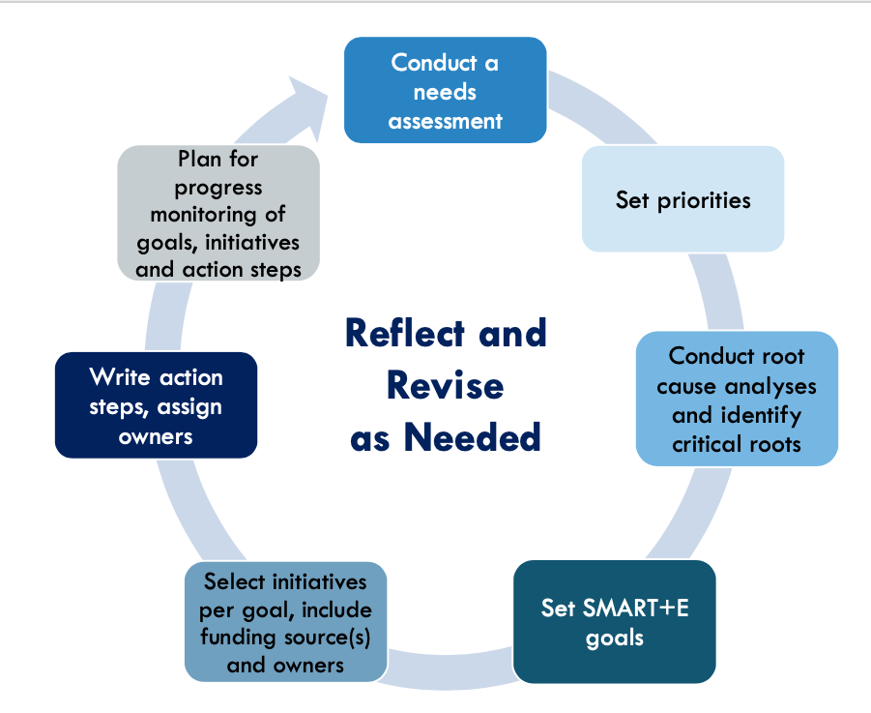
Needs Assessment
Required once every three years.
Aligns with the LEA Strategic Plan Requirements.
Data sources may include:
Student Achievement Data
Survey Works Data
School Safety Plans
Professional Learning Plans
Elements of a Strategic Plan

Slide 16
Stakeholder Input
LEAs must develop their applications in consultation with:
Parents
Teachers
Principals
Students
School leaders
Charter school teachers, principals, and other school leaders
Specialized instructional support personnel
Community-based organizations
Indian tribes and tribal organizations
Local government representatives
Others with relevant and demonstrated expertise in activities that meet the purpose of TIVA
LEAs must then engage in continued consultation with stakeholders in order to improve the activities and coordinate implementation with other related strategies, programs, and activities being conducted in the community.

Slide 17
Identifying Schools for Support
LEA’s must prioritize the distribution of funds to schools.
Schools with the highest % or # of students from low-income families in Title I-A schools.
Schools identified as Comprehensive Support and Improvement (CSI Schools).
Schools identified for Targeted Support and Improvement (TSI or ATSI plans).
Schools identified as a persistently dangerous public school.
Schools with the greatest need, as determined by the LEA.

Slide 18
Determining the Allowability of a Title IV-A Activity
Step 1:
Activities should be
informed by the results of a needs assessment and stakeholder engagement.
Step 2:
Make sure the activity
is aligned to the purpose of at least one topic area: well-rounded education, safe and healthy schools, or effective use of technology
Step 3:
The activity is
allowable
reasonable and necessary
allocable
Step 4:
Make sure the activity
for schools that were prioritized for participation.
is not prohibited in ESEA
is not required by federal, State or local laws
was not paid for with State, Local, or other funds in the previous year
supplemental
Notes:
Recap

Slide 19
Allowable Costs
Funding requests for must be:
Allowable
Necessary
Reasonable
Allocable
Authorized
Documented
under individual program rules.
for the proper and efficient performance of the program.
in that it would be a cost that a prudent person would incur under similar circumstances.
to the program, such that the program must benefit in proportion to the amount charged to the federal program.
or otherwise not prohibited, by federal, state or local rules.
to justify all fiscal and program requirements.

Slide 20
Title IV-A Funds are Supplemental
Additional Funds
Federal Funds
State and Local Funds
It is presumed that supplanting has occurred if the LEA uses Title IV-A funds to provide services:​
it was required to make available under other federal, state or local laws
it provided with non-federal funds in the prior fiscal year​, or
that the LEA would otherwise provide.
Title IV-A

Slide 21
Prohibitions in ESEA and TIVA
for construction, renovation, or repair of any school facility, except as authorized under this Act
for transportation unless otherwise authorized under this Act
to develop or distribute materials, or operate programs or courses of instruction directed at youth, that are designed to promote or encourage sexual activity, whether homosexual or heterosexual
to distribute or to aid in the distribution of legally obscene materials to minors on school grounds; to provide sex education or HIV-prevention education in schools unless that instruction is age-appropriate and includes the health benefits of abstinence
to operate a program of contraceptive distribution in schools
to purchase or provide training on use of dangerous weapons
Medical services, drug treatment, or rehabilitation
No child shall be required to obtain a prescription for a controlled substance

Slide 22
Equitable Services for Private School Students and Teachers

Slide 23
Agenda
Program Overview
Equitable Services for Private School
Consolidated Resource Plan (CRP) Application
Budget and other fiscal requirements
End of the Year Expenditure Report
References & Resources
Notes:
Linda – New slide

Slide 24
Providing Title IV-A Equitable Services
Funds are generated on an equitable basis
Services must be secular, neutral, non-ideological, and supplemental
Costs must be allowable, necessary and reasonable
The LEA must remain in control funds
Private schools receive services not funds
Private school services should start at the same time as the LEA’s program
Notes:
LEAs must provide equitable services for students and teachers for in district private schools that wish to participate in the Title IV-A program. Services must:
be supplemental and allowable under Title IV, Part A content areas;
meet the specific needs of in district private school students, their teachers, or other educational personnel;
be secular, neutral and nonideological, including materials and equipment;
remain in control of the district, meaning:
services must be provided by either an employee of the district or through a contract by the district with an individual, association, agency, organization or other entity; and
district must maintain title to, and administrative control of, materials, equipment and property purchased with these funds.
ESSA section 8501

Slide 25
Identifying Participating Private Schools
LEA
Send Intent to Participate letters to each private school in the district’s boundaries to determine which schools would like to participate*
Calculate the amount of funds available for services based on total enrollment of K-12 public and participating private school students
Private School
Reply to Intent to Participate letter by deadline
For participating private schools - include the number of K-12 students enrolled in the private school on October 1st with the response
Initial Consultation Schedule an initial consultation meeting for private schools that wish to participate.
* Remember to reach out multiple times to private schools, if needed, and to documents these attempts.

Slide 26
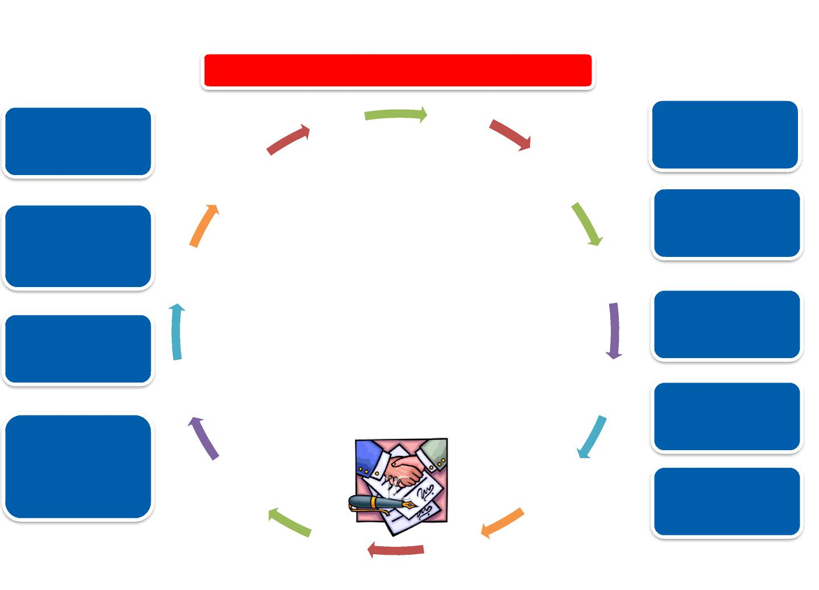
Title IV-A Equitable Services Consultation
Documentation of Consultation is Required
Needs of Private School Students and Teachers
December
January
Pooling of Funds
November
February
Size and Scope of Services
Amount of Funds Available for Services and How the Amount Is Determined
Timely and meaningful consultation
must occur before the local education agency makes any decision that affects the opportunity of eligible private school students, teachers, and other education personnel to participate and continue throughout the implementation and assessment of services.
October
March
Providing Services Directly or Via Another Entity
How, where, when and by whom services are provided
September
April
How & When Decisions are Made
Use of 3rd Party Provider and Written Explanation for Not Using 3rd Party Provider
August
May
Assessment of Services
July
June
13

Slide 27
Determining whether an activity can be funded using Title IV-A funds during the consultation
Step 1:
Activities should be
informed by the results of a needs assessment and stakeholder engagement
Step 2:
Activities should be
is aligned to the purpose of at least one topic area: well-rounded education, safe and healthy or effective use of technology
Step 3:
The activity is
allowable
reasonable and necessary
allocable
supplemental
Step 4:
Make sure the activity
is not prohibited in ESEA
is not required for federal, State or local laws
was not paid for with non-federal funds in the previous year
Notes:
ESSA section 8501

Slide 28
Equitable Services Timeline
Winter
Jan - March
Send and collect Intent to Participate letters
Begin initial consultation
Spring
March – May
Continue Private School Consultation – developing activity and evaluation plans
Summer
June - August
Hire staff and plan for program implementation
Fall
Sept – Dec
Implement LEAs private school program
Conduct ongoing consultation
Assess needs and plan for possible amendments
Continue program implementation and ongoing consultation
Close out current program and evaluate effectiveness
Document agreements
Complete Annual Funding Application for RIDE
Finalize LEAs private school program plans
Notes:
All services provided for the benefit of private school participants must:
Be allowable under Title IV, Part A;
Meet the specific needs of in district private school students, their teachers, or other educational personnel;
Be provided by either an employee of the district or through a contract by the public agency with an individual, association, agency, or organization which is
independent of the private school and any religious organization
Be under the control and supervision of the district; and
Funds must remain in control of the district responsible for providing equitable services.
ESSA section 8501

Slide 29
If the LEA and Private School Disagree…
LEAs are encouraged to work:
Work with their private schools to reach agreement on behalf of students;
Reach out to their federal program liaison at RIDE for support;
Have private schools file a complaint with the Ombud as a last resort.
A private school has the right to complain to RIDE if:
Consultation was not meaningful or timely;
The district did not give due consideration to the views of the private school official; or
The district failed to make decisions that treat the private school or its students equitably.
We are here to help – please reach out!

Slide 30
Ombud
ESEA requires the SEA’s Ombud to monitor and enforce private school consultation and equitable service requirements to help ensure equitable services are provided to private school students, teachers, and other educational personnel.
Rhode Island’s designated Ombud:
Anthony Cottone, Chief Legal Rhode Island Department of Education 255 Westminster Street Providence, RI 02903
(401) 222-8933 ombudsman@ride.ri.gov

Slide 31
Equitable Services Resources
Identifying Participating Schools
Send Intent to Participate Letters
Initial Consultation
Conduct initial consultation, including sharing amount of funds available for equitable services
Ongoing Consultation
Evaluate the impact of allowable activities
Gather student enrollment data to determine proportionate share
Resources: Letter of Introduction, Intent to Participate & Identity of Needs
Design allowable activities and evaluation plans based on identified needs
Resources: Consultation Affirmation, Identity of Needs, and Initial Consultation Worksheet
Revise original activities to improve services, as needed
Resources: Ongoing Consultation Worksheet
Notes:
ESSA section 8501

Slide 33
Consolidated Resource Plan (CRP)

Slide 34
Agenda
Program Overview
Equitable Services for Private School
Consolidated Resource Plan (CRP) Application
Budget and other fiscal requirements
End of the Year Expenditure Report
References & Resources
Notes:
Linda – New slide

Slide 35
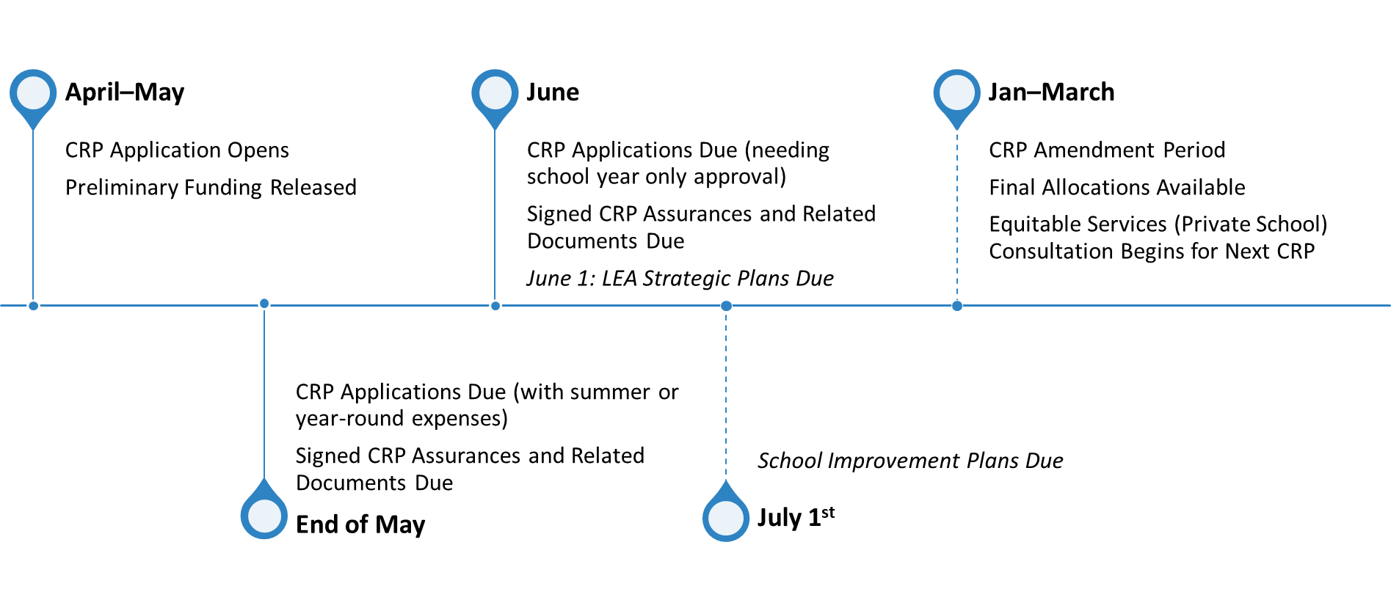
Annual Timeline

Slide 36
CRP Assurances
Three documents need to be submitted each year:
CRP Assurances
Request to Obligate Funds
Process for Developing the CRP

Slide 37
CRP Sections
Application Details Page
Content Area Pages
Equitable Services Pages
Private School Services
Private School Activities
Related Documents Page
Prior Year Outcomes Report
Budget
Assurances

Slide 38
CRP Sections
Application Details
Well-Rounded Educational Opportunities
Safe and Healthy Students
Effective Use of Technology
Private School Services
Private School Activities
Related Documents
Private School Equitable Share Worksheet
Private School Equitable Share Worksheet – Amended
Private School Consultation Affirmation(s)
Other
Prior Year Outcomes Report
Budget
Review Details
Equitable Services Pages
Note: Assurances must be reviewed and signed. They are submitted as part of the CRP application.
Notes:
Linda – new slide

Slide 39
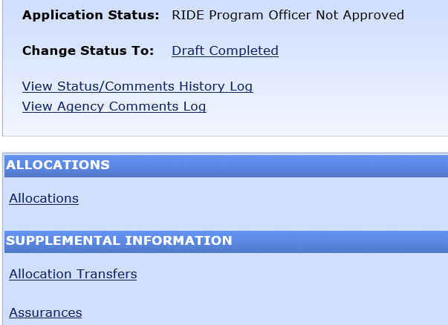
How to Determine the LEA’s Adjusted Allocation Total for Spending Rules
To calculate, pull data from the following pages:
Allocations Page - Original Allocation
Allocations Transfer Page – Transfer Totals
Original Allocation +/- Transfers =
Adjusted Allocation

Slide 40
Application Details Page
There are four questions on the application details page:
Question #1: Needs Assessment
Question #2: Stakeholder Input
Question #3: Process for Prioritizing Schools
Question #4: Direct Administration Costs

Slide 41
Application Details Page
There are four questions on the application details page:
Question #1: Needs Assessment
Question #2: Stakeholder Input
Question #3: Process for Prioritizing Schools
Question #4: Direct Administration Costs
See the Title IV-A CRP application for detailed instructions.
Notes:
Linda - new

Slide 42
Application Details Page Narratives
Needs Assessment
Stakeholder Input
Describe consultation process
Identified Schools
Describe the method(s) used for identifying schools
Administration Costs
If using funds for direct administrative costs, describe how funds will be used to support program implementation
Include key findings related to topic areas and when needs assessment occurred within last 3 years
Notes:
LEAs must conduct a needs assessment at least once every three years to assist in identifying how Title IV-A funds are spent in one or more content areas, ESEA 4106(d).
The response should describe:
how the LEA conducted its needs assessment;
when the needs assessment was last conducted;
which content areas were addressed (LEAs with allocations over $30,000 must include all three content areas); and
the key findings identified in the needs assessment that are relevant to the LEAs Title IV-A application.
An LEA must engage stakeholders during the design and development of its Title IV-A plan. The response to this question should describe:
How the LEA sought feedback from stakeholders
Which stakeholders (by role) were invited to give feedback; and
How the LEA uses this feedback to inform its Title IV-A plan.
The response to this question should include:
Which methodology the LEA and its stakeholders chose to use to identify participating schools;
If the LEA and its stakeholders created criteria to identify schools with the greatest need, describe the criteria used by the LEA.
Which schools were identified by the LEA and its stakeholders to participate in this program?
What interventions will be offered at each school as a result of this process?
LEAs with one school should respond with “NA”.
Keep in mind:
LEAs can have one stakeholder group, as it only takes one good plan to run a school.
Documentation / evidence is key to demonstrating how the LEA met this requirement.
An LEA may reserve up to two percent (2%) of its original allocation for direct administrative costs associated with implementing the grant. ESEA Section 4105(c)
The response to this section should:
describe how the funds will be used to administer the LEAs Title IV-A program, OR
be answered with NA if the LEA is not using direct administration funds.
Remember:
These costs cannot exceed 2% of the LEAs original allocation.
Funds reserved for indirect costs are a separate administrative reserve and should not be included in this response.

Slide 43
Title IV-A Application Details
Needs Assessment
Stakeholders
Describe how the LEA engaged stakeholders and how this feedback was used to help identify needs and design supports in the development of its Title IV-A application.
Schools Identified for Support
List the school(s) the LEA has identified for interventions and describe the LEAs process for selecting each school. Note: LEAs with only one school do not need to respond.
Administrative Costs
Describe how funds set aside for direct administration costs will be used to carry out the LEA's responsibilities under Title IV-A, if applicable.
Describe the process the LEA used to conduct its Title IV-A needs assessment.
Notes:
Linda – New
LEAs must conduct a needs assessment at least once every three years to assist in identifying how Title IV-A funds are spent in one or more content areas, ESEA 4106(d).
The response should describe:
how the LEA conducted its needs assessment;
when the needs assessment was last conducted;
which content areas were addressed (LEAs with allocations over $30,000 must include all three content areas); and
the key findings identified in the needs assessment that are relevant to the LEAs Title IV-A application.
An LEA must engage stakeholders during the design and development of its Title IV-A plan. The response to this question should describe:
How the LEA sought feedback from stakeholders
Which stakeholders (by role) were invited to give feedback; and
How the LEA uses this feedback to inform its Title IV-A plan.
The response to this question should include:
Which methodology the LEA and its stakeholders chose to use to identify participating schools;
If the LEA and its stakeholders created criteria to identify schools with the greatest need, describe the criteria used by the LEA.
Which schools were identified by the LEA and its stakeholders to participate in this program?
What interventions will be offered at each school as a result of this process?
LEAs with one school should respond with “NA”.
Keep in mind:
LEAs can have one stakeholder group, as it only takes one good plan to run a school.
Documentation / evidence is key to demonstrating how the LEA met this requirement.
An LEA may reserve up to two percent (2%) of its original allocation for direct administrative costs associated with implementing the grant. ESEA Section 4105(c)
The response to this section should:
describe how the funds will be used to administer the LEAs Title IV-A program, OR
be answered with NA if the LEA is not using direct administration funds.
Remember:
These costs cannot exceed 2% of the LEAs original allocation.
Funds reserved for indirect costs are a separate administrative reserve and should not be included in this response.

Slide 44
Topic Area Pages
Well-Rounded Education
Safe and Healthy Students
Effective Use of Technology
Updates

Slide 45
Funding Application Sections / Topic Areas
Well-Rounded Education
Safe and Healthy Students
Effective Use of Technology
Notes:
Linda - New

Slide 46
Topic Area Narratives
Name of Activity
Connects the narrative and budget descriptions.
Participating Schools
Select the participating schools.
Topic Areas Selection
NEW - select the applicable allowable use(s) of funds.
Goal Alignment
Data Sources and Data Points
Outcome Measures
How will you know if this activity was successful? What will success look like? What measures will you use?
Activity Description
List the LEA Strategic Plan or School Improvement Plan goal; or add a unique goal if “other goal” was selected.
Describe the data source and data points that demonstrate the need for this activity
Provide a description for each budgeted activity (use guiding questions from the application guide).
Goal
NEW – select if this is an LEA Strategic Plan goal, School Improvement Plan goal or Other goal
Notes:
Name of Activity
Create a name for the intervention that can also be used in the budget.
Describe how this activity aligns with the purpose and intent of well-rounded education in Title IV- A.
Select Participating Schools
Use the drop-down list to select the participating schools.
Topic Selection List
Select the applicable allowable use(s) of funds.
Describe the needs identified by the LEA to improve student academic achievement or digital literacy.
This response should describe: the needs of students and/or teachers i.e., improving reading scores in grades xyz; expanding student access to AP courses; creating new STEAM programs; increasing classroom learning time/decreasing absenteeism; improving SEL indicators; increasing staff capacity to support blended learning.
Describe the Activity/Intervention
This response should describe the allowable Title IV-A intervention including:
which students and/or staff will participate,
how, when, where and by whom the services will be provided,
the size and scope of the program (e.g., 3 after school sessions – each 8 weeks x 2 hours a day serving 40 students, with 2 teachers and 2 teacher assistants), and
what resources are neceEvaluation
This response should describe:
how the LEA will periodically assess the effectiveness of the program; and
how the LEA will determine if the intervention was successful at the end of the grant period (e.g., attendance records, course completion, assessment results, surveys, student portfolios).
If this program is a continuation from the prior year, the LEA should describe:
what successes have occurred that justify a continuation of the program,
any changes that were made to improve the program, and
how the LEA will evaluate the effectiveness of the activity for the coming year.
ssary to support this intervention? Are they being coordinated with other funds?

Slide 47
Program / Activity
Name of Activity
Connects the narrative and budget descriptions.
Participating Schools
Select the participating schools.
Goal(s)
Data Sources and Data Points
Outcome Measures
What does success look like? How will it be evaluated? (if continuation then describe any modification)
Activity Description
Describe the data source and data points that demonstrate the need for this activity
Provide a description for each budgeted activity (use guiding questions from the application guide).
Describe the LEA goal, SIP goal, or additional goal this activity supports (LEA Strategic Plan goal, School Improvement Plan goal, Other goal)
Notes:
Name of Activity
Create a name for the intervention that can also be used in the budget.
Describe how this activity aligns with the purpose and intent of well-rounded education in Title IV- A.
Select Participating Schools
Use the drop-down list to select the participating schools.
Topic Selection List
Select the applicable allowable use(s) of funds.
Describe the needs identified by the LEA to improve student academic achievement or digital literacy.
This response should describe: the needs of students and/or teachers i.e., improving reading scores in grades xyz; expanding student access to AP courses; creating new STEAM programs; increasing classroom learning time/decreasing absenteeism; improving SEL indicators; increasing staff capacity to support blended learning.
Describe the Activity/Intervention
This response should describe the allowable Title IV-A intervention including:
which students and/or staff will participate,
how, when, where and by whom the services will be provided,
the size and scope of the program (e.g., 3 after school sessions – each 8 weeks x 2 hours a day serving 40 students, with 2 teachers and 2 teacher assistants), and
what resources are neceEvaluation
This response should describe:
how the LEA will periodically assess the effectiveness of the program; and
how the LEA will determine if the intervention was successful at the end of the grant period (e.g., attendance records, course completion, assessment results, surveys, student portfolios).
If this program is a continuation from the prior year, the LEA should describe:
what successes have occurred that justify a continuation of the program,
any changes that were made to improve the program, and
how the LEA will evaluate the effectiveness of the activity for the coming year.
ssary to support this intervention? Are they being coordinated with other funds?

Slide 48
Equitable Services Pages
Private School Services page
Private School Activities page
Related Documents page
Notes:
By signing the Title IV-A assurances, LEAs are confirming the will comply with the following requirements:
Identify schools using the appropriate requirements
Follow 20-20-some portion spending rules
Meet equitable services expenditure requirements and
Annually report how funds are being used

Slide 49
Private School Services Page
Private School Table
Select participating or not participating for each private school
Some schools in the list may not be eligible, select not participating
Indicate the amount of funds each participating schools
Narrative Box
Respond if there are carryover funds from the previous year.
Explain why and describe the LEAs plan for providing additional equitable services.
Notes:
The SSAE program provides SEAs, LEAs, and schools the flexibility to tailor investments based on the needs of their unique student populations. Where possible, the Department encourages coordination and integration of the SSAE program with activities authorized under other sections of the law, as well as other federal programs to improve outcomes for students. The Department notes that ensuring all students have access to a holistic well-rounded education is central to the shared work across programs in ESSA.

Slide 50
Private School Activities
Name of Activity
Connects the narrative and budget descriptions.
Participating Schools
Use the drop-down list to select the participating schools.
Intervention Description
Describe:
planned intervention
how the LEA will assess the program
needs of private school students and/or teachers
how the LEA will maintain control of the program

Slide 51
Private School Narratives
Name of Activity
Create a name for the intervention that can also be used in the budget.
Select Participating Schools
Use the drop-down list to select the participating schools.
Intervention Description
The needs of private school students and/or teachers.
The intervention
How the LEA will periodically assess the effectiveness of the program
How the LEA will maintain control of the program

Slide 52
Related Documents Page
Initial Application Documents
Equitable Services Calculator
Equitable Services Consultation Documentation
Title IV-A Funded Job Descriptions
Amended Documents
Equitable Services Calculator (amended)
Notes:
By signing the Title IV-A assurances, LEAs are confirming the will comply with the following requirements:
Identify schools using the appropriate requirements
Follow 20-20-some portion spending rules
Meet equitable services expenditure requirements and
Annually report how funds are being used

Slide 53
Title IV-A: Budget Reserves
Every budget items needs a reserve:
Administration
Well-rounded Education Opportunities
Safe and Healthy Students
Effective Use of Technology
Technology Infrastructure
Private School: Well-rounded
Private School: Safe and Healthy
Private School: Effective Use of Technology
Private School: Technology Infrastructure
LEAs need to track these expenditures and be prepared to report out as part of their Final Expenditure Report.
Notes:
The SSAE program provides SEAs, LEAs, and schools the flexibility to tailor investments based on the needs of their unique student populations. Where possible, the Department encourages coordination and integration of the SSAE program with activities authorized under other sections of the law, as well as other federal programs to improve outcomes for students. The Department notes that ensuring all students have access to a holistic well-rounded education is central to the shared work across programs in ESSA.

Slide 54
Creating a Winning Budget
Reserve: Enter the applicable reserve category for all budget entries. Title I-A allows for the use of “Unspecified.”
Cost Basis: Provide a “number sentence” to provide detail for the cost.
Description: Indicate the position to be funded, service(s) to be provided, or items(s) to be purchased.
Justification: Describe how the request is specific to the program goals and why it is necessary to implement the program.
Notes:
The SSAE program provides SEAs, LEAs, and schools the flexibility to tailor investments based on the needs of their unique student populations. Where possible, the Department encourages coordination and integration of the SSAE program with activities authorized under other sections of the law, as well as other federal programs to improve outcomes for students. The Department notes that ensuring all students have access to a holistic well-rounded education is central to the shared work across programs in ESSA.

Slide 55
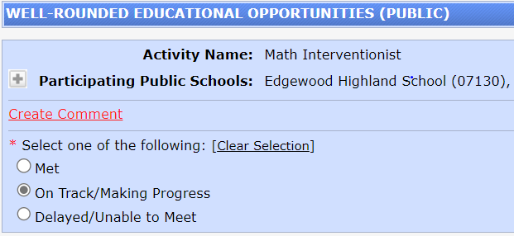
Prior Year Outcomes Report
Met
On Track/Making Progress
expended some
Delayed/Unable to Meet
expended minimal funds
delayed intervention
expended needed funds
approaching goals but did not meet
course correction needed on intervention
meet current year goals/action steps

Slide 56
Prior Year Outcomes Report
Met
Expended needed funds
Meet current year goals/action steps
On Track / Making Progress
Expended some funds
Approaching goals but did not meet
Delayed/Unable to Meet
Expended minimal funds
Delayed activity/intervention
Course correction needed on activity/intervention
LEA will need to describe why and next steps
Notes:
Linda - new

Slide 57
Notes:
By signing the Title IV-A assurances, LEAs are confirming the will comply with the following requirements:
Identify schools using the appropriate requirements
Follow 20-20-some portion spending rules
Meet equitable services expenditure requirements and
Annually report how funds are being used

Slide 58
and other fiscal requirements

Slide 59
Agenda
Program Overview
Equitable Services for Private School
Consolidated Resource Plan (CRP) Application
Budget and other fiscal requirements
End of the Year Expenditure Report
References & Resources
Notes:
Linda – New slide

Slide 60
TIV-A Expenditure Rules
20-20-Something Rule
15% Technology Infrastructure Cap
2% Cap for Direct Administration Costs
Supplement Not Supplant
Allowable Costs
Determining Funds for Equitable Services
Notes:
LEAs need to meet these rules in their budget and at the end of the year.

Slide 61
20-20-Some Portion Rule
20% MIN
20% MIN
portion
portion
Well-Rounded Education Opportunities
Safe and Healthy Students
Effective Use of Technology
LEAs with an adjusted allocation of $30,000 or more must expend their Title IV-A funds using the 20-20-some portion rule.

Slide 62
15% Technology Infrastructure Cap
LEAs may spend up to 15% of the total funds set aside for Effective Use of Technology as part of their Technology Infrastructure reserve.
Keep in mind that Tile IV-A looks at expenditures:
Technology Infrastructure spending cannot exceed 15% of Effective Use of Technology spending; and
Both public and private school services are included in this calculation.
Total Effective Use of Technology Reserve | $15,000
Effective Use of Technology (minimum expenditure) | $12,750
Technology Infrastructure (maximum expenditure) | $2,250

Slide 63
Allowable Administrative Costs
Two types of administrative costs:
Direct Administrative Costs
Indirect Costs
Direct Administrative Costs are capped at 2% of the LEAs Adjusted Allocation.
Original Allocation +/- Transfers =
Adjusted Allocation
Notes:
By signing the Title IV-A assurances, LEAs are confirming the will comply with the following requirements:
Identify schools using the appropriate requirements
Follow 20-20-some portion spending rules
Meet equitable services expenditure requirements and
Annually report how funds are being used

Slide 64
Title IV-A Funds are Supplemental
Additional Funds
Federal Funds
State and Local Funds
It is presumed that supplanting has occurred if the LEA uses Title IV-A funds to provide services:​
it was required to make available under other federal, state or local laws
it provided with non-federal funds in the prior fiscal year​, or
that the LEA would otherwise provide.
Title IV-A
Notes:
It is presumed that supplanting has occurred if the LEA uses Title IV-A funds to provide services:​
it was required to make available under other federal, state or local laws
it provided with non-federal funds in the prior fiscal year​, or
that the LEA would otherwise provide.
​Ask Yourself??​
Is the activity required by Federal, State, or local law?​
Was the activity paid for with State or Local funds in the previous year?​
If the answer to both is no, then funds are most likely supplemental.​​

Slide 65
Title IV-A Funds are Supplemental
Additional Funds
Federal Funds
State and Local Funds
It is presumed that supplanting has occurred if the LEA uses Title IV-A funds to provide services that:​
it was required to make available under other federal, state or local laws
it provided with non-federal funds in the prior fiscal year​, or
the LEA would otherwise provide.
Title IV-A
Notes:
Linda – New Linda made minor change
It is presumed that supplanting has occurred if the LEA uses Title IV-A funds to provide services:​
it was required to make available under other federal, state or local laws
it provided with non-federal funds in the prior fiscal year​, or
that the LEA would otherwise provide.
​Ask Yourself??​
Is the activity required by Federal, State, or local law?​
Was the activity paid for with State or Local funds in the previous year?​
If the answer to both is no, then funds are most likely supplemental.​​

Slide 66
Supplement Not Supplant (SNS)
It is presumed that supplanting has occurred if the LEA uses Title IV-A funds to provide services:​
it was required to make available under other federal, state or local laws
it provided with non-federal funds in the prior fiscal year​, or
that the LEA would otherwise provide.
​Ask Yourself??​
Is the activity required by Federal, State, or local law?​
Was the activity paid for with State or Local funds in the previous year?​
If the answer to both is no, then funds are most likely supplemental.​​

Slide 67
Supplement Not Supplant (SNS)
​Ask Yourself??​
Is the activity required by Federal, State, or local law?​
Was the activity paid for with State or Local funds in the previous year?​
If the answer to both is no, then funds are most likely supplemental.​​
Notes:
Linda - New

Slide 68
Allowable Costs
Allowable
Necessary
Reasonable
Allocable
Authorized
Documented
under individual program rules.
for the proper and efficient performance of the program.
in that it would be a cost that a prudent person would incur under similar circumstances.
to the program, such that the program must benefit in proportion to the amount charged to the federal program.
or otherwise not prohibited, by federal, state or local rules.
to justify all fiscal and program requirements.

Slide 69
Determining Funds for Equitable Services
Expenditures for services and other benefits provided to eligible private school children, teachers, and other educational personnel must:
be equal to the expenditures for participating public school children, taking into account the number and educational needs of the private school children to be served; and
be obligated for the fiscal year the funds are received.
Carry-forward funds are only allowable in extenuating circumstances, e. g. natural disaster or pandemic.
Notes:
Good planning and ongoing consultation throughout the year should prevent any unspent balance of equitable share funds. ​

Slide 70
Proportionate Share Calculator
Name of District:
FY 2023 Calculator used to Determine the Proportionate Share of Title IV, Part A Funds for Equitable Services to Private Schools within the LEA
A. Number of Students | Example | Input Your LEAs Data Below
A1: District Enrollment (Public Schools, K - 12 students) | 2,500
A2: Participating Private Schools Enrollment (K - 12 students) | 150
A3: Total Enrollment (A1 + A2) | 2,650 | 0
B. Title IV, Part A Allocation
B1: Total LEA Title IV-A Allocation for Current Fiscal Year | $25,000
B2: Transfer of funds out of Title IV-A to all other Title programs | $2,000
B3: Transfer of funds into Title IV-A from Title II | $0
B4: Administrative Costs (for public and private school programs) | $400
B5: LEA Adjusted Allocation = (B1 - B2 + B3 - B4) | $22,600 | $0
C. Per Pupil Rate
C1: Adjusted Allocation/Total Enrollment (B5/A3) | $8.53 | #DIV/0!
D. Equitable Services
D1: Current School/Fiscal Year equitable services share for all participating private schools (A2 x C1) | $1,279.25 | #DIV/0!
D2: Prior School/Fiscal Year unspent balance of funds reserved for equitable services to participating private schools | $200.00
D3: Minimum Amount LEA must budget/reserve for equitable services for participating private schools (D1 + D2) | $1,479.25 | #DIV/0!
Notes:
Calculator assists LEAs to determine proportionate share of each eligible participating private school.​
Number of Students
Enrollments include all K to 12 students. Preschool is not mandatory in RI, and therefore should not be included.
For private school students:
Use the count from October 1st of the previous school year. David Luther will load these into the spreadsheet for you.​
Counts include all students (K to 12) regardless of district of residency.
Allocations
Private School proportionate share is based upon LEAs Title IV-A allocation​ for the current year plus or minus and transfers
LEAs need to include their original allocation and any transfers into or out of the program
LEA may take administrative costs off the top, and would record it in this section.
This will determine the LEAs adjusted allocation.
Note: if the LEAs allocation changes at amendment time, this calculator, and potentially the equitable services program, would need to be updated.
Purple Section
The last section of the calculator provides calculates the minimum amount of funds available for equitable services.
LEAs should add any unexpended funds from the previous year to this calculation, bearing in mind that funds should be expended in the year they are allocated, and only carried over under exceptional circumstances.

Slide 71
Title IV-A End of the Year Expenditure Report

Slide 72
Agenda
Program Overview
Equitable Services for Private School
Consolidated Resource Plan (CRP) Application
Budget and other fiscal requirements
End of the Year Expenditure Report
References & Resources
Notes:
Linda – New slide

Slide 73
Reporting Categories
LEAs must report on all funds expended between July 1st and June 30th for the following categories:
Well-Rounded
Safe and Healthy
Effective Use of Technology
Technology Infrastructure
Private School Reserves
Direct and Indirect Administration Expenditures
For the 2022-2023 CRP, the report is due no more than 75 days after the grant ends -
September 13, 2023.
Notes:
RIDE also uses information from this report to fulfil our federal reporting requirements.

Slide 74
How to Determine the LEAs Adjusted Allocation Total for Spending Rules
To calculate, pull data from the following pages:
Allocations Page - Original Allocation
Allocations Transfer page – Transfer Totals
Original Allocation +/- Transfers =
Adjusted Allocation

Slide 75
Final Allocation Table
Automatically calculated (original allocation +/- any transfers).
Total Reported Expenditures Table
LEAs must report on any public and private school expenditures July 1, 2022 and June 30, 2023 (green arrow columns).
Total expenditures will automatically calculate for you.

Slide 76
Once your LEA enters the data, the system will generate reports for each TIV-A reporting rule:
Table 1: For LEAs with adjusted allocations of $30,000 or more
Table 2: For LEAs with Technology Infrastructure expenditures
Table 3: For LEAs with Direct Administration Costs

Slide 77
Agenda
Program Overview
Equitable Services for Private School
Consolidated Resource Plan (CRP) Application
Budget and other fiscal requirements
End of the Year Expenditure Report
References & Resources
Notes:
Linda – New slide

Slide 78
Title IV-A Statute
US ED's SSAE Non-Regulatory Guidance
Title IV-A Application Guide
Title II & Title IV-A Equitable Services Resources
Title IV-A Consortium Agreement
RIDE Title IV-A FAQs
Resources & References:
Also available in the Accelegrants Document Library
Notes:
By signing the Title IV-A assurances, LEAs are confirming the will comply with the following requirements:
Identify schools using the appropriate requirements
Follow 20-20-some portion spending rules
Meet equitable services expenditure requirements and
Annually report how funds are being used

Slide 79
We’d love you feedback – Survey Link
Please reach out to your Title IV-A liaison with any questions:
Stephanie Enos, Stephanie.Enos@ride.ri.gov
Eileen Botelho, Eileen.Botelho@ride.ri.gov
Ann Hampson, Ann.Hampson@ride.ri.gov
Notes:
By signing the Title IV-A assurances, LEAs are confirming the will comply with the following requirements:
Identify schools using the appropriate requirements
Follow 20-20-some portion spending rules
Meet equitable services expenditure requirements and
Annually report how funds are being used

