Slide 1
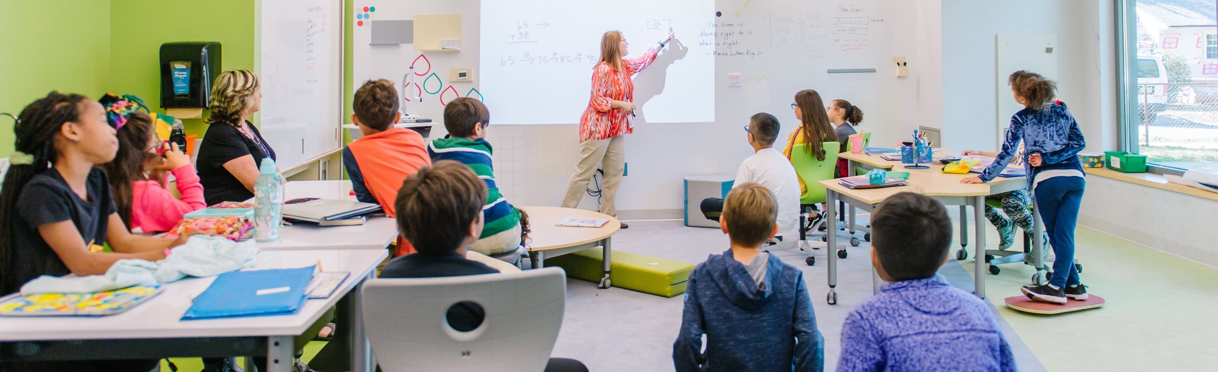

RIDE School Construction Program
Rhode Island Association of School Committees
April 29, 2023

Slide 2
RIDE Necessity of School Construction History
RIDE’s Necessity of School Construction program has evolved over the last 15 years.
2007
Revised review process, develop school construction regs, Adopted NECHPS
2011
School construction moratorium starts
2013
Statewide Facilities Assessment
2015
School construction moratorium ends
2017
Statewide Facilities Assessment
2018
$250M Statewide School Construction Bond passes, establishes Pay-go, Incentives
2022
New $250M Statewide School Construction Bond
1960-2006
Districts finance 100% of capital projects upfront, receive aid after completion
2016
School Building Authority (SBA), advisory board and capital fund established

Slide 3
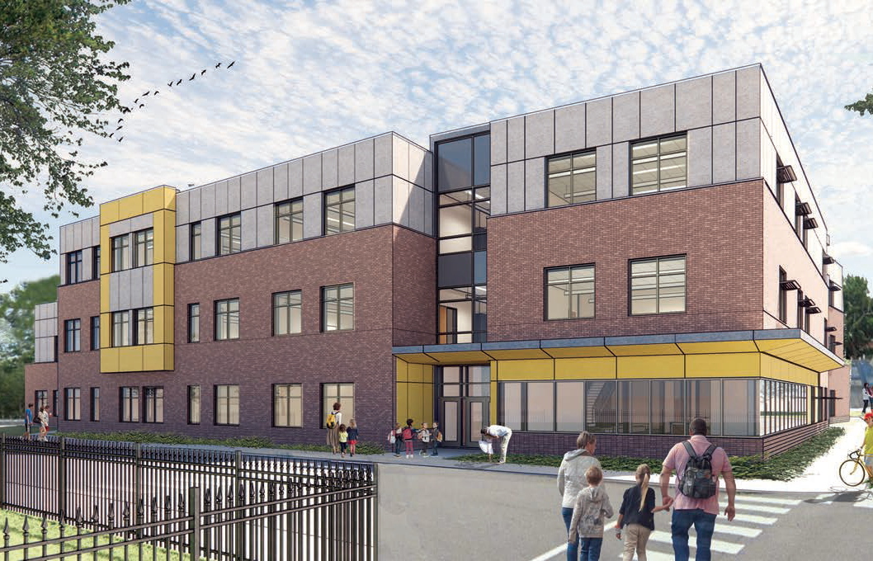
School Construction Regulations
RIDE’s School Construction Program is governed by the School Construction Regulations (SCR), which set standards for school facility design and construction.
Spaziano Elementary School in Providence, RI
Adopted by the Board of Regents in 2007
Identify:
  Funding Priorities
  Space Standards
  Application Procedures
  Construction Standards
Focused on providing the quality learning environments

Slide 4
Educational Facility Master Planning
Enrollment
Facility Conditions
Educational Programming
Facilities
Master Plan
Data Driven Decisions
Available Funding

Slide 5
Necessity of School Construction Process

Slide 6
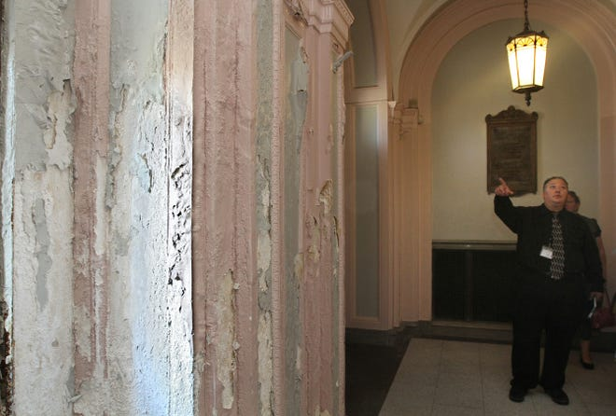
Stage I – Identification of Need
The Necessity of School Construction process is a multi-stage application that requires LEAs to conduct thorough assessments toward the creation of an efficient and prudent masterplan.
LEAs attain a comprehensive understanding of districtwide capacity, enrollment trends, and the alignment of existing facilities to the educational program being offered in each school by submitting:
Facility Conditions Assessment
Enrollment Projections
Educational Programs for Each School
Asset Protection Plan
School Building Committee List

Slide 7
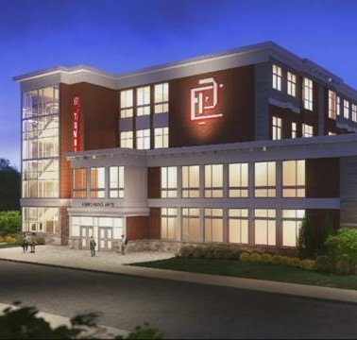
Stage II – Solution to Needs
During Stage II, LEAs work with an architectural and engineering team to propose solutions to the identified issues.
The State II application is the basis for establishing a budget and project descriptions that are forwarded to the SBA Advisory Board and the Council on Elementary and Secondary Education. These include:
Project Overview
Cost Estimates and Schematic Design for all projects
Local Approvals (Municipal and School Committee)
Financing Plan
Project Timeline
East Providence High School broke ground in 2019 and was completed in 2021.

Slide 8
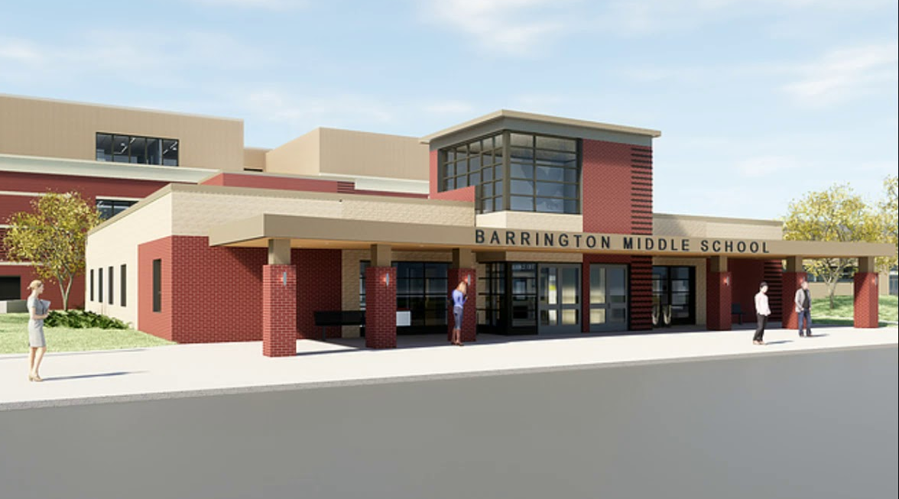
Stage III – Design Reviews
Design reviews must be conducted for all projects that are part of a multi-year capital improvement plan that exceeds $500,000, regardless of eligibility for housing aid.
Projects are reviewed three times to ensure compliance with the School Construction Regulations.
Schematic Design
Design Development
60% Construction Documents
Projects less than $500,000 can have use the express Portal and receive one review.

Slide 9
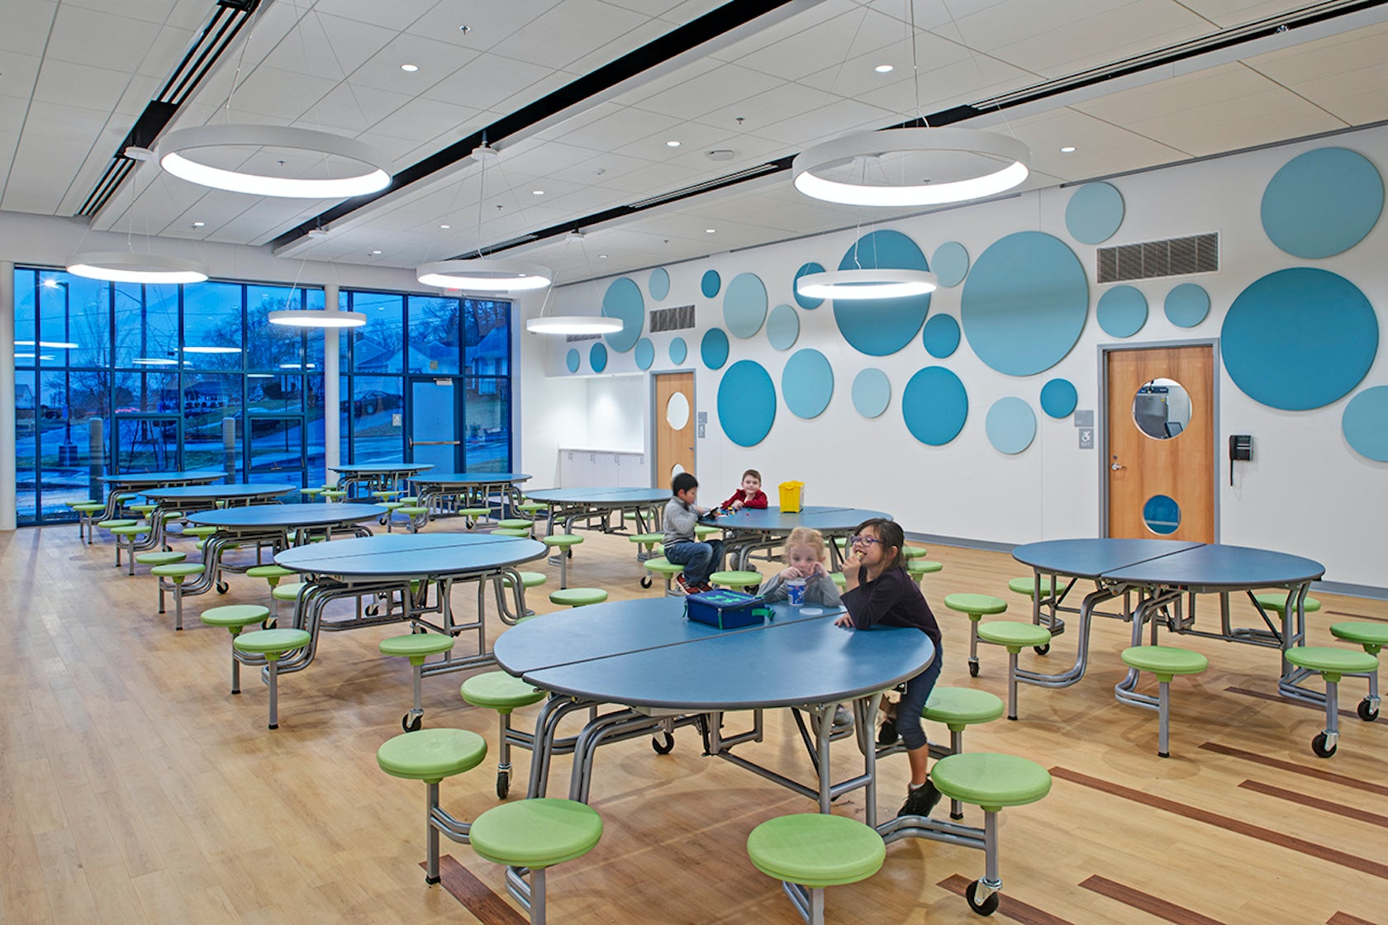
School Housing Aid
Foundational housing aid represents the state’s contribution to public school construction projects.
McGuire Elementary School in North Providence, RI, completed 2019
Only projects approved through the “Necessity of School Construction Application Process” are eligible to receive state funding
The state’s share ratio or housing aid reimbursement is calculated annually for each Local Education Agency (LEA) using a wealth ratio.
A majority of the state’s funding is based on a reimbursement model
  Payment occurs when the project is complete. Funding is tied to debt service payments.

Slide 10

School Housing Aid
Housing Aid is a reimbursement based, where funding is paid upon project completion.
Eden Park Elementary School in Cranston, RI
State reimburses cities/towns for a share of capital projects
  Includes principal and interest
  State share is based on district’s wealth compared to state wealth
Minimum state share is 35%; Maximum is 96%
Charter schools are at 30%

Slide 11
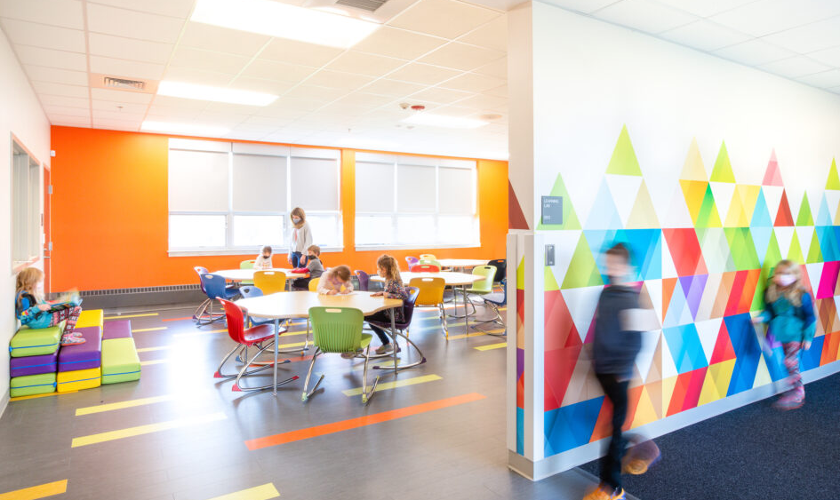
SBA Capital Fund
A funding mechanism designed to provide upfront funding for high priority projects while reducing the burden of financing costs from State and municipal budgets.
LaPerche Elementary School in Smithfield, RI, completed 2021
Designed to address high priority projects in communities with limited financial capabilities.
SBA allocates funding to different priorities:
  Shovel Ready Projects
  School Safety
  Facility Equity Initiative
  Outdoor Classrooms
  Equipment & Technology

Slide 12
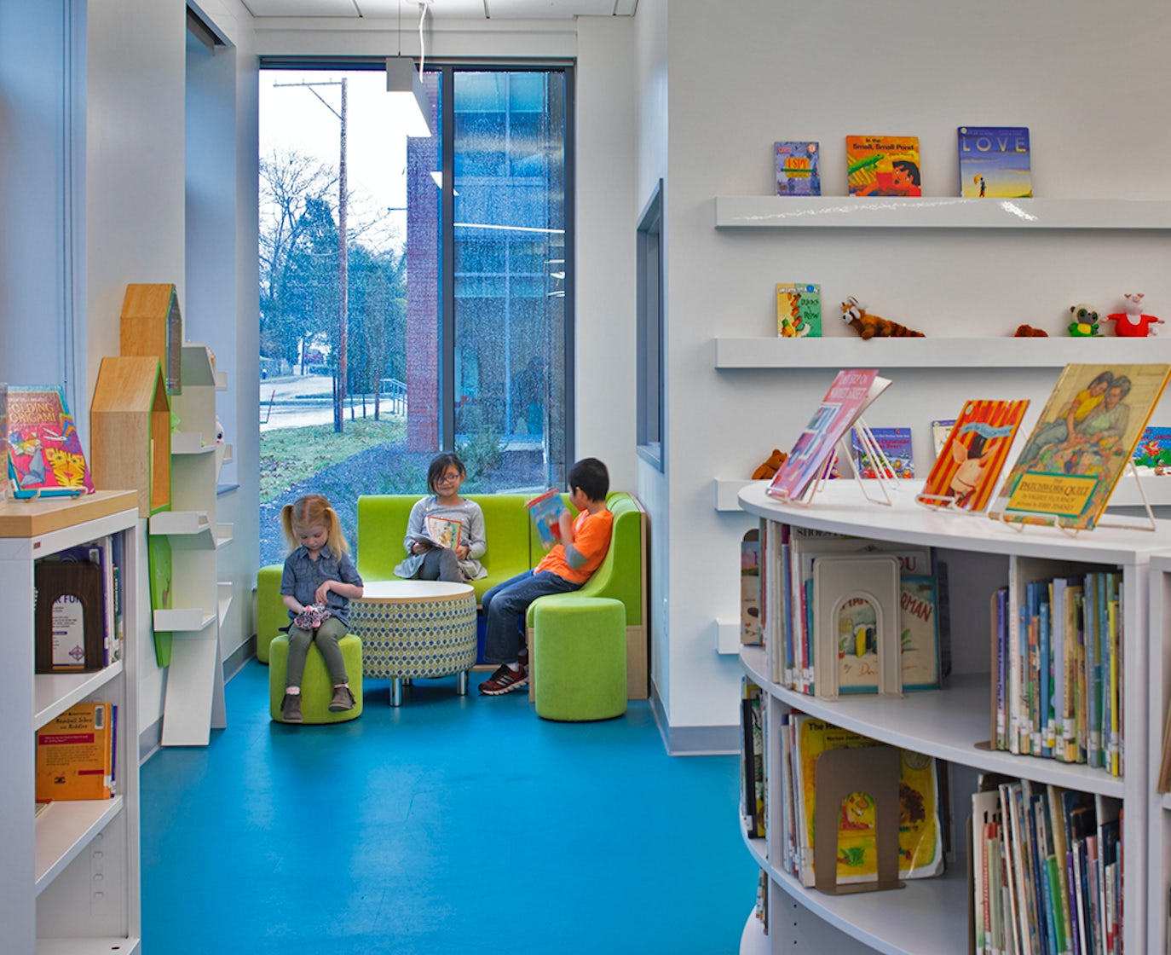
Pay-As-You-Go Funding
$500M provided through the Statewide School Construction bonds is available to LEAs to support the state share of foundational housing aid awarded (Necessity of School Construction Approvals) on a pay-as-you go basis.
McGuire Elementary School in North Providence, RI, completed 2019
LEAs submit invoices for immediate payment on eligible expenses (as opposed to waiting until a project is complete) to receive any state funds
15% of state share is awarded on each approval
Eligible expenses include:
  Approved projects, including new school construction, major renovations, security projects,
  Site purchases, swing space, soft costs, and general capital improvements funded by bonds or local capital reserve accounts.

Slide 13
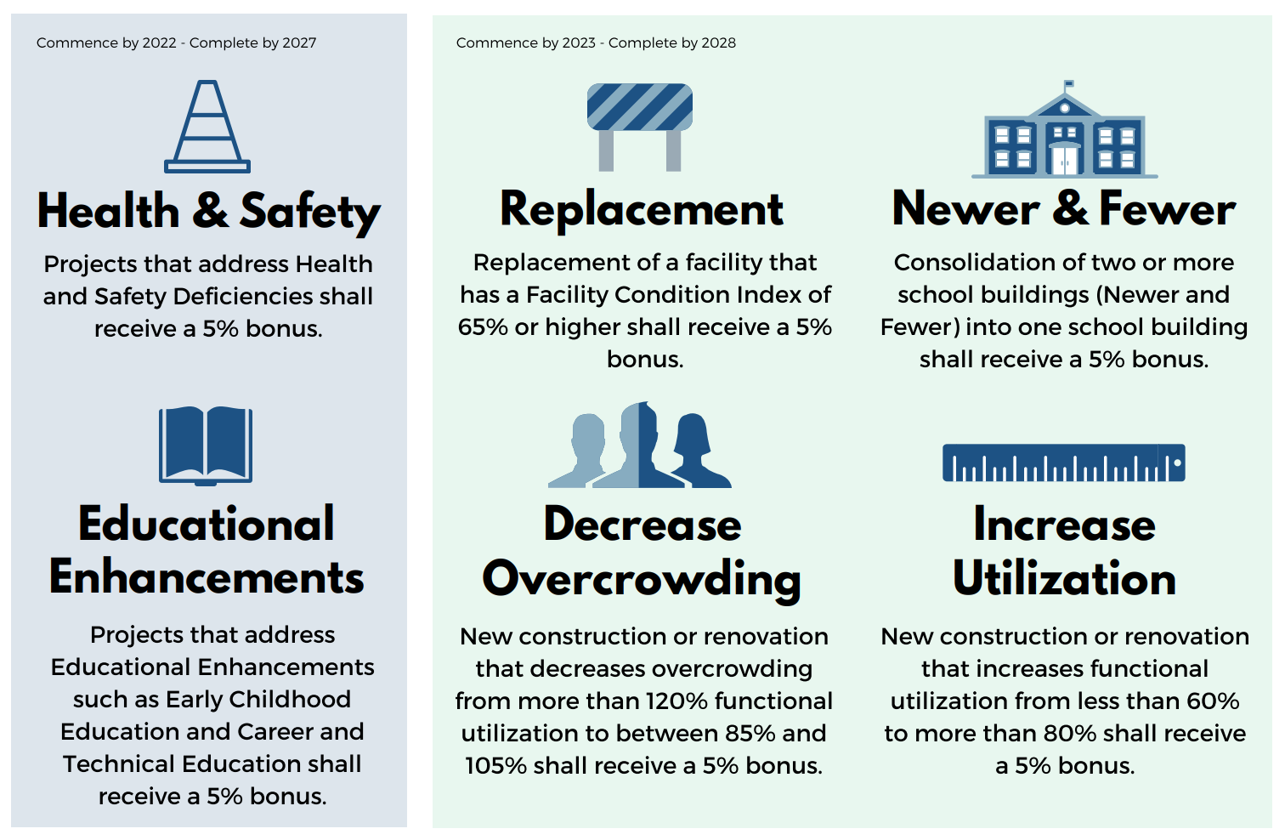
Temporary Bonuses
Bonuses were intended to create surge of activity to address concerns quickly
Must begin by December 30, 2023.
5-year window for completion
Bonuses can be combined
25% of total project or a minimum of $500,000 must be directed to a specific incentive
Max increase in state share is 20%, but can’t increase by more than half

Slide 14
Project Approvals
RIDE’s Necessity of School Construction program has evolved over the last 5 years.
Fiscal Year | Approvals | State Share
FY 2018 | $283.6 | $141.8
FY 2019 | $383.0 | $191.5
FY 2020 | $629.5 | $314.8
FY 2021 | $143.5 | $71.8
FY 2022 | $923.3 | $461.8
Total | $ 2,362.9 | $1,181.7
$ in millions; does not include incentives
*State Share is tied to debt service (20 years), not paid annually.

Slide 15
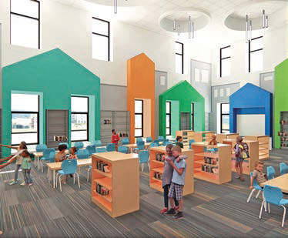
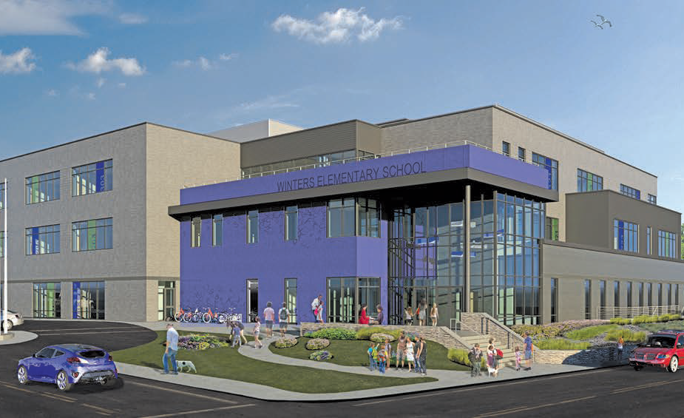
Update & Links
RIDE anticipates another $1B in project approvals in 2023 as the bonuses begin to sunset.
Renewing the Dream
ARTS Initiative
Learning Inside Out
Menu for Success (Food Trucks)
2017 Statewide Assessment (2023 version is underway)
Winters Elementary School in Pawtucket, RI

Slide 16
RIDE School Construction Program
Questions?

