Slide 1
DLM Moving from the Year End to Instructionally Embedded Model
Ronda J Layman
Molly Brown

Slide 2
Objectives
Become familiar with the similarities and differences of the Year End and Instructionally Embedded Model
Understand steps to take prior to the shift
Become familiar with how using the Instruction and Assessment Planner can help inform instruction

Slide 3
Model Comparison

Slide 4
Year End Model
Currently Rhode Island is a Year-End Model state
Next school year the transition to Instructionally Embedded assessments will occur
Instead of doing a summative assessment window in the fall, you will test in the fall and spring for ELA and Mathematics
  Science will continue to be assessed as Year-End
Assessment will be embedded into your instruction.

Slide 5
Model Comparison—Basics
Instructionally Embedded | Year-End
two required windows (fall and spring) | one required window (spring) and an optional instructionally embedded window (fall/winter)
teacher follows guidelines but chooses which skills to assess and when | teacher does not choose which skills to assess
assessment is ongoing and occurs shortly after instruction has been provided | assessment occurs near the end of the year to capture what students have learned
immediate feedback regarding student performance is available for the teacher; end-of-year score report produced following the spring window | no immediate feedback regarding student performance is available for the teacher; end-of-year score report produced following the spring window
Notes:
The Instructionally Embedded model has two required assessment windows: one in the fall and one in the spring. The Year-End model has only a required spring assessment window, although an optional instructionally embedded window is offered during the fall and winter months.
For the Instructionally Embedded model, teachers follow guidelines but choose which skills to assess and when for each student. Teachers do not make such choices for the Year-End model.
The Instructionally Embedded model is intended to closely tie instruction and assessment. Therefore, assessment is ongoing and occurs shortly after instruction has been provided, whereas the assessment for the Year-End model is completed during the spring window near the end of the school year to capture what students have learned to that point.
For the Instructionally Embedded model, immediate feedback regarding student performance is available for the teacher and then end-of-year results are provided following the spring window. For the Year-End model, results are only provided following the spring assessment window.

Slide 6
Test Blueprints
A key difference between the Year-End model and the Instructionally Embedded model involves the test blueprints.
Year-End Model | Instructionally Embedded
The test blueprints prescribe Essential Elements that will be assessed. | The test blueprints provide a menu of Essential Elements from which the teacher can choose to assess, following guidelines.
Notes:
A key difference between the Year-End model and the Instructionally Embedded model involves the test blueprints. For the Year-End model, the test blueprints prescribe Essential Elements that will be assessed. For the Instructionally Embedded model, the test blueprints provide a menu of Essential Elements from which the teacher can choose to assess, following guidelines.

Slide 7
Recall: Test Blueprint—Year-End
Claim and Conceptual Area | Essential Elements Assessed
Claim 1, Conceptual Area C1.2 | M.EE.6.NS.1—Compare the relationships between to unit fractions. M.EE.6.NS.5-8—Understand that positive and negative numbers are used together to describe quantities having opposite directions or values (e.g., temperature above/below zero).
Claim 2, Conceptual Area C2.2 | M.EE.6.G.1—Solve real-world and mathematical problems about area using unit squares. M.EE.6.G.2—Solve real-world and mathematical problems about volume using unit squares.
Claim 3, Conceptual Area C3.2 | M.EE.6.SP.5—Summarize data distributions shown in graphs or tables.
Claim 4, Conceptual Area C4.1 | M.EE.6.EE.1-2—Identify equivalent number sentences M.EE.6.EE.3—Apply the properties of addition to identify equivalent numerical expressions.
Example: Grade 6 Mathematics, Year-End Model
Notes:
Recall, too, that for the Year-End model, each student is assessed on each Essential Element listed on the blueprint for each assessed subject and grade. The teacher doesn’t make any choices about what to assess but decides when to administer each testlet. In the case of grade 6 mathematics, as shown here, every grade 6 student takes seven testlets to complete the mathematics assessment: one testlet for each of the seven Essential Elements listed on the blueprint.

Slide 8
Test Blueprint—Instructionally Embedded
Blueprint Coverage Criteria | Essential Element Options
Claim 1—Choose two Essential Elements in different conceptual areas. | (Conceptual Area 1.1) M.EE.6.RP.1—Demonstrate a simple ratio relationship (Conceptual Area 1.2) M.EE.6.NS.1—Compare relationships between two unit fractions. (Conceptual Area 1.2) M.EE.6.NS.5-8—Understand that positive and negative numbers are used together to describe quantities having opposite directions or values (e.g., temperature above/below zero). (Conceptual Area 1.3) M.EE.6.NS.2—Apply the concept of fair share and equal shares to divide. (Conceptual Area 1.3) M.EE.6.NS.3—Solve two-factor multiplication problems with products up to 50 using concrete objects and/or a calculator.
Claim 2—Choose one Essential Element. | (Conceptual Area 2.2) M.EE.6.G.1—Solve real-world and mathematical problems about area using unite squares. (Conceptual Area 2.2) M.EE.6.G.2—Solve real-world and mathematical problems about volume using unit cubes.
Claim 3—All students are assessed on the Essential Element. | (Conceptual Area 3.2) M.EE.6.SP.5—Summarize data distributions shown in graphs or tables.
Claim 4—Choose two Essential Elements. | (Conceptual Area 4.1) M.EE.6.EE.1-2—Identify equivalent number sentences. (Conceptual Area 4.1) M.EE.6.EE.3—Apply the properties of addition to identify equivalent numerical expressions. (Conceptual Area 4.1) M.EE.6.5-7—Match an equation to a real-world problem in which variables are used to represent numbers.
Example: Grade 6 Mathematics, Instructionally Embedded Criteria apply to both the fall and spring windows.
Notes:
In contrast, shown here as an example is the Instructionally Embedded blueprint for grade 6 mathematics. Four blueprint coverage criteria are specified. In all, every grade 6 student is assessed on at least six Essential Elements for the mathematics assessment in both the fall and spring windows. For the spring window, a student can be assessed on the same Essential Elements as the fall window, or the teacher can choose some different Essential Elements. However, the same coverage criteria apply to each window.
For grade 6 mathematics, the first set of criteria is to assess at least two of Essential Elements listed for Claim 1, and those Essential Elements must be from different conceptual areas, as denoted in the blueprint. For the second criterion, both Essential Elements are from the same conceptual area within Claim 2, and the criterion simply states, “Choose one Essential Element.” For the third criterion, only one Essential Element is listed for Claim 3. Therefore, the criterion states, “All students are assessed on the Essential Element.” Then the fourth criterion states, “Choose two Essential Elements” from the three Essential Elements listed in the blueprint for Claim 4.
Again, for the spring window, a teacher doesn’t have to choose and assess all of the same Essential Elements chosen for the fall. The goal is simply to satisfy the blueprint coverage criteria for each window.

Slide 9
Blueprint Coverage Criteria—
Instructionally Embedded
vary by grade and subject
allow teachers to make choices
guide teachers in providing instruction on a variety of skills
should be met for both the fall and spring windows
can be exceeded
Notes:
Note that blueprint coverage criteria vary by grade and subject, allow teachers to make choices, and guide teachers in providing instruction on a variety of skills. The criteria are intended to be met for both the fall and spring windows. Also, exceeding the blueprint criteria is acceptable.

Slide 10
Goals of the Instructionally Embedded Model
provide more accurate representation of what students with the most significant cognitive disabilities know and can do by measuring their learning as instruction occurs throughout the year
support connections to instructional practices by spanning full academic year
support teacher flexibility and decision-making within blueprint requirements for coverage

Slide 11
Goals Continued
integrate instruction and assessment to inform one another
provide instruction and assessment that align to academic goals for students with the most significant cognitive disabilities

Slide 12
Testlets
  The assessment for each subject is comprised of a series of short assessments called testlets. (this is the same format)
  All testlets (fall and spring) are secure and are part of the accountability score in the spring.
  Testlets are completed across multiple sessions during each assessment window rather than a single sitting.
  The number of testlets a student completes varies by grade and subject.
  Each testlet assesses a single Essential Element at a single linkage level.
    Writing testlets are the only exceptions.
Notes:
Like the Year-End model, the Instructionally Embedded assessment for each subject is comprised of a series of short assessments called testlets, and all operational testlets are secure. Testlets are completed across multiple sessions during an assessment window rather than a single sitting. The number of testlets a student completes per subject varies by grade, subject, and model. Each testlet assesses a single Essential Element at a single linkage level. Writing testlets are the only exceptions.

Slide 13
Preparing for the Shift

Slide 14
Preparing for the shift
There are steps that can be taken now to help prepare for the move to the IE model
  Use of the optional Instructionally Embedded window this Fall while still testing in the spring as a Year End state
  Becoming familiar with blueprints
  Using score reports to inform instruction

Slide 15
Before a Student Can be Assessed
teacher completes training
teacher completes test security agreement
student is enrolled
student is rostered
teacher completes the student’s First Contact survey
Notes:
Consequently, teachers will need to complete their Required Test Administrator Training and test security agreement earlier than before, and students will need to be enrolled and rostered earlier than before. The student’s Frist Contact survey must also be completed before a student can be assessed.

Slide 16
Understanding the process
Instructionally Embedded Assessments Optional Window
Notes:
Next is a discussion about the instruction and assessment process involved with the Instructionally Embedded model.

Slide 17
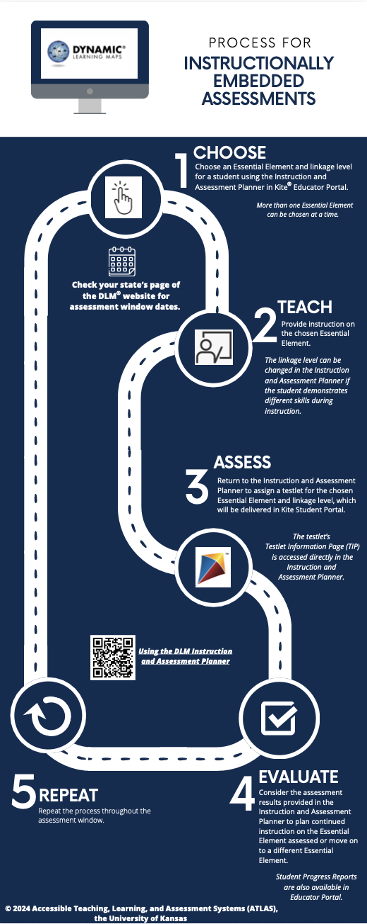
At a Glance

Slide 18
What will teachers see and do in the 2027/2028 SY?
Sandbox demonstration of IE window

