Slide 1
Rhode Island Social Studies Curriculum Framework
[This slide deck is meant to serve as a turn-key tool for educators to share with their teams whether at the LEA or school level. It can be used to help with understanding of and planning for the implementation of the Social Studies Standards. There is also a recorded version of this presentation available. See notes sections for talking points.]

Slide 2
Agenda
Section 1: Background, Related Legislation, and Vision
Section 2: Implementing a High-Quality Curriculum
Section 3: Implementing High-Quality Instruction
Section 4: High-Quality Learning Through Assessment
Notes:
Recordings of this information, section by section, is available on the social studies page of the website. In addition, within Section 2 of the Framework, is guidance for Standards implementation in elementary, middle, and high school and there are also short recordings for each of these.
Administrators and curriculum coordinators will want to be familiar with all of the guidance. Elementary, middle, and high school educators will need to focus on their respective level. However, I highly suggest that educators at these levels read through or watch the recordings for all levels to have a foundational knowledge of the big picture. Similarly, I suggest educators at least understand the Social Studies Standards for grades other than their own to know where their students have been and what they have upcoming with their social studies education.

Slide 3
Section 1
Introduction

Slide 4
Sections of the Framework
Section 1 provides an overview of the context, purpose, and expectations related to the curriculum framework.
Section 2 reiterates the organization of the Standards and provides a range of resources to help educators understand and apply them. Section 2 also addresses how standards support selection and implementation of high-quality curriculum materials.
Section 3 of this framework provides guidance and support around how to use the Standards to support high-quality instruction.
Section 4 offers resources and support for using the Standards to support assessment.
Notes:
Section 1 of the Social Studies Curriculum Framework introduces the framework and what a framework is.

Slide 5
Frameworks in the Legislation
Rhode Island General Law (RIGL) § 16-22-31 – requires development of curriculum frameworks for mathematics, English language arts, science and technology, history and social studies, world languages, and the arts
Criteria outlined in the legislation:
provide sufficient detail to inform education processes such as selecting curriculum resources and designing assessments;
encourage real-world applications;
avoid the perpetuation of gender, cultural, ethnic, or racial stereotypes;
present specific, pedagogical approaches and strategies to meet the academic and nonacademic needs of multilingual learners; and
present specific, pedagogical approaches and strategies to meet the academic and nonacademic needs of English learner, economically disadvantaged, special education, and academically advanced students.
Notes:
Rhode Island General Law RIGL § 16-22-31 requires the development of curriculum frameworks for Mathematics, English Language Arts, Science, Social Studies, World Languages, and the Arts. Math, ELA, and Science frameworks were published in 2021. Social Studies, World Languages, and the Arts were published recently.
The frameworks are designed to address the criteria outlined in the legislation which includes, but is not limited to...

Slide 6
Vision for Student Success in Social Studies
Rhode Island students will understand the world in which they live and will be prepared with the knowledge and skills to become informed, thoughtful, and active citizens in a culturally diverse democratic society and complex world.
Additionally, Rhode Island students will be civic ready upon graduation. A civic ready student has a strong knowledge of history, democratic processes, citizens’ rights and responsibilities, critical thinking and problem-solving skills, and is empowered to actively advocate and participate in their community. A civic ready student values having a range of perspectives, diverse communities, and promoting inclusion and equity in civic spaces.
Notes:
The National Council for the Social Studies (NCSS) defines social studies as "the study of individuals, communities, systems, and their interactions across time and place that prepares students for local, national, and global civic life”(National Council for the Social Studies 2023).
Also according to NCSS,
Using an inquiry-based approach, social studies helps students examine vast human experiences through the generation of questions, collection and analysis of evidence from credible sources, consideration of multiple perspectives, and the application of social studies knowledge and disciplinary skills. As a result of examining the past, participating in the present, and learning how to shape the future, social studies prepares learners for a lifelong practice of civil discourse and civic engagement in their communities. Social studies centers knowledge of human rights and local, national, and global responsibilities so that learners can work together to create a just world in which they want to live (National Council for the Social Studies 2023).
Social studies instruction is essential from the early years of a student’s schooling, and students deserve a comprehensive and cohesive social studies curriculum from kindergarten through high school. Social studies allows students to develop a civic disposition, understand their place in the world and in time through knowledge of the past and historical influences on the world today, recognize how geography has shaped people and cultures, and grasp the ways local and global economies work together. Through social studies, students build cultural awareness, develop critical thinking skills, and enhance their ability to read and write. Social studies education prepares students to be engaged, informed, and responsible citizens. They learn how to engage in civil discourse, how to vote, how others have made social change in the past, and how they can affect change today and into their adulthood. A strong social studies education is essential as students move into their college, career, and civic lives.
Thus, in the vision for student success in social studies, Rhode Island students will understand the world in which they live and will be prepared with the knowledge and skills to become informed, thoughtful, and active citizens in a culturally diverse democratic society and complex world.
Additionally, Rhode Island students will be civic ready upon graduation. A civic ready student has a strong knowledge of history, democratic processes, citizens’ rights and responsibilities, critical thinking and problem-solving skills, and is empowered to actively advocate and participate in their community. A civic ready student values having a range of perspectives, diverse communities, and promoting inclusion and equity in civic spaces.

Slide 7
College, Career, and Civic Life
A high quality program of social studies fosters lifelong participation in civic life and social action that leads to effective and productive citizenship in a world that is culturally diverse and interdependent. It fosters the ability to apply inquiry processes and to employ the skills of data collection and analysis, collaboration, decision-making, and problem solving.
- Rhode Island Basic Education Program (BEP)
Notes:
RIDE’s mission for College and Career Readiness is to build an education system in Rhode Island that prepares all students for success in both college and career. This means that all doors remain open, and students are prepared for whatever their next steps may be after high school.
Social studies education not only prepares students for college and career, but also prepares them to engage in civic life upon graduation. Rhode Island’s Basic Education Program (BEP) notes that “a high quality program of social studies fosters lifelong participation in civic life and social action that leads to effective and productive citizenship in a world that is culturally diverse and interdependent. It fosters the ability to apply inquiry processes and to employ the skills of data collection and analysis, collaboration, decision-making, and problem solving”(BEP, 2009).
Rhode Island’s Secondary Regulations, revised in November 2022, name social studies as one of the core content areas and civics has been identified as a “real-world relevant skill that will develop skills and support their success in participating in society”

Slide 8
What is a Curriculum Framework?
The Rhode Island Social Studies Standards outline what students should know and be able to do
The Social Studies Curriculum Framework provides guidance around the implementation of the Standards in relation to:
the selection and use of high-quality curriculum materials,
evidence-based instructional practices, and
valid and reliable assessments
Notes:
While the Standards outline what students should know and be able to do, the purpose of the Social Studies Curriculum Framework is to provide guidance to educators and families around the implementation of the Rhode Island Social Studies Standards, particularly as it relates to the design and use of curriculum materials, instruction, and assessment.

Slide 9
Section 2
Implementing a High-Quality Curriculum

Slide 10
Sections of the Framework
Section 1 provides an overview of the context, purpose, and expectations related to the curriculum framework.
Section 2 reiterates the organization of the Standards and provides a range of resources to help educators understand and apply them. Section 2 also addresses how standards support selection and implementation of high-quality curriculum materials.
Section 3 of this framework provides guidance and support around how to use the Standards to support high-quality instruction.
Section 4 offers resources and support for using the Standards to support assessment.
Notes:
The introduction to Section 2 explains how RIDE defines high-quality curriculum materials (HQCMs) in relation to Social Studies Standards. The middle section reiterates the structure of the Standards. The final part of this section explains how HQCMs are selected in RI and provides related tools.

Slide 11
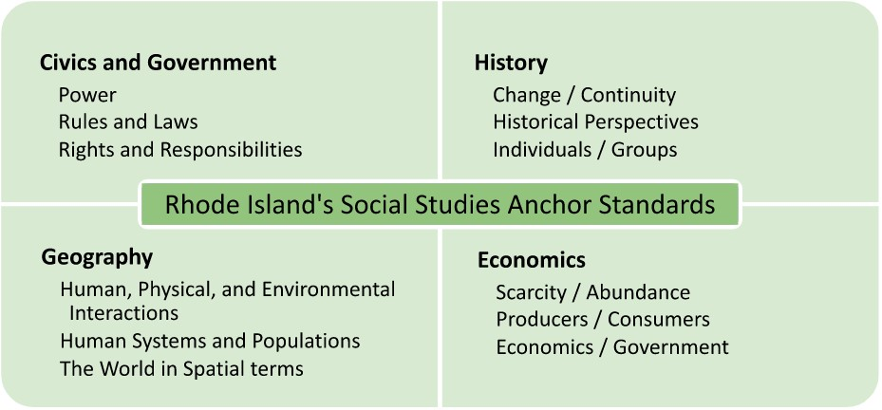
Re-visiting the Standards
Part of Section 2 revisits the structure and organization of the Rhode Island Social Studies Standards
Twelve Anchor Standards
How those work with each grade’s content standards plus those of the five model high school courses
Embedded four levels of rigor
Embedded inquiry
Embedded cultural responsiveness
Notes:
Because we started to build a framework around the Standards themselves, you will find part of this section repeats what is outlined in the Standards document. The organization of the Standards is reiterated here because much of this informs the guidance in the Curriculum Framework document surrounding instruction, curriculum, and assessment. This includes the explanation of the twelve Anchor Standards and how those work with each grade’s content standards and the standards within the five model high school courses. The ways inquiry, levels of rigor, and cultural responsiveness are embedded throughout the standards is also explained. Sinch much of this part of the Curriculum Framework was covered in the informational sessions about the Standards, it is not going to be repeated here. You are welcome to find the recording of that session on our website. You are also welcome to contact RIDE at the email address at the end of this slide deck if you have any questions about this part of section 2.

Slide 12
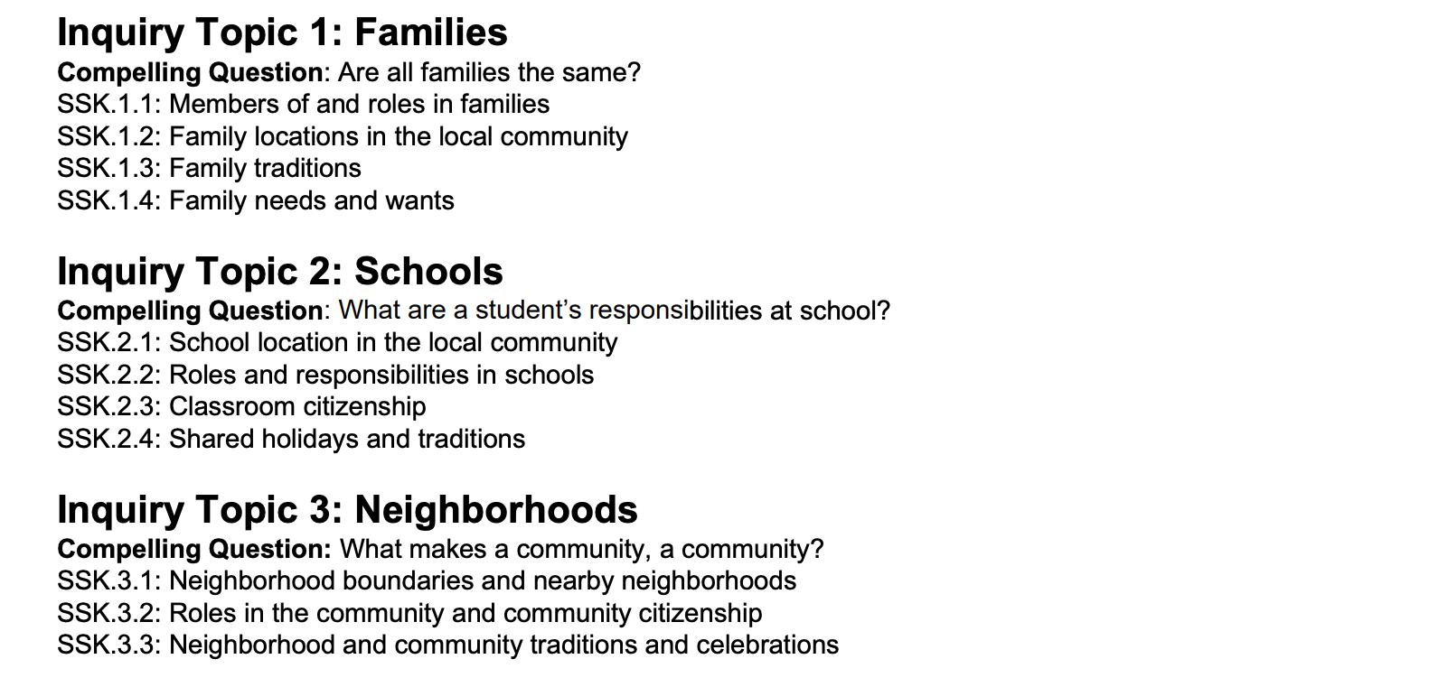
Revisiting the Standards
Notes:
Another thing to remember from the Standards document and to keep in mind throughout Curriculum Framework is the structure of the content standards. Remember that for each grade and model high school course, the standards are grouped into inquiry topics with a compelling question for each topic.

Slide 13
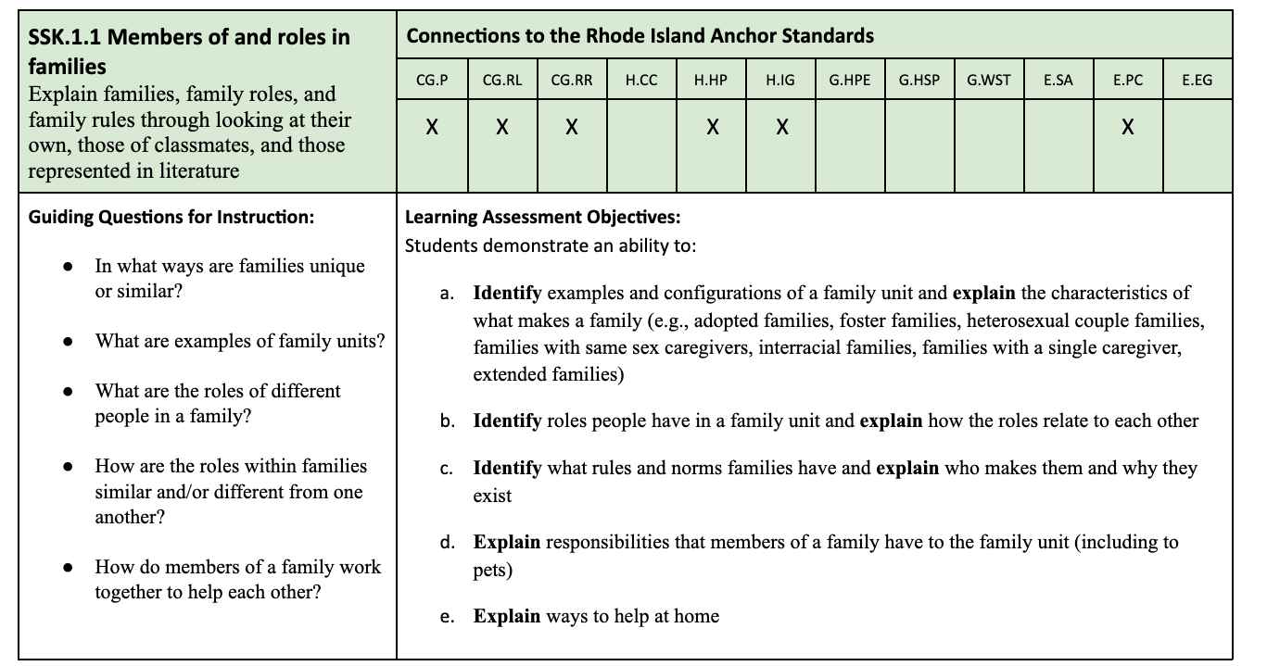
Revisiting the Standards
Notes:
Each standard is then unpacked through a table. The table shows how each content standard relates to the anchor standards, includes guiding questions for instruction, and learning assessment objectives. You will see the components of the standards table being used within components of the Curriculum Framework and this presentation.

Slide 14
Connections to Other Content Areas
ELA HQIM and RI Social Studies Standards Connections
Connections: RI Social Studies Standards and RI Core Standards for Mathematics
Connections: RI Social Studies Standards and Next Generation Science Standards
Connections with the World-Readiness Standards for Learning Languages
Connections with the National Core Arts Standards
Connections with the Rhode Island Social & Emotional Learning Standards
Connections to WIDA ELD Standards for MLLs
Notes:
ELA – In addition to the natural correlation to ELA/Literacy standards in reading, writing, listening, and speaking about topics while building content knowledge, we have created a document outlining ways that elementary and middle school ELA HQIM connects with the RI Social Studies Standards.
Math and Science - There are mathematical practices and social studies concepts that apply to all grade levels and contribute to a student’s overall critical thinking skills development in a comprehensive education. Similarly, there are science and engineering practices and cross-cutting concepts that correlate well with social studies concepts. Students engage with these practices and concepts at deepening and more complex levels as they progress through the grades. There are also areas where social studies content connects directly with mathematical or science standards that provide opportunities for cross-disciplinary understanding. RIDE has created two documents that outline the connections between the mathematics and social studies standards and the science and social studies standards.
In addition, the Curriculum Framework outlines connections with World-Readiness Standards for Learning Languages, Arts Standards, SEL Standards, and WIDA ELD standards.

Slide 15
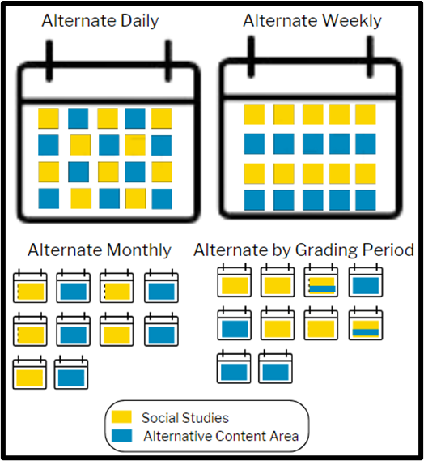
Implementing the Standards
There is also information about the following:
Terminology used in the Standards
Sequencing of the Standards
Implementing the Standards in the elementary grades
Implementing the Standards in the middle grades
Implementing the Standards in the high school
Notes:
Terminology You may have noticed that some terminology used within the Standards document may not be what is typically found in curriculum or instructional materials. Language is constantly evolving, and we attempted to use terminology that is currently most accepted, for instance using “Indigenous,” “unhoused,” or “enslaved.” Our choices are further explained in the Curriculum Framework document. Please keep in mind that not only may terms be different within instructional materials, but you and your students may come across older, outdated terminology when exploring primary and secondary sources.
Sequencing The Standards determine what topics are covered within certain grades, and the standards are presented within a scope & sequence, under Inquiry Topics. It is not necessary to find a curriculum that exactly matches the sequence as outlined nor is it always necessary for teachers to follow the sequence. The standards allow teachers some flexibility to implement the curriculum as long as the standards outlined in that grade or high school course are met.
For example, kindergarten’s Inquiry Topic 4 is sequenced so that students first learn about families around the world, then schools around the world, and finally neighborhoods around the world. Teachers could instead choose to have students explore a family, school, and neighborhood in one location in the world before exploring a family, school, and neighborhood in another location depending on curriculum and resources. Either way, students will still meet the three standards in that topic.
Similarly, if the standards are presented thematically, teachers may choose to instead explore the topics chronologically or vice versa.
Elementary, Middle , High The Curriculum Framework also lays out expectations for implementing the Standards in elementary, middle, and high school. These include scheduling and pacing of elementary content, integration with ELA, and high school courses and credits. We highly recommend that elementary, middle, and high school teams meet to discuss the full spectrum of a student’s social studies K-12 experience and are familiar with the Standards across the grades. This familiarity and teamwork will help teams plan as implementation is phased in within a district.

Slide 16
{The following three groupings of slides pertain to the implementation of Standards in elementary grades (slides 17-23), middle grades (slides 24-29), and high school (slides 30-36) from Section 2 of the Social Studies Curriculum Framework. Depending on your audience, you may choose to hide or show these slides. You may see some repetition between the notes that you will want to re-work if you use two or more groupings since each grouping was designed to be stand alone. The general presentation begins again at slide 37, High-Quality Curriculum in Social Studies}

Slide 17
Implementing the Standards in the Elementary Grades
Notes:
While much of the Social Studies Curriculum Framework pertains to Kindergarten through high school, there are subsections to Section 2 of the Curriculum Framework that provides guidance specific to implementing the Social Studies Standards in elementary, middle, and high school. In this section, I will outline the guidance pertaining to implementing the Standards in the elementary grades.

Slide 18
K-5 Elementary Grade Progressions for Content Standards
Kindergarten: Living and Working Together in Schools, Families, and Neighborhoods
Grade 1: Living and Working Together in Local Communities
Grade 2: Living and Working Together in Global Communities
Grade 3: Living and Working Together in Regions of the United States
Grade 4: Living and Working Together in Rhode Island
Grade 5: United States History: Pre-European Contact to Reconstruction*
*Considered middle school in some LEAs
Notes:
A reminder of the elementary grade progressions as outlined in the Rhode Island Social Studies Standards. Grade progressions for content standards are grade specific at the elementary school level to ensure every Rhode Island student receives a cohesive and comprehensive social studies education.

Slide 19
Implementing the Standards in the Elementary Grades
Importance of Social Studies
“If young learners are to become effective participants in a democratic society, then social studies must be an essential part of the curriculum throughout the elementary years”
-National Council for the Social Studies, 2017
Notes:
As noted in Section 1 of the Social Studies Curriculum Framework document, a comprehensive and cohesive K-12 social studies education is crucial. Through social studies, students develop skills they will bring with them into their college, career, and civic lives. The National Council for the Social Studies notes that “If young learners are to become effective participants in a democratic society, then social studies must be an essential part of the curriculum throughout the elementary years” (National Council for the Social Studies, 2017). Students learn about their communities and the world, learn about different cultures, and develop appreciation for diversity. Students cultivate critical thinking and problem-solving skills, learn to make informed decisions, and begin to understand how to civically participate in their communities.
In addition, NCSS also notes that “denying students opportunities to build social studies vocabulary and background knowledge…can lead to lower literacy levels and…increase the achievement gap” (National Council for the Social Studies, 2017). A 2020 study by Fordham Institute found that increased social studies instructional time in the elementary grades, more than any other subject, was correlated with improved reading ability (Tyner and Kabourek, 2020).

Slide 20
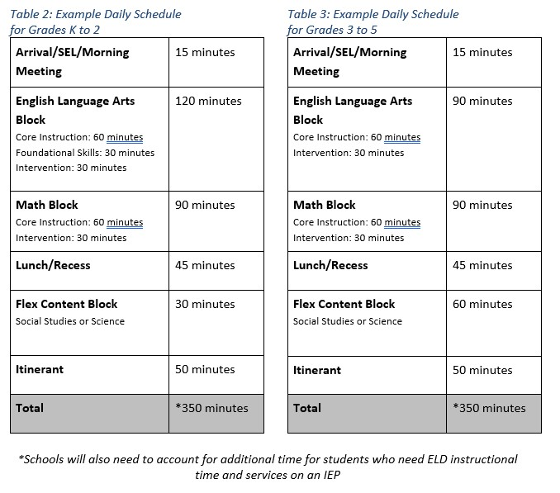
Scheduling for Social Studies in the Elementary Grades
Notes:
Due to increased foci on mathematics and English language arts instruction, some of Rhode Island’s LEAs have shifted away from dedicated instructional time for social studies at the elementary levels, as is the trend nationally (CCSSO, 2018; Dilberti, Woo, & Kaufman, 2023). LEAs find it difficult to set aside time for social studies in the school schedule. Some LEAs have begun to rely on the social studies content present in ELA materials for social studies instruction. However, while RIDE supports cross-curricular connections, there are no ELA curriculum materials which fully align with the Social Studies Standards. Instructional time must be devoted to social studies.
The Social Studies Collaborative of the Council of Chief State School Officers (CCSSO) recommends that elementary students receive at least 45 minutes of dedicated social studies instruction each day (CCSSO, 2018). While that is ideal, the Rhode Island Social Studies Standards at the elementary level do not require a full 180 days of instruction to fully address them. The actual number of instructional sessions needed will be driven by the LEA’s adopted social studies curriculum and should be balanced with the broader instructional needs and goals of the students in the LEA. These K-2 and 3-5 sample schedules (tables 2 and 3 in the Curriculum Framework document) provide guidance on how social studies can be integrated into an elementary school day. LEAs will need to adjust the minutes for each block according to their high-quality instructional materials (HQIM).
Since elementary social studies standards can be adequately addressed in fewer than 180 days of instruction, the content block can alternate with science or other content areas as appropriate. In grades 3-5, though, the anticipated number of lessons will increase across the grades as the topics increase in complexity. ELA lessons typically require less time in grades 3-5 and more time can be allocated to social studies and science instruction. Schools may opt to alternate social studies and science or other content areas daily, weekly, monthly, or by unit or grading period. In addition, some social studies HQIM also offer flexible timing and literacy-based options. Literacy-based social studies HQIM can be used in addition to the ELA HQIM and within its own block of instructional time.

Slide 21
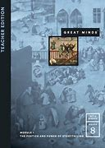
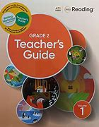
ELA & Social Studies
When possible, ELA materials can be used to draw connections to Social Studies standards.
When possible, Social Studies materials can be used to draw connections to ELA standards and content.
ELA materials cannot be used to replace Social Studies materials.
All LEAs will need to adopt Social Studies materials by 2026.
Notes:
There may be opportunities for LEAs to make connections between their chosen social studies and ELA curricula. Though many of the approved ELA curriculum materials include reading content in the sciences and social studies, this content is considered supplemental and not a replacement for robust social studies and science curricula. RIDE supports and encourages the integration of ELA and social studies curricular topics as long as both the social studies and ELA standards are met.

Slide 22
ELA & Social Studies
Elementary Examples | Social Studies Standard | ELA HQCM Content
Example 1: Connection | Grade 4, Topic 4: The American Revolution and Becoming a State Students analyze the events of the American Revolution with a specific focus on the involvement and perspectives of Rhode Islanders | Grade 4, EL Module 3: American Revolution Students read informational and narrative texts to analyze the events of the American Revolution through different perspectives
Example 2: Non-connection | Grade 1, Standard 1.3.2: Jobs and Careers Students analyze different jobs and careers and explain how they contribute to the community and economy | Grade 2, American Reading Company: Jobs in My Community Students learn about the aspects involved in running a community and how each job contributes to the well-being of individuals and the community
Notes:
This table shows examples of a connection and non-connection between Social Studies and ELA content at the elementary levels.
Example 1 demonstrates that the Social Studies Standards and ELA materials both investigate the American Revolution. Both are specifically focusing on looking at the war through various perspectives. This cross-curricular connection allows students to deeply explore how various groups were impacted by the event.
Example 2 demonstrates that the Social Studies Standards and ELA materials both cover jobs in the community. However, they are taught in different years, making this a non-connection. Students can use the background knowledge they built in the previous grade to build the topic. However, teachers cannot skip this social studies standard in grade 1 knowing it occurs in second grade ELA.

Slide 23
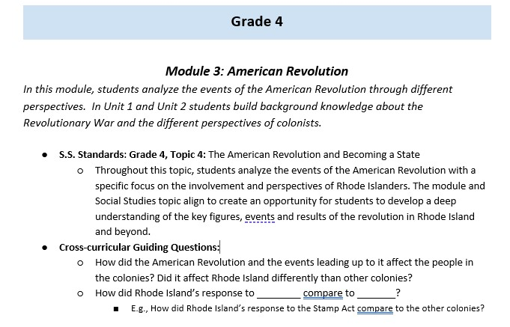
ELA & Social Studies
Connections Between RI Social Studies Standards and ELA HQCM:
Opportunities to connect ELA and Social Studies standards
Cross-curricular guiding questions
Notes:
RIDE has created a crosswalk document, Connections Between RI Social Studies Standards and ELA HQCM, to demonstrate connections between some commonly used ELA HQCM (CKLA, EL, and Wit and Wisdom) and the Rhode Island Social Studies Standards for grades Kindergarten to eight, where connections are applicable, to help teachers make connections during instruction. The document includes opportunities to connect ELA curriculum and the Social Studies Standards and provide cross-curricular focusing questions.

Slide 24
Implementing the Standards in the Middle Grades
Notes:
While much of the Social Studies Curriculum Framework pertains to Kindergarten through high school, there are subsections to Section 2 of the Curriculum Framework that provides guidance specific to implementing the Social Studies Standards in elementary, middle, and high school. In this section, I will outline the guidance pertaining to implementing the Standards in the middle grades.

Slide 25
5-8 Middle Grade Progressions for Content Standards
Grade 5: United States History: Pre-European Contact to Reconstruction*
Grade 6: Ancient to Medieval World History and Geography
Grade 7: Early Modern to Modern World History and Geography
Grade 8: Government and Civic Life in the United States and Rhode Island
*Considered elementary school in some LEAs
Notes:
A reminder of the middle grade progressions as outline in the Rhode Island Social Studies Standards. Grade progressions for content standards are grade specific at the middle school level to ensure every Rhode Island student receives a cohesive and comprehensive social studies education.

Slide 26
ELA & Social Studies
When possible, ELA materials can be used to draw connections to Social Studies standards.
When possible, Social Studies materials can be used to draw connections to ELA standards and content.
ELA materials cannot be used to replace Social Studies materials.
All LEAs will need to adopt Social Studies materials by 2026.
Notes:
In the middle grades, the content, depth, and complexity of the standards grows, and students should experience social studies content on a more regular basis. This could be daily in a traditional five days a week schedule. As with the elementary grades, there may be opportunities to make connections between topics in both the ELA HQCM and social studies curricula.
Though many of the approved ELA curriculum materials include reading content in the sciences and social studies, this content is considered supplemental and not a replacement for robust social studies and science curricula. RIDE supports and encourages the integration of ELA and social studies curricular topics as long as both the social studies and ELA standards are met.

Slide 27
ELA & Social Studies
Middle School Examples | Social Studies Standard | ELA HQCM Content
Example 1: Connection | Grade 7, Standard 7.6.2: World War II Students argue the global impacts of the cause, course, and consequences of World War II | Grade 7, Wit and Wisdom: Americans All Students analyze how the events of World War II affected various populations
Example 2: Non-connection | Grade 6, Standard 6.4.2: Spread of Ideas and Social Transformations Students argue the impacts of the cultural, intellectual, political, economic, and environmental changes happening across Africa, Europe, and Asia from 1200-350 BCE | Grade 6, Into Literature, Unit 5: Never Give Up Students read I Am Malala to identify evidence to support how Malala Yousafzai impacted change in her community
Notes:
This table shows examples of a connection and non-connection between Social Studies and ELA content at the middle school levels.
Example 1 demonstrates that the Social Studies Standards and ELA materials both investigate World War II and specifically focus on the impacts of the war. This cross-curricular connection allows students to deeply explore how various groups were impacted by the war.
Example 2 demonstrates that the Social Studies Standards and ELA both cover the impacts of social, cultural, and intellectual change. However, the time periods are vastly different, and the social studies standard specifically focuses on the BCE era.

Slide 28
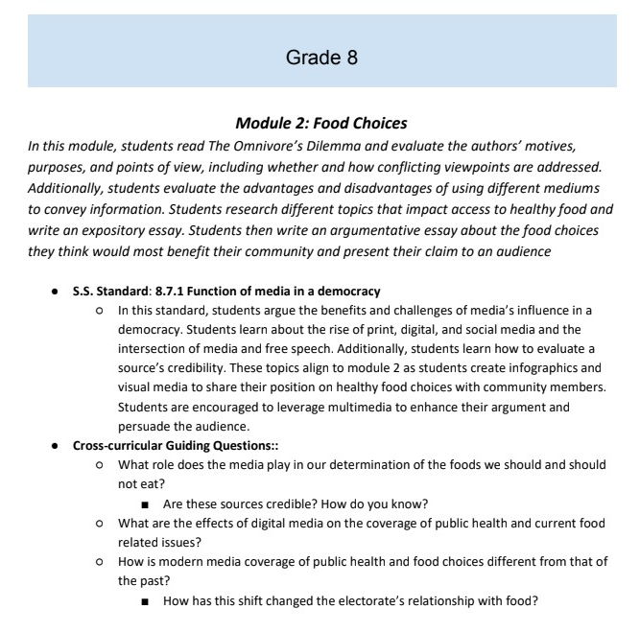
ELA & Social Studies
Connections Between RI Social Studies Standards and ELA HQCM:
Opportunities to connect ELA and Social Studies standards
Cross-curricular guiding questions
Notes:
RIDE has created a crosswalk document, Connections Between RI Social Studies Standards and ELA HQCM, to demonstrate connections between some commonly used ELA HQCM (CKLA, EL, and Wit and Wisdom) and the Rhode Island Social Studies Standards for grades Kindergarten to eight, where connections are applicable, to help teachers make connections during instruction. The document includes opportunities to connect ELA curriculum and the Social Studies Standards and provide cross-curricular focusing questions. RIDE encourages middle school teams to plan instruction around these connections.

Slide 29
Implementing the Required Civics Project in Middle School
Civics Literacy Act requires a student-led civics project in either middle or high school
RIDE recommends that LEAs require the project in grade 8 given the content
RIDE recommends the project is also offered with a high school Civics course
Notes:
The grade 8 focus on civics and government provides an opportunity for LEAs to fulfill their legislative requirement to provide a student-led civics project {RIGL §16-22-2}, and RIDE recommends that the project be offered with the grade 8 content and with a high school Civics course. Additional guidance on the civics project and civic engagement activities, including how to incorporate project work within the scope and sequence of grade 8 as outlined in the Standards will be available on the social studies landing page on RIDE’s website {Coming Summer 2024}. Further recommendations to LEAs on incorporating the civics project in high school is outlined in the section “Implementing the Standards in High School” in the Social Studies Curriculum Framework document.

Slide 30
Implementing the Standards in High School
Notes:
While much of the Social Studies Curriculum Framework pertains to Kindergarten through high school, there are subsections to Section 2 of the Curriculum Framework that provides guidance specific to implementing the Social Studies Standards in elementary, middle, and high school. In this section, I will outline the guidance pertaining to implementing the Standards in high school.
When considering RIDE’s following recommendations for high school, LEAs should be mindful of what students will have learned from kindergarten through grade 8 to ensure that an LEA’s high school social studies requirements are not creating learning gaps for students, especially when first making the shifts to the new Social Studies Standards from the LEA’s current social studies curricula.

Slide 31
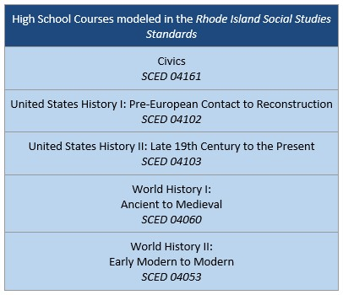
High School Social Studies Course Content Standards
Notes:
RIDE has developed model year-long sequences of content standards for five high school courses in social studies in the Rhode Island Social Studies Standards document for Civics, United States History I, United States History II, World History I, and World History II for LEAs to use in their planning.
Though the recently revised Readiness-Based Graduation Requirements did not change the number of social studies credits required for graduation, the new civics proficiency requirements, the new Social Studies Standards, RIDE’s recommendations in the Social Studies Curriculum Framework, and changing graduation requirements in other subjects present the opportunity for LEAs to reimagine social studies education. Therefore, LEAs should consider the following recommendations from RIDE along with the kindergarten through grade 8 sequence in their planning when deciding which courses they may want to require of their high school students or offer as options.

Slide 32
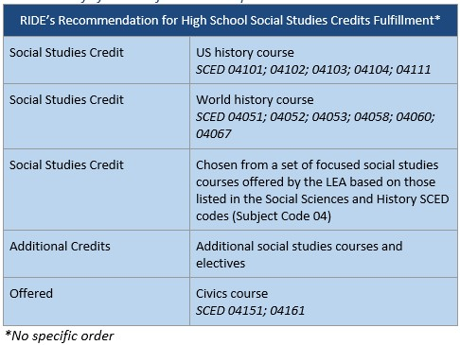
Recommendations for High School Social Studies Credits
Notes:
Rhode Island’s Readiness-Based Graduation Requirements require that students take three credits of social studies in high school for graduation. Although students will have a range of courses available to them to satisfy these credit requirements, LEAs may require specific social studies courses as part of their graduation requirements. RIDE recommends that all Rhode Island students should, at a minimum, fulfill one of those credits with a United States history course and a second credit with a world history course.
RIDE encourages LEAs to establish a list of social studies courses focused on expanding U.S. and World history experiences or other social studies courses as options for the required third credit. They can use the SCED Codes for Social Sciences and History (subject code 04) as guidance. A list of example additional courses under SCED Code 04 can be found in the Social Studies Curriculum Framework document.
In addition, RIDE recommends that LEAs offer in their course catalog a stand-alone Civics course and encourage students to explore additional social studies courses beyond the three required credits.
Establishing these recommendations will ensure that all students receive a strong, foundational understanding of our world today and will contribute toward their successes in their college, career, and civic lives.

Slide 33
Recommendations for High School Social Studies Credits
One Credit Through United States History - LEAs consider requiring US History II (SCED 04103) as the course to fulfill the recommended high school United States history credit
One Credit Through World History - LEAs consider requiring World History II (SCED 04053) as the course to fulfill the world history credit
Additional Social Studies Courses – LEAs provide a number of a number of social studies courses for students to choose from to fulfill the third required credit (based on SCED Codes subject code 04)
Civics - LEAs offer a stand-alone Civics course (SCED 04151, 04161) in high school
Notes:
RIDE recommends that, given the kindergarten to grade 8 sequence, LEAs consider requiring US History II (SCED 04103) as the course to fulfill the recommended high school United States history credit. Through the Rhode Island state study in grade 4, students will have been introduced to topics such as colonization, the American Revolution, slavery and the slave trade, industrialization, and the Rhode Island state government. Many of those topics will be studied more deeply and with a national lens during their grade 5 studies, which includes the formation of the United States and extends through the Civil War. Topics like revolution and the formation of the United States government are reintroduced in greater depth in grade 8. Thus, students will have had a foundational knowledge of the early part of United States history when entering high school. Modern United States history topics such as the world wars and the Cold War are introduced in grade 7 through their study of the world, and civil rights movements are introduced in grade 8. However, students would not have had a full experience of the later part of United States history before high school. Having the high school United States History II course as a requirement will ensure students gain fuller and deeper knowledge of the later part of United States history and will allow students to comprehend the roots of difficult topics more deeply (e.g., the thread from slavery to Civil War, to Jim Crow to the Civil Rights Movement).
Though students will have studied world history in grades 6 and 7, the standards for the World History I (SCED 04060) and II (SCED 04053) high school courses are designed for students to gain more in-depth proficiency in these topics of study. High school students will better grasp difficult topics and hone their critical thinking, analytical, and argumentative skills. RIDE recommends that LEAs consider requiring World History II (SCED 04053) as the course to fulfill the world history credit. The deeper dive into modern world history in high school provides the basis to understanding our world today.
To strengthen the foundation Rhode Island high school students are building, RIDE recommends students select from a number of social studies courses offered by the LEA to fulfill the third required credit. They can use the SCED codes for Social Sciences and History (subject code 04) as guidance. To allow for student exploration of topics and fields such as Anthropology (SCED 04251), Rhode Island History (04105), or contemporary issues, students are encouraged to take additional courses beyond the three-credit graduation requirement.
RIDE recommends that LEAs offer a stand-alone Civics course (SCED 04151, 04161) in high school. RIDE recommends that the course be offered as an option for 11th and 12th graders to prepare students as they approach adulthood. LEAs may decide to offer the course as an optional course or as a requirement as some already do. The model civics course outlined in the Rhode Island Social Studies Standards is designed as a full-year course. Civics can be used to fulfill one of the three social studies credits toward graduation.

Slide 34
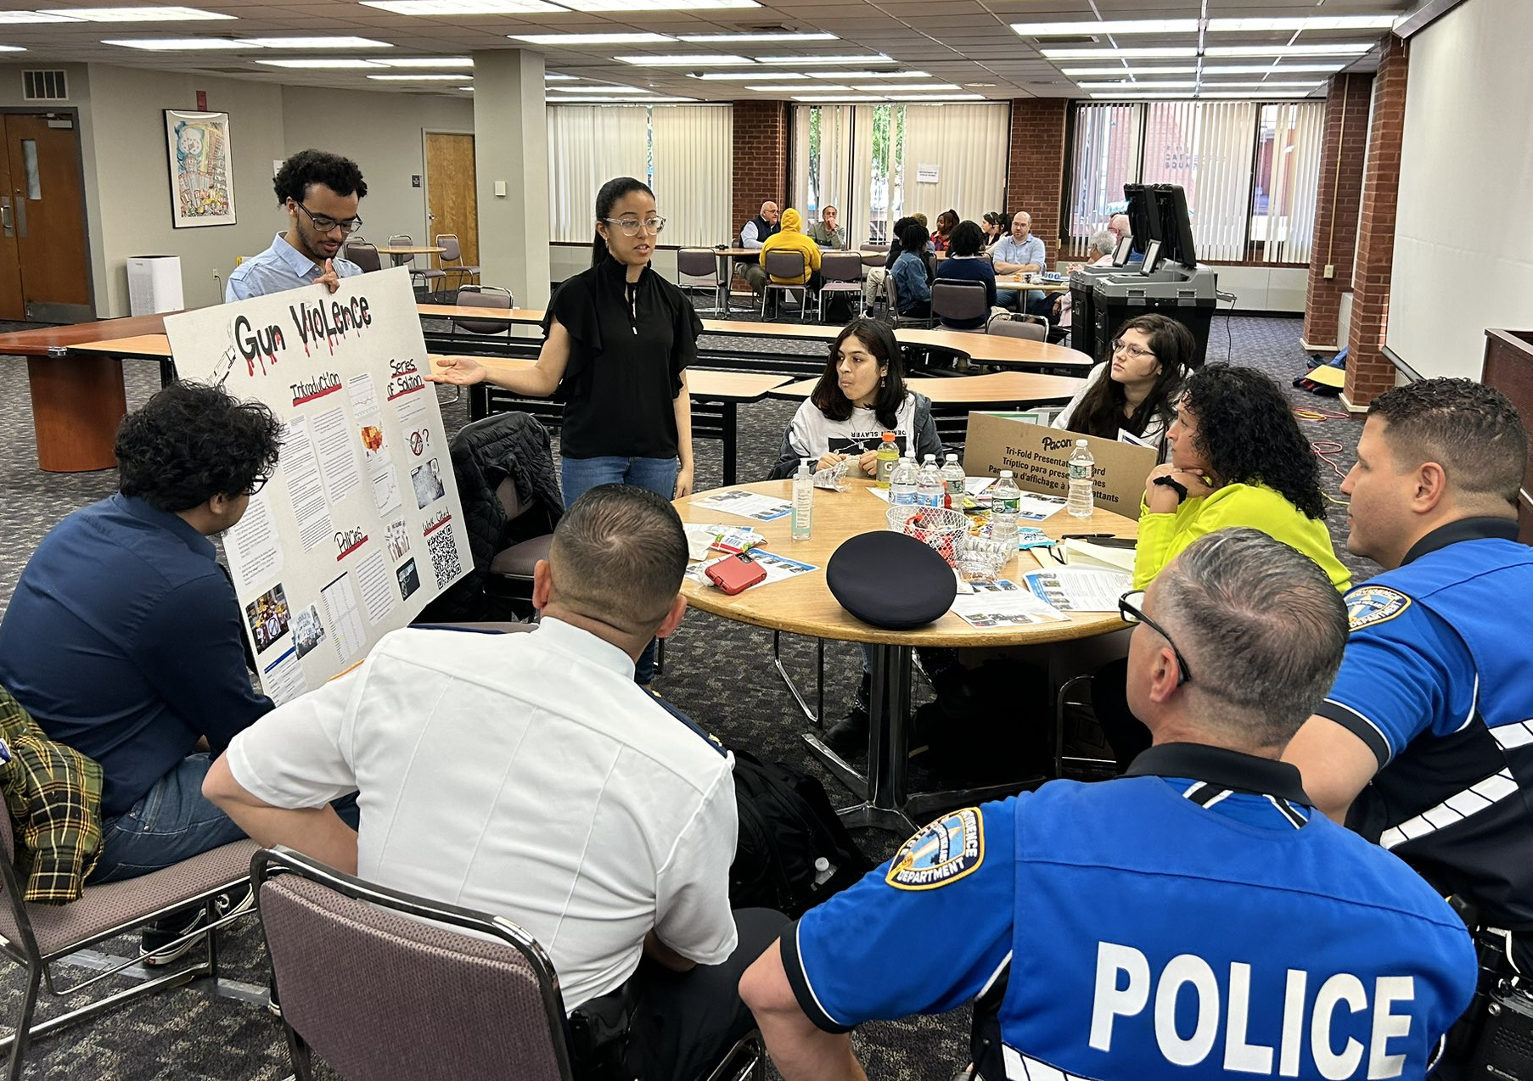
Implementing the Required Civics Project in High School
Civics Literacy Act requires a student-led civics project in either middle or high school
RIDE recommends that LEAs require the project in grade 8 given the content
RIDE recommends the project is also offered with a high school Civics course
Providence HS Civics Students present their Gun Violence Prevention "action civics" project to members of Providence Police Department
Notes:
The grade 8 focus on civics and government provides an opportunity for LEAs to fulfill their legislative requirement to provide a student-led civics project {RIGL §16-22-2}, and RIDE recommends that the project be offered with the grade 8 content and with a high school Civics course.

Slide 35
Implementing the Required Civics Project in High School
If an LEA offers the high school Civics course as an option, then:
RIDE recommends that the student-led civics project, as required by legislation to graduate {RIGL §16-22-2}, be offered within the grade 8 scope and sequence and within the high school Civics course.
Students who moved into the district after grade 8 and did not complete a civics project can take the Civics course in high school to complete the project and to learn the civics content they may have missed.
Students who were in the district for grade 8 and/or have completed the civics project may choose to take the high school course to deepen their knowledge and complete a second civics project as an opportunity to learn from and improve upon their grade 8 work.
Notes:
More specifically, if an LEA chooses to offer the high school Civics course as an option then…..

Slide 36
Implementing the Required Civics Project in High School
If an LEA offers the high school Civics course as a requirement, then:
LEAs may choose whether to offer the required student-led civics project in either grade 8 or during the high school Civics course, or both. However, if only offered in grade 8, the LEA will need to offer a way for students who moved into the district after grade 8 and did not complete a project to be able to do so.
LEAs should have a process to record student completion of the student-led civics project in order to support student transitions across districts
Notes:
If an LEA chooses to offer the high school Civics course as a requirement then…..
In either case, LEAs should develop a process to record at the individual student level on their transcript whether and when they completed the student-led civics project. This will ensure that LEAs know whether a student has met the requirement and will support students who may move to a different district.
Additional guidance on the civics project and civic engagement activities, including how to incorporate project work within the scope and sequence of the high school Civics course as outlined in the Standards will be available on the social studies landing page on RIDE’s website {Coming Summer 2024}.

Slide 37
High-Quality Curriculum in Social Studies

Slide 38
High-Quality Curriculum in Social Studies
Should align to the Rhode Island Social Studies Standards by
Including instructional materials that connect to the principles as outlined by the social studies anchor standards.
Including content that aligns to the social studies content standards that are specific by grade and high school course and include content required by legislation.
Emphasizing culturally responsive and sustaining education (CRSE) principles and practices by supporting equitable representations and disrupting cultural norms and biases to meet the needs of every student within the educational space.
Notes:
Rhode Island legislation (RIGL§ 16-22-32) requires that LEAs adopt high quality curriculum materials in English language arts, mathematics, and science and technology, primarily using curriculum reviews by EdReports. Although this law does not currently name social studies, it is expected that LEAs adopt high quality curriculum for all the core subjects. EdReports does not review social studies curricula, therefore, RIDE has developed criteria for recognizing high-quality curriculum in social studies. The Curriculum Framework outlines the criteria as those that align to the Rhode Island Social Studies Standards by…

Slide 39
High-Quality Curriculum in Social Studies
Should align to the Rhode Island Social Studies Standards by
Emphasizing academic rigor as outlined in the Standards, allowing students to identify, explain, and analyze content and make evidence-based arguments.
Developing students’ civic skills and dispositions.
Fostering an inquiry-based learning environment and engaging students in grade-appropriate historical inquiry and analysis.

Slide 40
High-Quality Curriculum in Social Studies
Should align to evidence-based best practices by
Including authentic primary sources and a variety of secondary sources that reflect a range of perspectives and experiences that will allow students to think critically as they identify, explain, and analyze content and make evidence-based arguments.
Providing avenues for facilitating discussions of current events that allow students to draw connections between issues of the past and issues today.
Including grade-level appropriate text that builds reading, writing, speaking, and listening skills through social studies content.
Including supports for multilingual learners (MLLs) and differently-abled students (DAS).
Notes:
The Curriculum Framework also outlines criteria that align to evidence-based best practices in social studies such as…
More criteria for this category are listed in the Curriculum Framework.

Slide 41
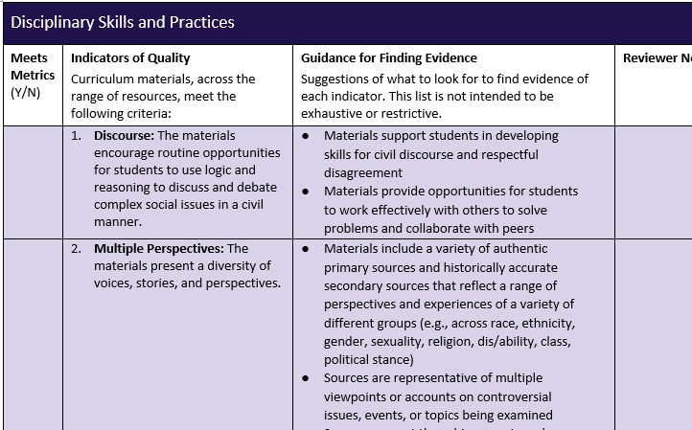
High-Quality Curriculum in Social Studies
Selecting HQCMs for Social Studies
Rhode Island Social Studies Review Tool for Selecting High-Quality Curriculum Materials
Rhode Island Guide for Assessing Curriculum Materials in Social Studies for High-Quality
For Reviewing core and supplemental instructional materials
Notes:
RIDE took all of these criteria and created a Review Tool for selecting high-quality materials in social studies and a review protocol. [Show where these live on the website. Also that the Review Tool is available as PDF or fillable google doc.] There are also standards correlations document available. To receive those, you can email RIDE at the email address at the end of this slide deck to ask for the zip drive folder.
Many of the instructional practices and assessment that will be discussed in the next sections of the Curriculum Framework are included in the Review Tool

Slide 42
High-Quality Curriculum in Social Studies
Core and Supplemental Materials
Core instructional materials are the comprehensive print or digital educational material, including basal material, which constitute the necessary instructional components of a full academic course of study.
Supplementary instructional materials are used to reinforce, enrich, or enhance Instruction driven by core instructional material.
Definitions adapted from New Mexico’s instructional materials legislation 6.75.2.7 C and W
Notes:
Definitions of core and supplemental materials

Slide 43
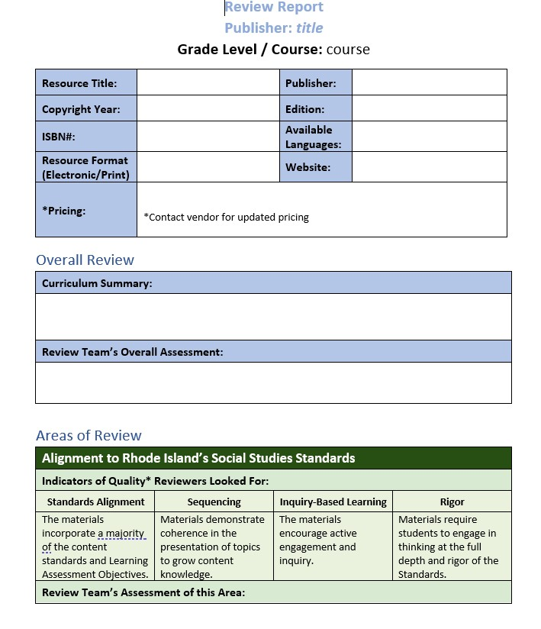
High-Quality Curriculum in Social Studies
Selecting HQCMs for Social Studies
RIDE is in the midst of conducting state-supported reviews of core curriculum materials
Reviews conducted with teams of Rhode Island teachers
Includes curricula for all grades (K-8) and the five high school courses modeled in the Standards
LEAs are not required to select materials that have been reviewed through RIDE’s review process
Notes:
{At the time of the posting of this presentation} RIDE is also in the midst of conducting state-supported reviews of core curriculum materials to provide reports to help LEAs make their adoption decisions. We decided to vet materials to provide a starting place for LEAs to either LEAs to either conduct their own review or to choose curricula that we reviewed. Materials reviewed by RIDE were submitted by vendors through a Request for Curriculum. Review teams were formed through an application process and were comprised of Rhode Island educators from throughout the state. LEAs are not required to select materials that have been reviewed through RIDE’s review process. Social studies curriculum review reports will be found on RIDE’s website.

Slide 44
Section 3
Implementing High-Quality Instruction

Slide 45
Sections of the Framework
Section 1 provides an overview of the context, purpose, and expectations related to the curriculum framework.
Section 2 reiterates the organization of the Standards and provides a range of resources to help educators understand and apply them. Section 2 also addresses how standards support selection and implementation of high-quality curriculum materials.
Section 3 of this framework provides guidance and support around how to use the Standards to support high-quality instruction.
Section 4 offers resources and support for using the Standards to support assessment.
Notes:
Section 3 of the Curriculum Framework provides guidance and support around how to use the Standards to support high-quality instruction.
In order to effectively implement high-quality curriculum materials, as well as ensure that all students have equitable opportunities to learn, it is essential that teachers are familiar with and routinely use instructional practices and methods that are research- and evidenced-based.

Slide 46
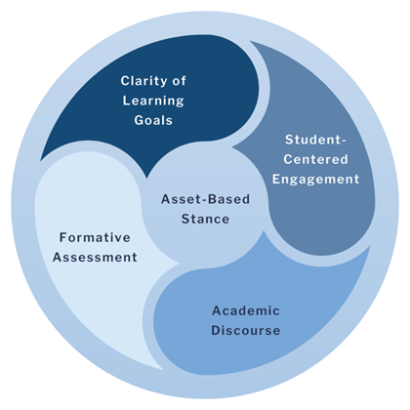
High Quality Instructional Practices
High-Quality Instruction in All Disciplines
Asset-Based Stance
Clear Learning Goals
Student-Centered Engagement
Academic Discourse
Formative Assessment
Notes:
RIDE has identified five high-quality instructional practices as essential to the effective implementation of standards and high-quality curriculum in all content areas. You will notice that these practices are also incorporated in the Review Tool for Assessing High-Quality materials.
Each of the Curriculum Frameworks outlines the attributes of each of these five practices. The social studies Curriculum Framework also adds what these practices look like in social studies instruction and outlines ways to adjust or differentiate instruction for each of these principles for MLLs and DAS.

Slide 47
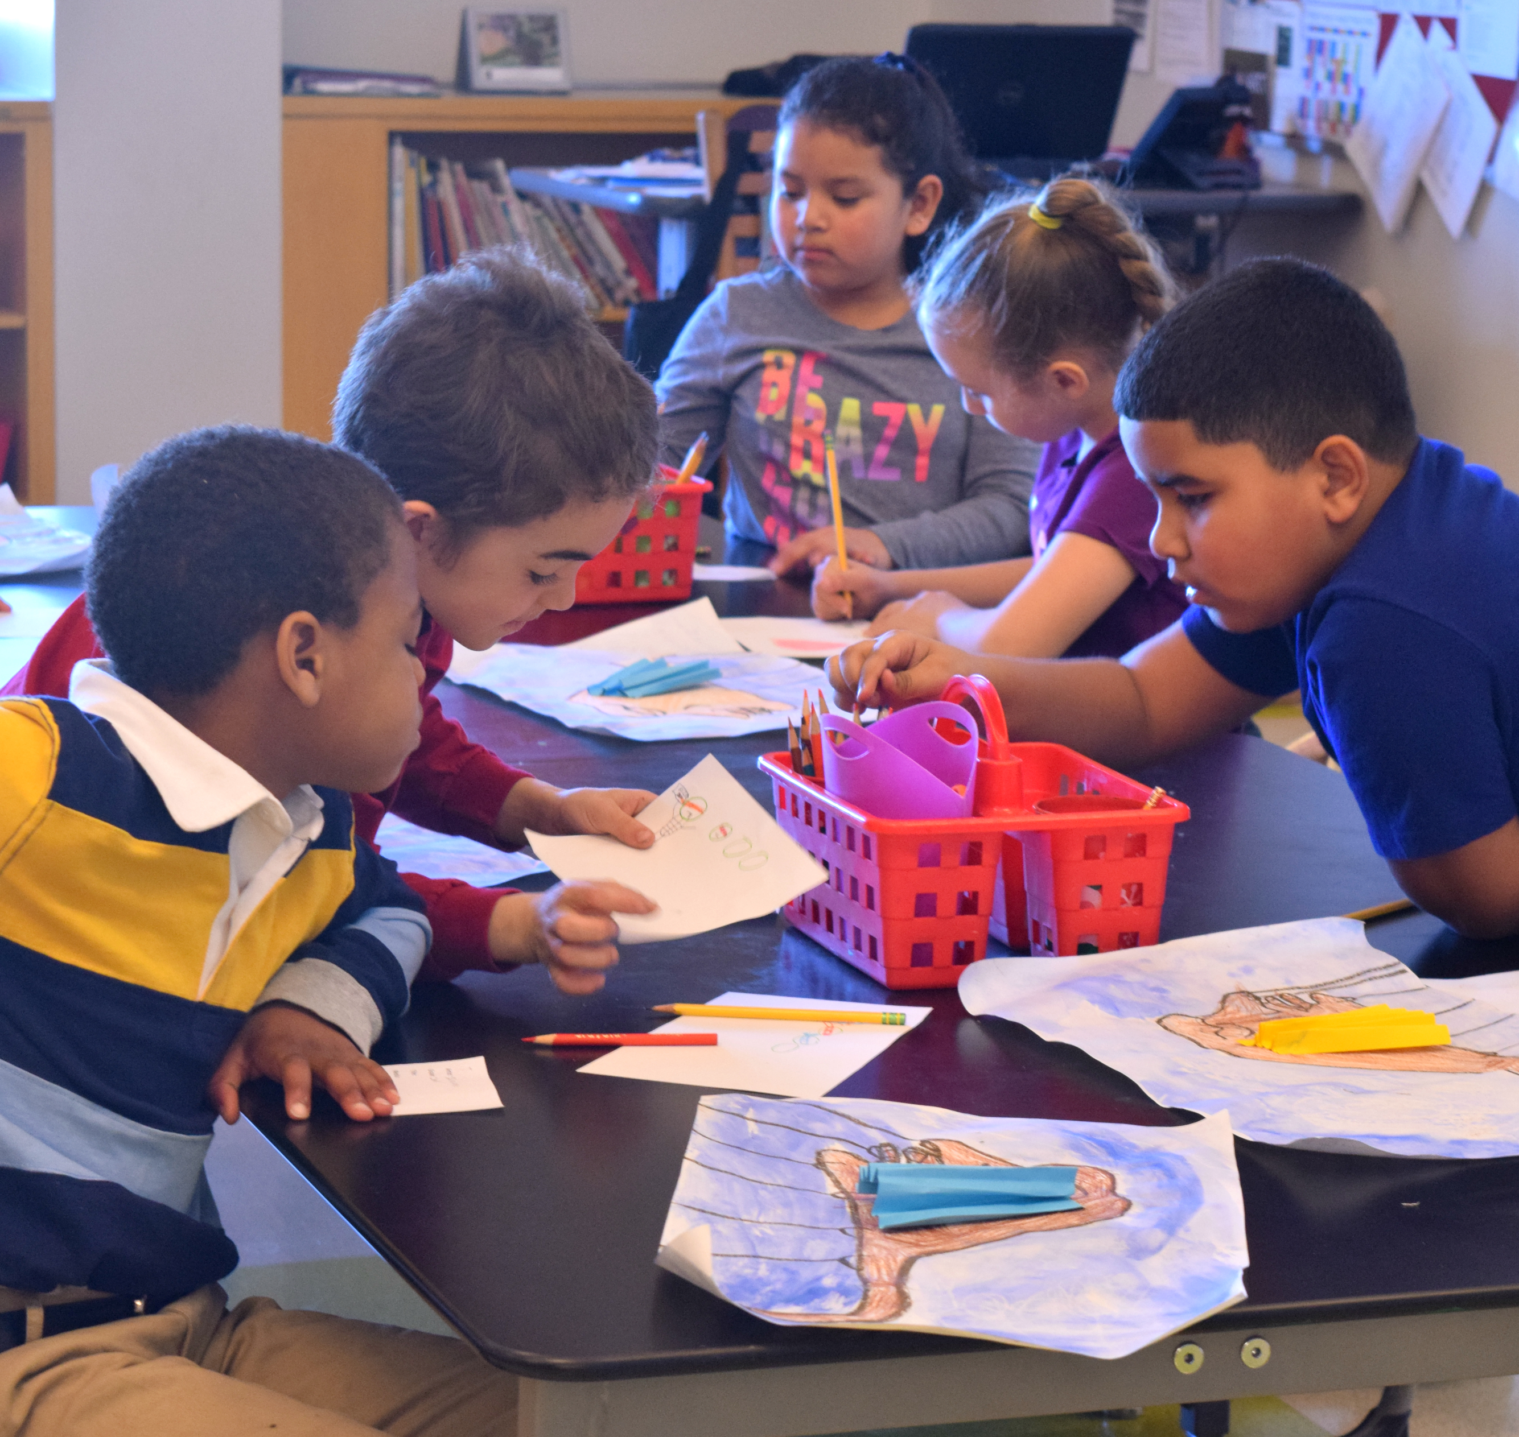
High-Quality Instruction in All Disciplines
Asset-Based Stance
Teachers routinely leverage students’ strengths and assets by activating prior knowledge and connecting new learning to the culturally and linguistically diverse experiences students bring with them to the classroom, while also respecting their individual differences.
Notes:
Taking an asset-based approach requires teachers to routinely leverage students’ strengths and assets by activating prior knowledge and connecting new learning to the culturally and linguistically diverse experiences students bring with them to the classroom, while also respecting their individual differences. We use “routinely” in this and the following slides to mean that teachers should make these instructional practices a part of their regular thinking and planning for instruction rather than for special occasions.
Social studies is primed to incorporate an asset-based stance in instruction. Teachers take an assets-based stance and promote equitable teaching when they routinely consider students’ background knowledge and experiences when designing teaching and learning experiences. Students’ backgrounds, cultures, and experiences are assets to the teaching and learning environment, and social studies instruction provides ample opportunities to include students’ lived experiences and background knowledge of a particular topic.

Slide 48
High-Quality Instruction in All Disciplines
Clear Learning Goals
Teachers routinely use a variety of strategies to ensure that students understand:
What they are learning,
Why they are learning it, and
How they will know when they have learned it.
Notes:
Clear learning goals articulate clear, consistent expectations about knowledge, skills, and practices students should know and be able to do at each grade level. Teachers routinely use a variety of strategies to ensure that students understand what they are learning and what proficiency looks like, why they are learning it (how it connects to their own learning goals, what they have already learned, and what they will learn), and how they will know when they have learned it (how their work align with the learning goals or scoring rubric).
The Rhode Island Social Studies Standards articulate clear, consistent expectations about knowledge, skills, and practices students should know and be able to do at each grade level. As teachers prepare for and implement high-quality instructional materials, it is imperative that they have a full understanding of the depth, breadth, and rigor of each standard in order to make efficient and effective decisions within instruction. Instructional materials that have met the benchmark of high quality should include clear learning goals aligned with the Rhode Island Social Studies Standards. As teachers implement high-quality instructional materials, they articulate clear learning goals consistently so that students always know what they are expected to learn, why it is important, and how they need to demonstrate it.

Slide 49
High-Quality Instruction in All Disciplines
Student-Centered Engagement
Teachers routinely use techniques that are student-centered and foster high levels of engagement through individual and collaborative activities.
Notes:
Teachers routinely use techniques that are student-centered and foster high levels of engagement through individual and collaborative sense-making activities that promote practice, application in increasingly sophisticated settings and contexts, and metacognitive reflection.
From setting group norms to fostering civil discourse in a safe environment to following the inquiry approach highlighted in the Social Studies Standards, the social studies classroom is a ripe environment for student-centered learning. Resources for this approach such as the Inquiry Design Model, Reading Like a Historian, the Question Formulation Technique, and more are outlined in the Curriculum Framework.

Slide 50
High-Quality Instruction in All Disciplines
Academic Discourse
Teachers routinely facilitate and encourage student use of academic discourse through effective and purposeful questioning and discussion techniques and the integration of discipline-specific language into all aspects of learning.
Notes:
Teachers routinely facilitate and encourage student use of academic discourse through effective and purposeful questioning and discussion techniques that foster rich peer-to-peer interactions and the integration of discipline-specific language into all aspects of learning.
The Social Studies Standards lend themselves to academic discourse by using the four levels of rigorous thinking - identifying, explaining, analyzing, and arguing. Through academic discourse, students use higher-order thinking skills, develop tools for engaging in civil discourse, and obtain a deeper understanding of the content. Skills practiced and acquired through academic discourse in social studies will be carried into a students’ successful college, career, and civic life.

Slide 51
High-Quality Instruction in All Disciplines
Formative Assessment
Teachers routinely use qualitative and quantitative assessment data to analyze their teaching and student learning in order to provide timely and useful feedback to students and make necessary adjustments that improve student outcomes.
Notes:
Teachers routinely use qualitative and quantitative assessment data (including student self-assessments) to analyze their teaching and student learning in order to provide timely and useful feedback to students and make necessary adjustments (e.g., adding or removing scaffolding and/or assistive technologies, identifying the need to provide intensive instruction) that improve student outcomes.
Additionally, formative assessments can support educators to understand students’ prior knowledge in social studies topics and concepts to ascertain what students know and leverage students’ background knowledge as they encounter new topics and concepts in social studies. The Rhode Island Social Studies Standards inquiry topics include compelling questions that can be used to develop oral and written formative assessment tasks. The learning assessment objectives within each standard table can also be used to develop assessment tasks. Students' ability to identify, explain, analyze, and/or make evidence-based arguments as outlined in the learning assessment objectives are good indicators of understanding of the inquiry topic or standard being assessed.

Slide 52
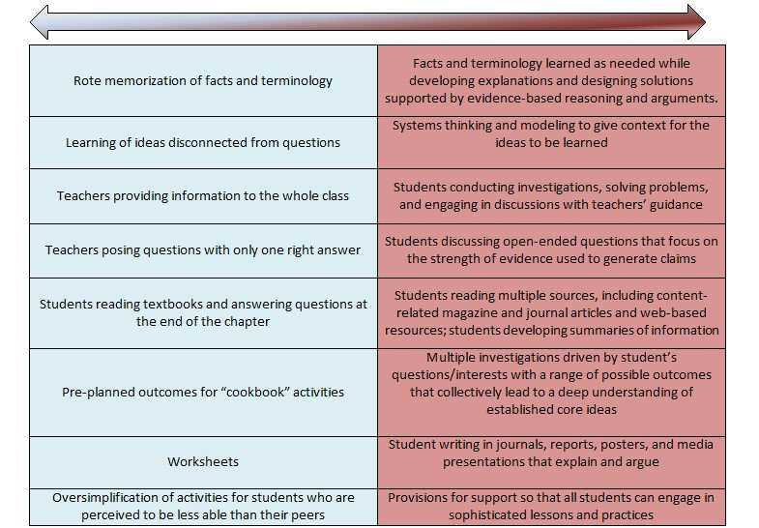
Instructional Shifts Guidance* (for Social Studies)
*from the Colorado Department of Education based on the National Science Teaching Association's "A New Vision for Science Education."
Notes:
[Table Source: "Instructional Shifts Guidance" (for social studies) from the Colorado Department of Education based on the National Science Teaching Association's "A New Vision for Science Education."]
Like other core subjects, there have been shifts in social studies instructional practices over the past decade. Instructional focus has moved to teaching skills through content. Rather than memorizing names and dates, students learn to analyze current or historical events and issues in context to make evidence-based reasonings for causality and consequence in history or to problem-solve current issues. Students also need to experience the opportunity to view past and present actions and events through multiple perspectives and to analyze and evaluate the impact those perspectives offer.

Slide 53
High Quality Instructional Practices
High-Quality Instruction in Social Studies
Inquiry-Based Instruction
Thinking and Acting Like Historians and Social Scientists
Teaching Current Events
Teaching Difficult Topics
Notes:
In addition to the five instructional practices for all disciplines I just outlined for you, the Social Studies Standards are designed to support these current instructional best practices in social studies that echo the instructional shifts of the previous slide.

Slide 54
High-Quality Instruction in Social Studies
Inquiry-based Instruction
Teachers incorporate inquiry-based instruction that privileges rigorous and relevant questions that speak to students' knowledge and experiences, sources that reflect multiple perspectives and access points for all students, and tasks that build in complexity and offer teachers information at formative and summative levels.
Notes:
Inquiry-based instruction privileges rigorous and relevant questions that speak to students' knowledge and experiences, sources that reflect multiple perspectives and access points for all students, and tasks that build in complexity and offer teachers information at formative and summative levels. A focus of this approach is to help students develop a deeper understanding of history and the social sciences, learn about diverse cultural perspectives, as well as to build their capacity for civic engagement in society. It can also foster a sense of curiosity that can lead to lifelong learning. When done well, inquiry-based instruction helps students develop critical thinking skills, historical empathy, as well as an appreciation for the complexity of historical events and diverse cultural perspectives.
Rhode Island Social Studies Standards are specifically designed to encourage inquiry through the sequencing of inquiry topics within each course, the compelling questions for each topic of inquiry, and the guiding questions for each content standard.

Slide 55
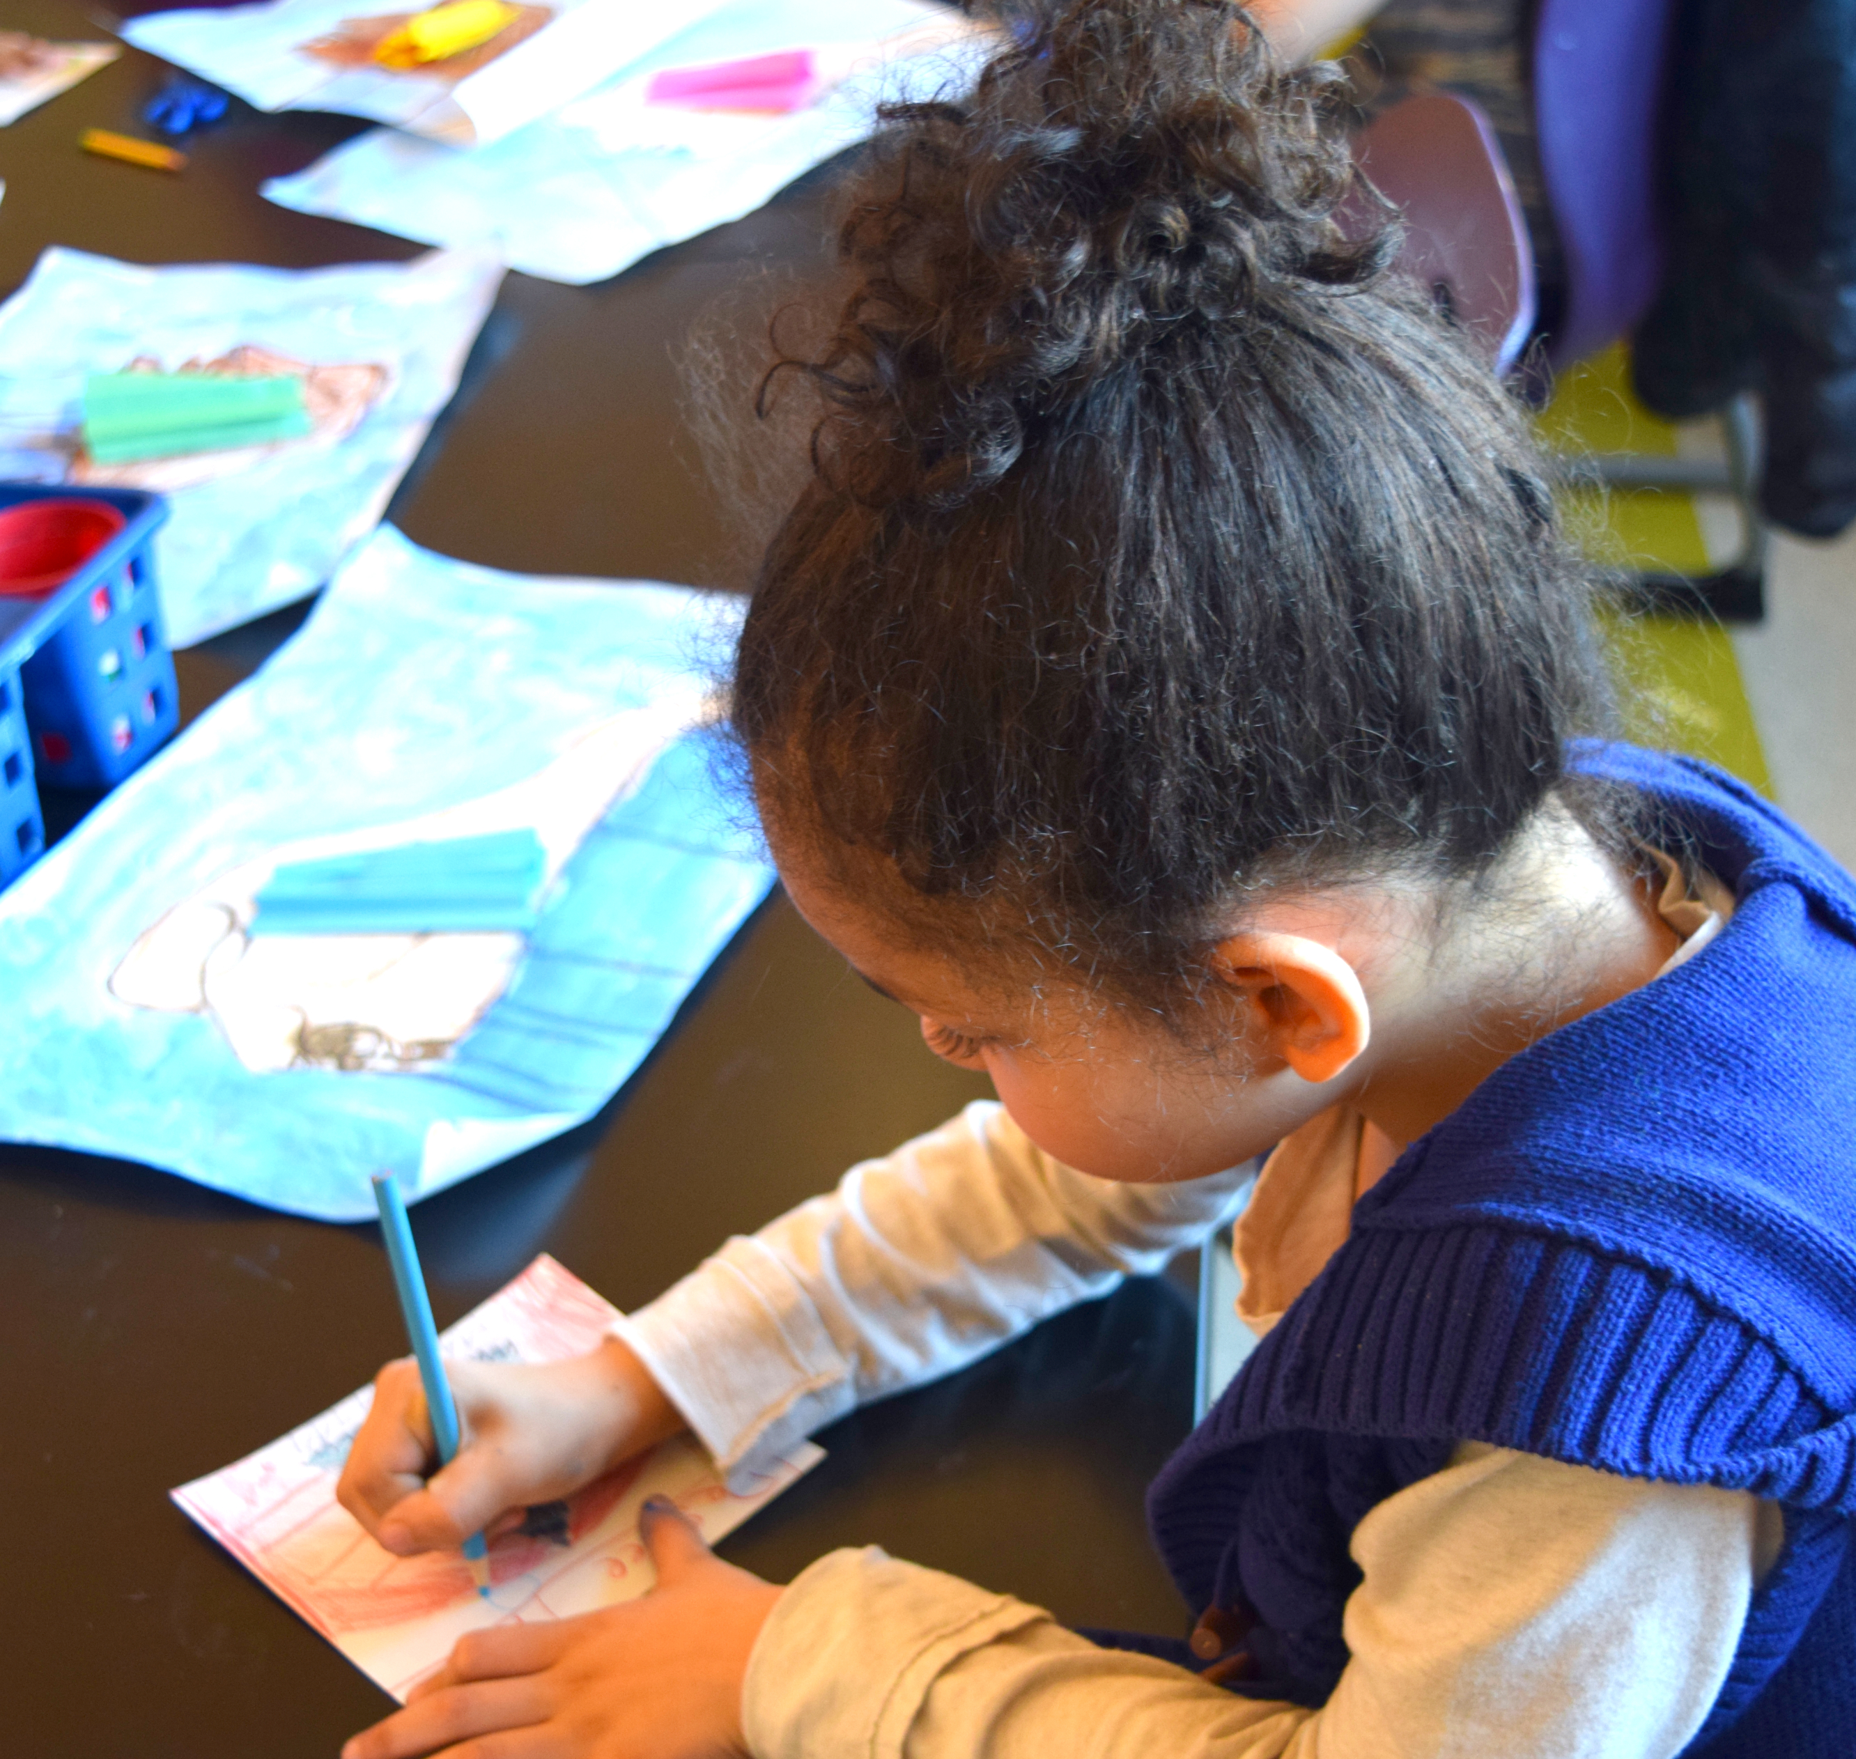
High-Quality Instruction in Social Studies
Thinking and Acting Like Historians and Social Scientists
Teachers encourage students to think and act like informed citizens, historians, geographers, and economists.
Notes:
The Rhode Island Social Studies Standards, particularly the set of twelve anchor standards, are designed to encourage students to think and act like informed citizens, historians, geographers, and economists. Thinking and acting in these ways is essential for students to develop a deep appreciation for and understanding of social studies content. In addition, thinking and acting in these ways involve a range of cognitive processes that allow students to engage with primary and secondary sources, analyze historical events and concepts from diverse perspectives, and draw and support meaningful and impactful conclusions.

Slide 56
High-Quality Instruction in Social Studies
Teaching Current Events
Teachers integrate the teaching of current events on a routine basis.
Notes:
The teaching of current events is critical because it helps students develop an understanding of what is taking place around them and how current events connect to the past and help shape the future. Since what happens in the world, nationally, or even locally is ever unfolding, there is no simple method or approach to how teachers can leverage current events to support and/or augment what students are learning and exploring at any given time.

Slide 57
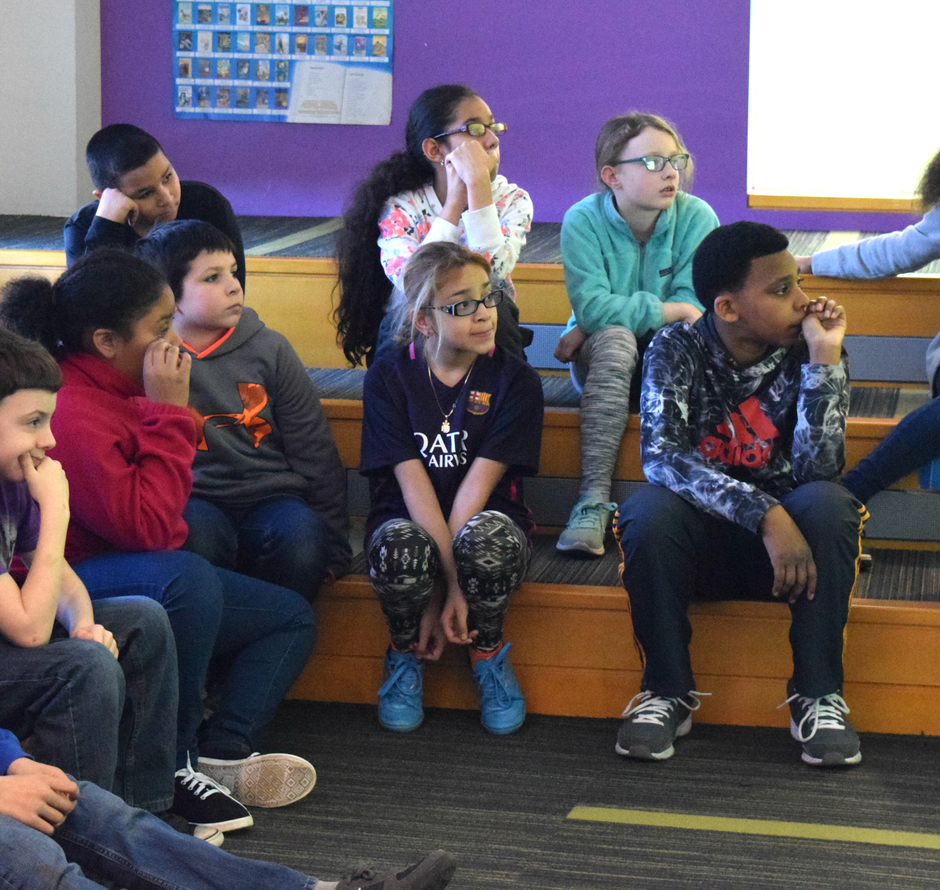
High-Quality Instruction in Social Studies
Teaching Difficult Topics
At every grade level and within every course, social studies teachers must be prepared to support students in exploring and learning about difficult parts of history.
Notes:
A common challenge that social studies teachers must contend with is how to teach challenging topics. At every grade level and within every course, social studies teachers must be prepared to support students in exploring and learning about difficult parts of history. Therefore, teaching difficult topics like genocide and racism in social studies requires careful consideration of how to approach these topics in a sensitive and meaningful way.
Some effective strategies to navigate difficult topics are:
Creating a safe learning environment focused on empathy
Providing historical context
Using primary and secondary sources
Analyzing multiple perspectives

Slide 58
High-Quality Instruction in Social Studies
A Note about terminology
Terminology and language are constantly evolving
Teachers should model using current terminology during instruction
Teachers should discuss why terminology students see in primary or secondary sources is outdated or even derogatory
Teachers should instruct students that despite what terminology is used in a source, students should use current terminology when speaking and writing
Some terminology should never be read aloud (i.e., the "N word"), even if it appears in literature
Notes:
As I noted in Section 2, teachers may find various terminology being used in current instructional materials and will particularly find outdated terminology in older secondary sources and primary sources. Teachers should use the opportunity to discuss proper current terminology, even where there is debate around certain terms, with their students. Students will come across varying terminology during inquiry and learning, particularly during independent research, and they may need to use outdated terminology in key word searches when conducting research. Teachers should inform students that despite what terminology is used when analyzing sources or conducting research (e.g., Negro), they should use current terminology in their speaking and writing (e.g., Black). Students may come across a word that is derogatory, such as the “N word,” when analyzing primary sources or when reading works of historical fiction. Teachers should prepare students for this, inform them of the word’s harmful history, and never speak or write the word in full. This is true during a student read-aloud.
See the Curriculum Framework for more information, tips, and resources related to the teaching of these instructional practices.

Slide 59
Section 4
High-Quality Learning Through Assessment

Slide 60
Sections of the Framework
Section 1 provides an overview of the context, purpose, and expectations related to the curriculum framework.
Section 2 reiterates the organization of the Standards and provides a range of resources to help educators understand and apply them. Section 2 also addresses how standards support selection and implementation of high-quality curriculum materials.
Section 3 of this framework provides guidance and support around how to use the Standards to support high-quality instruction.
Section 4 offers resources and support for using the Standards to support assessment.
Notes:
Section 4 focuses on how rigorous standards and high-quality curriculum materials inform high-quality learning through assessment. When properly designed and implemented, a comprehensive assessment system provides multiple perspectives and sources of data to help educators understand the full range of student learning and achievement. Assessment information may be used to evaluate educational programs and practices and make informed decisions related to curriculum, instruction, intervention, professional learning, and the allocation of resources to better meet students’ needs.

Slide 61
High-Quality Assessment
Assessment inspires educators to ask:
Are we teaching what we think we are teaching?
Are students learning what we want them to learn?
Is there a better way to teach the subject and student better, thereby promoting better learning?
Notes:
Assessment inspires educators to ask these hard questions:
“Are we teaching what we think we are teaching?”
“Are students learning what we want them to learn?”
“Is there a way to teach the subject and student better, thereby promoting better learning?”
Section 4 of the document addresses the purposes and types of assessment, the concepts of validity, reliability, and fairness in assessment, factors to consider when selecting or developing assessments, and considerations when assessing differently-abled students and multilingual learners.

Slide 62
High-Quality Assessment
Types of Assessment
 | Inform Instruction | Screen/Identify | Measure Outcomes
Summative | Generally, not used as the primary source of data to inform instruction. May be useful in examining program effectiveness. | Generally, not used as the primary source of data to screen/identify students. May be one of multiple sources used. | Primary purpose is to measure outcomes (at classroom, school, LEA, or state level). Can be used for accountability, school improvement planning, evaluation, and research.
Formative | Primary purpose is to inform instruction. | Generally, not used to screen/identify students. | Generally, not used to measure long term outcomes; rather, it is used to measure whether students learned what was just taught before moving on to instructional “next steps.” Evidence gathered as part of the formative assessment process may inform a referral to special education and may be used to help measure short-term objectives on IEPs.
Interim | May be used to inform instruction. | May be used to screen/identify students. | May be used to measure outcomes in a longer instructional sequence (e.g., end of a unit of study or quarter, semester, MTSS intervention goal, IEP goal). May be part of a special education referral.
Notes:
The primary purpose of formative assessment is to inform instruction. Thus, formative assessment appeared in Section 3 of the Curriculum Framework as an instructional practice. Formative assessment is a planned, ongoing process used by all students and teachers during learning and teaching to elicit and use evidence of student learning to improve student understanding of intended disciplinary learning outcomes and support students to become self-directed learners.
Summative assessments are formal assessments that are given after a substantial block of instructional time, for example at the end of a unit, term course, or academic year. Interim assessments are administered during instruction and, depending on the type of interim assessment, can be used inform instruction or measure outcomes. They provide an overall picture of achievement and can be useful in predicting student outcomes/supports or evaluating the need for pedagogical or programmatic changes. These assessments should be written to include a variety of item types (e.g., selected response, constructed response, extended response, performance tasks) and represent the full scale of Webb’s Depth of Knowledge (DOK), which is built into the Rhode Island Social Studies Standards.

Slide 63
High-Quality Assessment
Types of Assessment – Performance Tasks
Community service projects,
Civic action-based projects,
Project-based learning projects,
Class debates and discussions,
Civic participation like writing a letter to the mayor, attending a town hall meeting, or participating in a mock trial
Notes:
For social studies teachers, performance tasks are an excellent way to assess students' understanding and application of social studies concepts and skills. Performance assessments can be designed to be formative, interim, or summative assessments of learning. They also allow for richer and more authentic assessment of learning.

Slide 64
High-Quality Assessment
Using the Social Studies Standards to design assessments
Identify
Name some goods and services available in your community. (SS1.3.1 Goods and services in the community)
Make a list of individuals and organizations who remained loyal to the crown during the American Revolution. (SS5.3.3 Open rebellion)
Describe common types of geographical features located around the world and provide examples of each. (SS7.1.1 Population and geography of the world in 1300 CE)
Define key characteristics of Nazi racial ideology. (SSHS.USII.4.4 The revelations of Nazi genocide against the European Jews)
Notes:
Districts and school leaders should begin with their high-quality instructional materials (HQIM) and identify the types of assessments available within the materials. Utilizing the high-quality instructional materials resources is a critical component of a comprehensive assessment system in social studies. Assessments within HQIM should encompass a balanced system that include a variety of formative, performance, and summative assessments. Assessments should offer accommodations that allow all students to demonstrate their knowledge and skills without changing the content of the assessment. Assessment is included in our curriculum Review Tool mentioned earlier.
In addition to assessments built in an adopted HQIM, assessments can also be designed using the Social Studies Standards.
The Social Studies Standards are rooted in four levels of academic rigor: identify, explain, analyze, and argue. These levels are translated into the learning assessment objectives associated with each content standard. Teachers can use the levels of rigor and the learning assessment objectives in the standards tables to design assessment questions.
Identifying - When identifying, students show that they know and understand key facts and definitions related to important concepts, processes, ideas, events, dates, statistics, and the like. This is a foundational level of declarative knowledge and students should be able to communicate what is in the materials they have read or engaged with. Common strategies for assessing students’ ability to identify include short answer responses, matching, multiple choice questions, and fill in the blanks.
This slide shows examples of short-answer prompts teachers can ask that require students to identify based on the Standards.

Slide 65
High-Quality Assessment
Using the Social Studies Standards to design assessments
Explain
Explain how the physical environment influences how people in your community live. (SSK.1.2 Family locations in the local community)
Define the roles and functions of the President, Vice President, and other Cabinet leaders (SS3.1.4 National government)
Explain how archeologists use physical evidence left behind by humans to understand human culture and how it has developed over time. (SS6.1.1 Experts of the past)
Describe some of the key arguments in Common Sense and why they are important. (SSHS.USI.2.3 Common Sense and the Declaration of Independence)
Notes:
When students are asked to explain, they are expected to go beyond being able to identify or describe discrete concepts and show that they understand how key ideas and concepts, ideas, data, and the like, are related. To show that they are explaining, students may be asked to describe relationships between concepts, show how processes produce desired outcomes, or demonstrate the function and roles of leaders within communities. Teachers can use short- and extended-response questions and multiple-choice questions to assess students’ ability to explain.
This slide shows examples of prompts for Standards that ask students to explain.

Slide 66
High-Quality Assessment
Using the Social Studies Standards to design assessments
Analyze
Analyze the similarities and differences between different neighborhoods in your community. (SSK.3.1 Neighborhood boundaries and nearby neighborhoods)
Research different origins and courses of African enslavement in the American colonies and explain key similarities and differences. (SS5.2.4 Development of slavery and the African slave trade)
Investigate the fall of two or more river valley civilizations to identify common reasons for their decline. (SS6.3.1 Early river valley civilizations)
Explore a range of ideas or inventions during the renaissance and rank five or more in order of least to most impactful. (SSHS.WHII.1.3 The Renaissance)
Notes:
Tasks that ask students to analyze require them to process and understand various kinds of information, often across multiple sources, in order to observe patterns and differences and to make inferences that are not explicitly stated in the materials. Typically as the complexity and amount of material being analyzed increases, the difficulty of analysis also increases. An example of a less complex analysis could include reading an account of a historical figure and inferring the motivations behind the person’s actions. An example of more complex analysis might ask students to read multiple resources and documents that provide different perspectives and insights into why the United State entered WWII.
“Analysis” tasks require students to infer relationships, whereas “explain” tasks often ask students to describe relationships between ideas that have been directly stated in materials. In this way, it is often the case that students will be required to identify or explain what they find through their analyses, but in order to do so, they will need to rely on data from their sources to support their explanations, since what students find will not be explicitly stated.
This slide shows examples of prompts for Standards that ask students to analyze.

Slide 67
High-Quality Assessment
Using the Social Studies Standards to design assessments
Argue
Make an argument for how geography, environment, and available resources of the Northeastern region of the United States contributed to where people chose to live and where industry grew. (SS3.2.4 The Northeastern region today)
Considering the impact on Indigenous peoples, challenge the idea that Manifest Destiny was an inevitable course of action for the United States. (SS5.4.2 Expansion of United States territory)
Debate the ways the United States has and has not lived up to the ideals written in the Declaration of Independence. (SS8.2.1 The Declaration of Independence)
Pick a historical issue surrounding voting and argue the ways it impacted voter turnout. (SSHS.CVC.6.4 Contemporary controversies surrounding elections and voting)
Notes:
When students argue, they are making and logically defending well-reasoned, evidence-based assertions or claims based on the results of their analyses. In other words, before students can effectively argue, they must first engage in analysis of information and data in order to sufficiently understand the evidence in order to make claims. In all cases, when making arguments, students must be able to 1) present one or more claims, 2) provide evidence in support of each claim, and then 3) clearly explain their reasoning for how the evidence actually supports the claim.
This slide shows examples of prompts for Standards that ask students to argue. {see slide}
The compelling questions aligned with each of the inquiry topics in the Standards can be used to develop argumentative assessment tasks to assess students’ understanding of the inquiry topics following instruction on each of the Standards in a given inquiry topic. Compelling questions are designed to require students to make evidence-based arguments using what they learned in that topic as evidence, even at the elementary level.

Slide 68
High-Quality Assessment
For an argumentative assessment...
Teachers should “...teach students the art of argument and … give feedback on how they express themselves - not what they express.”
-Heather Wolpert-Gawron for Edutopia, 2017
Notes:
In any argumentative assessment task, the conclusion a student or group of students arrive at is not what is being assessed. Rather, it is the process of reaching the conclusion, the evidence that is presented, and the articulation of how the analysis of the evidence led to that conclusion that matters. When assessing argumentative tasks, especially if the task is around a difficult or controversial topic, teachers need to take a moment to check their own biases regarding the topic. Teachers need to focus on assessing student work and not allow disagreement with a student or group of students’ viewpoints on a topic affect assessment scoring.

Slide 69
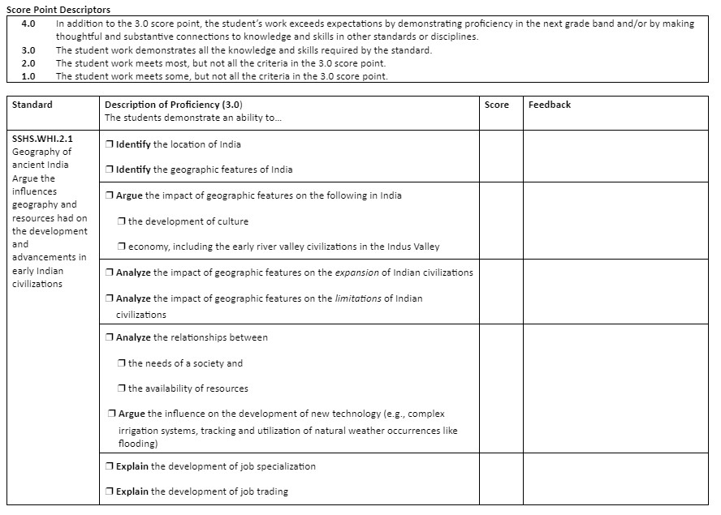
High-Quality Assessment
Using the Standards to design assessment rubrics
Notes:
Since the content standards are framed in tables within the Standards document, the Standards are in a way “unpacked” and ready for instructional and assessment development. Using the information provided within the standards tables, teachers can design their own assessment rubrics as an easy way to track students’ progress in demonstrating proficiency of a standard or multiple standards within an inquiry topic. (see rubric documents on web). No matter the grade level or course, the assessment rubrics are designed to assess students’ knowledge of the standard by using the learning assessment objectives (LAOs) in the same way. To assess a student’s knowledge of a standard, use the learning assessment objectives with their levels of rigor as the point of demonstration. Include all of the components of a learning assessment objective in the rubric.
Although this presentation covers a lot of information, there is much more in the Curriculum Framework document including tips, resources, recommendations, strategies for applying all curricular, instructional, and assessment practices for MLLs and DAS, and resources for professional learning. I hope this overview will help you have a better understanding of what to find in the document and where to look. I am always happy to answer questions.

Slide 70
Thank you!
RIDE Contact:
Education Specialist, Humanities and Social Studies
socialstudies@ride.ri.gov

