Slide 1

RI Next Generation Science Assessment
(NGSA)
Test Coordinator Training
Spring 2024
Notes:
Welcome to our test coordinator training for the Spring 2023 administration of the Rhode Island Next Generation Science Assessment, or NGSA.

Slide 2
Introductions
Erica Gray Heather Heineke
Senior Program Manager Assessment Specialist
Cambium Assessment RIDE
Randa Elmoazzen Erin Escher
Senior Program Manger Science Specialist
Cambium Assessment RIDE
Carolyn Higgins
Science Specialist RIDE

Slide 3
Welcome
Training Purpose
  Outline key concepts and tasks for preparation and administration of NGSA.
  Familiarize participants with processes and tasks in NGSA TIDE and TDS.
Training Objectives for Participants
  To understand the state policies and procedures specific to NGSA and how to use them to guide local policies and administration.
  To increase understanding of NGSA, how to prepare for it and administer it, and how to best support schools and educators.
  To gain experience using the Cambium Assessment, Inc. (CAI) systems needed to prepare for and administer NGSA.
Notes:
The purpose of this training is to provide information to test coordinators about the preparation, policies, and administration of NGSA to support you as prepare for and administer the test this year.
By the end of this training, we intend for participants to have a better understanding of NGSA policies and procedures, how to prepare for NGSA, and how to administer the test using CAI systems (TIDE & TDS).
There will be a lot of information to cover in a relatively short amount of time, and so we fully expect there to be questions during (and even after) this training. We will post this presentation deck and a recording to the RI NGSA Portal for anyone to reference later on, as well. There will also be a brief TIDE refresher in early April for anyone that is interested.
Finally, this will be interactive. We will have activities and discussions along the way, and feel free to stop us with questions as we go. We will be doing live demonstrations and asking to log into your own accounts to practice and replicate what we’ll be showing. So have your laptops ready!
We have scheduled breaks throughout, but feel free to take your own breaks as necessary.

Slide 4
Agenda
NGSA Assessment Background/Overview (5)
Preparing for NGSA Assessments (10)
Test Information Distribution Engine (TIDE) Overview and Practice Session (30)
Break (10)
Preparing Test Administrators (10)
Preparing Students (10)
7. Test Delivery System (TDS) Overview and Demonstration (20)
8. Break (10)
9. TDS Practice Session (10)
10. Resources and Support (5)
11. Q & A/One-On-One Support (30)
Notes:
Here is the agenda for today’s training.
Review agenda at a high level. We’ll cover all the acronyms throughout the afternoon!
We’ll finish with some helpful resources and have left time for one-on-one support and Q & A.

Slide 5
NGSA Background and Overview
Notes:
We will begin with the NGSA overview.

Slide 6
PRE-TEST
On a scale of 1-5 (1 = not at all, 5 = very), how comfortable with and knowledgeable do you feel about each of the following:
NGSA Test Design
Policies and procedures related to NGSA Administration
TIDE (Test Information Distribution Engine)
TDS (Test Delivery System)
Notes:
We can’t talk about assessments without starting the session with one!
Participants will hold up numbers with hands- very informal to engage the group.
Goal is to get all of you to a 4 or 5 by the end.

Slide 7
Student Participation
 |  | Alternate Assessments
 | ACCESS 2.0 for ELs English language proficiency | Alternate ACCESS for ELs English language proficiency | DLM ELA and math | DLM science | NAEP | NGSA Science | RICAS ELA and math | PSATTM10 reading and math | SAT® School Day Reading, writing, and math
Kindergarten | K | K
1 | 1 | 1
2 | 2 | 2
3 | 3 | 3 | 3 |  |  |  | 3
4 | 4 | 4 | 4 |  | 4 |  | 4
5 | 5 | 5 | 5 | 5 |  | 5 | 5
6 | 6 | 6 | 6 |  |  |  | 6
7 | 7 | 7 | 7 |  |  |  | 7
8 | 8 | 8 | 8 | 8 | 8 | 8 | 8
9 | 9 | 9
10 | 10 | 10 |  |  |  |  |  | 10
11 | 11 | 11 | 11 | 11 |  | 11 |  |  | 11
12 | 12 | 12
Notes:
NGSA is one in the suite of assessments that comprise our Rhode Island State Assessment Program, or RISAP. As you can see, students in grades 5, 8, and 11 take NGSA. This includes all students, even first year EL learners and those placed in out of school placements, both in and outside of RI.

Slide 8
NGSA Administration
It is administered over four weeks to students in grades 5, 8, and 11
  Primary Testing Window: Wednesday, May 1 – Friday, May 17, 2024
  Makeup Testing Window: Monday, May 20 – Friday, May 31, 2024
    District- and school-testing windows must be scheduled during the primary testing window.
    Make-up testing may be conducted during the primary and makeup testing windows.
NGSA is a computer/device-based assessment administered on a secure application
  Paper-based formats are available.
Notes:
All students in Rhode Island public schools (including outplaced students) in grades 5, 8, and 11 are expected to participate unless the student meets the criteria for and participates in the alternate assessment.
The assessments are administered over a four-week period. The primary testing window is Wednesday, May 1st – Friday, May 17st and the makeup testing window is Monday, May 20th – Friday, May 31st. The district and school testing windows must be scheduled during the primary testing window. The make-up testing may be conducted during the primary AND makeup testing windows.
Paper tests are available (more on that later)

Slide 9

NGSA Test Design
  The NGSA measures the Next Generation Science Standards (NGSS).
    Measures students’ science knowledge and their ability to think critically, analyze information, and solve complex problems.
    Each test (grades 5, 8, and 11) measures the science standards in the corresponding grade band (3-5, 6-8, and high school).
  The test assesses the three Disciplinary Core Ideas (DCIs) in each grade level:
      Earth and Space Science
      Life Science
      Physical Science
  Items ask students to use science and engineering practices and apply their understanding of the DCI’s and crosscutting concepts to make sense out of real-world phenomena.
Notes:
Evidence centered design that requires students to use skills that cross all areas of science.
The test is only given in 3 grades but covers content in corresponding grade bands.
Multiple interactions in which students engage with a phenomenon in each DCI.
Identify
Describe
Model
Predict
Explain

Slide 10

NGSS Design

Slide 11
RI NGSA Testing Time
Session 1 | Session 2
60 minutes | 60 minutes
There are two separate test sessions.
  Students must log in, complete, and submit each test session separately.
Session information:
  All tests are untimed. The session times listed are recommended.
  Times are for students testing time only. Schools should plan for an additional 10 minutes for logging in, reading test directions, etc.
  Breaks are not required:
    Based on student need, schools may provide one short (3-5 minutes), supervised break per session.
    If administering both sessions in one day, scheduling a longer break between test sessions is recommended.
  Students may continue testing beyond the scheduled testing session (extended time) if they are working productively.
Notes:
Districts and schools then select the days within the testing window on which they will administer the NGSA sessions. But they must be completed before end of the state window.
The test is broken into 2 sessions, which must be completed and submitted separate from each other.
All tests are untimed, but we recommend scheduling sessions for a minimum of 60 minutes of actual testing time per session. Schools should plan for an additional 10 mins for logging in, reading test directions, etc.
Breaks are not required however; schools may provide one short 3-5 min supervised break per session. If both sessions will be administered on the same day, it is recommended to schedule a longer break between test sessions.
Some students may finish before the recommended time is over (and so may work on approved activities as noted in the TAM until the session is finished), and others may need extended time which they are welcome to have so long as they are working productively.

Slide 12
NGSA Item Development
Items are developed with input from Rhode Island educators, and input from educators in other states that are members of to the Cambium Next Generation Science Standards MOU- a group of states that work together to develop and share high-quality NGSS-aligned assessment items.
Each summer, committees of educators review and provide feedback on potential field test items. They review not just the content, but also review the item to make sure it is free of bias.
Item statistics are reviewed by RIDE after each summative window to ensure the test items performed as expected.
For more information about joining an Educator Review Committee, contact Erin Escher (Erin.Escher@ride.ri.gov) or Heather Heineke (Heather.Heineke@ride.ri.gov)
Notes:
RI has been a member of the MOU committee since 2018.
Currently there are X states that participate in the MOU
Ask if any members have participated on the committees or have had educators who did.
High level overview of the feedback and revisions CAI does.

Slide 13
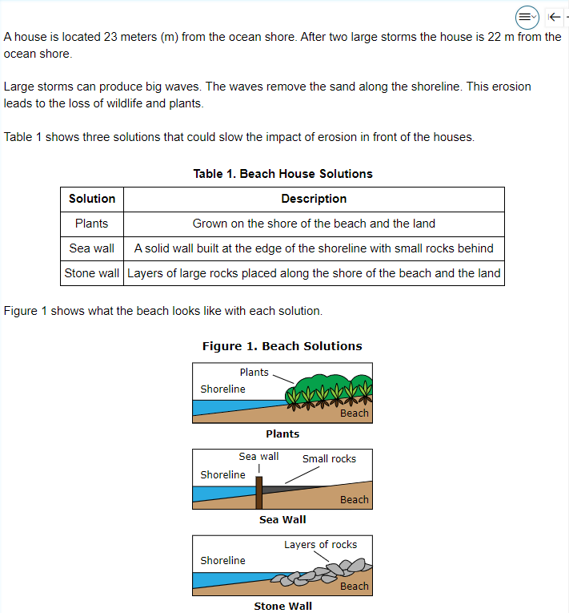
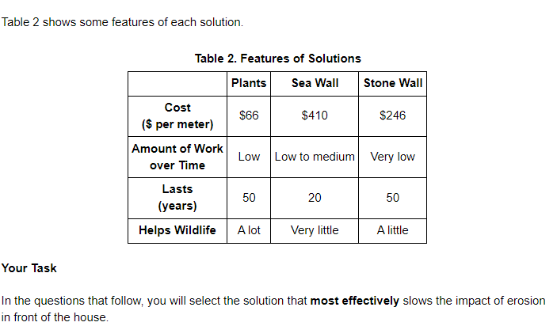
Sample Item – Fifth Grade (Stimulus)
Notes:
Here is a Sample Item for a 5th grade assessment.

Slide 14
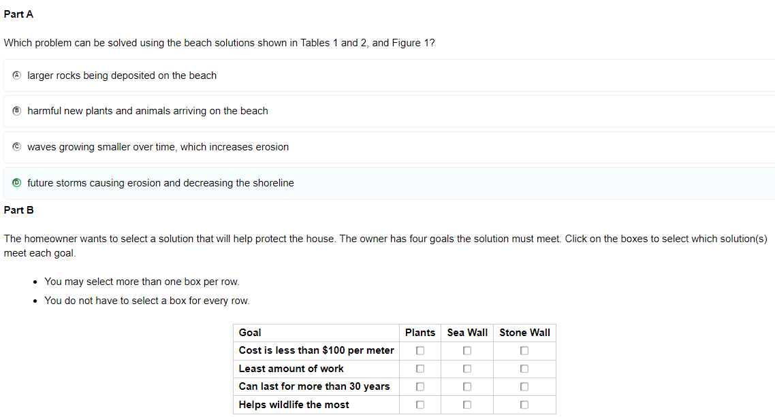
Sample Item – Fifth Grade (Item)

Slide 15
NGSA Reporting Timeline
Type | When | Data Available | Data Can be Found:
Early Reporting | Summer | Student-level data No scale scores School-level embargoed aggregate data | Centralized Reporting System (CRS). Log in using your Cambium Account.
Individual Score Reports (ISRs) | Fall | Scale scores Overall achievement levels Performance Levels by DCI | Paper copy mailed to districts Send copy to outplacements CRS: Printable Cambium ISRs
Confidential Release | Fall | District and school administrators receive access to district, school, and student-level data. | RIDE Portal’s Student Data Portal (SDP). Log in using your RIDE Portal account. Centralized Reporting System (CRS) (After RIDE releases data publicly).
Public Release | Fall | Public access to all state, district, school-level data. | RIDE’s Assessment Data Portal (ADP)
Remember that state assessment data (scale scores, proficiency levels, etc.) should be used in conjunction with other data sources (attendance, local achievement data, observations) to make the best instructional decisions.
Notes:
We’re jumping ahead to after the test, but one of the most frequent questions we receive is when results will be available.
In the summer, students' results are available once all students are done with both sessions (typically the final day of the testing window or soon after) in the Centralized Reporting System (we’ll review how to access later on). Note this is not all information, and does not include school level results or scale and growth scores.
Review ISR- Reminder that one copy of ISRs are sent to districts. They should send home to families and make a copy. There are also printable ISRs available in CRS that vary slightly from the ISRs that are shipped to districts. Only the ISRs that are mailed to districts should be sent to families.
In the fall, there will be 2 releases – one for district and school staff to review embargoed data, and then the public release.

Slide 16
Preparing for the NGSA Assessment
Recommended Activities in the Months Before the Window Opens
Notes:
Before we move on, are there any remaining questions about NGSA?
Moving on to the first section: before testing and how to prepare for the NGSA Assessment.

Slide 17
Student Enrollment and Registration
Students will be registered to take the NGSA in their enrolled school at their current grade level.
  Outplaced students will be registered in their outplacement school based on the information in the Enrollment Census
  RIDE uploads a file nightly to the Test Information Distribution Engine (TIDE) for all participating students
  Changes may not be reflected in TIDE for 24-48 hours due to timing of district collections sent to RIDE.
Test Distribution System (TDS)
Student Information System (SIS)
Rhode Island Department of Education (RIDE)
Cambium Assessment Inc. (CAI)
Test Information Distribution Engine (TIDE)
Notes:
Students in grades are automatically enrolled at their school through a nightly upload from eRIDE. Please contact outplaced schools to ensure student information is correct, as those students will be visible in that outplaced school. Homeschooled students may participate provided they have a SASID and are coded “H” in the enrollment census.
The nightly feed refreshes in the fall of every year, and as changes are made, they will be reflected in TIDE (may take 24-48 hours to be reflected).

Slide 18
The Importance of Verifying Student Enrollment Data
Districts must ensure the following daily RIDE collections are accurate:
  Enrollment Census (demographic information)
  Special Education Census (alternate assessment indication)
  LEP Census (students who are currently receiving services or who are in monitored status)
This information is the basis for NGSA registration and assessment reporting.
Inaccurate data may delay your ability to complete testing.
Notes:
Emphasize the importance of eRIDE data. This feeds into TIDE and drives the information we use to register students for the test.

Slide 19
Setting Student Test Settings
Enter and confirm test settings in TIDE as early as possible for students who will test with accommodations (IEP/504, MLL).
  Plan for testing space required for certain accommodations (e.g., Read Aloud, Simplified Test Directions)
  Note how many students require a paper test.
This makes last-minute additions or changes (e.g., new students, IEP updates) easier to manage.
More information on how to set test settings will be in the TIDE Overview.
Notes:
This is the process of assigning students the accommodations and supports needed to ensure they have them on the test.
For non-embedded supports that may require a one on one or small group, setting these early on can help plan for space and staff scheduling. It will also identify how many of your students will require a paper test so an order can be placed.
We will cover exactly how to do this when in the interactive TIDE session later but wanted to mention this as a VERY important preparation activity.

Slide 20
Scheduling Sessions
Schedule sessions as early as possible after the state primary testing window opens on Wednesday, May 1st
  All district and school testing windows must be scheduled during the primary testing window (May 1 – 17).
  Make-ups may be conducted during the primary testing window and make-up testing windows.
Use effective testing locations:
  That are quiet and not prone to interruptions.
  Allow enough space between students and for the proctor to actively monitor.
  That have all science-related content removed from walls or covered.
Notes:
Schedule sessions as early as possible and communicate this to your schools and teachers so they know when testing will begin and can prepare.
Emphasize the window opening on April 24th, and scheduling early on will allow for plenty of make up time before the window closes.
Remember to schedule sessions in locations that are quiet and free of distractions.

Slide 21
Ensuring Technology Requirements are Met
All testing devices must meet minimum operating system and device requirements as outlined in the Technology Guide (https://ri.portal.cambiumast.com/tech-guide.html).
Install the latest secure browser from the RI NGSA portal to all testing devices.
  The secure browser from previous years will not work.
  Close all applications, or the browser will not launch.
  Students must use the secure browser to log in to the Student Interface of the TDS.
TIP: Have extra devices available during testing sessions in case of any device-related issues.
Required Technology
Test Administrators | Computer with internet to monitor testing sessions. Phone to contact test coordinator or technology coordinator for help.
Students | Computer or device for testing that meets the technical requirements for the Secure Browser App. Devices or accessories (e.g., headphones, assistive technology) for accommodations or accessibility features.
Notes:
As with all computer-based tests, there are specific technology requirements. The Secure Browser, the app students must use to access the test, has minimum OS requirements to be installed. (similar to an app update on your cell phone)
The SB must be on any device a student is using to test or they will not be able to access the NGSA. One tip is to download the SB on additional devices and have them available during testing in case of any device issues.
The Technology Guide on the RI NGSA Portal website is your access point for all of the systems associated with NGSA. It is also where you can the link to download the SB, troubleshooting tips and information on minimum OS requirements.
As noted here and in the Test Coordinator Manual, test administrators and students both must have computers/devices with internet capability in order to access the Test Delivery System through their separate interfaces. While test administrators may have access to a cell phone in case of a testing irregularity and needing to contact the test coordinator, students are forbidden from having cell phones at all during testing.

Slide 22
TIDE
(Test Information Distribution Engine)
Overview and Practice Session
Notes:
Ask for questions on Preparing for NGSA before moving on.
TIDE is the online system used to manage student information in preparation for testing – ordering paper materials, updating students’ accommodations, etc.

Slide 23
Accessing TIDE
NGSA uses a Single Sign-On System.
  Usernames and passwords for TIDE are used for all other NGSA systems
    Test Delivery System (TDS), Centralized Reporting System (CRS) and the Data Entry Interface (DEI).
User Account Management:
  RIDE creates District Test Coordinator accounts.
  District Test Coordinators create and remove other district- and school-level accounts.
    At the start of this school year, all school coordinator and teacher accounts were removed, except in those districts that were administering interims.
  School Test Coordinators create and remove test administrator accounts.
Notes:
TIDE is the online system used to manage student information in preparation for testing – ordering paper materials, updating students’ accommodations, etc.
NGSA TIDE is one of several systems all linked together through a single-sign-on: the Reporting system, the test delivery system, the data entry interface,
High school and district test coordinators – please note that while College Board also uses a TIDE system, it is completely separate from NGSA TIDE.
RIDE ->DTC ->STC -> can add or remove users. It’s important to keep users updated.

Slide 24
Different Roles Have Different Tasks Available
Task | DA | SC | TE
Editing Student Settings | ✓ | ✓ | ✓
Creating and Managing Rosters | ✓ | ✓ | ✓
Adding and Removing User Accounts | ✓ | ✓
Adding User Accounts at the same level | ✓
Creating Appeals | ✓ | ✓
Running Participation Reports | ✓ | ✓ | ✓
Printing Test Tickets | ✓ | ✓ | ✓
Submitting Paper Material Orders | ✓ | ✓
Notes:
Your TIDE account has a role that you will see when you sign in.
DA= District Administrator (DTC)
SC= School Test Coordinator
TE= Teacher, could be anyone who will administer a test (Any TA)
Go through each row of the table
In addition to limiting tasks, your role limits what you can access in TIDE. For example, a district-level user can work with data pertaining to that district, and a school-level user can work with data pertaining to that school.

Slide 25
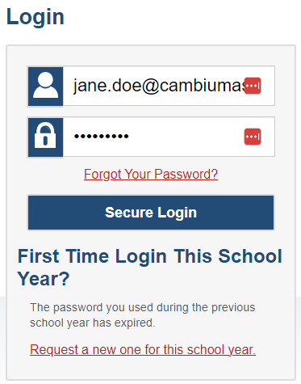
Reactivating Your Account
CAI automatically resets all user accounts at the beginning of the school year.
All users will need to reset their passwords by doing the following:
  Go to the TIDE Log-In Screen
  Select “Request a new one for this school year”
  The Reset Password page appears.
  Enter your TIDE email address and select Submit. TIDE sends you an email containing a link to reset your password
Notes:
User accounts are rolled over annually. Each year, users need to reset their password to reactivate your account. If you haven’t done that already this year, you’ll need to do that now before we continue.
If you are a new user, you will receive an email to set up their account and PW.
Walk through steps. Assist audience if needed.

Slide 26
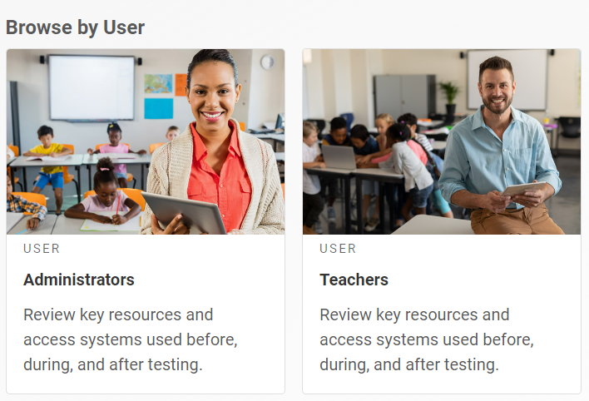
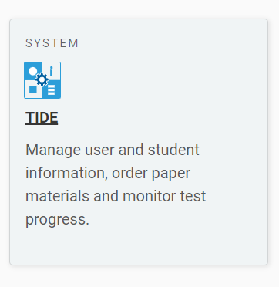
Logging In
Visit the RI NGSA Portal (https://ri.portal.cambiumast.com/)
Select the Administrators or Teachers user cards based on your user role.
From the appropriate user page select the TIDE card.
Notes:
Walk through steps and log into TIDE (Log in as DA role)
Pause to let participants log into their account and troubleshoot if needed.

Slide 27
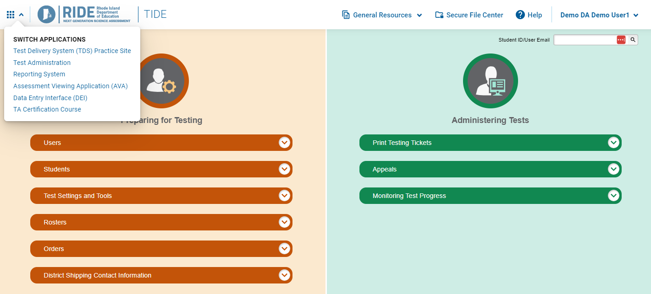
TIDE User Dashboard
Tasks in each section will differ slightly based on role.
Once logged in, users can open the top-left dropdown menu to navigate between systems.
Notes:
When you login, you will see that the NGSA TIDE User Dashboard is organized into three columns: Preparing for Testing, Administering Tests and After Testing. The tasks available to you in each column will vary depending by your user role – I am logged in as a DA (point out in upper right corner)
After logging in, the user is free to navigate between systems. In the top left of any CAI system, you’ll see a dropdown menu. This menu will initially show you the system you are in. You can click on the dropdown and select the linked system you wish to navigate to.
For today, we will focus on preparing for and administering tests.

Slide 28
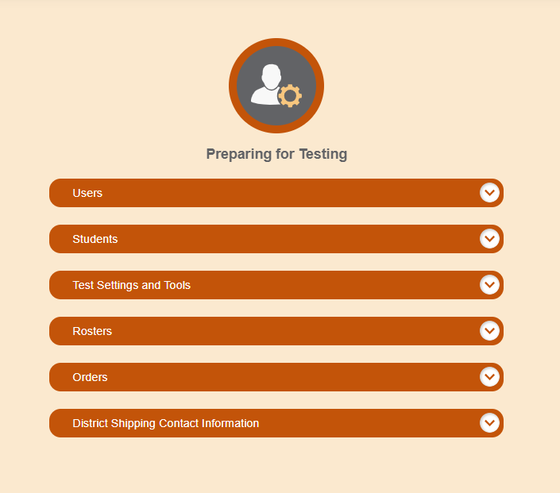
Preparing for Testing
Notes:
We’ll start by discussing important tasks to complete in TIDE prior to the testing window

Slide 29
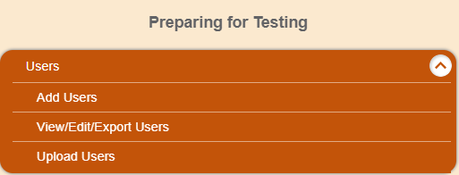
Adding, Editing, and Deleting Users
Add users by selecting the “Add Users” dropdown.
To delete or edit existing users, select “View/Edit Export Users and enter the appropriate information.
Notes:
It’s important to keep your users up to date. Make sure any old users are deleted, and all new users that will be administering TIDE or accessing results in CRS are added.
Walk through the steps in TIDE. Have users navigate on their own but ask they don’t take any actions.

Slide 30
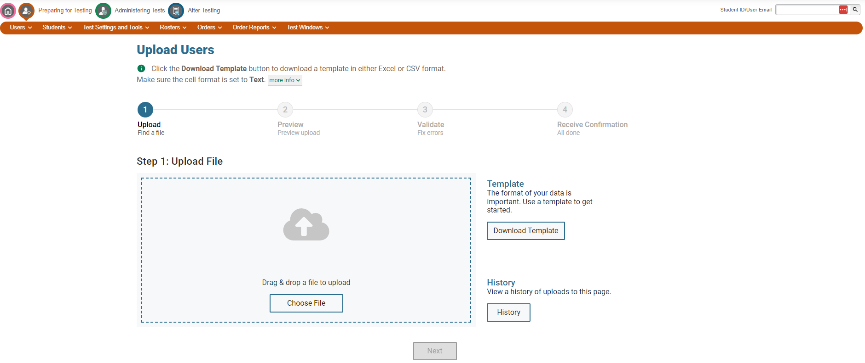
Adding, Editing, and Deleting Users (cont’d)
When adding multiple new users, you can use the “Upload Users” feature.
  Download the Template and complete with User information.

Slide 31
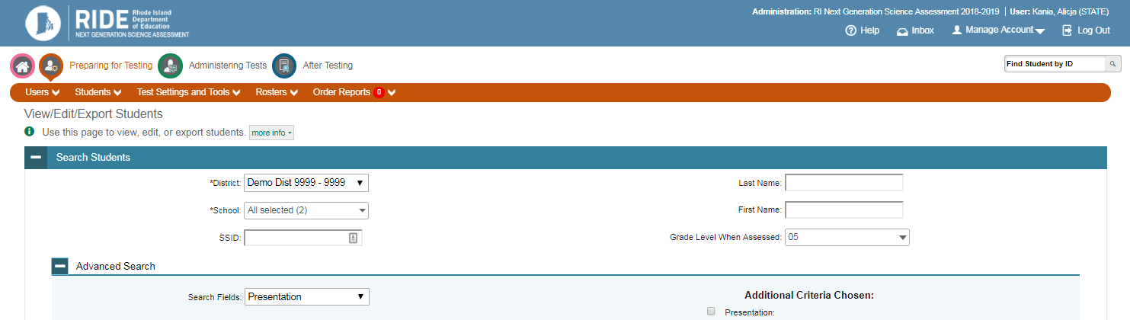
Viewing Student Information
There are two main ways to find students within NGSA TIDE:
  Search by SSID on every page in top corner.
  Use View/Edit/Export Students form to search for specific subsets (e.g., all students with Spanish presentation)
Students in all grades will be in TIDE during the summative window.
Notes:
From the Users screen, show how the breadcrumb trail can be used to navigate back to different sections. Go back to the dashboard and expand View students.
In TIDE there are two ways to locate students:
1) You can use the Search by SSID field that’s found on every page in the top corner. Note that SSID is the same as SASID – state-assigned student identifier.
2) (especially if you are looking for multiple students) You can use View/Edit/Export Students form to search for specific subsets: for example, this screenshot shows the user searching for all 5th Grade Braille students in the demo district to make sure they order enough paper booklets for all students.
Once you have located the student, you can review their information, or edit specific sections of their record (more on that on the next slide)
Pause and have audience navigate on their own.

Slide 32
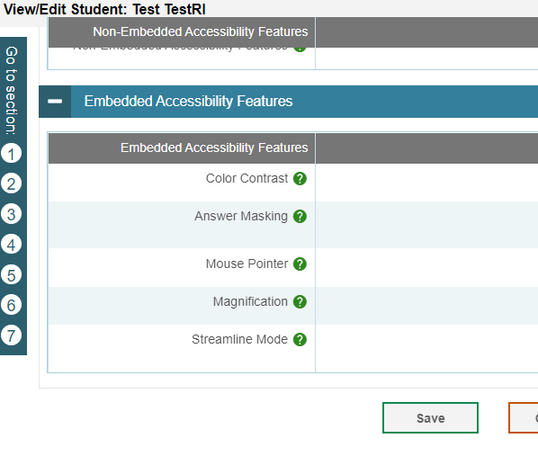
Setting Student Test Settings and Tools
This process should be completed well in advance of testing (Late Winter/Early Spring).
For multiple students, you can use the “Upload Test Settings and Tools” form.
Embedded Accommodations
  The IDEA Indicator or 504 Plan field must be set to Yes.
  Embedded within TDS
  Ex: Text-to-Speech, Print on Demand
Non-Embedded Accommodations
  The IDEA Indicator or 504 Plan field must be set to Yes.
  Require materials or support not available in TDS
  Ex: Read aloud, bilingual dictionary, paper test
Non-Embedded Accessibility Features
  Can be set for any student
  Require materials or support not available in TDS
  Ex: magnification, noise buffers
Embedded Accessibility Features
  Can be set for any student
  Embedded within TDS
  Ex: color contrast, mouse pointer, answer masking
Notes:
The Student Test Settings Process is the process of setting certain accessibility features and accommodations on for students to ensure that embedded test supports are present when the student takes the test in TDS. It also ensures that students who need a paper format are eligible for it. (Reference the earlier slide and the importance of doing this EARLY)
There are 4 categories of test settings and tools:
(walk through each on the slide)
Accommodations are only available for students with that documented in their IEP/504 plan. Accessibility features are available for any student, but – like accommodations – should be documented as something that meets a specific need and should be something the student the student is used to.
(Have audience go to View Test Settings and Tools, and search for Demo district 9999). Select a school, and click on a student. Expand each Accom/Access section and review the functionality, options. Click cancel

Slide 33
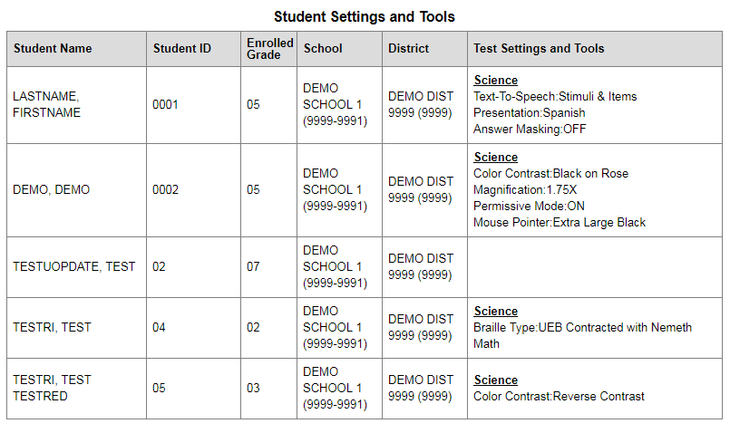
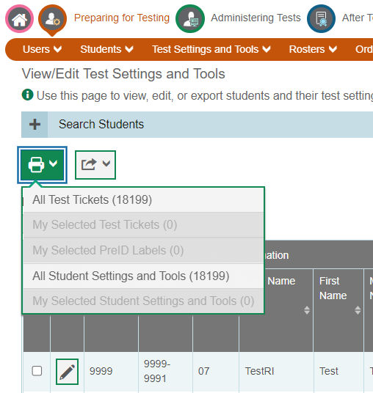
Student Settings and Tools Report
At least two weeks prior to test administration, print the “Student Settings and Tools” report in TIDE and share it with test administrators.
They can use this as a quick reference when verifying student test settings in the TA Interface.
Notes:
A helpful tip to verify student accommodations and accessibility features in TIDE is to use the use the print a “student settings and tools report” prior to test administration (see the NGSA TIDE User Guide).
This can help both test coordinators prior to testing, and test administrators on the day of testing as they’ll have a quick reference for confirming student test settings through the TA Interface.
At least two weeks prior to testing, the Test Administrators should verify student settings and provide any corrections before testing begins.

Slide 34
Activity
Review the TIDE Users in your school/district:
  Identify those that need to be removed
  Identify users that need to be added
“Print” a Test Settings report for a students in a school.
  Note: You will have to “Save to PDF” instead of print.
Notes:
Give users 5 minutes to complete. Circulate and provide help if needed.

Slide 35
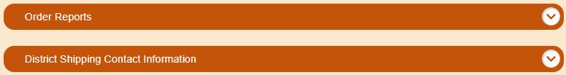
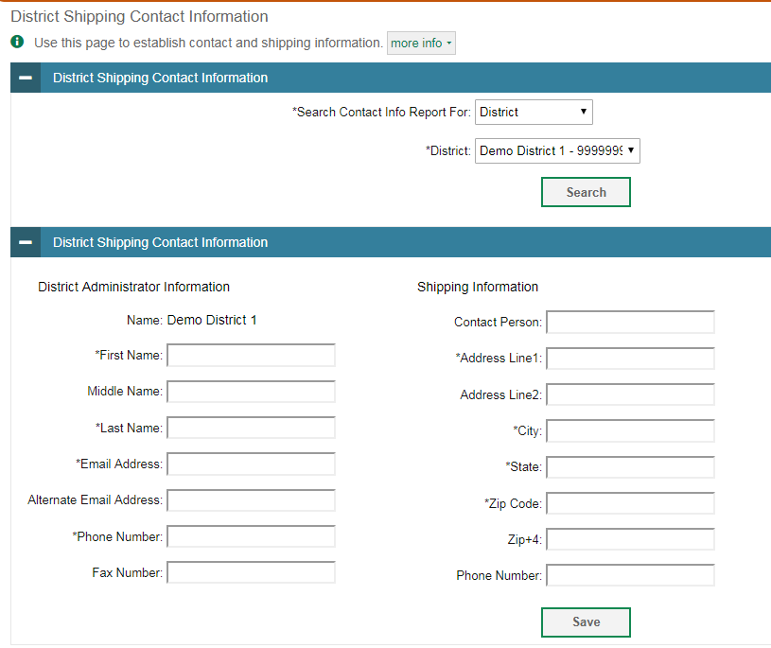
Ordering Paper Testing Materials
Window for ordering opens March 11, 2024 and closes on May 24, 2024
  Braille, Large Print, and Standard paper tests available.
  Reminder: confirm that the student has the non-embedded accommodation set properly in NGSA TIDE.
Place orders through the “Orders” task within the Preparing for Testing dashboard.
  Make sure District or School Shipping Information is accurate
Notes:
The window for ordering paper testing materials opens March 11. District test coordinators submit the materials orders for a particular school or the entire district within the Preparing for Testing section, and the “Orders” task. This section is currently gray in TIDE since the order window has not yet opened.
There are three paper test forms available for NGSA. Please note that Spanish does not have a separate paper test form – Spanish paper tests use the “print-on-demand” feature. These students simply need to have the presentation in their profile set to Spanish in TIDE, so that the test items are translated into Spanish. We’ll cover print-on-demand in more detail on a later slide.
The screenshots on this slide show an example of an order form interface (bottom of the slide), and also the shipping contact information window (bottom right). As a reminder, manuals are not printed for NGSA – only student testing materials can be ordered.
NOTE: We will Zoom the images on the screen so users can see the information that is required. Emphasize that users will NOT be able to see this information UNTIL MARCH 11.

Slide 36
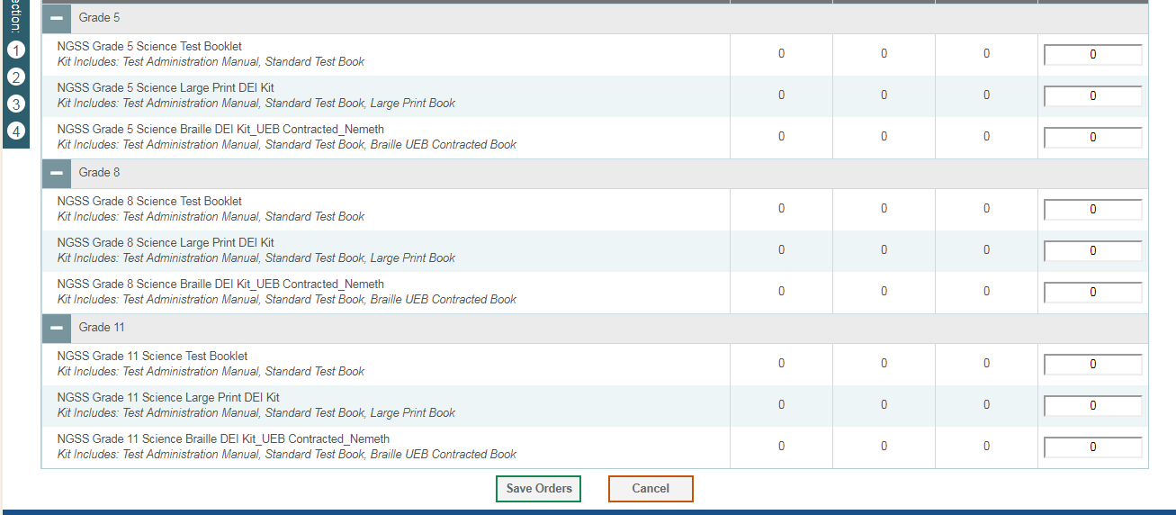
Ordering Paper Testing Materials (cont’d.)
  Enter the quantity needed for each of the materials needed.

Slide 37
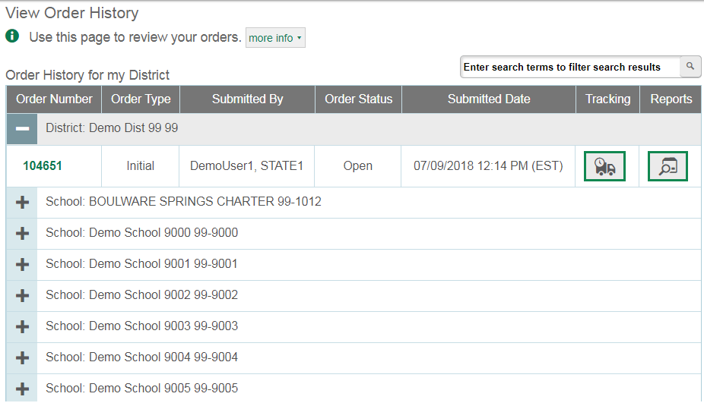
Ordering Paper Testing Materials
District administrators (DA) and School Test Coordinators (SC) can check and edit shipping information for their district, and schools within their district.
View Order History:
  View tracking details by selecting the truck icon.
  Packing lists, manifests, and security checklists are available by selecting the report icon.
The Order Details form includes:
  Material Description
  Shipment Quantities
  Approval Status
  (this information is also available
  on the Order Quantity Reports)
Notes:
When viewing order history, as a district test coordinator, you can click on a specific order to expand and view the order details. An example of the view order history screen is pictured here.
(Zoom in so audience can see images)

Slide 38
Spanish Paper Test Accommodation
Spanish accommodation can only be given to students who are coded as LEP in the LEP Census and have LEP status set to Currently Receiving Services, Monitor Year 1, or Monitor Year 2.
Use "print-on-demand" for students who need to take a paper test in Spanish.
Students will need the following settings in TIDE:
  Presentation: Spanish Edition
  Print-On-Demand: Stimuli & Items
  Magnification: if large print is also needed
Procedure
  The student would login normally to the TDS and request for the items to be printed individually.
  The student would complete the test on paper. ​
  After the student completes the test, that TA would then enter the student's responses into TDS exactly as indicated by the student on paper. ​
  Paper tests are considered secure materials and should immediately be shredded by the Test Coordinator following the entry.
Notes:
NGSA does not have a paper test booklet in Spanish. For students with an IEP/504 plan with a paper accommodation for state assessments, whose presentation is set to Spanish, you would use the “print-on-demand” accommodation so the test could be printed in Spanish. They would also need to scribe accommodation set to Yes.
The administration procedure is documented in the Accommodations and Accessibility Features Manual (Appendix J). In brief, the student would login normally to the Test Delivery System (TDS), with the Spanish language version, and then the test administrator would print items individually for the student to complete on paper.
The test administrator – as a scribe – would then enter the student’s responses into the TDS while it is still logged in, exactly as the student indicated on paper.

Slide 39
Spanish Text To Speech (TTS)
Chromebooks should be using the Long Term Support channel.
If they are using the stable channel instead, Spanish voice packs are not available on ChromeOS 119 and 120. There are two options to address this:
  Switch to the Long Term Support Channel
  Upgrade to ChromeOS 121 stable, which will be available as of February 6, 2024
Notes:
Work around for an issue with Google. They should provide these directions to their tech coordinators and walk through these steps on every device that will be used for students with Spanish TTS

Slide 40
Setting up Student Rosters
Rosters are groups of students associated with a teacher, for example:
  Entire classrooms in lower grades
  Individual course periods in upper grades
  Entire caseload for a Special Education teacher
Students do not need to be in a roster in order to take the test.
It is recommended that rosters be created before the testing window for teachers to view their students’ scores after testing.
  CAI recommends having a minimum of 10 students in a roster.
Notes:
Rosters are optional for testing but are required after testing for teachers to be able to see their students’ scores. When teachers have students rostered to them, they are able to print test settings for the students in their roster and check them prior to the testing session.
Rostering is important so that teachers can access their students data in CRS after testing. If students are not rostered to a teacher, they will not be able to see detailed student results.
Rosters of any size can be created, but they should represent a grade, class, or caseload, etc. Having rosters of hundreds isn’t helpful, but having a roster of 2 also is not. Because of data rules, rosters of fewer than 10 students will not have detailed SEP level data available because the size is too small.
EMPHASIZE roster size and the importance of rosters in allowing teachers access to their student’s results.

Slide 41
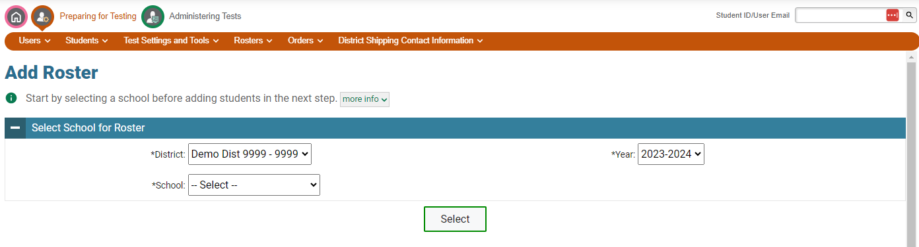
Setting up Student Rosters (cont’d.)
Choose your district, school and year from the dropdowns.
Notes:
Point out the changes from last year – student
*Log into TIDE and walk participants through what this looks like.

Slide 42
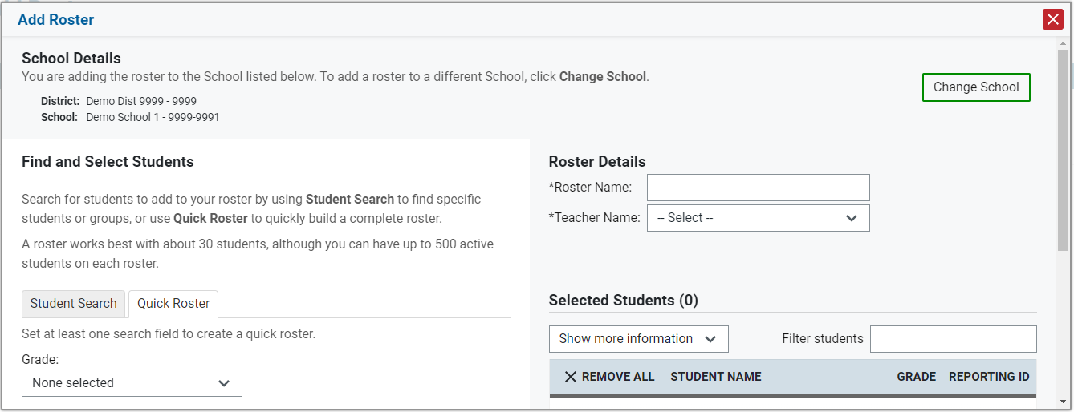
Setting up Student Rosters (cont’d.)
Select either the Student Search or Quick Roster tab and enter your search criteria.
Add the students to the Roster by clicking the + button.
Select the Teacher's Name, name the Roster and save it.

Slide 43
Activity
Using the View/Edit/Export Roster feature, find a Roster for a teacher in your school (or a school in your district).
  If there are no or few rosters, think about how you can communicate the importance of encourages teachers to roster students.
Download and review the “Upload Rosters” template.
Notes:
Give users 5 minutes to complete. Circulate and provide help if needed.
Informal conversation on how many rosters they found? Did that surprise them? Can they set a goal for how many teachers they have using rosters this year?

Slide 44
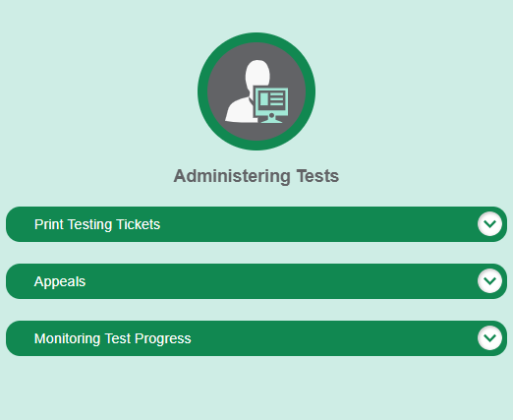
Administering Tests
Notes:
Pause for questions on Preparing for Test section before moving on.
Call attention to the first dropdown –test tickets. We will be following the tasks in the order they appear in TIDE.

Slide 45
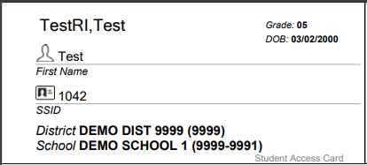
Printing Test Tickets
Test Tickets contain student login information for TDS.
Can be printed by Student List or Roster List.
  If printing by Roster List, students must already be rostered to a teacher.
  Can also select and print tickets in “batches”
  Test Tickets should be printed before the first day of testing.
Notes:
Test tickets have the information students need to log into TDS (full name, ID) They can be printed by student list or roster list. And should be done prior to testing.
(Pause and have users navigate to the print testing tickets section)

Slide 46
Test Monitoring Reports Available
Report Name | Role | Information Provided
Plan and Manage Testing | Teachers, Test Administrators, School Coordinators | Specific report used to view each student’s test status. Helpful during the testing window to monitor student progress in your school or district.
Test Session Status Report | District Coordinators | Shows the name of each school that is testing on a given day, and the status of the tests. Helpful during the test window to monitor testing activity.
Test Completion Rate | District Coordinators, School Coordinators | High-level reports used to summarize the number and percentage of students who have started or completed a test. Helpful near the end of the testing window to identify what students still need to complete the test.
Participation Search by SSID | Test Administrators, School Coordinators, District Coordinators | View an individual student’s test progress and status.
Notes:
There are multiple reports that can be accessed in TIDE to help monitor test progress.
(Run through the different types and audience for each as listed in the table)
Navigate to this section on the TIDE dashboard and show the different reports. In the dropdown menu We will run sample reports in a bit.

Slide 47
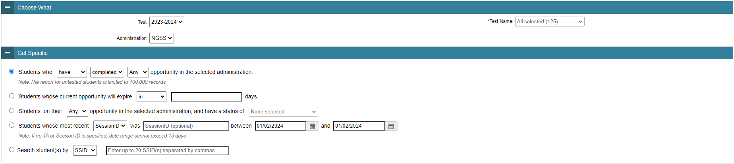
Plan and Manage Testing
Allows users to run reports and select multiple variables including test status, expiration date or Session ID.
May be generated at the district or school level, depending on your user role
Report should be generated each day testing is taking place. This will give test coordinators the most accurate testing status for all students in your school or district.
Notes:
Under the Plan and Manage Testing, users can use a variety of criteria to generate of reports.
Frequently run reports include the following: Students who have not yet complete an opportunity this administration, students in a specific Session ID, students with a certain test status, etc. This should be done for each test. When you select in the drop down, you can see tests by grade as well as the 1st or 2nd day/session.
Navigate to this section on my screen and select some different options.

Slide 48
Test Irregularities
Incidents that represent a deviation from prescribed testing procedures.
Examples of test irregularities include:
  Student impropriety
  Errors in providing accommodations
  Educator misconduct
  Mishandling of secure test materials
All test irregularities must be reported to the School Test Coordinator using the process outlined at https://ride.ri.gov/instruction-assessment/assessment/assessment-irregularities-test-security

Slide 49
Appeals Overview
Some testing situations may require the student’s test be “appealed” within the TIDE system, such as:
  A device malfunction
  Incorrect or missing accommodation
  A test was accidentally submitted before a student was finished
  Cheating Incident
District and School Coordinators can now process “re-open a test” appeals.
Notes:
There may be a situation specific instances where a student’s test needs to be reset or re-opened. To do that, users have to file an appeal, which is done in TIDE.
Examples of some scenarios where an appeal might be necessary are (read as listed on the slide)
District and School coordinators can now process appeals.
Navigate and show audience how to create and view appeals section in TIDE. Note that there won’t be any applicable tests to appeal now as the summative window has not opened.

Slide 50
Types of Appeals
APPEAL | PURPOSE / RESULT | SCENARIOS:
Reset a Test | Removes all student responses and scores from the system Enables student to start the test again | A student took a test with the wrong accommodation, and they need to restart with the correct test settings in place.
Re-open a Submitted Test | Allows for a test that has already been submitted to be re-opened | A student accidentally submitted the test before they were ready. They have blank items they want to revisit and answer.
Re-open a Paused Test | Allows for a test that has been paused for more than 40 minutes to be re-opened so students can revisit items they previously viewed. | A student’s test is paused for 42 minutes due to an unexpected fire drill.
Restore a Test That Has Been Reset | Returns a test from the Reset status to its prior status A test can be restored if it was reset in error | A user accidentally submitted a “Reset a Test” appeal for a student who only needed a Re-open Test appeal. This appeal will restore the student’s original responses and test.
Invalidate a Test | Rarely Used Eliminates the test Student does not receive a score and cannot restart the test. | A student is caught cheating and should not be given another opportunity to test.
Notes:
Read through the types and scenarios on the screen.
Note: Tests are automatically paused after 20 minutes of inactivity.

Slide 51
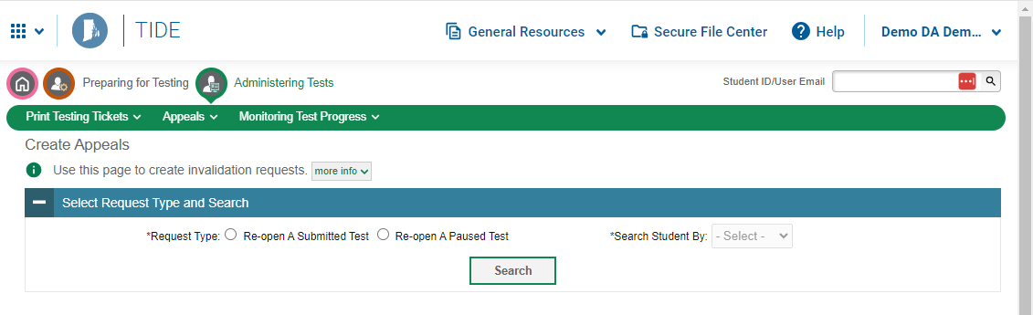
NGSA TIDE: Creating Appeals
  Select the appeal type
    If you aren’t sure, use the ? icon for information on each appeal type
  Search for the test record to appeal by SSID, Result ID, or Session ID.
  Select the test opportunity you would like to appeal and enter the reason for appealing the test.
Notes:
Because the summative window isn’t open yet, we can’t practice doing appeals, but we’ll run through the steps.
Navigate to the create appeals menu. Then users select the appeal type and search for the student who’s test you need to reset by SSID (aka, the student’s SASID), Result ID or Session ID. Definitions for each of the appeals are available in the NGSA TIDE User Guide.
You can search by student, Session ID or Result ID to find the test opportunity you would like to appeal. Once those results come up, you will enter in information about why you are requesting the appeal type you’ve chosen. These appeals no longer require RIDE approval.

Slide 52
Activity
Run a Test Completion Report for your district or a school in your district.
Explore the different variables that can be selected in Plan and Manage Testing.
Notes:
Give users 5-10 minutes to complete. Circulate and provide help if needed.

Slide 53
BREAK and QUESTIONS
Notes:
10 minutes

Slide 54
Preparing Test Administrators
Notes:
Before moving on, ask for outstanding questions related to TIDE

Slide 55
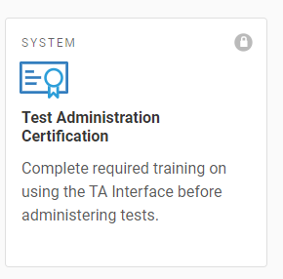
Test Administrator Certification Course
Online course accessed through the Teachers page of the RI NGSA Portal.
All users are required to take the Test Administration Certification course before administering NGSA.
  Multiple viewing opportunities
  Takes about 30 minutes to complete
  Generates a certificate of completion
Test coordinators must complete the course as well.
Course covers the Test Delivery System (TDS) only – Test administrators still need to be trained in test administration, security, and accommodations.
Notes:
This is a brief summary of the TA Certification course and how to locate it.
Please ensure all of your test administrators have completed this course prior to the state testing window begins, or at least prior to their administering a test.

Slide 56
Training Requirements
Training Requirements
  Test coordinators must participate in RIDE’s test coordinator trainings.
  Test administrators must be trained by school test coordinators using the RICAS/NGSA Test Administrator Core Training (download at www.ride.ri.gov/assessment-training)
  Complete the TA Certification Course.
Sign any Affirmations of Test Security Documents
  All personnel involved with testing must sign a statement affirming they will follow protocol for proper test administration and to maintain test security.
Receipt of Manual
  All test administrators must receive the Test Administrator’s Manual (TAM).
  Any personnel serving as proctors or hall monitors must receive the Test Security Requirements section of the Test Administrator’s Manual.
Notes:
Training is extremely important. There are two elements for NGSA training: training in test administration and test security for all personnel, and test administrators completing the TA Certification Course through the NGSA Portal in order to be able to access the Test Delivery System (TDS) and administer the assessment.
All personnel must sign an affirmation of test security (there’s an example in Appendix A of the TCM, as well as a sign-in sheet with a simplified statement), and also must receive a manual (or the test security requirements section, if they are not a test coordinator, test administrator, or proctor). Manuals may be distributed in PDF form, or may be printed by schools and distributed that way.

Slide 57
Preparing Students

Slide 58
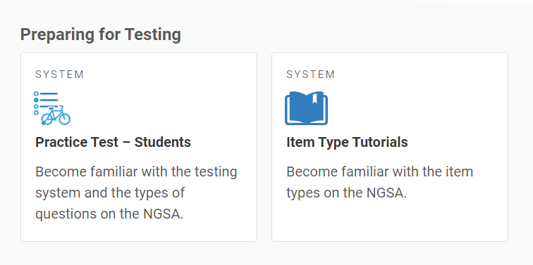
Preparing Students
Plan for students to interact with the practice tests and the test platform through the item type tutorials.
  Test administrators can lead a practice test activity in their classrooms.
  Schools can conduct a practice test session for one or more grades.
Students will be able to:
  practice using the universal tools (calculator, notepad, etc.).
  practice using any accommodations or designated supports they will use.
  become familiar with how to navigate through the test platform.
  see what the NGSA test item types look like.
  understand how testing will be conducted in their classroom or school (if you are doing a practice test session).
Communicate expectations with students prior to the test session
  Sessions are untimed, but will take about an hour.
  What to do if a student has a technology issue or needs to pause their test.
Notes:
Seeing and interacting with actual test items is one of the best ways to help families and students feel more comfortable with any assessment. Emphasize being transparent with students and families about what to expect during and after the test (results).
When communicating to students and families about NGSA (or state testing in general), please emphasize the purpose of NGSA as a tool to assess learning. You may want to share with students and families how your school or district uses NGSA results to help families understand they are more than just an accountability tool.

Slide 59
Technology Skills Needed for NGSA
Skill | Example
Using navigation buttons | Login, logout, username, password, save, resume, quit
Scrolling | Scroll vertically up and down screen views
Highlighting text | Use a pointing device (such as a mouse) to highlight text
Selecting from drop-down menus | Use a drop-down menu to make a selection
Dragging and dropping | Distinguish between instances when an answer option can be used only once or can be dragged and dropped multiple times.
Plotting points/connecting lines | Plot points and draw connecting lines using mouse pointer
Using calculators | Use an on-line and/or hand-held calculator
For the full list of skills, visit https://www.ride.ri.gov/InstructionAssessment/Assessment/NGSAAssessment.aspx
Notes:
Practice tests are also a great way for students to master important tech skills – not just for NGSA, but for online literacy.

Slide 60
Test Delivery System (TDS)
Test Administrator Interface
Overview and Practice Session

Slide 61

Overview of Test Administration Process
TA readies the room for testing by covering all science-related content, posting the Do Not Disturb sign on the door, and double-checking that they have all of the necessary testing tickets.
The TA collects all cell phones and electronic devices as they admit students to the testing room.
The TA distributes all testing tickets and scratch paper, and any other testing materials to the test coordinator.
The TA ensures that all student testing devices are open and turned on.
The TA begins to read the test script verbatim.

Slide 62
Overview of Test Administration Process (cont’d.)
The TA admits students into the testing session and starts timing the test session.
The TA actively monitors the students as they test, answers any questions about their technology or navigating the Student Interface, and dismissing students for restroom breaks.
At the end of the test session, the TA collects the test tickets and scratch paper, and prepares to move any students who have not completed testing to a Test Completion Room.
The TA dismisses students who have submitted their tests and escorts any other students to the Test Completion Room.
The TA returns all testing tickets and scratch paper, and any other testing materials to the test coordinator.

Slide 63
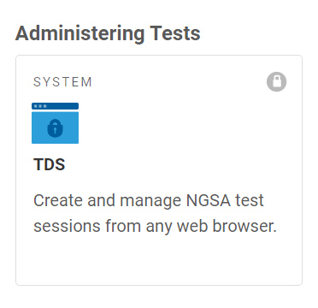
Logging Into the Test Administrator (TA) Interface
Go to the RI NGSA Portal: https://ri.portal.cambiumast.com/
Select the Administrators or Teachers user card based on your user role.
From the user page select the TDS card. Log in using the same credentials you used to access TIDE.
*The state testing window does not open until May 1st. Unless your district uses NGSS Interims, you will not be able to proceed with creating a test session until then.
Notes:
We will walk through these steps in the browser window. Emphasize they shouldn’t log in on their own yet.
Emphasize the summative window date, and that only audience members in interim districts will be able to see tests in TDS.

Slide 64
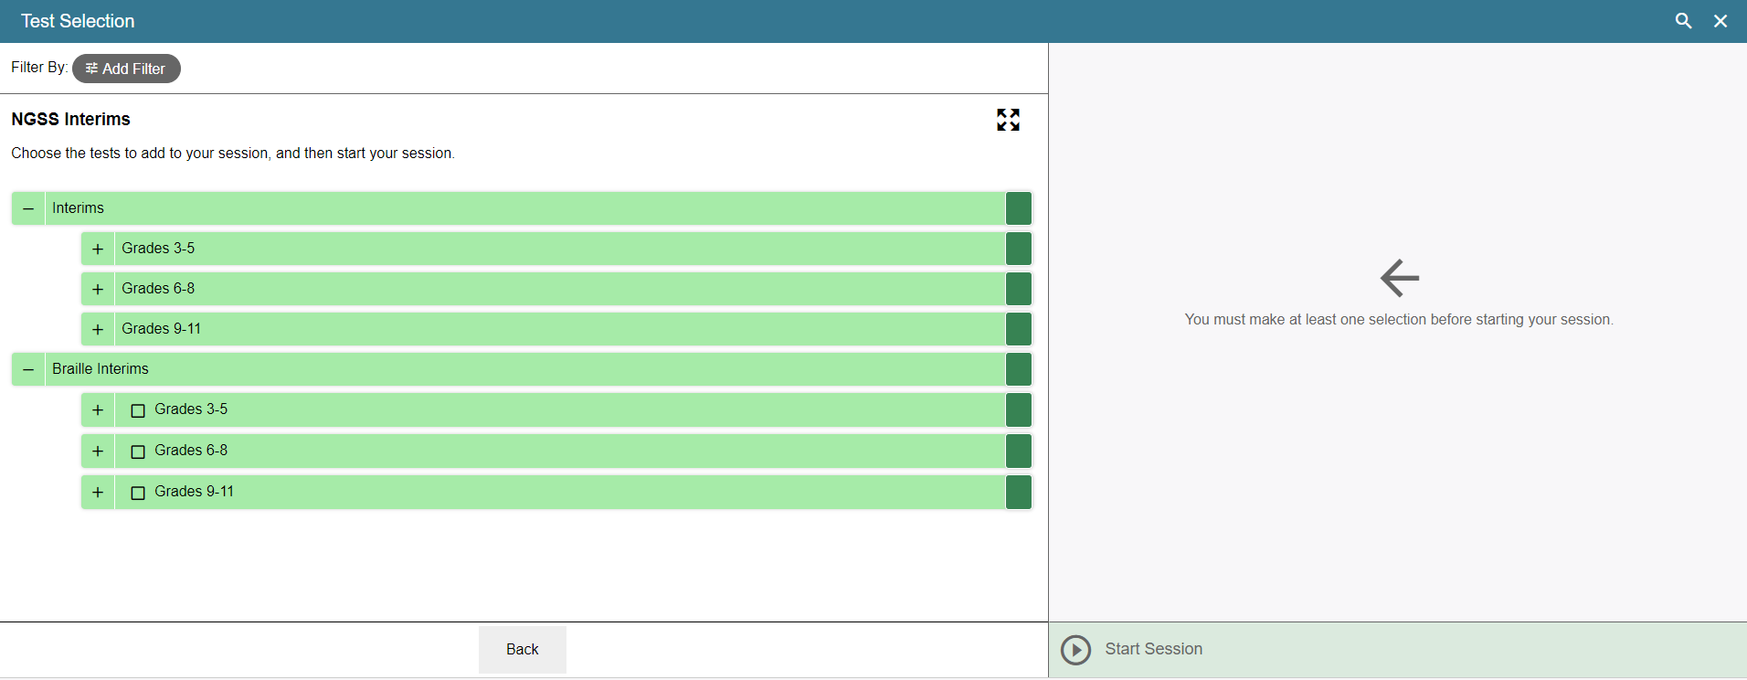
Starting a Test Session
Select a Test Family and click “Start Session”
For Summative Assessments
For Summative Assessments, there will be expandable check boxes. Test administrators will select either Session 1 or Session 2, depending on the testing schedule.
Example:
Notes:
We will walk through these steps in the browser window. Emphasize they shouldn’t log in on their own yet.
Note that these are interim assessments.

Slide 65
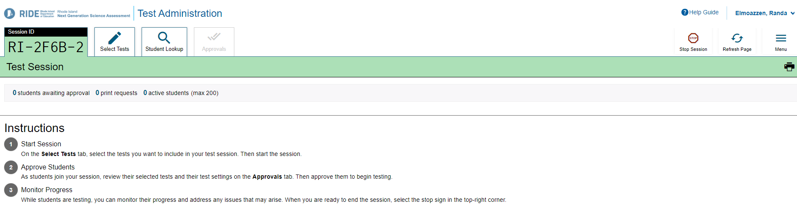
TA Screen and Session ID
Notes:
Once tests are selected, this is the TA user interface.

Slide 66
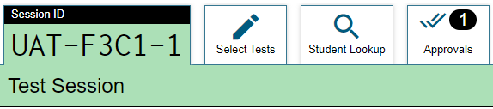
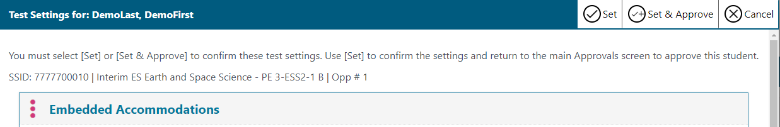
Approving Test Settings Screen
You will see a notification when students are waiting for approval to be admitted to the session.
Click the eye icon to view the test settings for a student. To confirm, click “Set” to admit the student into the session, then click “Set & Approve.”
Notes:
Discuss connection to having the correct test settings uploaded prior to testing. Accessibility features can be set in TDS, but not the accommodations.

Slide 67
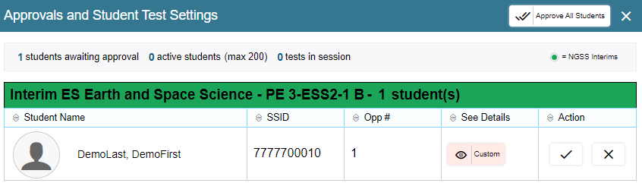
Approving Test Settings Screen
There are two ways to approve a student into a testing session:
  You can admit all students to the session by clicking the “Approve All Students” box at the top of the screen.
  The check mark will admit individual students without viewing their test settings.

Slide 68
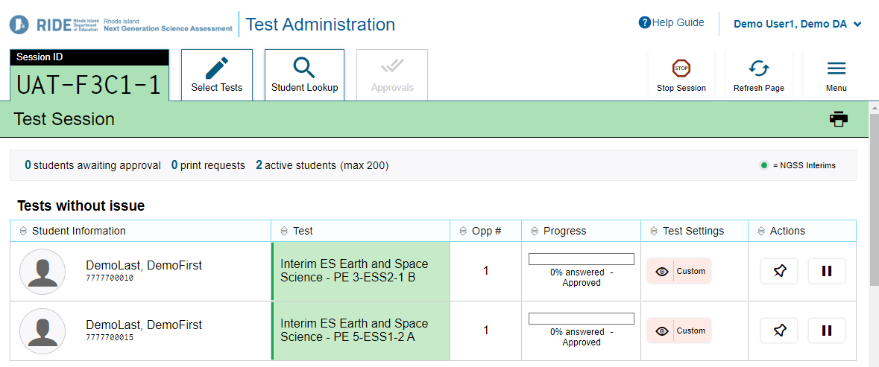
Monitoring Progress
It is important for Test Administrators to monitor student progress by using the progress bar in the Test Administrator Interface and by circulating through the testing room to ensure that students are working.
If a student’s progress bar stops, they may need assistance or a break.
Notes:
Highlight the progress bar, and emphasize that will increase as the student progresses through items on the test.
Point out the paused status and more info button, as well as how a TA can pause the test and view test settings.

Slide 69
Test Administrator Interface (TA Interface) Features
Feature | Description
Student Lookup button | Searches for student information. See Looking Up Students.
Approved Requests button | Displays a list of print requests you approved during the current session. See Viewing Approved Print Requests.
Print Session button | Prints your screen. See Printing Session Information.
Help Guide button | Displays the online version of this user guide.
Alerts button | Informs users that an alert is available with important information.
Log Out button | Logs you out of the TA Site. See Logging Out of the Test Administrator Interface.
Stop Session button* | Ends the test session. See Stopping a Test Session.
Session ID* | Displays the unique ID generated for the test session.
Select Tests button | Opens the Test Selection window. See Start a Test Session.
Approvals button* | Opens the Approvals and Student Test Settings window. See View and Approve Students to Enter Session.
Refresh button* | Updates the on-screen information.
Students in Your Test Session table** | Displays the testing progress for students in your test session. See Monitoring Students’ Progress.
*Feature appears after you start a test session. **Feature appears after you approve students for testing.
Notes:
This is helpful for reference, and includes everything you saw in the previous slide with a brief description.

Slide 70
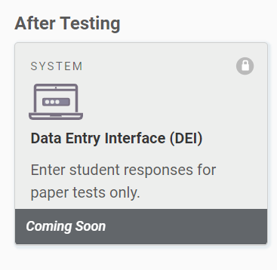
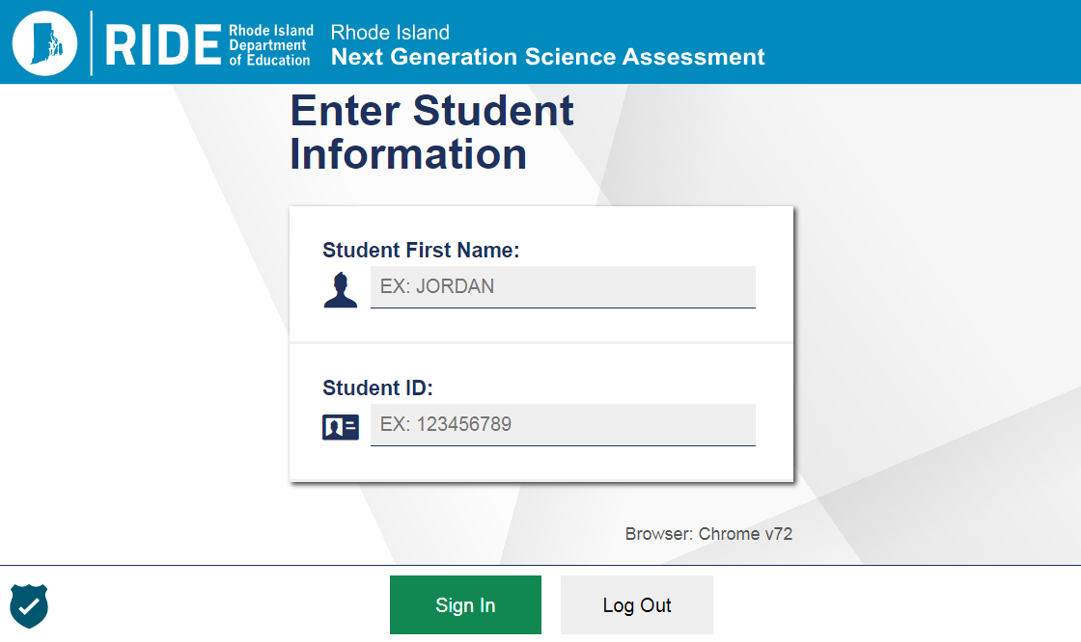
Entering Student Responses in the Data Entry Interface (DEI)
For students testing on paper, the test administrator (or test coordinator) must enter the student responses into the DEI after the test is completed.
Accessed through the RI NGSA Portal.
The DEI interface matches the student interface.
Reminder: Print-on-demand items (e.g., Spanish paper test) cannot be entered into the DEI.
  For Spanish paper tests, the student's responses should be entered into TDS exactly as indicated by the students.
Notes:
An after-testing process that is unique to NGSA is the entry of student responses from paper test booklets (not print-on-demand!) into the Data Entry Interface (DEI).
After testing and before the test booklets are mailed back to Cambium, the student’s responses will need to be entered into the DEI exactly as they appear in the test booklet.
If you had to order any emergency paper assessments, please contact the RI NGSA Help Desk for assistance in handling.

Slide 71
Activity - Start a Practice Test Session
Return to the RI NGSA Portal.
From the appropriate user page select the Practice Test card. You will not need to log in again.
If necessary, choose an Institution from the list.
When the TA screen appears, review the features menu functionality at the top of the screen.
Notes:
Now using the practice test, you are going to log into TDS. Notice the buttons, tools at the top. You can use the search function, refresh, and end session functions.
We will do a demo next.

Slide 72
BREAK and QUESTIONS
Notes:
10 minutes

Slide 73
TA Interface Demonstration
Notes:
CAI will lead a demonstration using an interim test session and demo student in UAT, showing both the student and TA interfaces.
District/School: Demo District 9999-9999 Demo School 9999-9991
Grade: 5
Demo ID: 7777700000
First: DemoFirst
Last: DemoLast

Slide 74
Resources and Support

Slide 75
Contact Information
NGSA Help Desk:
  Phone: 1.866.757.9437
  Email: rihelpdesk@cambiumassessment.com
  RI NGSA Portal: https://ri.portal.cambiumast.com
RIDE:
  General inquiries: assessment@ride.ri.gov
Team Member | Specialty | Email | Phone
Heather Heineke Assessment Specialist | NGSA policies, testing irregularities | Heather.Heineke@ride.ri.gov | 401-222-8493
Erin Escher Science Specialist | NGSA content | Erin.Escher@ride.ri.gov | 401-222-8168
Jackie Branco Assessment Specialist | Testing accommodations | Jacqueline.branco@ride.ri.gov | 401-222-4685
Phyllis Lynch Director, Office of Instruction, Assessment, and Curriculum | NGSA policies, testing irregularities | Phyllis.Lynch@ride.ri.gov | 401-222-4693
Notes:
This slide provides the contact information and helpful links for help desk and technology support, as well as who to contact at RIDE for policy, accommodations, and general test design questions about NGSA and the NGSS.

Slide 76
Who to Contact…
Questions about…. | Contact…
Student eligibility and which students are required to participate | RIDE
Testing irregularities and test security issues | RIDE
Poor connectivity during testing | Technology Coordinator
Accessing and using TIDE or TDS (TA or Student Interface) | NGSA Help Desk
Widespread technology issues | NGSA Help Desk
Policies related to appeals | RIDE
Submitting orders for paper testing materials | NGSA Help Desk
TDS Student Log-in Issues | NGSA Help Desk
Accommodations | RIDE
Notes:
Please reference the topics on this slide when deciding whether to contact the NGSA Help Desk, your district testing coordinator, or RIDE.
Please do not contact RIDE to troubleshoot technical issues (e.g., user or student login not working) – the RI NGSA Help Desk specializes in that area of support. That said, RIDE must be contacted for testing irregularities due to technology issues that impact testing, but the help desk should be able to help resolve the issues first.
Remember: when emailing anyone about an issue involving a student and their test, email is not secure. To protect student confidentiality when contacting RIDE or the RI NGSA Help Desk via email, only include the student’s SASID, along with grade level and school/district. Do not ever include screenshots where any student information (e.g., name, date of birth) other than the SASID is visible.

Slide 77
Thank you!
Notes:
Thank you! This now concludes our NGSA Test Coordinator Training for Spring 2022. Thank you for participating.

Slide 78
Q & A

