Slide 1
State Data Management System (SDMS)
Spring 2024
RIDE SAT and PSAT 10

Slide 2
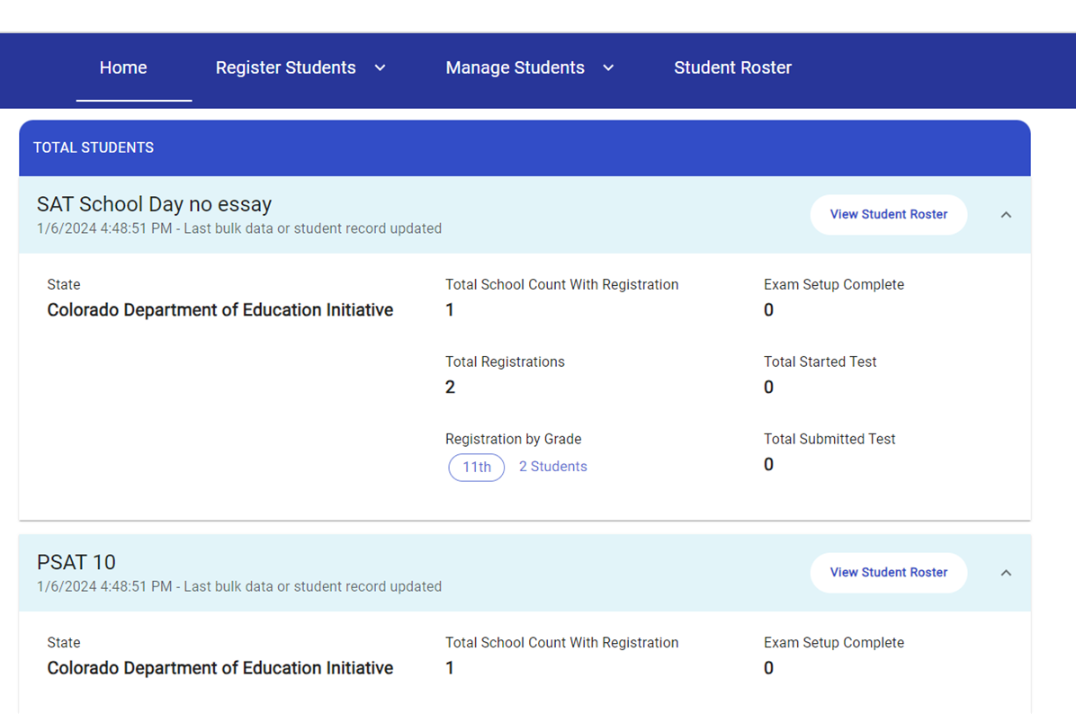
SDMS – What Is It?
State Data Management System (SDMS) is a new tool created by College Board to manage student registrations for state-proved SAT & PSAT 10 testing.
In spring 2024, student registration data will flow from RIDE’s Student Information System to College Board’s State Data Management System (SDMS) to College Board’s Test Day Toolkit (TDTK).
Unlike fall, College Board’s SAT Suite of Assessment Ordering and Registration (SSOR) system will not be used for spring accountability testing.
SAT
Rhode Island Department of Education
Rhode Island Depart of Education

Slide 3
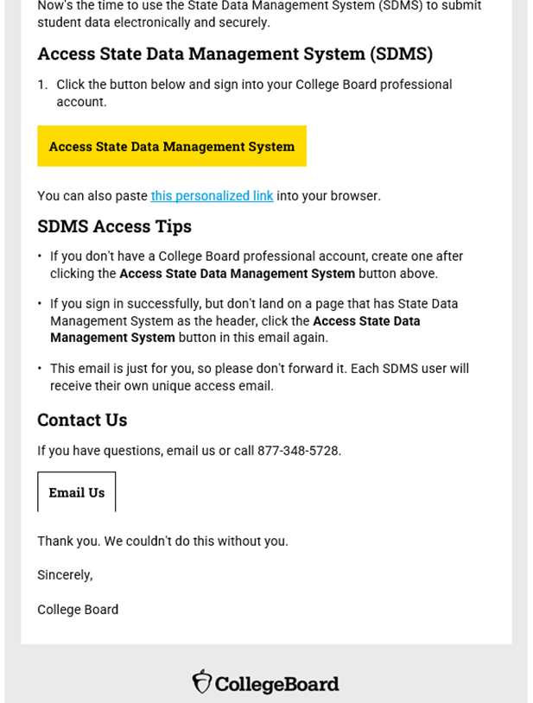
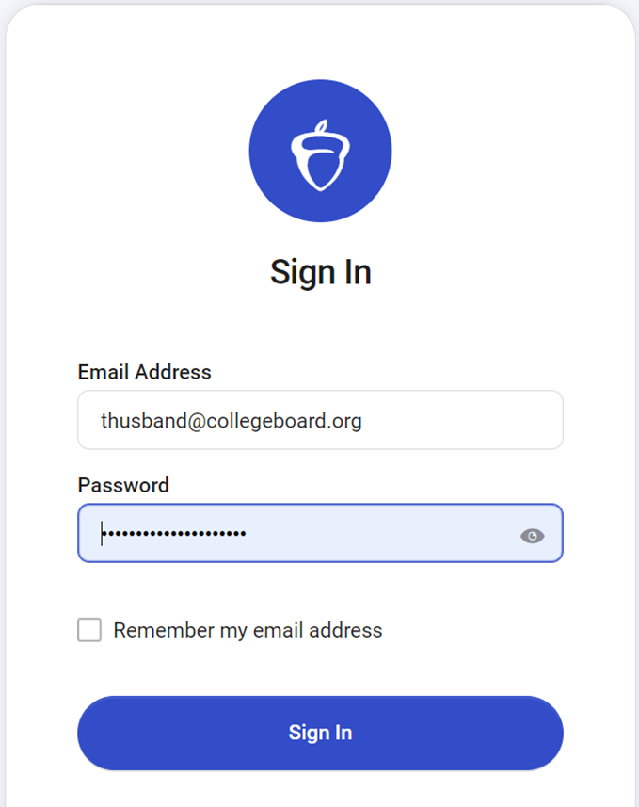
SDMS Email and Access
Student data will be visible in SDMS beginning late in the week of February 5.
District and school users will receive the email on Tuesday, February 6.
The invitation is unique to each user and is not forwardable.
Educators will log in using their College Board account.
If a user has changed, please complete the Update Your Coordinator Form.

Slide 4
SDMS Function
Student Data from RIDE SIS
Test Day Toolkit
Up to 48 hours
State Data Management System
Up to 48 hours
Student Accommodations Data from SSD Online
Up to 48 hours
Bluebook
Up to 48 hours
Data from SDMS integrates with accommodations data from SSD Online
Approved accommodations will appear in the student’s record in SDMS
Approved accommodations may be waived, entirely or in-part, in SDMS if a student chooses and their guardian consents
Student rosters from SDMS automatically populate Test Day Toolkit
Student data in SDMS determines the generation of a student’s test in Bluebook

Slide 5
SDMS Permissions and Communication
Role | District SDMS Coordinator | School Test Coordinator | Technology Coordinator | SSD Coordinator
View student registrations and associated accommodations
Transfer a student from one school to another within a district.
Edit student registrations
Waive all or partial accommodations
Force match accommodations
Backup Test Coordinators will have access to SDMS.
When waiving accommodations or force matching in SDMS, please allow at least four days for an updated test package to appear in Bluebook.

Slide 6
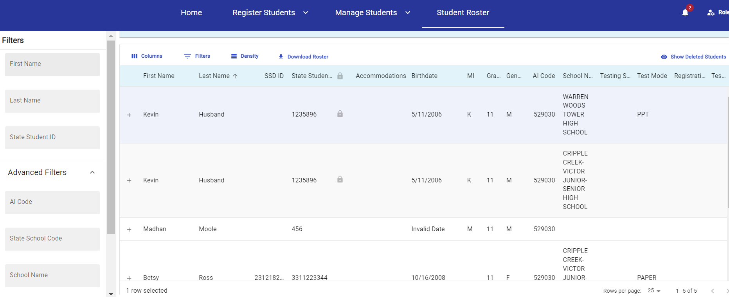
SDMS Dashboard
The Dashboard allows users to:
Filter and search by multiple fields
Download rosters
Waive accommodations
Force match accommodations

Slide 7
Manage Students: Waiving Accommodations
If a student is approved for accommodations in SSD Online but would like to waive some or all of them for their Spring 2024 test administration, SSD Coordinators, Test Coordinators, and District Coordinators are able to do this in SDMS.
Navigate to the student’s profile in SDMS.
Use the toggle switch next to each of the student’s accommodations listed under their “student details” to waive any that the student does not want to use.
We recommend that the school obtain the request to waive accommodations in writing from the student’s parent/guardian or the student (if 18 or older).
Accommodations must be waived at least four days prior to the student’s test to make sure the student’s test package is configured correctly for testing.

Slide 8
Manage Students – Force Match
If a student’s SDMS registration data does not exactly match their demographic data in SSD Online, a match will not occur and that student’s approved accommodations will not appear in SDMS, Test Day Toolkit, or their exam in Bluebook.
If you are certain the student in SDMS is the same student associated with a particular SSD ID in SSD Online, you may “force match” these students by entering the SSD ID from SSD Online in the SSD ID field on the Student Details page. This will generate the confirmation prompt.
Force matching should occur at least four days prior to the student’s test to make sure the student’s test package is configured correctly for testing.

