Slide 1
How might we reduce chronic absenteeism with behavioral science?
1. School Dashboard
2. Nudges to Families
3. State Leaderboard
Easy to read display of school level statistics
Comparison to last year
Charts absences over time
Reminders that raise awareness
Proven effective
Targets parental misunderstanding of absences
Introduces competition
School comparison to state mean and top 10% of schools
Sortable statewide listing of absence rates

Slide 2
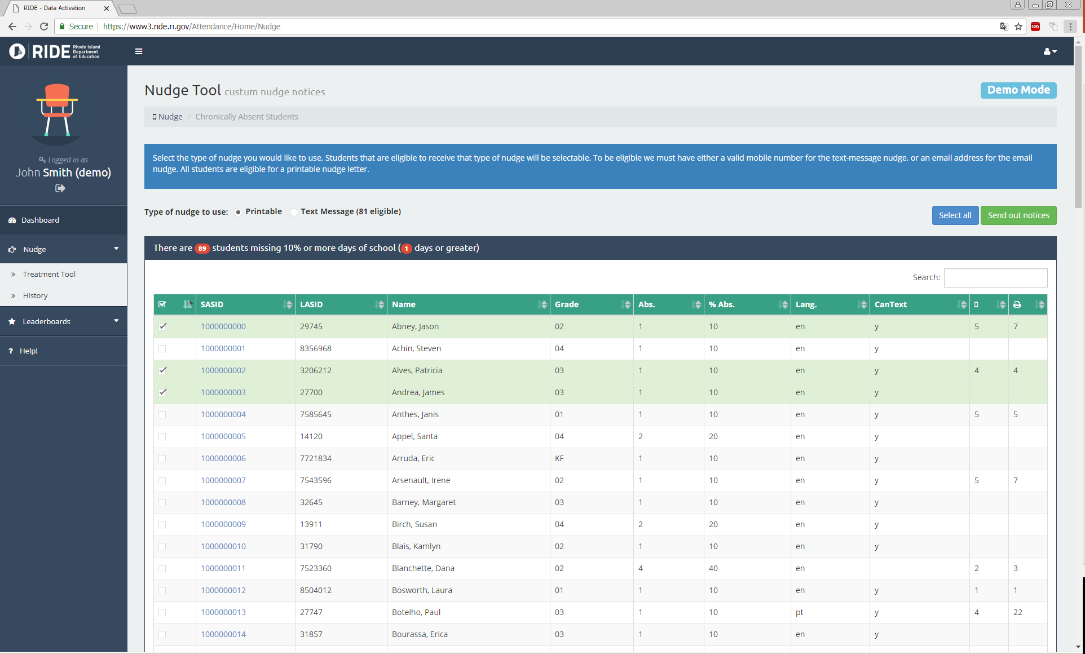
Real time student-level attendance

Slide 3
Nudge Text Message
Notes:
Each phase we will understand challenges and ways to improve:
Delivery
Paper
Text capacity
Parent reaction
Student reaction
LEA/Community reaction
Impact

Slide 4
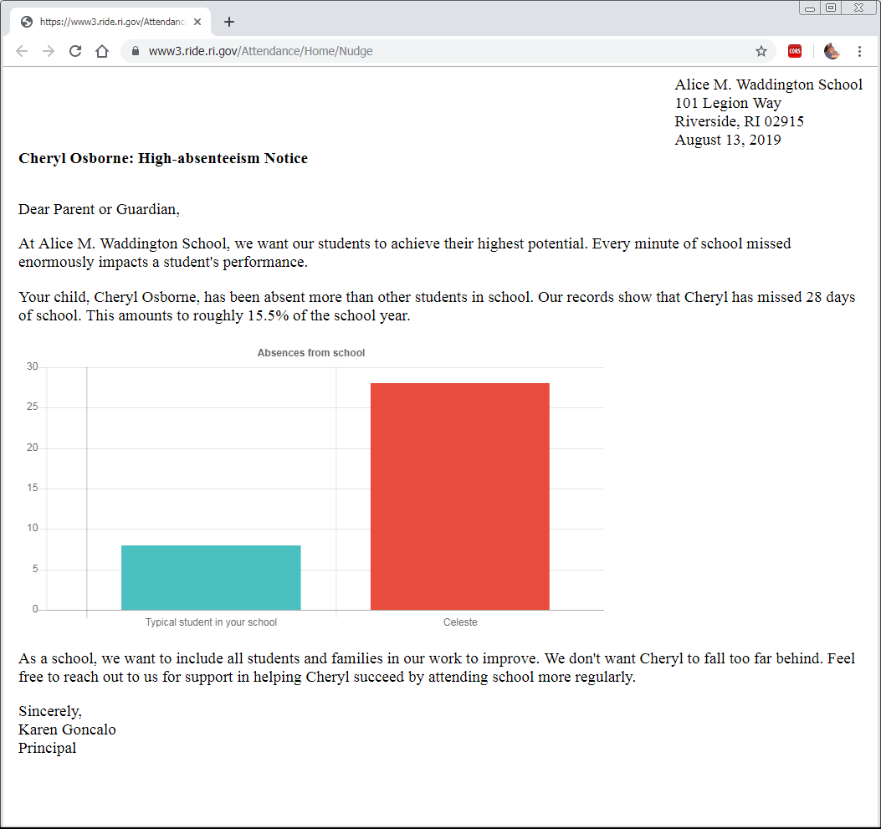
Backpack Letter

Slide 5
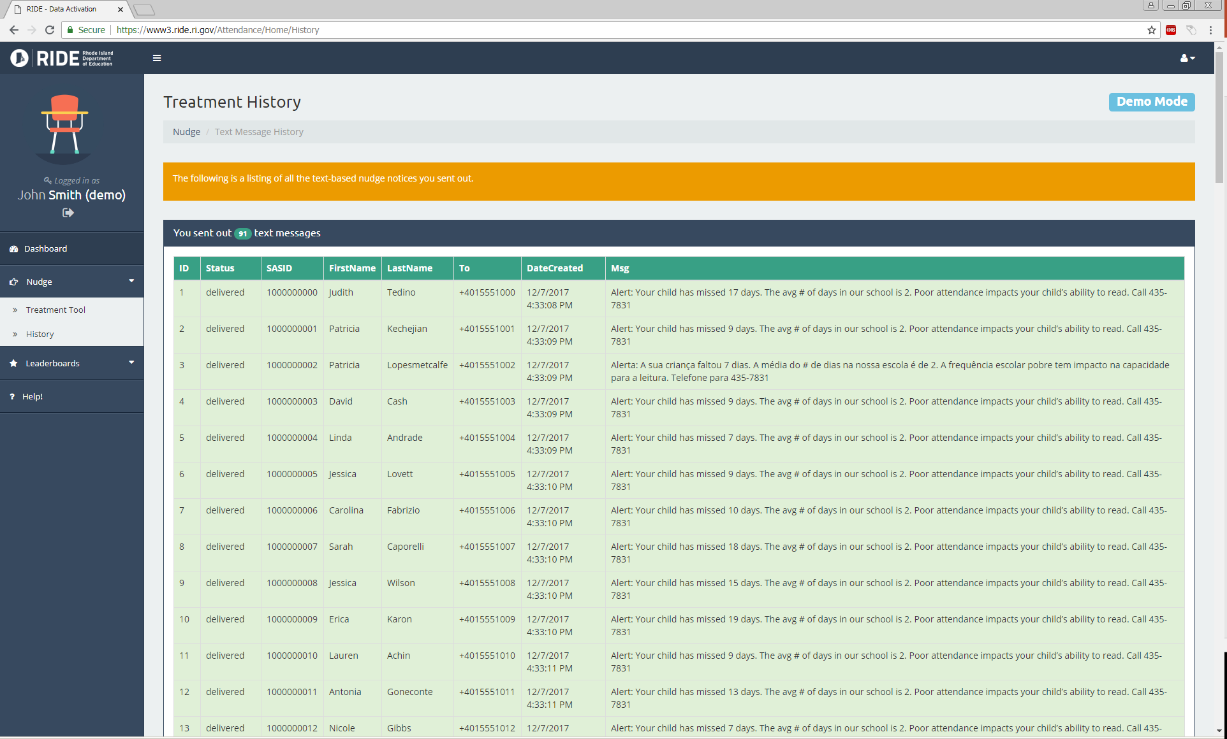
Parent Outreach History

Slide 6
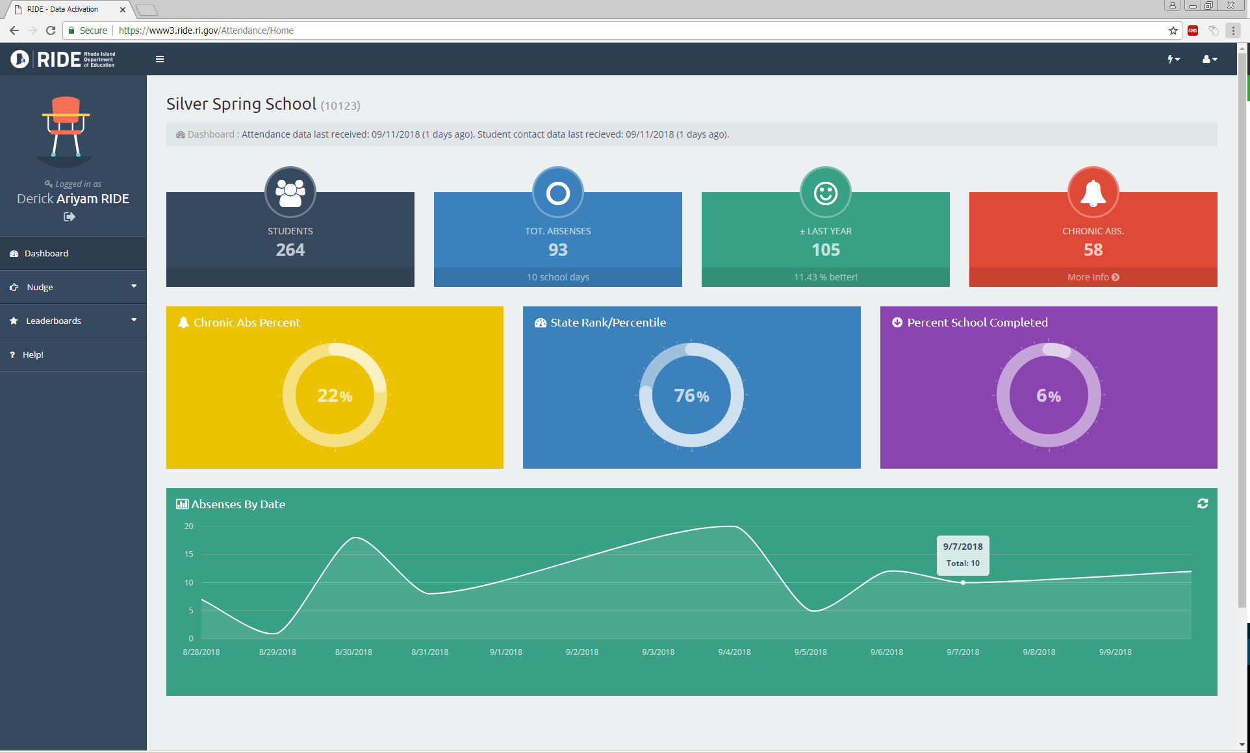
School Attendance Dashboard

