Slide 1
Module 1: Overview of Professional Practice
Asynchronous
Notes:
Welcome to the first of five training modules designed for new evaluators using the RI Model Evaluation and Support System. This first module is self-driven and aims to provide foundational knowledge around observing teachers, the most critical piece to an educator’s formal evaluation.
This module should take you approximately 2 hours, perhaps a less if you are already very familiar with the RI Model.
For reference and additional information, we encourage you to consult the Teacher Guidebook, Edition V, when needed, as it will be referenced throughout this module: https://www.ride.ri.gov/Portals/0/Uploads/Documents/Teacher_Guidebook_Ed_V_2019.pdf?ver=2019-09-10-163020-400.

Slide 2
Module 1: Intended Outcomes
By the end of this module, you will:
Understand how different types of bias can negatively impact an evaluator’s evidence gathering
Understand general features about the RI Model Evaluation and Support System
Demonstrate an understanding of the eight components of the Teacher Professional Practice Rubrics
Understand the importance of gathering evidence statements
Notes:
READ

Slide 3
Ice-Breaker: Reflecting on Educator Evaluation
Think about a time when you were evaluated. What made the process comfortable or uncomfortable? Why?
Notes:
As a warm-up, this is an opportunity for you to think about some challenging evaluation experiences and how they could have been prevented or remedied by different approaches. For example, we often hear that teachers get upset that they receive their scores and feedback from their evaluator too long after the observation. Perhaps if there were clear guidelines about the turnaround time, teachers would feel more valued and feedback would be more meaningful and actionable.
Throughout these training modules, we will push you to think about how, as an evaluator, you can leverage evaluation as a positive experience for educators, one that supports opportunity and growth.
Please complete the section for “Slide 3” on the Module 1 handout.

Slide 4
Your Role as Instructional Leaders
Dedicate time and effort to develop, support, and grow your educators
Give priority feedback
Focus on educator growth
Collect and analyze data from practice
Positively affect student outcomes
Notes:
It’s important to consider how becoming an evaluator is only one aspect of being an instructional leader. Our identity is developed through our collective experiences, thus the way we have experienced being evaluated may shape how we approach evaluating others. As an instructional leader, evaluation is a tool that you will use toward professional growth and improvement. It is only one piece of your larger responsibilities, which include positively affecting student outcomes. While this training will be geared towards educator evaluation, the skills you learn here will be applicable to other aspects of your practice as an instructional leader—conducting classroom walkthroughs, facilitating focused instructional conversations with teachers, coaching and inducting both seasoned new faculty.

Slide 5
Training Overview
On-going support and feedback provided via co-observations, office hours, and help tickets
BOY
Module 1: Professional Practice (Asynchronous)
MOY
Module 6: Mid-Webinar (Asynchronous)
Module 2: Observation and Calibration (Synchronous)
Module 3: Professional Responsibilities (Asynchronous)
Module 4: Student Learning (Asynchronous)
Module 5: Student Learning Flexibilities (Synchronous)
EOY
Module 7: Spring Training for New Evaluators (Asynchronous)
Scoring SLOs/SOOs
Scoring PRs
Scoring PP
EOY Conferences
Understanding and scoring FERs
Conducting mid-year conferences
Revising SLOs/SOOs
Assigning formative scores
Reviewing data
Assessing implementation progress
Handling difficult situations
Notes:
We’ve revised our training approach this year. To address our own capacity concerns, as well as the need for increased health and safety precautions given our new reality, we’ve determined that it is a good time to restructure our trainings to include both synchronous and asynchronous modules. While in-person trainings are always encouraged because we can control for messaging and intent, and larger numbers are ideal for calibration activities, we recognize the need to provide a more flexible approach that prioritizes the safety of our participants.
Not listed on this slide, but nevertheless important, is our posted Support Professional (SP) training. The SP training is entirely team-driven and designed for LEA teams to go through together. New evaluators who will be evaluating SPs should connect with their district administration to determine how to best engage with the SP training for new evaluators. You can access the LEA training materials for the Support Professional evaluation type here: https://www.ride.ri.gov/TeachersAdministrators/EducatorEvaluation/RIModelEvaluationResources.aspx#4114291-lea-sp-training-resources

Slide 6
New BA Differentiation Option
Designed to differentiate the process between varying BA experience levels through…
Flexible multi-year activities spanning 2-3 years
Informal and Formal evaluation years
Intentional goal-setting and evidence collection
The option of using one Student Outcome Objective (SOO) in place of a second SLO
Notes:
While this training only focuses on evaluating teachers, we’d be remiss if we didn’t make you aware of the new BA differentiated option now available for your own evaluation. In response to feedback in recent years from building administrators (BAs) and superintendents, representatives from RISSA and RIASP partnered with members of the RIDE team to devise a new model for BA evaluations through flexible multi-year activities which aim to differentiate the process between varying BA experience levels – while still honoring the annual evaluation requirement. The work of this group was well received by each representative constituency throughout the 2018-19 engagement sessions.
Starting in the 2019-20 school year, the new differentiated model for experienced BAs (i.e., those who have completed two years in the same district) have provided LEAs with flexibilities to tailor local evaluation processes across two- or three-year evaluation activities. This cycle of “informal” and “formal” evaluation years supports goal setting and evidence collection over multiple years, as well as opportunities for evaluators of BAs to engage in authentic dialogue and locally-developed activities highlighting daily work. Learn more about the multi-year model through this helpful chart.
Also beginning in 2019-20, all BAs have the option of using one student outcome objective (SOO) in place of a second student learning objective (SLO). The SOO can be used to highlight the school-level systems, structures, or programs impacted through the leadership work of BAs each year. RIDE intends to learn from BAs employing this new SOO option and showcase examples from their experiences as exemplars in the near future.
While the changes to the BA model present new flexibilities, the professional practice and professional responsibilities rubrics undergirding the evaluation process remain unchanged. Visit our website for the latest edition of the BA Guidebook, Edition IV.
We encourage you to further discuss your own Building Administrator evaluation with your evaluator.

Slide 7
Frontline’s Employee Evaluation Management (EEM) System
Know that regulations require annual evaluation data to be reported to RIDE. Frontline is your system of record to manage this data for reporting.
Determine if your district is one of the 55 RI LEAs that uses Frontline’s EEM System to manage educator evaluations.
Understand that Frontline provides support (pgsupport@frontlineed.com) and asynchronous training modules for the EEM system.
Review all evaluator training modules on RIDE’s evaluation webpage.
Familiarize yourself with all EEM forms for teachers, support professionals and building administrators (where applicable).
Plan how you will complete each part of the evaluation, using the correct forms, and on your local evaluation timelines.
Notes:
The following RI Model LEAs do NOT use the Frontline system for evaluation management and so this section will not be relevant for those who work/will be working in one of the following districts:
Burrillville
Foster
International Charter
MET Career and Tech
Middletown
RINI
Scituate
TAPA
RIDE’s EEM Training Modules for evaluators can be found here: https://www.ride.ri.gov/TeachersAdministrators/EducatorEvaluation.aspx#4116253-eem-training-modules (also linked above).

Slide 8
Minimizing Bias in Teacher Observations

Slide 9
Objectives
By the end of this brief module, you should:
Be able to define bias
Understand different sources of bias
Know multiple strategies for reducing bias
Understand some of your potential triggers
Craft evidence statements
The content of this module has been modified with permission from the Center on Great Teachers and Leaders.
Notes:
This section will define bias, discuss different potential sources of bias, and share some potential strategies for reducing bias. You will also have an opportunity to reflect on your potential triggers of bias. This module is intended for evaluators but also may be helpful for coaches, administrators, and anyone else providing coaching, conducting classroom walkthroughs, or conducting observations.

Slide 10
The Importance of Minimizing Bias
Bias in this context refers to factors unrelated to teaching practice that can influence an observer’s collection and rating of evidence.
Everyone has biases, but these biases must be minimized during evidence collection.
Ensure you gather objective evidence by only recording what you see and hear.
GATHER evidence during observation
Notes:
A grounding tenet of the RI Model is that the implementation of a fair, accurate, and meaningful system will help improve teaching and learning.
As an evaluator, it is critical that you acknowledge and try to minimize bias. Bias in this context refers to factors unrelated to teaching practice that can influence an observer’s collection and rating of evidence. It’s important to pay attention to bias in observation not only within the context of educator evaluation but also during walkthroughs, coaching, and other informal opportunities.
In the next slide, we will share some different sources of bias.

Slide 11
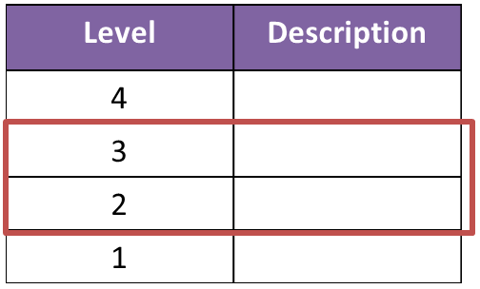
Central Tendency Bias
Definition An evaluator rates practice using points on the middle of the scale and avoids extremely high or low ratings | Sounds Like “I don’t want to create conflict.” “No one is perfect.” “I don’t give ones.”
Looks Like | Strategies Compare observation evidence with the descriptions. Check your own personal opinions about the rubric or how it should be used. Remember that using the tool with fidelity ultimately benefits teachers, who want honest feedback. Calibrate colleagues.
Notes:
Central tendency bias is present when an evaluator rates the observation using points on the middle of the scale and avoids extremely high or low ratings. There may be many reasons why an evaluator intentionally or unintentionally does this. For example, some evaluators may want to avoid potential conflict among teachers. Others might hold personal beliefs about whether a 4 is attainable or whether a 1 is too low. However, it’s important to make sure the level descriptor for a rating reflects what you observed. Otherwise, educators may distrust the system or feel disheartened.
When I was in college, I had a professor who said perfection is reserved only for God, so, even if you answered every question on a test correctly, you could not earn higher than an A-. As you might imagine, this was infuriating to some students who really deserved an A. In an evaluation context, sometimes we hear that evaluators believe a new teacher should never get a 4 because they are new to the field. However, it can be extremely frustrating if teachers feel that they are not receiving accurate ratings.
To check yourself, compare your evidence with the level descriptions in the rubric. Try to keep your personal opinions about the rubric or the evaluation process separate from scoring evaluations. Remember that using the tool with fidelity ultimately benefits teachers. Give honest ratings and feedback. If performance is significantly below expectations, explain why. If the performance is stellar, recognize that performance and explain how performance exceeds expectations.
In addition, calibration with colleagues is extremely important. Conducting co-observations or watching a video of practice with a colleague can help you check and see if you tend to stick in the middle when you rate educators.

Slide 12
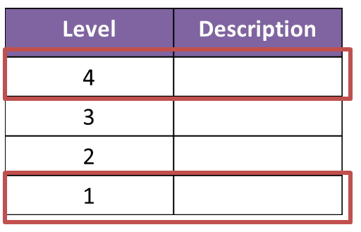
Severity or Leniency
Definition A rater gives mostly high or low ratings to an educator in a manner inconsistent with the observation data collected. | Sounds Like “I want to give teachers the benefit of the doubt.” “I have extremely high expectations for my teachers.”
Looks Like | Strategies Compare observation evidence with the descriptions. Check your own personal opinions about the rubric or how it should be used. Remember that using the tool with fidelity ultimately benefits teachers, who want honest feedback. Calibrate with colleagues.
Notes:
The opposite of central tendency bias is severity or leniency in ratings. This occurs when a rater gives mostly high or low ratings to an educator in a manner inconsistent with the observation data collected. Sometimes we hear evaluators acknowledge that they want to give teachers the benefit of the doubt and maybe rate teachers higher than they should. Remember, the success of evaluation depends on fair, accurate, and meaningful ratings of practice. If you feel like you are being overly-lenient or overly-harsh, conduct a co-observation with one or more colleagues to check yourself.

Slide 13
Contrast Effect
Definition When an evaluator directly compares the performance of one educator to that of another educator | Sounds Like “Her classroom management is not as strong as Mrs. A’s.” “This lesson is so much better than the last one I observed!”
Looks Like | Strategies When scheduling observations, build in time to rate the teacher directly after the observation to avoid potential comparisons. When possible, spread out observations so you are not observing classrooms back to back.
Notes:
Another source of bias is called contrast effect. This occurs when an evaluator directly compares the performance of one educator to that of another educator. For example, picture a principal in the back of room observing a class while also thinking about what he saw in another teacher’s classroom a little while ago. Sometimes, it can be hard to make comparisons, such as “This teacher’s classroom management is not as strong as Mrs. A’s management.”
There are two strategies you can use to help minimize the contrast effect. One, build in time to rate the teacher directly after the observation. This not only helps ensure that you get information back to the teacher in a timely information but also limits potential comparisons. Another strategy is to spread out your observations rather than going directly from one observation to another. For example, you might schedule one observation early in the morning, plan on typing up your notes and evidence statements from the first observation later that morning, and then schedule another observation in the afternoon. This way there is space between your two observations.

Slide 14
One or Two Incident Focus
Definition When ratings are based only on an event or piece of evidence that typically includes either very strong or very weak examples of practice, which results in an artificially high or low rating | Sounds Like “I can’t believe she ripped up that child’s paper in front of the class!” “But that activity was just so excellent.”
Looks Like | Strategies If needed, address the specific event first outside of the evaluation process. When scoring the observations, rely on your notes. Take into account the full range of performance. Remember that components are separately scored and your ratings on one component should not influence your other ratings.
Notes:
We have all had those traumatic experiences where something went terribly wrong during an observation. As challenging as it may be to do so, evaluators must try to not let one event influence the evidence they gather. For example, once during an ELA lesson, a teacher saw that a student was not following her directions to skip lines during the drafting phase and then proceeded to yell at the student and rip up the student’s work in front of the entire class. As you can imagine, I was stunned.
When I left the classroom, I thought “What a terrible teacher!” However, I had to step back and think about what else I had observed during that lesson—transitions, delivery of content, student-driven discussions of student work, etc. Although this teacher definitely deserved lower ratings in some components based on what I had observed, there were other aspects of this teacher’s practice that were strong.
There are a couple of strategies you can use to reduce the likelihood that you let one or two incidents influence your ratings. In the example I shared above, I first had to address the specific event separate from the process. We discussed the incident immediately after the school day and the teacher apologized to both the student and the student’s parents. If something is egregious or exceptional, you should address it then. However, once back in your office, rely on your notes. Take into account the full range of performance. Remember that components are scored separately. Review the level descriptor for each component and focus just on what is included in that component—not anything else that you might have observed.

Slide 15
Halo Error
Definition When an evaluator allows an overall impression of an educator to influence ratings of an educator’s practice | Sounds Like “That wasn’t the best lesson, but he’s such a good teacher!”
Looks Like | Strategies Focus on gathering evidence of what you see and hear within the individual lesson.
Notes:
As an evaluator, you might have certain overall impressions of an educator based on what you hear from others or what your first impressions are. If these impressions are allowed to influence your judgment, that might result in a halo error. For example, an evaluator might know that the educator is very proficient in using technology in the classroom, and they allow that to influence their other ratings. Like in the other scenarios described, it’s important to focus just on what you see and hear within the individual lesson you are observing.

Slide 16
Potential Error
Definition When an evaluator gives higher or lower ratings to an educator than is warranted by the observation evidence because he or she believes the educator has/does not have the potential to be an excellent educator | Sounds Like “Her performance was mediocre, but she has such great potential. I don’t want to discourage her.” “His performance wasn’t terrible, but I don’t see it going anywhere.”
Looks Like | Strategies Focus just on the evidence you gathered—what you heard and saw. Remember that other aspects of the evaluation, such as Professional Responsibilities, provide you an opportunity to address whether or not the educators seeks to improve and contributes to the community.
Notes:
Another source of bias is potential error. This occurs when an evaluator gives higher or lower ratings to an educator because she or he believes the educator has or does not have the potential to be an excellent educator. For example, picture a first year educator who still has some areas of practice to work on. If you don’t want to discourage the teacher, it can be tempting to give her higher ratings than what she deserves because you have confidence that she will grow over time. Remember, however, that if you do not provide objective evidence and honest feedback, this educator may not know where or how to improve. Focus on the evidence you gathered.
In addition, if you find yourself wanting to give higher or lower ratings based on the perceived potential of the educator, remember that there are other places in the evaluation system that assess other dispositions and skills of educators. For example, if your first-year teacher is actively seeking professional growth opportunities, this should be acknowledged in the Professional Growth domain of Professional Responsibilities.

Slide 17
Recency Bias
Definition When an evaluator weights events that occur near the end of an observation more heavily than those that occurred earlier in the lesson | Sounds Like “The end of her lesson was very strong.”
Looks Like | Strategies Take notes throughout the lesson! Include evidence statements from the beginning, middle, and end of the lesson in your write-up.
Beginning of Lesson
End of Lesson
Notes:
It’s natural to remember more of the end of the lesson than the beginning of the lesson—it’s how our memories work. However, this can be a potential source of bias. Therefore, do your best to take notes throughout the lesson so that, later one, you have something to jog your memory. In addition, when writing evidence statements, try to select examples from the beginning, middle, and end of the lesson so that observation statements are balanced.

Slide 18
Similar-to-Me Bias
Definition When an evaluator gives higher ratings to educators who are similar to themselves and lower ratings to educators who are dissimilar | Sounds Like “He reminds me of when I was just starting out as a teacher.” “Her teaching style is so different than mine.”
Looks Like | Strategies Avoid allowing personal preferences, feelings, or perceptions about the educator to influence the evidence you collect or the ratings you assign. If you think you cannot be objective about this individual, see if the someone else can evaluate this educator.
Notes:
The final source of bias we will discuss is similar-to-me bias. This occurs when an evaluator gives higher ratings to educators who are similar to themselves and lower ratings to educators who are dissimilar. This could be based on teaching experience, content area, race, cultural background, or even teaching style. For example, you might be evaluating a new educator who reminds you of your first experience teaching, or maybe you are evaluating someone who started in the district the same year as you so you feel a bond with that individual. These situations can be challenging. In most cases, you should be able to avoid similar-to-me bias by leaving your preferences, feelings, or perceptions at the door and focusing on what you see and hear. However, there may be situations where you strongly feel you cannot be objective. For example, maybe an educator is your neighbor or you are close friends with the teacher. In that case, you might want to assign that person to someone else’s caseload, bring in another colleague to co-observe with you, or work with your supervisor to find a different solution.

Slide 19
Common Triggers
Triggers are something outside of rubric observation criteria (e.g. a teacher chewing gum) that impacts how you assess the teacher’s practice.
Common triggers:
Familiarity with the teacher
Teacher’s attire or appearance
Accents
Classroom organization/appearance
Particular teaching styles
Notes:
We all have things that get under our skin—teachers chewing gum, classrooms that are messy. We need to be aware of our triggers so that, when we see them, we make sure we do what we can to minimize potential bias and focus just on what we see and hear.
A few common triggers are listed here.

Slide 20
Reflecting on Your Role as Observer: What Are Your Triggers?
What are the triggers that you might observe that may cause you to add bias, inference, or judgment?
Are there instructional styles that you prefer?
Are there instructional approaches that you disagree with?
Are there characteristics about the educator that will lead you either have positive or negative feelings without even looking at the evidence?
Notes:
Review the questions on this slide. Take a minute to think about what some of your triggers might be. What are some of the things that might color the way you view a lesson?
Please complete the section for “Slide 20” on the Module 1 handout.

Slide 21
A Preview of Writing Evidence Statements
Sample Evidence Statement: The teacher challenges students to justify their thinking and engages most students in the discussion. For example, she asks, “Why do they need a hat for Africa?” At another point, she says: “What do you need to dress in the mountains? Tell me more about this.”
Evidence statements should include…
What you saw
What you heard
Clear examples, often with numbers (e.g. “The transition took 90 seconds) or quotes (e.g. “The teacher said, ‘I’m so proud of you!’”)
Evidence statements should NOT include:
Bias
Opinions/judgments
Inferences
Feedback
Notes:
We have spoken at length about making sure you capture what you see and hear. During an observation, you will take notes and then will turn these into evidence statements, which shares pieces of evidence that support the rating for a component. These examples should be as neutral and illustrative as possible. Many times, it is helpful to include numbers. For example, you might note that when a teacher asked for a volunteer, 23 of 24 students raised their hands. You might keep an eye on a clock during a transition and estimate how long it took. It is also helpful to include quotes of what students and teachers said. Your notes should NOT be a running record of everything said, but you might in your objective statement highlight a key question the teacher or students asked.
It’s important to keep objective statements as objective as possible. As such, objective statements should not include opinions, judgments or feedback. Feedback will be recorded elsewhere.

Slide 22
Closure
What are two possible sources of bias that you will try to avoid?
What are two strategies that you will try to use to make sure your observations are as objective as possible?
Notes:
Please take a moment to consider the following two questions: [read questions]. We hope that this module has helped you understand what bias is, helped you identify some personal triggers, and think about ways you can minimize bias.
Please complete the section for “Slide 22” on the Module 1 handout.

Slide 23
Mini-Observation
Watch the video clip of a sixth-grade math lesson. While you view this lesson, actively consider how you would gather evidence of professional practice.
Notes:
Where might personal bias influence your observations? Practice gathering objective evidence through which to evaluate this teacher according to the professional practice rubrics for teachers. You can practice writing anecdotal notes while viewing the clip and going back to your notes to reflect and make improvements. We will spend more time in the next part of this module about gathering evidence.
Please take your notes in the section for “Slide 23” on the Module 1 handout.

Slide 24
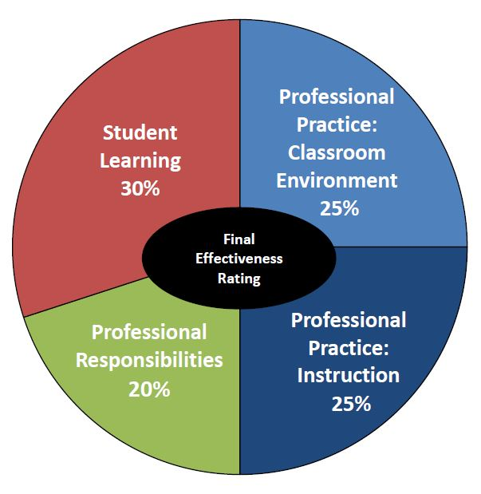
Professional Practice:
The Big Picture
Notes:
Likely, you are familiar with professional practice because you were probably evaluated in some way, shape, or form with observations being a big part. The last section focused on the types of biases that can influence the way in which we collect data, how we use that data to write feedback, and what is expected from each of the rubrics within the BA, SP, and Teacher models. Now, we are going to go deeper into the teachers’ evaluation model.
It’s important to note this pie chart that represents the overall components of the RI Model scoring. We will talk more about the scoring process during the Spring Training for New Evaluators, but it may help to ground you in the model by understanding where we are situated within the model as we move forward. Here, when we refer to professional practice, we are speaking to 50% of the overall process, which is captured through observations of teachers in practice. This includes both the Classroom Environment, which we call Domain 2, and Instruction, which is Domain 3. More on that later. For now, this image will follow us throughout the presentation to ground us in the portion of the RI Model at the bottom right corner of our screen.

Slide 25
Observing Professional Practice
Flexibility Factors
Requirements:
Conduct at least three observations
one announced (at least a week in advance) and two unannounced
Observations should be at least 20 minutes in length.
Scores, rationale statements, and written feedback after each observation and provided as soon after the observation as possible.
Conduct at least three conferences (Typically BOY, MOY, and EOY). RI Model does not require pre-/post-observation conferences.
Teachers who are non-summative, or on “cyclical” (pp. 4-5 in Teacher Guidebook) are required to have an annual conference at minimum.
LEA decisions:
Additional observations
Pre-post conferences
Narrower windows for observations
Notes:
During a full evaluation year, evaluators must complete at least three observations (one announced at least a week in advance and two unannounced.) An announced observation does not necessarily mean that you say, “I will be there at 10 pm on Tuesday.” Some districts adopt RIDE’s guidance, which is that you let the teacher know which week will you will observe him or her. Others might say “I will be in to see a math lesson.” Check with your district to see what guidelines they provide about what kind of detail you should give related to an announced observation. Observations should be at least 20 minutes in length. Within 20 minutes you should be able to see all components in action. However, some districts prefer that you stay for the whole period or lesson. Check with your district. While pre- and post- conferences are not required in the Rhode Island Model, you are required to have at least three conversations with educators in a full evaluation cycle—a BOY, MOY, and EOY. Some districts require that these conferences be post-observation conferences and some districts require pre-conferences as well. Check with your local district. Throughout your guidebooks you’ll see these blue boxes that we call “Flexibility Factors” that have already been decided within each of your LEA’s, so check with your central offices for more details.

Slide 26
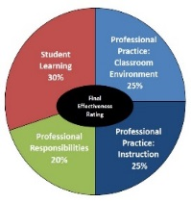
Professional Practice: Overview
Teacher Professional Practice Rubric Components
Professional Practice: Classroom Environment Domain 2 |  | Professional Practice: Instruction Domain 3
2a: | Creating an Environment of Respect and Rapport | 3a: | Communicating with Students
2b: | Establishing a Culture for Learning | 3b: | Using Questioning/Prompts and Discussion Techniques
2c: | Managing Classroom Procedures | 3c: | Engaging Students in Learning
2d: | Managing Student Behavior | 3d: | Using Assessment in Instruction
Evidence is gathered through observations.
Notes:
Open to page 43 in your Teachers’ Guidebooks. Here, you’ll see the overview page of the Professional Practice Rubric Components in two domains: Classroom Environment (Domain 2), which accounts for 25% of the teachers’ final effectiveness rating at the end of the evaluation cycle, and Instruction (Domain 3). Each domain contains four components that will provide the focus areas for our work in observing teachers’ practices. As we mentioned on the last slide, there are three observations throughout the evaluation year and each evaluation requires you as the evaluator to capture all eight components that you see here within the observation period. This is why we say there is a 20-minute minimum, because it will be difficult at times to see everything, particularly as you become accustomed to the process of recording evidence in action. In my practice as an evaluator, I found it helpful to synthesize each of the components into one-word headings, so that as I’m observing, I’m already thinking about the eight areas: (Environment, Culture, Procedures, Behavior, & Communication, Questioning, Engagement, Assessment). After each observation, you’ll need to have evidence for each component so that you can align it to level descriptors and assign a score. This is how at the end of the year you’ll account for this 50% of the teacher’s evaluation score.

Slide 27
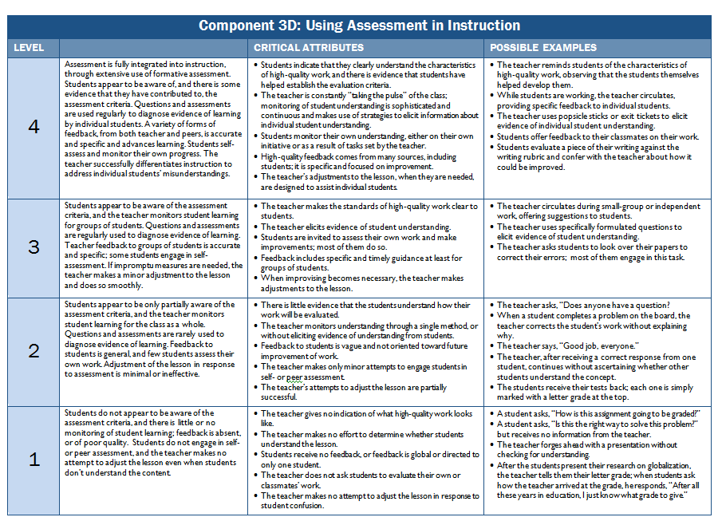
Notes:
Turn to page 44 (next page). Here you can see how each component has an overview with elements and indicators. Below that you’ll find the rubric on page 45, and we’re going to focus here on the level descriptors. This is where you will always provide your score. Your guardrails are the critical attributes and possible examples, but will not be a determinant in the score, which should be based on the preponderance of evidence you collect during each observation. You will need to find evidence for each of the eight components, and then assign a score. Today, we will also discuss how to write a rationale and provide specific, actionable, and timely feedback after each observation, ultimately leading to the educator’s growth in practice.

Slide 28
Activity: Component Values & Examples
Review each of the 8 Professional Practice components, noting:
What is valued in this component as explained in the descriptors?
What are some new examples and non-examples of what this would could like during an observation?
Use this table to record your findings:
Component | What is valued? | What could this look like? (Positive) | What could this look like? (Negative)
2a
2b
2c
2d
3a
3b
3c
3d
Notes:
Now is an opportunity to engage more deeply with the 8 professional practice components. At this point, you should have your Guidebook opened to Page 39, the beginning of the rubrics. You will begin to understand the values of each component, and in doing so, try to provide new examples (positive ones), and non-examples (negative ones), of what you might see in teachers’ practice.
Please complete the section for “Slide 28” on Handout #1.
Depending on your familiarly with the RI Model, this activity may take you between 60-90 minutes. Please understand that a strong foundational knowledge of these 8 components is critical to conducting strong, evidenced-based observations.

Slide 29
Observing Professional Practice
Each observation requires that you:
Gather Evidence
Write Rationales
Provide Feedback
Notes:
These are the three steps we will work through during this module. Now that we’ve acquainted ourselves with the rubrics, we will discuss the ways through which we record evidence during observations, and without biases. Later, you will use all of these steps after observing a teacher in action, either in person or through video.

Slide 30
Types of Evidence
Reflect:
1. What is your note taking style?
Script word for word
Bullet specific evidence as observed
Align evidence to specific components as it is recorded
2. What format is most efficient for you?
Writing
Typing
Words spoken by the teacher and students
Ex. “Can anyone think of another idea?”
Actions by teacher and students
Ex. “The students took 45 seconds to line up by the door.”
Notes:
Read the slide and be sure to leave a few minutes for the reflection.
Complete the “Slide 30” section on the Module 1 handout.

Slide 31
Activity: Evidence Statements
Which of the following statements below are evidence? If not, how would you make it an evidence statement?
1. Teacher says “Buenos Dias” to the class. There is no student response.
2. After the teacher says ”Buenos Dias” to the class twice, only a few students respond with little enthusiasm.
3. A student asks the teacher, “Did you go to like Mexico or Africa or something?” The teacher responds, “I was out gardening a lot this weekend.” One or two students laugh.
4. The interactions between the students and teacher are disrespectful.
5. The students laugh at the teacher’s sunburn.
6. The teacher wastes the beginning of class answering questions about his sunburn and discussing his garden. The teacher should consider having a “do now” for students to do when they enter the room.
7. A student responds to the teacher’s answer by saying, “That’s cute”. The teacher responds, “Thank you.” and continues to take attendance.
Notes:
These statements come directly from a video clip of a high school Spanish class. Unfortunately, we cannot offer access to the clip. That said, we do offer a transcription of the interactions between the teacher and the students. Please take a couple of minutes to first read the transcription individually, and then go through these statements individually, annotating which ones are evidence statements and which ones are not. You can access the transcript here: [ADD LINK HERE]
Please complete the section for “Slide 31” on the Module 1 handout. Then, on the following slide, compare your answers to the answer key.

Slide 32
Answer Key: Evidence Statements
Which of the following statements below are evidence? If not, how would you make it an evidence statement?
1. Teacher says “Buenos Dias” to the class. There is no student response. | Evidence Statement
2. After the teacher says “Buenos Dias” to the class twice, only a few students respond with little enthusiasm. | No; “few” & “little enthusiasm” are subjective
3. A student asks the teacher, “Did you go to like Mexico or Africa or something?” The teacher responds, “I was out gardening a lot this weekend.” One or two students laugh. | Evidence Statement
4. The interactions between the students and teacher are disrespectful. | No; “disrespectful” is subjective
5. The students laugh at the teacher’s sunburn. | Evidence Statement
6. The teacher wastes the beginning of class answering questions about his sunburn and discussing his garden. The teacher should consider having a “do now” for students to do when they enter the room. | No; “wastes” is subjective & the second idea jumps to feedback – do not include this here
7. A student responds to the teacher’s answer by saying, “That’s cute”. The teacher responds, “Thank you.” and continues to take attendance. | Evidence Statement
Notes:
Compare your answers on handout #1 to the answers above. Annotate on the handout as you wish.

Slide 33
Module 1: Closing
Throughout this module, you should have been able to complete all sections of the Module 1 handout.
Please submit your handout, and any questions you might have, to edeval@ride.ri.gov for proof of completion of Module 1.

