Slide 1
RTTT Project Review Superintendent Meeting
Carolyn Dias
Mary Ann Snider
March 1, 2012

Slide 2
Today’s Agenda & Objective
Agenda
Scope of Coordination
Milestones with completion dates
Communication Plans
Project Review and Status
A Day in the Life
Objective
Everyone understands what each project is, its objectives, and current status

Slide 3
PMO Scope of Coordination
Data Warehouse
Educator Performance & Support System (EPSS)
Instructional Management System (IMS)
Interim and Formative Assessments
Growth Model Visualization (GMV)
RICERT
Data Quality Initiative
Single Sign On (SSO)
Early Warning System (EWS)
10 Project Teams
7 different vendors
23 FTEs on teams

Slide 4
PMO Project Component Completion Dates
Milestones
EPSS
11/1/11 - 3/19/12
GMV
RICERT
Formative
EWS
11/1/11 - 5/4/12
Complete
3/1/12 7/1/12
Interim
6/1/12 7/1/12
9/1/11 - 12/31/11
12/1/11 - 3/31/12
5/8/12 - 6/20/12
2/28/12 – 5/3/12
12/12/11 - 8/14/12
5/1/12 9/28/12
6/1/12 10/1/12
1/1/12 - 8/6/12
5/1/12 - 7/31/12
7/27/12 - 8/31/12
4/24/12 - 5/14/12
9/3/12 - 9/26/12
5/7/12 10/1/12
8/1/12 12/1/12
5/1/12 - 8/31/12
7/30/12 - 8/10/12
6/29/12 - 8/10/12
10/2/12 - 6/30/13
5/31/12 10/19/12
11/1/12 2/15/13
Districts
8/13/12 - 9/1/12
9/10/12
8/29/12
10/12/12
5/7/12 10/1/12
10/1/12 1/15/13
9/15/12
9/10/12
Business & Technical Requirements
SSO Needed
Testing
Train the Trainer
System Live
IMS
Develop/ Configure
7/26/12
3/2/12
3/1/12
NA TBD
3/1/12 NA
TBD
TBD
End User Training
3/27/12 - 4/27/12
6/21/12 – 6/29/12
TBD
TBD
10/1/12 1/1/13
8/1/12 – 8/31/12
TBD
Districts
Can start
4/27/12
Data Mart Needed
Hardware Needed
3/1/12
2/8/12
6/1/13
2/27/12
2/28/12
NA
3/1/12 NA
Complete TBD
NA NA
6/1/12 NA
NA
NA
NA
Via IMS
Public
Private
Fixed Format
Constructive
Dates are best estimates
in work plans as of 2/28/12

Slide 5
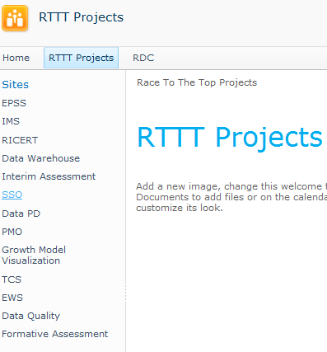
Project Communications
District Data Team Presentations
PMO Dashboard Report
Sharepoint sites

Slide 6
Educator Performance and Support System (EPSS)
Status & Estimated PD
Project Description, Goal, and Value
The EPSS will provide an easy-to-use interface to collect and manage data on all three components of RIDE’s Evaluation System – Student Learning, Professional Practice, and Professional Responsibility.
Completing business requirements; configuration has started
The EPSS will allow users to manage activities related to the evaluation process such as scheduling observations and conferences, two-way communication between evaluators and educators, as well as tools for self-assessment and observations.
Go Live Date: 8/29/12
Testing: 4/24-5/14
Train the trainer: 6/21-6/29 End user training: 6/29 – 8/10

Slide 7
Dashboards- Educator View
Notes:
-The system is designed to support educators through the evaluation process to facilitate ongoing improvement and professional development

Slide 8
Dashboards- Evaluator View
Notes:
-The system is designed to support educators through the evaluation process to facilitate ongoing improvement and professional development

Slide 9
Instructional Management System (IMS)
Status & Estimated PD
Project Description, Goal, and Value
The IMS will provide a systematic, coherent and ongoing combination of curriculum (including standards), instruction and assessment to support student achievement. The system will:
Completing requirements and training plan
Align curriculum, instruction and assessments to support student achievement
Query data to determine areas of student strengths and needs while being able to track student progress so that learning gaps do not form or widen
Access relevant and timely visual reporting of assessment and other data (“dashboards”) for immediate student, class, school and district needs
Manage and access curricular, instructional, professional development and student support materials
Go Live Date: 9/10/12
Testing: 7/27 – 8/31
Train the Trainers: 3/27 – 4/27 Trainers plan District training plan

Slide 10
IMS Screenshot (from demo environment)

Slide 11
Interim Assessment (IA)
Status & Estimated PD
Project Description, Goal, and Value
Interim Assessments will be developed for instructional planning and monitoring purposes. Components will include:
Business requirements definition in process
Diagnostic tests that augment the state assessments so that teachers can gather richer and more specific information to inform their instruction for students who don’t appear to be “on track” for end of year proficiency.
Test Blueprints that can pre-populate a test form for assessing certain standards while maintaining good psychometric properties
Teacher-created tests built through an online test construction tool used for quick snapshots of whether students obtained recently taught material
Go Live Date: 10/1/12 (Fixed Form release)
Testing: 8/1 – 9/1 End User Training: 10/1 - 11/1

Slide 12
Formative Assessment (FA)
Status & Estimated PD
Project Description, Goal, and Value
Configuration in process; testing starts in May
Formative assessment is an instructional process/practice, rather than a series of discrete tests. It focuses identifying learning gaps during instruction that can be addressed before the summative assessment.
RIDE will develop online training modules as a primer for all RI educators to learn about the formative assessment process, including a variety of strategies for conducting formative assessments and best practices for how to alter instruction based on formative assessment data.
Go Live Date: 9/15/12
Testing: 5/1 – 8/31
Train the trainer: 8/1 – 8/31 Trainers coordinate district training plans

Slide 13
Early Warning System (EWS)
Status & Estimated PD
Project Description, Goal, and Value
Business requirements definition in process
To determine the most user-friendly and effective way of indicating students at risk to key users
Indicators and thresholds will be established to effectively identify at risk students in the state of Rhode Island
Tentative Go Live Date: 9/10/12
Testing & Training dates still being developed

Slide 14
Growth Model Visualization Systems (GMV)
Status & Estimated PD
Project Description, Goal, and Value
Requirements for private release in process
The Growth Model Visualization Tool is a robust reporting platform for student growth percentiles, a new metric being used in the Educator Evaluation system and other quality assurance activities. This tool has both a public and private view that displays district and school media growth percentiles as well as subgroups within districts and schools.
It will enable a broad array of education stakeholders to better understand the student growth percentile model and provide a new way to take a rich look at student performance in Rhode Island.
Go Live Date: 5/7/12 (public) 10/1/12 (private)
Testing: 9/1 – 10/1 End user training: 10/1 – 10/19

Slide 15
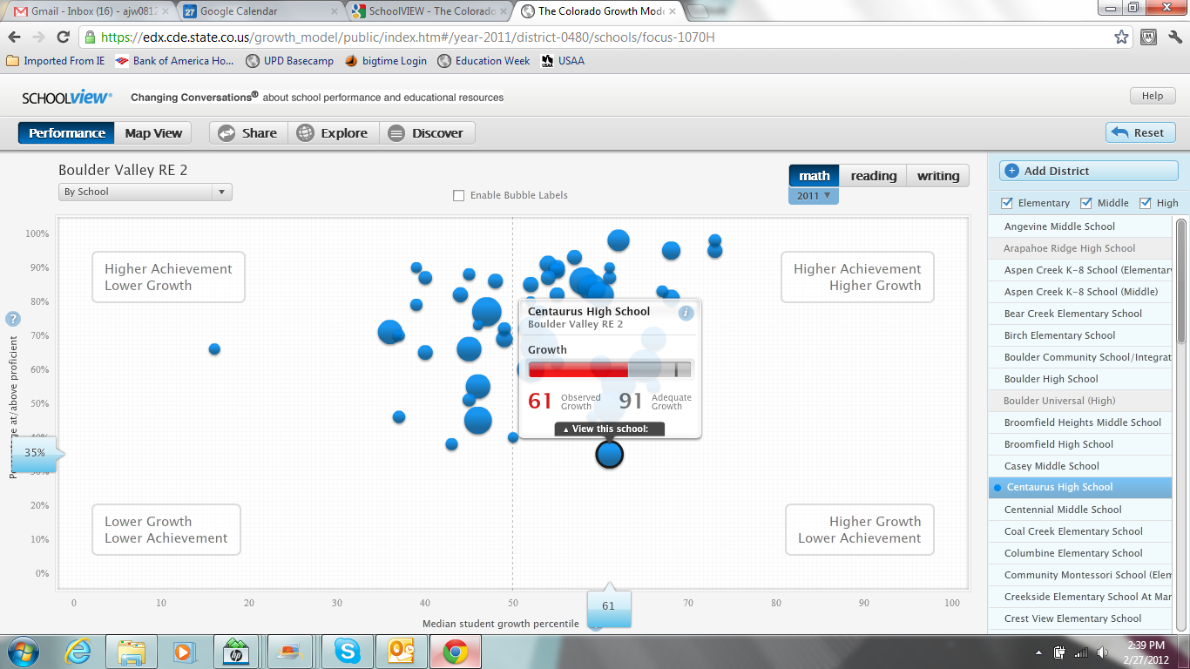
GMV Potential Look & Feel

Slide 16
Rhode Island Certification System (RICERT)
Status & Estimated PD
Project Description, Goal, and Value
Develop a web-based application which provides educators an interface to apply for certification, renew a certification and view all user certification data.
Requirements complete; development in process
RICERT will also provide critical functions internal to RIDE, such as managing state teacher certification data, application processing, cross-domain data analysis and state/federal reporting.
Application will be the system of record for state Teacher IDs, and must be integrated into RIDE’s Enterprise System to ensure validity and accuracy of all teacher-related data.
Go Live Date: 10/12/12
New system will be easier and more cost effective to maintain and make program changes going forward
Testing: 9/3 – 9/26 Training starts 10/2

Slide 17
Data Quality Initiative
Project Leads and Status
Project Description, Goal, and Value
Jan Mermin – Project Lead
Conducting interviews to establish priorities
Enable improvements in data quality, transparency, accessibility and use
Developing metrics to gauge baseline and anticipated improvements
Enable data-driven decision-making by stakeholders at all system levels (classroom, school, district and state)
Ensure that data from LEAs integrated into major RIDE data systems are more valid and reliable.
Elaine Budish – Project Coordinator

Slide 18
Single Sign On (SSO)
Status & Estimated PD
Project Description, Goal, and Value
Business requirements process has begun
Most of these RTTT systems are now, and will be in the future, mandatory for our users, so simplifying the access to these systems is critical for the overall success of our new data enterprise system.
The purpose of this team is to install hardware and software that will allow each user a single username and password that can access all the systems.
Testing and training plans are not yet finalized

Slide 19
Data Warehouse
Project Leads and Status
Project Description, Goal, and Value
Short term: Refine RIDE’s enterprise architecture to provision all needed data for the IMS, EPSS, and Growth Model Visualization Tool.
Completed IMS, EPSS, and GMV data marts
Betty Landry &Jason Becker
Working on physical data warehouse
Mapping data elements and requirements for connectivity (ETL)
Long term: provide a state of the art architecture for all RIDE data and collections.

Slide 20
Project Data Relationships
SIS
RICERT
NECAP
Educator
Effectiveness
Rating
Student & School Data (SSD)
Teacher Course Student (TCS)
Teacher ID
Assessment Data
eRide ODS
Data Warehouse
Data Marts
DATA
Growth Rosters
Growth Model Score
Growth
Data
EPSS
GMV
Verified Growth Rosters
Ed Effectiveness Rating
Test
Results
Attendance
Discipline
NECAP / Grades
SGP
NECAP
TCS / SSD
Test Results
Interim
Assessment
EWS
SY 2012-2013
IMS
Future
Usage
Statistics
Formative
PD
Notes:
Growth Model Score: determined from the median SGP of all teachers’ students. For a teacher this is all students in a classroom. For an admin, this would be the median of the whole school.
SGP: student growth percentage.

Slide 21
A Day in the Life
1. A teacher signs into RICERT and re-certifies in Secondary Math using the Internet from home during the summer.
2. As she prepares for her first week in the classroom, she logs in through the single sign-on portal and enters the IMS to view her students and their previous assessment data.
3. She uses the common core curriculum standards and other IMS content to build her first two weeks of lesson plans.
4. While in the IMS, she accessed the interim assessment functions, developing initial tests for her students using the item bank.
5. She then decides to enter the formative assessment training system to participate in a web-based training that will help her incorporate these techniques into her daily practice once the school year starts.
6. She also takes time to go into GMV to see a visualization of the most current NECAP data for her students.
7. After receiving an email alert, she schedules a mid-year conference in EPSS. While there, she updates her student progress in her SLOs.
8. She is excited to have all these tools available to improve instruction in her classroom.

