Slide 1
Using SLO/SOO Flex to Engage in Shorter Cycles of Instruction
A flexible approach to measure student learning
Notes:
Welcome! We thank you for reviewing this module on the benefits of using SLO/SOO Flex, in place of traditional SLOs/SOOs, during the 2020-21 school year. We recognize this coming year will require collective flexibility and adaptability. This presentation is intended to provide information for evaluators and other district leaders on how to effectively employ the SLO/SOO Flex Model within their local settings.

Slide 2
Context
SY 19-20
All RI LEAs engaged in Distance Learning (DL) for the last 3 months of the school year.
Problem: Among other things, DL may have had a negative impact on the evaluation system: many educators did not receive their three required observations, nor were they able to accurately measure their students’ learning against year-long SLO/SOO targets
Response: RIDE released evaluation flexibilities for LEAs to employ in order to honor work already done and so that evaluators could close out evaluations for the school year with minimal impact to caseloads
SY 20-21
While most RI LEAs have begun the school year with a full return to in-person instruction, it is likely that they will return to DL, in some capacity, at some point in time
Solution: To avoid the need to offer statewide flexibilities as the only way to complete the student learning component of evaluations, we encourage LEAs to consider using SLO/SOO Flex, over traditional SLOs/SOOs, as the measure of an educator’s impact on student learning
Benefit: Because SLO/SOO Flex is extremely similar to the original SLO/SOO, widespread implementation is possible without the need for new templates or approval processes
Notes:
Please take a moment to read the text on this slide. In short, we are trying to avoid some of the issues that last year’s distance learning caused with regard to completing educator evaluations. Because the original SLO/SOO has educators set objectives and targets at the beginning of the year, with measurement of student learning occurring at the end of the year, most educators were not able to accurately assess just how much their students learned. Therefore, RIDE determined that assigning all educators a ‘3’ for their two SLOs/SOOs seemed fair and equitable given the circumstances in 2019-20.
But what if there were another way to accurately and more easily score educators on student learning? We believe that the SLO/SOO Flex Model provides a structure for teachers to monitor and assess students’ learning throughout the year, rather than being fixed to a beginning and end point only.
Please note that this module is only about the student learning component of the evaluation system. This module does not address observations of professional practice. Therefore, please look out for forthcoming resources on best practices when conducting virtual observations, which we hope will complement the work you’re already doing to support educators in both in-person and virtual learning environments.

Slide 3
What is SLO/SOO Flex?
Let’s Compare:
SLO/SOO Original
SLO/SOO Flex
Original processes and procedures that have been in effect since SY 12-13
All students
Aligned content standards
Year-long cycle of instruction
Year-long objective(s) & targets
Original scoring method
30% RI Model, Achievement First, & Learning Community
Matrix for i3 districts and Coventry
Flexible processes and procedures using SLO/SOO original template:
All students or a targeted subset
One or more content standards
Year-long or shorter cycles of instruction
Targets may be adjusted based on data/evidence from shorter cycles of instruction
Original scoring method
30% RI Model, Achievement First, & Learning Community
Matrix for i3 districts and Coventry
Notes:
Let’s start by comparing it to the original SLO/SOO, which has been in effect for almost ten years. <Please read the slide>
The advantage of the SLO/SOO Flex is that it doesn’t require any new processes or templates, meaning, educators should not require any new instruction or training on how to set their SLOs/SOOs. Additionally, the approval process remains the same—educators will continue to submit their SLOs/SOOs to their evaluator for approval.
SLO/SOO Flex provides the opportunity for educators to focus on all of the students on their roster or a targeted subset. Instead of setting targets for every student on their roster, educators may elect to focus on a specific sub-population of their classes (e.g., students who are Multilingual Learners, Differently Abled, Gifted and Talented, etc.)
SLO/SOO Flex provides the option for each SLO’s/SOO’s objective to focus on one content standard instead of needing to consist of multi-standards, as is the case with SLO/SOO Original. A focus on one content standard may allow for a more targeted objective, thereby providing the educator a formal path to hone in on a specific aspect of instruction.
SLO/SOO Flex offers educators the ability to set year-long targets with the option of adjusting targets at the mid-year, if warranted (as is shown with Option 1 in Slide 5) or the opportunity to engage in two shorter cycles of instruction, where the educator will set targets for two SOOs/SLOs for each cycle, for a total of four SLOs (as is shown with Option 2 in Slide 7).
To summarize, SLO/SOO Flex affords educators the flexibility to engage in an reimagined SLO/SOO where students, standards, cycles of instruction, and targets provide for a more intentional and controlled measure of student learning. Given the uncertainty of schools remaining open for in-person instruction, educators and evaluators alike may prefer SLO/SOO Flex over traditional SLO/SOOs.
Finally, the same scoring guidance is in effect for the Flex model—no new guidance or processes to learn.
What parts of the SLO Flex are actually flexible ? EXPLAIN THIS HERE Does the slide not do that? Not sure what else to say, as it would become a repeat of what’s on the slide already

Slide 4
What is a ‘Cycle of Instruction’?
Plan Lessons
Teach
Analyze Student Work/Data
Adapt teaching and Reassess
Reflect
Prepare
Teaching & Learning Cycle
Respond
Assess
Notes:
While we know that all educators engage in a similar teaching and learning structure as is shown on this slide, we find it helpful to reground ourselves in this common vocabulary to anchor expectations for teaching and learning for all educators. Furthermore, it is critical that educators continue to implement each component, or “piece” of this cycle of instruction even when teaching remotely. In fact, there is likely an even greater need for educators to remain committed to each piece of the teaching and learning cycle during distance learning.
In a moment we will dive into the two different Flex options mentioned in the previous slide. In both cases, this graphic is useful, as it illustrates how educators engage in the ‘business’ of teaching and learning.

Slide 5
Using the Flex Model—Option 1
BOY
SLO/SOO 1 is set and approved at or before the BOY Conference
EOY Conference
SLO/SOO 1 is scored and overall student learning score is calculated
MOY Conference
Formatively assess student learning progress thus far. Adjust year-long targets accordingly
SLO/
SOO 1
BOY
SLO/SOO 2 is set and approved at or before the BOY Conference
EOY Conference
SLO/SOO 2 is scored and overall student learning score is calculated
MOY Conference
Formatively assess student learning progress thus far. Adjust year-long targets accordingly
Plan-Teach-Assess-Analyze-Adapt-Reflect
SLO/
SOO 2
Plan-Teach-Assess-Analyze-Adapt-Reflect
Notes:
Flex Model Option 1, as with the SLO/SOO Original, asks the educator to set two year-long SLOs/SOOs that include rigorous-yet-attainable tiered targets based on available student data at the beginning of year (BOY). The educator will engage in the familiar rhythm of instructional cycles leading up to the MOY Conference. By the MOY, the educator will have gathered and reflected on all relevant student data in order to prepare for a discussion with their evaluator—the educator should have a good idea of whether or not their students are on track to meet end of year targets. Together, they will discuss and determine whether or not end of year targets should be adjusted based on progress monitoring data thus far. It should be noted that what differentiates SLO/SOO Flex from SLO/SOO Original, is the ability to revise targets at the MOY—it is not ‘allowed’ under the latter.
The revising of targets may be necessary given an abrupt transition from in-person learning to distance learning or changes in students’ personal circumstances (e.g., several students may have had to quarantine, some students may have gotten sick, others may be dealing with the stress of having sick family members, etc.). Still, it is critical that educators engage in a rigorous and authentic teaching and learning cycle, where analyzing student work, changing instructional strategies, and reflecting occur—educators should never lower expectations/targets because students are simply not performing well. The onus is ultimately on the evaluator to determine whether or not targets should be revised.

Slide 6
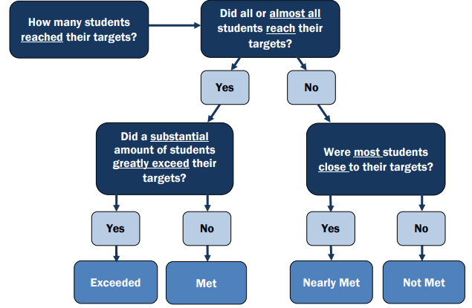
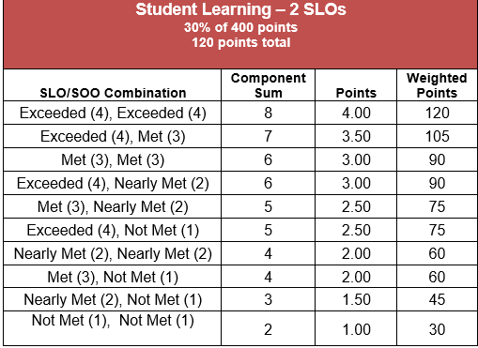
Scoring SLO/SOO Flex – Option 1
Look-up table for overall student learning score
Scoring process map and additional guidance
Notes:
This slide should be very familiar to educators and evaluators alike. As previously stated, even though educators have the ability to adjust their year-long targets based on student learning data collected by the MOY, the two SLOs/SOOs will still be scored at the EOY according to the process map/guidance and look-up table that have been in effect for SLO Original.
For full details on scoring student learning, please visit pages 28-29 in the Teacher Guidebook: https://www.ride.ri.gov/Portals/0/Uploads/Documents/Teacher_Guidebook_Ed_V_2019.pdf?ver=2019-09-10-163020-400.
And please visit pages 28-29 in the Support Professional Guidebook: https://www.ride.ri.gov/Portals/0/Uploads/Documents/SP_Guidebook_Ed_IV_2019.pdf?ver=2019-08-28-124931-380.

Slide 7
Using the Flex Model—Option 2
SLO/SOO 1 + SLO/SOO 2
Engage in Plan-Teach-Assess-Analyze-Adapt-Reflect
MOY
(Jan-Feb)
SLO/SOO 1 and 2 are scored and SLO/SOO 3 and 4 are submitted
SLO/SOO 3 + SLO/SOO 4
Engage in Plan-Teach-Assess-Analyze-Adapt-Reflect
EOY
(June)
BOY
(Sept-Oct)
SLO/SOO 1 and 2 are set and approved at or before the BOY Conference
SLO/SOO 3 and 4 are scored and overall student learning score is calculated
Cycle 1
Cycle 2
Notes:
We certainly recognize that Flex Model Option 2 requires more record-keeping/paperwork for both the educator and the evaluator than Option 1. Still, we present Option 2 for those educators who may desire more than two measures of student learning, who may teach semester-long classes, or who are elementary teachers wishing to focus on content areas other than ELA and math. Since the Flex Model does not mandate that all students must be included in the targets, an educator may even wish to select an entirely different group of students in Cycle 2 than Cycle 1.
By the BOY Conference, the educator has set their 2 SLOs/SOOs for Cycle 1, which will last until the MOY (Jan.-Feb. timeframe). Different from SLO/SOO original, the educator will focus on a ‘tighter’ and shorter objective for each SLO/SOO, ones that can be attained within a few months versus the whole year. At or before the MOY Conference, the educator will bring the results of their first two SLOs/SOOs so they may be scored by the evaluator. Please remember that these scores are not formative; essentially, Cycle 1 has concluded and so these two SLO/SOOs must be ‘closed out’ and submitted. Also during the MOY Conference, the educator and evaluator will discuss the two new SLOs/SOOs for the remaining half of the year. They may even determine how results from Cycle 1 may shape instructional strategies for Cycle 2. Therefore, the MOY Conference is a critical point for educator and evaluator to engage in fruitful and purposeful data discussions.
And just like Cycle 1, at or before the EOY conference, the educator will submit results from their second set of SLOs/SOOs so they may be scored by the evaluator and then submitted. Finally, the overall student learning score will be calculated using the results from all four SLOs/SOOs. Please see next slide for Option 2 scoring guidance.

Slide 8
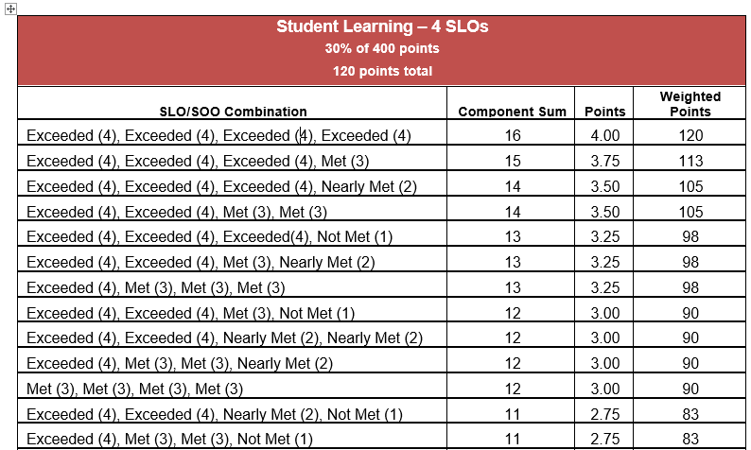
Scoring SLO/SOO Flex – Option 2
**Please note that this screenshot does not reflect all four possible combinations. Please see accompanying lookup table for all combinations.
Notes:
The scoring process is the same for an SLO/SOO scored at the MOY as it is at the EOY. Evaluators will use the scoring map and guidance already outlined on Slide 6 to score SLO/SOO 1 and 2 at the MOY and then score SLO/SOO 3 and 4 at the EOY. Also at the EOY, the Overall Student Learning score will be calculated using the look-up table for four SLOs/SOOs. As stated on the slide, please see the accompany handout for the look-up table in its entirety. Fortunately, the Frontline system, EEM, already supports the calculation of four SLOs/SOOs so new configurations are needed.

Slide 9
Next Steps for Use
Share Presentation with educators on-cycle this year. Add slides or additional text for local context and considerations. We recommend using part of a PD day or faculty meeting/PLC to explain and discuss with relevant personnel. Ensure that educators understand both Flex Options and which one may be best suited for their use.
Provide time for teams of educators to ‘workshop’ their SLOs/SOOs and to ensure comfort with the Flex Model and with engaging in all the ‘pieces’ of a cycle of instruction. Consider grouping educators by content or grade-level to ensure that priority content and/or student sub-populations are equitably represented.
Stress that with the Flex Model, the MOY Conference becomes critical for data discussions between educator and evaluator. A key opportunity to discuss student learning, the MOY conference provides the structure for the revising of targets, if necessary (Option 1) and the transition from Cycle 1 SLOs/SOOs to Cycle 2 SLOs/SOOs (Option 2). Both options provide for informed data-driven decision-making.
Notes:
We hope that the SLO/SOO Flex Model will be useful to your educators and evaluators alike. As district leaders, before sharing with your relevant personnel, we encourage you to determine if either Flex Models are options for educators to decide themselves, or if the decision to use one must be mutually agreed upon between educator and evaluator. As demonstrated, Option 1 will likely be the more palatable choice, as it still only requires the submission of two SLOs/SOOs with the added benefit of target revision—given the uncertain times we are in, many educators will find this flexibility comforting! And although Option 2 requires more ‘paperwork’, as educators will ultimately be responsible for 4 SLOs/SOOs (as opposed to two), some might find the opportunity to engage in two shorter cycles of instruction more manageable and wieldy, given the precarious position schools are in, and will likely be in for the remainder of this school year.
We should also underscore that this model is predicated on an established and trusting relationship between educators and evaluators, as they both need to be committed to the process, and be willing to leverage the MOY as a fixed point in time to engage in meaningful data discussions around student learning.

Slide 10
Contact RIDE for Support
Please reach out to EdEval@ride.ri.gov for questions regarding educator evaluation.
Please visit our webpage for additional evaluation resources and materials: https://www.ride.ri.gov/TeachersAdministrators/EducatorEvaluation.aspx
Notes:
Please reach out with your Educator Evaluation questions and concerns—we are happy to support you and to help you determine if SLO/SOO Flex is right for your districts and schools.

