Slide 1
The Writing – Reading Connection Writing Instruction Strategies that Enhance Reading Comprehension
Project created in partnership with the Rhode Island Department of Education Literacy Ambassadors 2020

Slide 2
During this presentation, participants will:
Use the Simple View of Writing as an organizing framework for writing instruction
Discover The Writing Revolution (TWR) resource for teaching writing
Watch a TWR video explaining because, but, so sentence expansion as one example out of many presented in TWR.
Practice because, but, so sentence expansion.
Develop an understanding of why explicit instruction in sentence structure is an important part of developing literacy skills

Slide 3
Why is writing hard to teach?
Take a few minutes to write down 2-3 things that make teaching writing challenging in your classroom?
Turn and share with a table partner/ or type into chat feature.

Slide 4
What do we mean by "Written Expression"?
Written expression instruction includes:
the mechanics and conventions of writing,
composition (handwriting, spelling, punctuation, syntax),
semantics,
as well as the phases of the writing process (composition, revision, and editing).
(International Dyslexia Association)

Slide 5
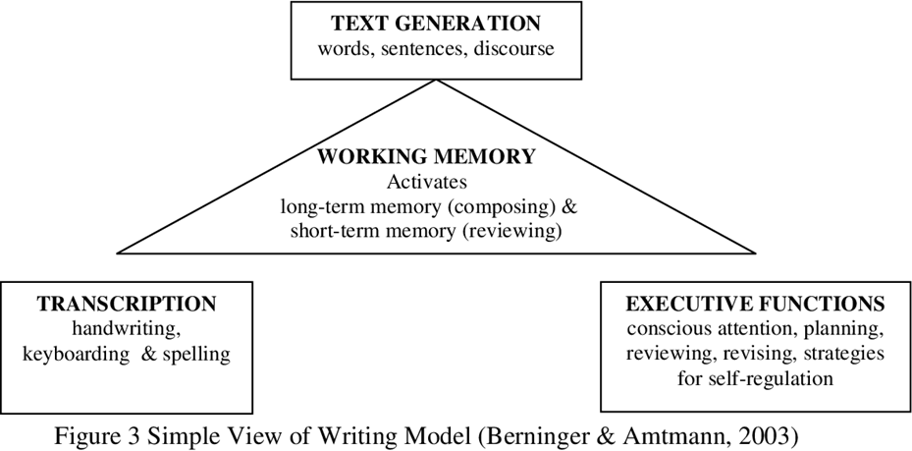

Slide 6
Writing Instruction is Reciprocal with Reading Comprehension Abilities
"As students learn to employ more complex sentences in their oral and written language, their ability to make sense of what they read increases, too. " – Timothy Shanahan

Slide 7
The Writing Revolution - TWR
Transform how you teach writing…right away!
Help students use more precise language when they summarize their reading.
Provide academic language development while writing about content.

Slide 8
Six Principles of Writing Instruction outlined in The Writing Revolution:
Students need explicit instruction in writing, beginning in the early elementary grades.
Sentences are the building blocks of all writing.
When embedded in the content of the curriculum, writing instruction is a powerful teaching tool.
The content of the curriculum drives the rigor of the writing activities.
Grammar is best taught in the context of student writing.
The two most important phases of the writing process are planning and revising.

Slide 9
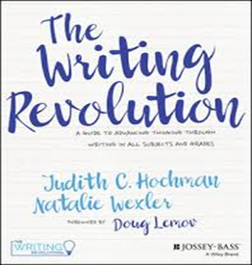
TWR Principle # 1: Students need explicit instruction in writing, beginning in the early elementary grades.
Framework for organizing effective,
explicit instruction.
Teaching strategies

Slide 10
TWR Principle # 2: Sentences are the building blocks of all writing.
Text Generation is part of Simple View of Writing (SVW)
Good writing often involves more complex sentence structures and a more varied and precise vocabulary than spoken language.
A writer who can’t compose a decent
sentence most likely will not produce a
decent essay—or even a decent paragraph.

Slide 11
TWR Principle # 3: When embedded in the content of the curriculum, writing is a powerful teaching tool.
To maximize the benefits of writing instruction, students should start practicing their writing skills on topics embedded in content as soon as possible. (Hochman).
Teachers can use writing as a check for comprehension.

Slide 12
TWR Principle # 4: When embedded in the content of the curriculum, writing is a powerful teaching tool.
Students can learn simple writing strategies that can be applied to all content areas.
The form of the activity will stay
the same, but the content is what
makes it more or less rigorous.

Slide 13
TWR Principle # 5: Grammar is best taught in the context of student writing
Teachers should refer to CCSS Language Standards in addition to the CCSS Writing Standards when planning instruction.
As students begin to use more complex
terms and sentence constructions in
their written language, they begin to
incorporate those features into their
spoken language as well.
Multilingual Learners

Slide 14
TWR Principle # 6: The two most important phases of the writing process are planning and revising.
The Simple View of Writing reminds us that the planning and revising phases of the writing process are located in “Executive Functions.”

Slide 15
A Focus on TWR Principle # 4
Let’s examine a high-leverage sentence-level strategy focused on the use of the conjunctions because, but, and so to better understand what is meant by TWR Principle #4: the content of the curriculum drives the rigor of the writing activities.

Slide 16
Because, but, so...
Co-Executive Directors of The Writing Revolution, Toni-Ann Vroom and Dina Zoleo, discuss the because, but, and so strategy.

Slide 17
TWR Principle # 4 Elementary ELA Example:
If you’re teaching elementary students, you might give them this stem:
Rocket learned to read _______________________________.
You’ll ask the students to complete the stem with a phrase beginning with because, but, and, or so. They might respond:
Rocket learned to read because ________________.
Rocket learned to read, but____________________.
Rocket learned to read, so_____________________.

Slide 18
TWR Principle # 4 Elementary ELA Example:
If you’re teaching elementary students, you might give them this stem:
Rocket learned to read _______________________________.
You’ll ask the students to complete the stem with a phrase beginning with because, but, and, or so. They might respond:
Rocket learned to read because the yellow bird taught him.
Rocket learned to read, but at first he was bored.
Rocket learned to read, so he was proud of himself.

Slide 19
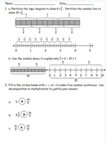
TWR Principle # 4 Writing in Mathematics Example
In mathematics, instead of asking, “What is a fraction?,” you can give your students this stem:
Fractions are like decimals ______________________________.
They might complete it like this:
Fractions are like decimals because _____________.
Fractions are like decimals, but _________________.
Fractions are like decimals, so__________________.

Slide 20
TWR Principle # 4 Writing in Mathematics Example
In mathematics, instead of asking, “What is a fraction?,” you can give your students this stem:
Fractions are like decimals ______________________________.
They might complete it like this:
Fractions are like decimals because they are all parts of wholes.
Fractions are like decimals, but they are written differently.
Fractions are like decimals, so they can be used interchangeably.

Slide 21
Why is explicit instruction of sentence structure an important part of developing literacy skills?

Slide 23
Analyzing Student Writing
Analyze student writing samples and spelling tests to refine instructional targets (e.g., development of phonological awareness, knowledge of spelling rules, awareness of inflectional morphemes). International Dyslexia Association Knowledge and Practice Standards.
Student writing also yields information on syntax, composition, organization, comprehension, and handwriting.
Error Analysis

Slide 24
Deliberate Practice
Students need plenty of opportunities to
practice writing skills.
Sentence composing:
Is manageable for teachers and students
Works well in small group instruction

Slide 25
Feedback is important and nourishes student learning
Students need feedback provided in a timely manner, with suggestions targeted toward improvement.
Feedback is best when given during instructional time, such as in a writing conference or small group.

Slide 26
Resources and Activities for
GOING FURTHER

Slide 27
The Writing Revolution
●The Writing Revolution is a great text for PLC study
●Multiple strategies included to help students with notetaking, summarizing, sentence combining, grammar in context, single and multiple paragraph outlining
●Great companion text to study alongside The Knowledge Gap, by Natalie Wexler

Slide 28
The Writing Revolution Writing Principles #2 and #5 in Action:
Sentence
Expansion
Sentence Combining
https://vimeo.com/207849027
https://vimeo.com/208687154

Slide 29
To provide a stronger understanding of the breadth and depth of TWR, here are topics covered in the Table of Contents from the book, The Writing Revolution:
1 Sentences: The Basic Building Blocks of Writing 23
2 Sentence Expansion and Note-Taking: Getting Students to Process What They’ve Read 55
3 One Step at a Time: Why Students Need to Plan Before They Write 69
4 First Steps in Planning: The Single-Paragraph Outline 83
5 Putting Flesh on the Bones: Revising a Draft 111
6 Summarizing: Mining Texts for the Essentials 138
7 Moving on to Compositions: The Multiple-Paragraph Outline 152
8 Take a Stand: Writing Opinion, Pro-Con, and Argumentative Essays 179
9 A Gauge and a Guide: Assessing Students’ Writing 204
10 Putting the Revolution Into Practice: Combining Our Sequence With Your Judgment 218

Slide 30
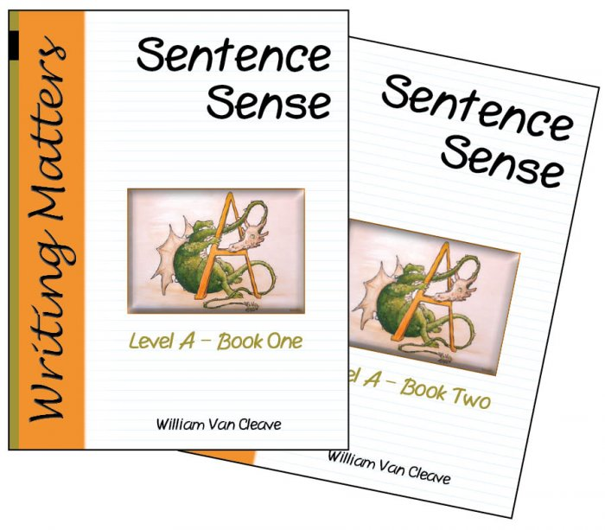
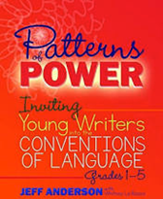
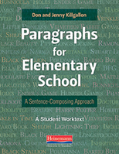
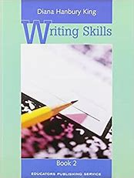
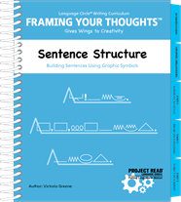
More sentence level resources
There are a number of good resources for teachers to integrate sentence instruction into the curriculum. These are just a few (click on image for link):

Slide 31
Wrap Up
3-2-1 Strategy Exit Slip
3 things you learned from today’s presentation
2 ideas you will try in your classroom
1 question you still have

