Slide 1
Comprehensive Needs Assessment and Root Cause Analysis
Monday April 1st

Slide 2
Conducting a Comprehensive Needs Assessment
1
Select a comprehensive needs assessment (LEA)
Present data to the collaborative team (LEA presents to school and CAB)
4
Prioritize indicators for root cause analysis (school and CAB)
2
Identify and gather data (LEA)
3
Notes:
Throughout we’re going to talk about each of these steps, and note the shifting amounts of responsibility and authority, gradually moving from the LEA being the main driver of the process to the school and CAB teams becoming the deciders, supported by the LEA

Slide 3
Select a comprehensive needs assessment (LEA)
1
Rhode Island Model Needs Assessment
Georgia Department of Education Comprehensive Needs Assessment
Moving Your Numbers District Self Assessment Guide
Global Best Practices 2nd Edition (Secondary schools only)
Notes:
LEA will take the lead on this. Should be underway now.
Different needs assessments take different approaches, select the one that works for your context. Here are a sample of four high quality needs assessments.
Make sure it covers all major aspects of teaching and learning.
Make sure it captures measures in our accountability system and can be aligned to the framework for SI.
Make sure you have valid and reliable data to populate the indicators
Make sure it allows for prioritization, you will have to identify specific priorities at the conclusion of the needs assessment

Slide 4
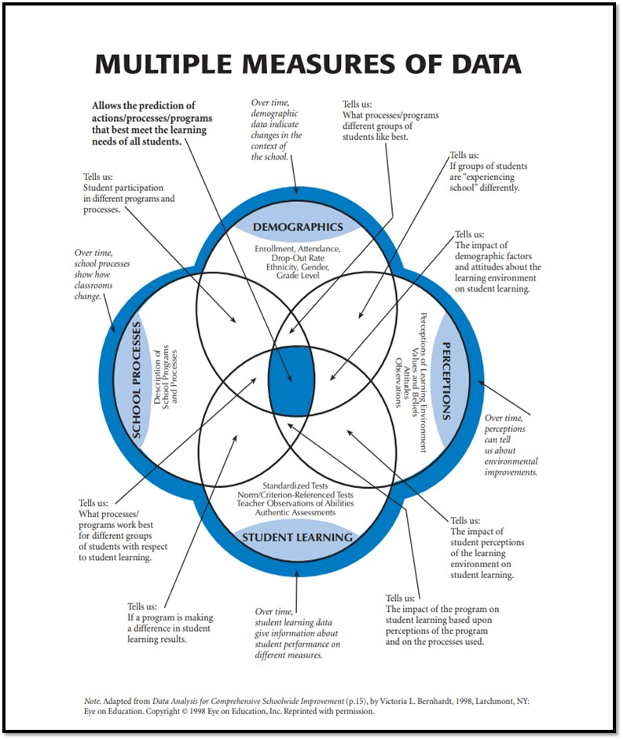
Identify and gather data (LEA)
2
For every indicator,
data should be:
Triangulated
Contextualized
Visualized/Summarized
Notes:
LEA key player again. LEA examines all indicators and brings together robust data for each, where available.
LEA should consider 4 types of data and triangulate data sources as much as possible.
4 Types of data collected: Demographic information, tells who your people are, perception data tells you what your people think, school processes include instruction, systems and procedures, and student learning are measurable outcomes (this last is the most familiar and what most people think of first as data, but the other three are also of critical importance)
Data should be contextualized, meaning it is provided with other data that help make it meaningful – historical trend data, averages from the LEA, or district, Comparisons to similar schools, relative to local, state, or national benchmarks or goals etc.
Data should be made meaningful, accessible through visualizations (graphs, charts, tables) and should be at a summary level (1000 data points, i.e. individual student data is less useful than school or grade level summaries)
Same data will likely inform many indicators
Note this is a district level activity, possibly in conjunction with building leaders, but not yet the work of the collaborative team

Slide 5
Thinking Broadly About Data
Test scores are necessary but not sufficient
A robust needs assessment includes many factors that help paint a rich picture of teaching and learning

Slide 6
Present data to the collaborative team (LEA presents to school and CAB)
3
LEA builds collaborative team’s capacity to understand and analyze data
LEA should emphasize equity of voice in ensuring all members of the CAB and school team can meaningfully engage
Protocols can be helpful, should be tailored to needs and desires of the CAB, School, and LEA
Collaborative team asks questions:
Additional data?
Clarifying questions?
Avoids making judgements, proposing solutions
Notes:
Recommend adoption of a protocol for looking at data

Slide 7
Prioritize indicators for root cause analysis (school and CAB)
4
Individual or groups of indicators are analyzed and evaluated on two axes:
Each collaborative team should end with 3-5 High Priority, Weak Performance indicators
Strong performance
Low priority, strong performance: Minor Area of Strength
High priority, strong performance: Major Area of Strength
Current performance
Low priority, low performance: Minor Area of Weakness
High priority, Weak Performance: Major Area of Focus
Weak performance
Low priority
High priority
Priority

Slide 8
Conducting a root cause analysis
RCA allows us to:
Sharpen Focus
Solve the right problem
Prioritize factors within our control
Notes:
Most powerful root causes are those that:
Are within your control to address
Supported by the data
Specific and robust
Protocol for identifying key root causes provided in your Practitioner's Guide
Challenge assumptions about what is and isn’t within the control of the school and CAB –part of the purpose of CABs is to force system-level change in response to community voice – if there are political challenges we hope, in departure of past precedent, that CABs can be the voice needed to overcome these challenges

Slide 9
Conducting a root cause analysis
Priority Indicator: Low Performance on Math Assessments
Students are not proficient in math
Math curriculum is low quality
Math instruction doesn’t meet student need
Students are proficient but test poorly in math
Students are unmotivated
Students are distracted
Students are unfamiliar with test format
Inadequate instructional time
Lack of instructional resources
Ineffective Lessons
Poor Testing Environment
Notes:
Branching root-cause analysis
Multiple pathways, each with it’s own causal chain
Follow a chain as far as you can, until the collaborative team reaches what they believe is the true underlying cause or causes
Deprioritize causes truly outside of your control
Look for causes that appear multiple times, or in multiple chains

Slide 10
Process
3-5 High Priority Needs with identified Root Causes
Evidence-Based Interventions Designed to Address Root Causes
Comprehensive School Improvement Plan And Funding Application (Due 5/15)
Now Through Early May (~5 weeks)
Notes:
All of this is leading to a school improvement plan of coherent evidence-based interventions and goals tied to the accountability system metrics as well as other important measures of teaching and learning, and an application for funding to support these plans using federal school improvement (1003) dollars

Slide 11
Questions?
Email: schoolimprovement@ride.ri.gov
Web: www.ride.ri.gov/improvement
Requests for technical assistance from the School Improvement team may be submitted here:
https://docs.google.com/forms/d/1A-3liJ53xDbGh04jaUV0Ohitse9FC7UFAaJz37ImDOU/viewform?edit_requested=true

