Slide 1
Collaborating to Increase Access to
Advanced Placement Courses
Rhode Island Department of Education

Slide 2
Benefits of Advanced Placement
Recent research from the Regional Education Laboratories (REL) compared RI Accelerated College Credit students to statistically similar students:
Notes:
Outcomes from study conducted by REL using graduating class of 2017. Accelerated college credit refers to AP, Dual and Concurrent enrollment. Compares participating and non participating students who were statistically similar in 8th grade. Accelerated credit students are 21 pp more likely to graduate HS, 20 pp more likely to enroll in college and 3 pp less likely to be in remediation (note that many more participating students enroll in college at all).
Of all three programs, AP students saw the biggest increase in likelihood of enrolling in college (63 versus 87). Outcomes were similar across program times for other metrics.

Slide 3
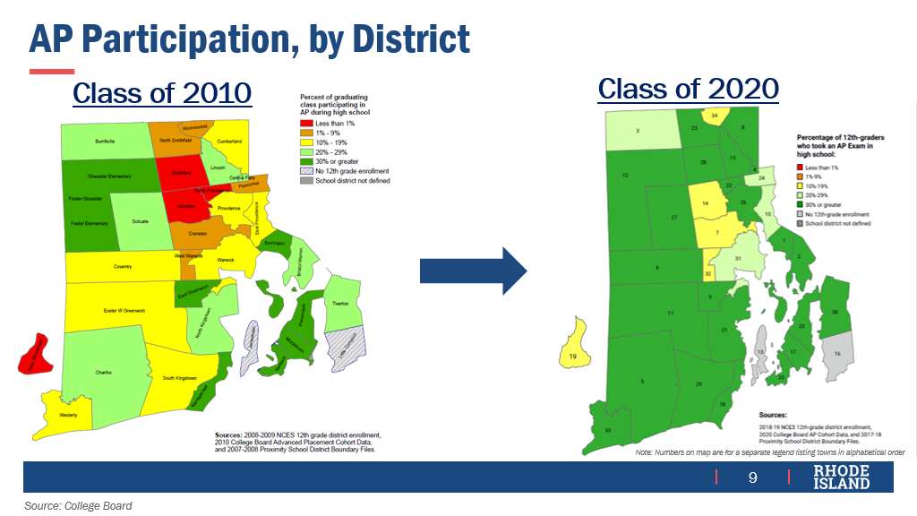

Slide 4
Notes:
(Access has expanded also over the past 10 years: Only 17.5% of the Class of 2010 took an AP exam, while 40.5% of the Class of 2020 took the test.)
Despite this progress, gaps persist, 2020

Slide 5
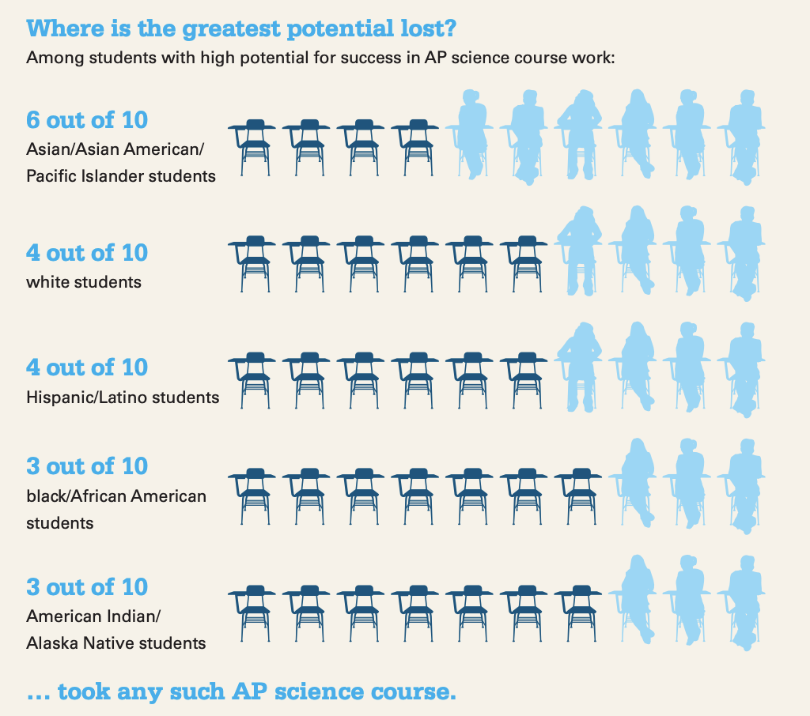
Research on Increasing AP Access
Minoritized students are successful in advanced placement courses when given the chance.
Barriers:
Selection Criteria
Students of color are less likely to self-select
Lack of information
Notes:
Research from the College Board shows that significant portions of students of all races who have the potential to succeed in AP are not accessing these courses. The disparity is largest for African American and Native American students. (stats focus on STEM but similar patterns are seen across subjects) Data from 2014.
Barriers to Access:
Selection Criteria, Using recommendations only has a particularly high potential for missing students with a high potential for success. Some research suggests high-achieving white student is twice as likely as an equally high-achieving black student to get assigned to such a program (2016 reporting by the Atlantic).
Self-selection: Research suggests that even when they have a high probability of success based on prior performance students of color are less likely to be believe they belong in advanced courses. A lack of representation in AP courses contributes to this problem as students may lack older peer examples who look like them. So even in schools that opt open admission policies, SOC may self-select into AP at lower rates.
Lack of information: students and families of underrepresented students way have less context about the benefits of AP.

Slide 6
RIDE Priorities for SY 2122
100% of schools publicly post AP offerings and selection criteria on their school website
Notes:
Information gathering: is UEP info correct in terms of if it is posted?
Discuss possibility of adding or shout out for already having it

Slide 7
RIDE Priorities for SY 2122
AP descriptions emphasize malleable rather than fixed traits.
Sample AP Course Description: Through the Advanced Placement (AP) Program, students can take college-level courses at their high school and have the opportunity to earn college-credit. These courses use a rigorous college-level curriculum developed by the College Board. AP students tackle topics head-on and go deeper into subjects that interest them. AP classes are challenging, but any student who is willing to work hard and is academically prepared can succeed in this program.
Taking AP courses can give students an advantage in the college application process by showing that they are ready for college-level work. Most colleges and universities will also award college credit to students who score at least a 3 out of 5 on their AP course examination. A full list of the available AP Courses at [School] can be found________ . Students interested in enrolling in AP should____________. Parents and families can learn more about AP here.
Notes:
Information gathering: is UEP info correct in terms of if it is posted?
Discuss possibility of adding or shout out for already having it

Slide 8
RIDE Priorities for SY 2122
AP descriptions emphasize malleable rather than fixed traits.
Sample AP Course Description: Through the Advanced Placement (AP) Program, students can take college-level courses at their high school and have the opportunity to earn college-credit. These courses use a rigorous college-level curriculum developed by the College Board. AP students tackle topics head-on and go deeper into subjects that interest them. AP classes are challenging, but any student who is willing to work hard and is academically prepared can succeed in this program.
Taking AP courses can give students an advantage in the college application process by showing that they are ready for college-level work. Most colleges and universities will also award college credit to students who score at least a 3 out of 5 on their AP course examination. A full list of the available AP Courses at [School] can be found________ . Students interested in enrolling in AP should____________. Parents and families can learn more about AP here.
Notes:
Information gathering: is UEP info correct in terms of if it is posted?
Discuss possibility of adding or shout out for already having it

Slide 9
RIDE Priorities for SY 2122
AP descriptions emphasize malleable rather than fixed traits.
Sample AP Course Description: Through the Advanced Placement (AP) Program, students can take college-level courses at their high school and have the opportunity to earn college-credit. These courses use a rigorous college-level curriculum developed by the College Board. AP students tackle topics head-on and go deeper into subjects that interest them. AP classes are challenging, but any student who is willing to work hard and is academically prepared can succeed in this program.
Taking AP courses can give students an advantage in the college application process by showing that they are ready for college-level work. Most colleges and universities will also award college credit to students who score at least a 3 out of 5 on their AP course examination. A full list of the available AP Courses at [School] can be found________ . Students interested in enrolling in AP should____________. Parents and families can learn more about AP here.
Notes:
Information gathering: is UEP info correct in terms of if it is posted?
Discuss possibility of adding or shout out for already having it

Slide 10
RIDE Priorities for SY 2122
If tests are required, information about fee reductions or district-level waivers is linked.
College Board Fee Reduction
Notes:
Information gathering: is UEP info correct in terms of if it is posted?
Discuss possibility of adding or shout out for already having it

Slide 11
RIDE Priorities for SY 2122
Look for disparities in AP participation at your school.
https://datacenter.ride.ri.gov/Data/PrepareRI
Notes:
Information gathering: is UEP info correct in terms of if it is posted?
Discuss possibility of adding or shout out for already having it

Slide 12
Next Steps for Increasing Equitable Participation
Publicly post an accessible description of AP offerings, selection criteria and process.
Review school specific data for disparities.
Use open-enrollment or multiple measures for AP selection: GPA/ grades, student interest, application essay, test scores, teacher recommendation (not sole requirement)
Assertively recruit students
Pay for AP exams
Introduce an Opt-Out Course
Notes:
Light: post offerings and enrollment policies on your website. We want 100% of schools to do this by September 21-22. Note that words like ”talented” “above average” etc. can actually deter underserved students because they may be less likely to believe they belong in AP, despite past academic success. Focus instead on traits students can control such as work ethic and motivation. If the AP exam is required, ensure that you also provide any information around support funding the exam (including the CollegeBoard’s Fee Reduction option) so that students are not immediately deterred by the hefty price tag for the exam.
The next slide provides a link to sample language from RIDE for describing AP in a accessible way. We also want to Shout Out Cumberland and Chariho high schools for their inclusive and informative descriptions of aP in the student handbook- feel free to look to them as an example if you want tips.
Medium: Use multiple measures beyond teacher recommendations. The College Board has a tool that uses PSAT scores to help you ID students. Consider using this as well as other measures and then reaching out directly to the students or families identified.
Heavy: Many districts have tried opt-out courses, in which all students are automatically registered for AP in a certain subject.

Slide 13
Additional Opportunity
RIDE is partnering with the Office of the Postsecondary Commissioner and the nonprofit Let’s Get Ready to offer free application support to 2020 and 2021 graduates!
Please share this survey with your networks: surveymonkey.com/r/ride_survey
Notes:
Light: post offerings and enrollment policies on your website. We want 100% of schools to do this by September 21-22. Note that words like ”talented” “above average” etc. can actually deter underserved students because they may be less likely to believe they belong in AP, despite past academic success. Focus instead on traits students can control such as work ethic and motivation. If the AP exam is required, ensure that you also provide any information around support funding the exam (including the CollegeBoard’s Fee Reduction option) so that students are not immediately deterred by the hefty price tag for the exam.
The next slide provides a link to sample language from RIDE for describing AP in a accessible way. We also want to Shout Out Cumberland and Chariho high schools for their inclusive and informative descriptions of aP in the student handbook- feel free to look to them as an example if you want tips.
Medium: Use multiple measures beyond teacher recommendations. The College Board has a tool that uses PSAT scores to help you ID students. Consider using this as well as other measures and then reaching out directly to the students or families identified.
Heavy: Many districts have tried opt-out courses, in which all students are automatically registered for AP in a certain subject.

Slide 14
Resources
RIDE guide to Advanced Coursework
Student-Facing Guide to AP (and dual enrollment)
Folder of Accessibility-Focused Outreach Materials
College Board AP Accessibility Resources
Notes:
The Folder includes social media posts and sample language to describe AP and tips for increasing accessibility

