Slide 1
Division of Teaching & Learning June 2020
Review Tools & Guidance for Selecting High-Quality Curriculum Materials in Rhode Island
Notes:
Over the past three years, RIDE continues to work with districts through a statewide strategy to select, adopt, and implement high quality curriculum materials. This is a nationwide call for schools and districts to respond to improve students’ equitable access to high-quality materials that are aligned to grade-level content and provide a foundation for instructional rigor.

Slide 2
Notes:
In 2017, a cross-office, collaborative team at RIDE worked to define curriculum as a starting point for a statewide strategy aligned to national priorities with the Council for Chief State School Officers. This was the beginning of a long-term process to align priorities, and support LEAs, in the process of selecting and adopting high quality curriculum materials in Rhode Island.

Slide 3
RIGL§ 16.22.30-33: The ”Curriculum” Bill
Develop List of HQCM
Identify at least (5) examples of HQCM In English Language Arts (ELA), Mathematics, and Science
LEAs Review HQCM for MLL Supports and CRSE
LEAs shall select curriculum and materials that are responsive to the LEA’s cultural and linguistic needs, and support culturally responsive practice
Support Implementation
Support LEAs in the selection and implementation of HQCM
Notes:
Having access to high-quality curriculum materials is an important component of increasing equitable access to a rigorous education that prepares every student for college and careers. Through this national movement to increase access through high-quality materials, in 2019, RIGL§ 16.22.30-33 was passed which requires the Commissioner of Elementary and Secondary Education, and RIDE, to accomplish the following:
Identify at least five (5) examples of high-quality curriculum and materials for each of the core subject areas (English Language Arts, Mathematics, & Science);
Support LEAs in the selection and implementation of curriculum materials.
This legislation requires that all RI LEAs adopt high quality curriculum materials in K-12 schools that are (1) aligned with academic standards, (2) aligned with the forthcoming curriculum frameworks, and (3) aligned with the statewide standardized test(s) (i.e. RICAS, PSAT/SAT, NGSA), where applicable. The legislation also requires LEAs to select curriculum materials that are responsive to the LEAs cultural and linguistic needs, and support culturally responsive practices. In June 2020, RIDE published RI’s approve lists of high-quality curricula.

Slide 4
Review Tools to Support HQCM Selection
Multilingual Learner (MLL) Review Tools
Culturally Responsive & Sustaining Education (CRSE) Tools
K-2 Audit Tool for Foundational Reading Skills
Notes:
RIDE has developed three tools in this guidance document to support local teams in reviewing materials as part of the curriculum selection process to ensure alignment with the requirements of high-quality curriculum selection, and the legislation. The use of these review tools, within the selection process, is designed to support LEA teams in becoming critical consumers of curriculum materials: in order to ensure that LEAs have selected the high-quality curriculum that best meets their needs, RIDE has developed several tools to dig deeper during the investigation phase.
The tools include:
Multilingual Learner Review Tool for ELA Curricula
Multilingual Learner Review Tool for Mathematics Curricula
Culturally Responsive and Sustaining Education Tool for ELA Curricula
Culturally Responsive and Sustaining Education Tool for Mathematics Curricula
K-2 Audit Tool for Foundational Reading Skills

Slide 5
Selecting High-Quality Materials
Develop Your Local Lens
Gather data
Establish a committee
Know & Winnow Your Choices
Understand the market
Indentify a subset of programs that can be deeply investigated for alignment to your local criteria
Investigate the Materials
Engage in a hands-on study of 2-4 products to deeply understand before making a decision
Make Your Decision
Develop your instructional vision
Set priorities to ensure a successful adoption & launch
Using RIDE's tool(s), review materials for MLLs, Foundational Skills (K-5), and CRSE
Launch and Implement
Work with your committee to analyze evidence collected during the study
Make a final selection that meets your local priorities
Plan how you will prepare teachers & leaders to implement materials with integrity and assess the implementation program
Notes:
These are the steps in the process to select high-quality curriculum materials. This framework has been used with RI LEAs in partnership with EdReports over the past couple years to identify ELA and math curricula that are aligned to the LEA’s instructional vision, and the overall needs of their student populations. For the purposes of this webinar, we’re highlighting the ”Investigate the Materials” step, which is supported through RIDE’s newly published guidance and tools to review materials. This deeper dive into the materials as part of the review process is not designed to identify a ‘perfect’ set of materials, which at this point in time, does not exist. Also, these three focus areas are not the only components in a set of curriculum materials that teams would consider throughout the review process and before making a final selection. This component of the overall high-quality curriculum selection process is designed, through the use of these tools, to identify which areas are, or are not, present in a set of materials, and reflective of the needs of students in the LEA. In the case that teams determine supplementation of materials is required to address gaps, there should be an intentional conversation about the quality of materials, and the way in which it could impact the integrity of the curriculum design. In other words, this process is designed to help you understand the ways in which the materials are ready to implement, or where additional work will be necessary during rollout.

Slide 6
Considerations for Your Team’s Review Process
Embed the tool in the team’s process to select & adopt a high-quality curriculum.
Plan for the use of the tool in advance through a review and calibration with local curriculum adoption team.
Teams must have norms and a productive structure for adult learners.
The conclusions and implications drawn from a review of evidence should guide teams to make decisions about selection and implementation.

Slide 7
Multilingual Learner Non-Negotiables for ELA & Mathematics
Provide MLLs with the necessary rigor in language development
Integrate scaffolding for MLLs without compromising rigor or content
Provide MLLs access to text that increases in complexity, with intentional connections between ELD and ELA instruction, all anchored in the CCSS
Provide MLLs with full access to grade-level instructional content
Notes:
RIDE has developed tools for use when selecting high-quality English Language Arts (ELA) and Mathematics curriculum. These tools are a modified version of the Guidelines for Improving English Language Arts Materials for English Learners and the Guidelines for Improving Mathematics Materials for English Learners developed by the English Language Success Forum (ELSF), a non-profit whose work equips educators and content developers to help English Learners. The purpose of this tool is seen on this slide above.

Slide 8
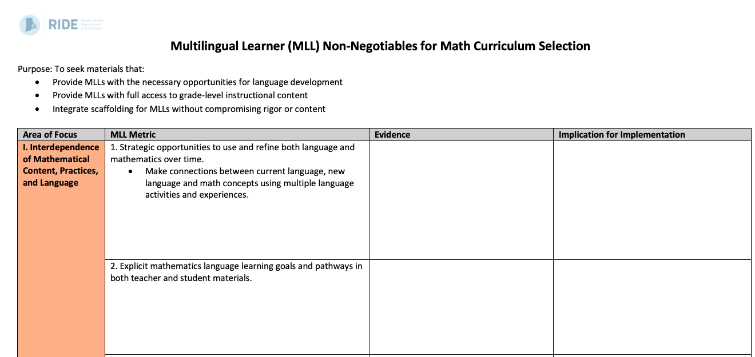
Using the MLL Support Tools
Notes:
It is imperative that educators support the needs of diverse and multilingual students in a way that provides access to, and success in, grade-level content through high-quality curriculum materials. The curriculum that LEAs select should offer research-based practices for supporting every student, including multilingual students. In the cases where these practices are not included, LEAs must make appropriate additions to ensure that English language development for multilingual learners is embedded in the core, grade-level content through the units and lessons plans that teachers will implement each day.
Toward this end, the tool has been designed with four sections in a Word template, which you can download and type into during your review process: [CLICK]
1. Area of Focus: These focal areas are color-coded to support organization and categorize the metrics to support a thematic analysis of the materials through the review process. [CLICK]
2. MLL Metric : Each metric is framed as a prompt, or question(s), to support evidence collection in a particular area. In most cases, concepts in these metrics will require group calibration on how key terms are understood, interpreted, and applied to the group’s holistic review process. [CLICK]
3. Evidence: This is gathered from teacher's manual, student materials, and other components of the curriculum based on the agreed-upon section(s) of the materials that the team has decided to review. Evidence can be collected in any way you prefer like bullet points, links, etc. [CLICK]
4. Implications for Instruction: Based on your team’s review of the evidence, determined the implications for instruction. For instance, if the materials in ELA or math lack scaffolds for multilingual learners, the team must recognize the implications for resources to supplement the core materials. While no set of materials will meet every need, this part of the process should shed light on whether or not a set aligns to your instructional vision, especially if your LEA has multilingual learners.

Slide 9
Culturally Responsive & Sustaining Education (CRSE)
Diverse Identities
Instructional Engagement
High Expectations
Cultural Awareness
Critical Consciousness
Notes:
RIDE’s CRSE Review Tools are intended to be used by teams of educators and district leaders to understand the degree to which a set of curriculum materials is reflective of student identities, lived experiences, and instructional needs from a global context. The design of RIDE’s CRSE Review Tool is based on two curriculum material review tools: NYU Steinhardt’s Culturally Responsive Scorecard and Great Lakes Equity Center’s Assessing Bias in Standards and Curricular Materials.
These tools were designed to focus on five areas which together can support Culturally Responsive & Sustaining Education:
1. Instructional Engagement
2. High Expectations
3. Cultural Awareness
4. Critical Consciousness
5. Diverse Identities
Similar to the MLL tools, the CRSE tools for ELA and math provide prompts and questions that support review teams in a deep dive in each of these five areas using the materials in a given curriculum. Knowing there is much to learn through this process, RIDE intends to support LEA teams in the use of this tool through our cohort supports, as part of the overall selection and implementation process starting in the 2020-21 school year.

Slide 10
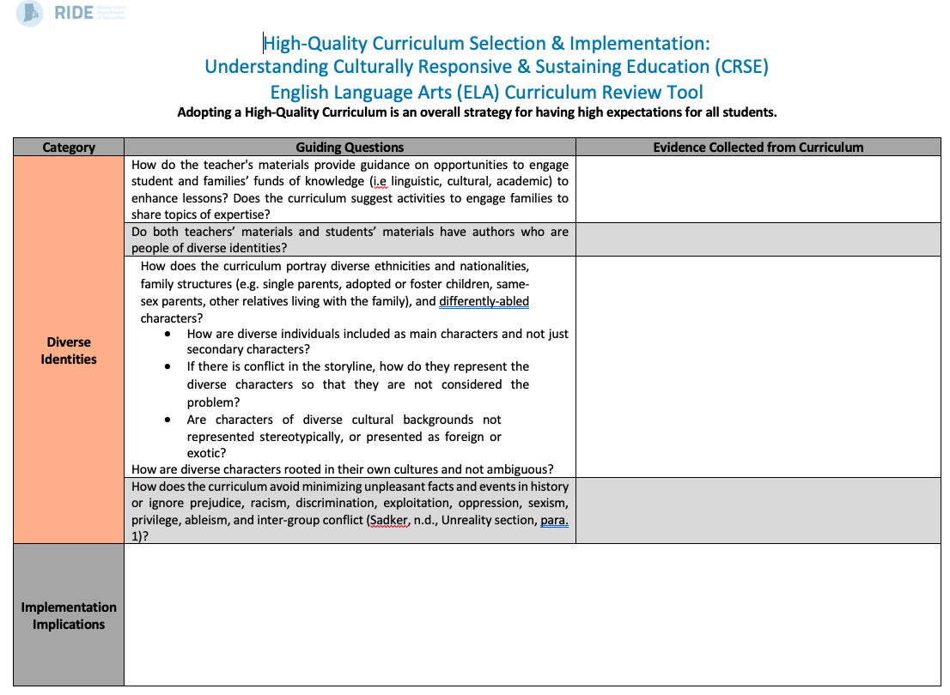
Using the CRSE Tools
Notes:
It is imperative that educators support the needs of diverse and multilingual students in a way that provides access to, and success in, grade-level content through high-quality curriculum materials. The curriculum that LEAs select should offer research-based practices for supporting every student, including multilingual students. In the cases where these practices are not included, LEAs must make appropriate additions to ensure that English language development for multilingual learners is embedded in the core, grade-level content through the units and lessons plans that teachers will implement each day.
Toward this end, the tool has been designed with four sections in a Word template, which you can download and type into during your review process: [CLICK]
1. Categories: These focal areas are color-coded to support organization and categorize the metrics to support a thematic analysis in each of the five areas of CRSE through the materials review process. [CLICK]
2. Guiding Questions: Each category is framed with prompts, or question(s), to support evidence collection. In most cases, concepts in these questions should provoke group dialogue and will require calibration on how key terms are understood, interpreted, and applied to the group’s holistic review process. There is an opportunity here to build capacity around the ways curriculum materials set a foundation for what is, and what is not, taught in the classrooms and who is, and isn’t, represented. [CLICK]
3. Evidence: This is gathered from teacher's manual, student materials, and other components of the curriculum based on the agreed-upon section(s) of the materials that the team has decided to review. Evidence can be collected in any way you prefer like bullet points, links, etc. [CLICK]
4. Implications for Instruction: Based on your team’s review of the evidence, determined the implications for instruction. For instance, if the materials in ELA or math overrepresent, or misrepresent, a particular cultural group, the team must recognize the implications for resources to supplement the core materials. While no set of materials will meet every need, this part of the process should shed light on whether or not a set aligns to your instructional vision.

Slide 11
K-2 Audit Tool for Foundational Reading Skills
Phonological Awareness
Phonics
Encoding
Decodable Text
Fluency
Assessment
Syntax
Vocabulary
Notes:
The Right to Read Act (RIGL§ 16.11.4-6) requires all teachers to have the required knowledge and skills to teach reading consistent with the best practices of the Science of Reading and structured literacy instruction. This legislation intersects with the selection of high-quality curriculum materials in English Language Arts. Specifically, LEAs will need to ensure that high-quality curriculum materials in grades K-2 attend to foundational reading skills.
This review tool is designed to ensure your K-2 literacy curriculum includes a solid foundation in early reading skills that target both decoding and language comprehension. A curriculum should include explicit instruction in phonological and phonemic awareness, phonics and word recognition with practice in decodable texts, vocabulary, grammar, syntax, and fluency to ensure students are learning to decode and comprehend grade-level text in a way that aligns with how the brain learns to read. Without these essential components, many students are often left to rely on undependable reading strategies such as guessing or sight word memorization, which often result in less-proficient readers. Thus, building a strong reading foundation is crucial to students’ future academic success.

Slide 12
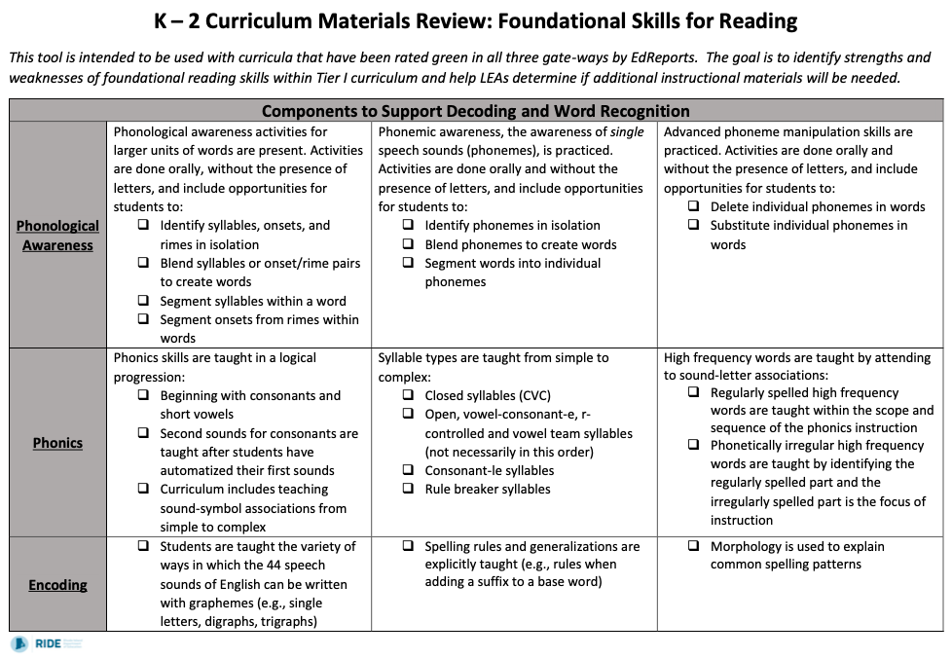
Using the Foundational Skills Audit Tool
Notes:
RIDE’s tool to review for foundational reading skills is a hybrid of tools that have been developed by national experts including the Student Achievement Partners and the Florida Center for Reading Research. Local review teams comprised of educators and leaders should review the rubric, prerecorded introductory presentation, and accompanying glossary of terms ahead of its use and calibrate on the understanding of key language and concepts. There may be new learning for members of the team, and to accomplish the goals of this tool, calibrating is essential.
As seen on the previous slide, there are eight (8) components to be reviewed. Each component in this review tool, noted in the categories in the left column, includes indicators to be located within the curriculum. If the skill described by that indicator is fully present in the curriculum, that box will be checked and the indicator will be colored green, if there is minimal evidence, it will be colored orange, and if there is no evidence it will be colored red. After assessing each indicator, reviewers will use the notes section to determine what resources they may use to fill the gaps in foundational reading skills that are missing from the curriculum materials being reviewed.

Slide 13
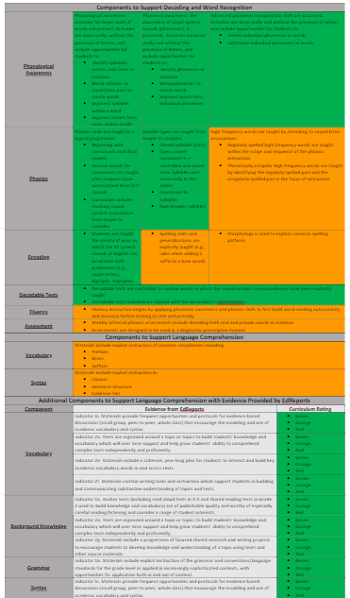
Using the Foundational Skills Audit Tool
Notes:
The tool is aligned with theoretical models of reading including the Simple View; thus, components are divided amongst a section to support developing skills related to decoding on top and a section to support developing skills related to language comprehension in the lower portion. Several aspects of language comprehension have already been thoroughly reviewed by EdReports, so LEAs will color code these components according to these findings. Many other components require further study to determine the depth of instruction of these critical skills. For example, while phonological awareness awareness is within a list of skills in EdReports’ indicator 1 O, this tool helps LEAs to go deeper to find if both phonological and phonemic awareness are explicitly taught and practiced to the level of proficiency.
RIDE recently engaged in this review process with Newport. This is a section of their final color-coded tool for one of their curriculum choices. You will notice that there was evidence found of phonological and phonemic awareness instruction in the top row, but the orange shows that the curriculum was less strong in areas encoding, fluency, assessment, morphology, and syntax.
The feedback from Newport was positive, and we look forward to engaging in this work with other LEAs. Please reach out to us at curriculum@ride.ri.gov if you are interested in contacting Newport to hear more about how they found the auditing process to be and please contact us if you would like to undergo this process of reviewing your materials for Foundational Reading Skills with us.

Slide 14
Thank you!
Register on our Curriculum Webpage for our upcoming webinar:
Waiver Options Webinar: Wednesday, July 29 from 2-3
Contact curriculum@ride.ri.gov with additional questions.

