Slide 1
RICAS: ELA/Literacy Calibration
Winter 2019

Slide 2
Goals
  To understand the purpose and benefits of calibration/looking at student work
  To use student work from RICAS Released Items to further understand the RICAS rubric and the implications for instruction

Slide 3
Calibration
PURPOSE:
Build CONSISTENCY
  Interpretation of rubric
  Evaluation of qualities found in student work
  Application of rubric to score student work across classes, schools, and LEAs
Establish RELIABILITY of scores
ALIGN student work to the standard(s)
Notes:
Calibration enables a group of teachers and other educators to reach agreement on how to score student responses to a given prompt.
Through discussion of student work,
educators develop a common understanding of the rubric
and how they evaluate qualities in the student work
Both of which might cause educators to differ in their scoring.
Goal is to build consistency in scoring student work across classes in a school, across schools in am LEA and for RICAS we are also looking for consistency across LEAs within the state.
This will help to establish reliability of the scores and show how student work is aligned to a particular standard or standards.
A good example might be: Educators may look at wording in the rubric that deals with the "selection and explanation of evidence and/or details” Initially, educators may be unclear about what the rubric means by “effective selection” or disagree about whether the explanation of evidence in a particular sample of student work is appropriate or limited. By the end of the calibration session, the educators will have reached agreement about such issues and be interpreting and applying the rubric in the same way. When they go on to score the remaining papers written to that task/prompt, their results will be more reliable because it is likely that any given paper would have been scored the same by another evaluator in the group. Their results will also be more accurate, in that the group has collectively and deeply thought through the rubric before applying it.

Slide 4
Calibration can:
Align the scorers with the existing rubric & anchor papers
OR
Identify anchor papers using the rubric
Notes:
We will be using the existing RICAS Rubric for Grades 6-8 along with some anchors papers that have been selected for this activity.

Slide 5
RICAS Grade 6 Passage Set
Students would
Read: 2 texts
Complete: 7 Selected Responses (SR) includes:
multiple choice, multiple select, and/or
technology enhanced items
based on Reading Informational, Reading
Literature or Language standards
1 Essay (ES) based on Language and Writing
standards
Notes:
To begin our calibration session we have selected a grade 6 passage set.
In this set students would have …..

Slide 6
Grade 6 Passage Set
TEXTS:
Passage from A Jar of Dreams, by Yoshiko Uchida
Poem “Somewhere Among,” by Annie Donwerth-Chikamatsu
Notes:
The texts for this passage set from Grade 6 are …..
All of you should be on the TestNav platform in order to read the texts and answer all the items. Please note that Participants will skip the first 7 questions within the Grade 6 Released Items and begin with reading the 2nd set: A Jar of Dreams and "Somewhere Among." The second set begins with ePAT item #8 - #16
https://ri.testnav.com/client/index.html#login?username=LGN201300611&password=ENPX24LQ
Be sure to record your essay "notes" within a separate word document on the computer or use the scratch paper provided. For those of you who still need to find the the Passage set. The following slide will go step by step to help you find the platform. If all participants are on the TestNav platform you may skip the next slide and go directly to the directions of the for the calibration protocol.

Slide 7
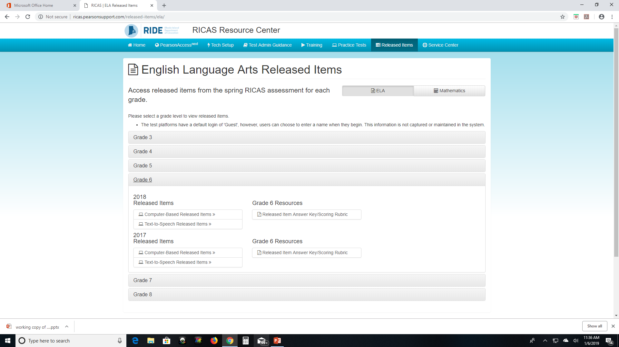
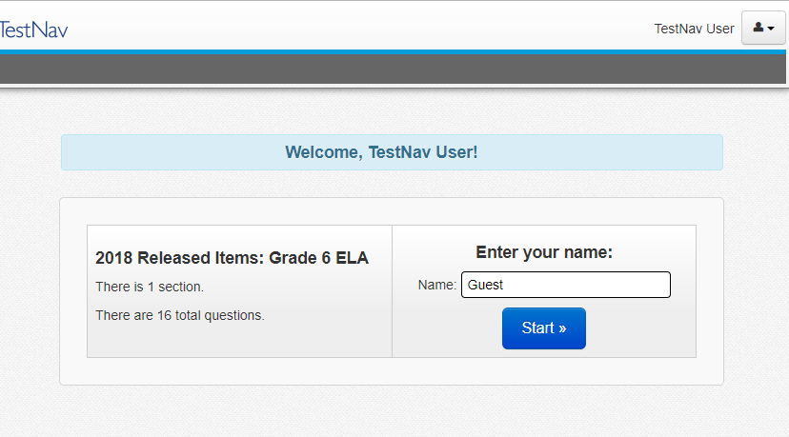
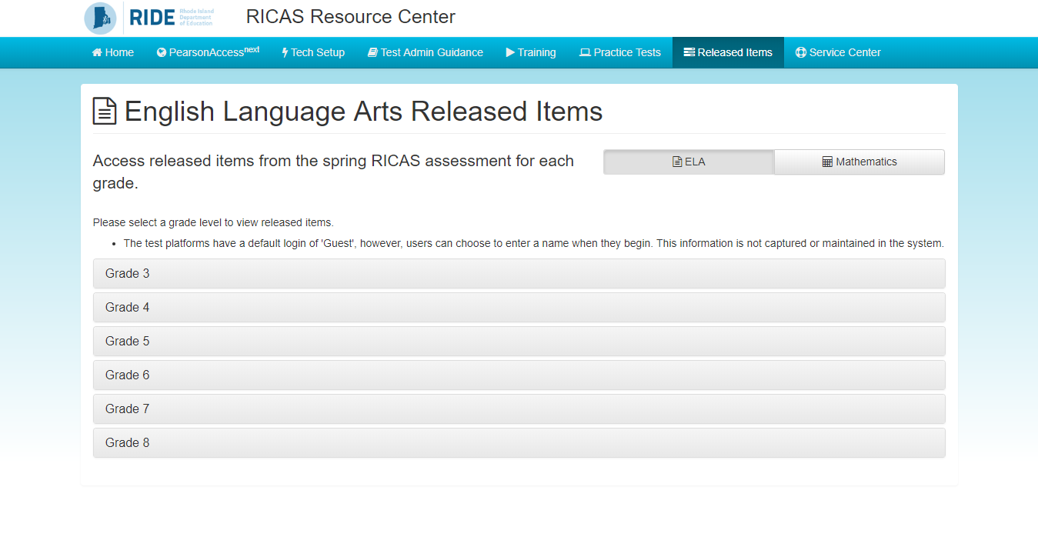
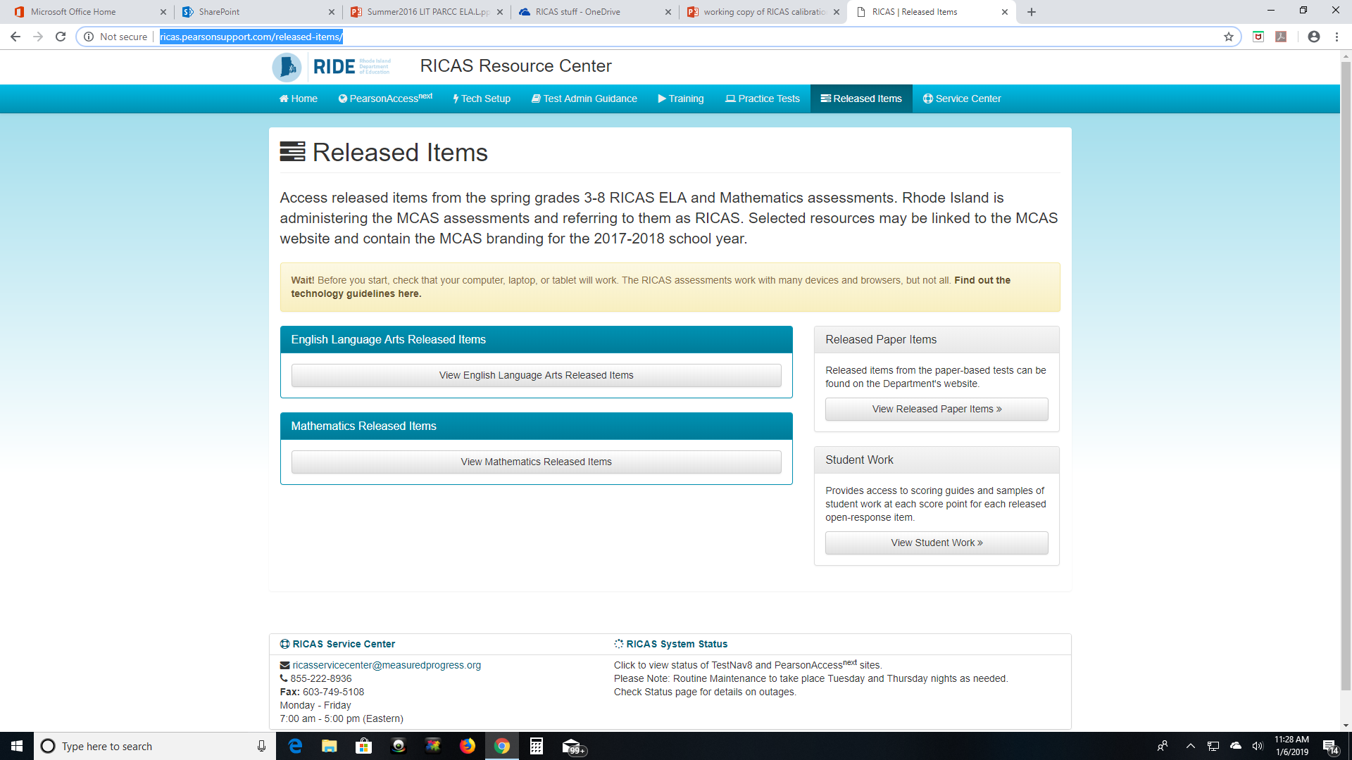
Using TestNav
Available on the RICAS Resource Center
(http://ricas.pearsonsupport.com/released-items/)​
Notes:
Released items from the computer-based version of the test are available online at the Pearson RICAS Resource Center.
The computer-based released items are collected in a mini test called an ePAT (electronic practice assessment tool). Items in the ePAT are displayed in TestNav 8, the testing platform for the computer-based tests.
Once you click into a subject and grade in the Resource Center, you will see a link to the released items (the ePAT).

Slide 8
Calibration Protocol Directions
Independently READ both texts: passage and poem
Complete all the Selected Response Items
Record outline/notes articulating the big ideas you would use to frame your essay response on your scratch paper
Identify evidence you would use to answer the essay prompt yourself
Predict what you will see in a 6th graders’ response
Notes:
Talk through the 5 steps
Please complete steps 1-5 using the second passage set from the Grade 6 released items. The second passage set begins with ePAT item #8 and goes to #16
At this point, please pause or stop the webinar until all participants have completed steps 1-5. Remember to use the scratch paper or a separate word document to outline your response to the essay. While recording your own response may seem trivial, it is an important step that will aid in your discussions about this item set, so ….Don't Skip It!

Slide 9
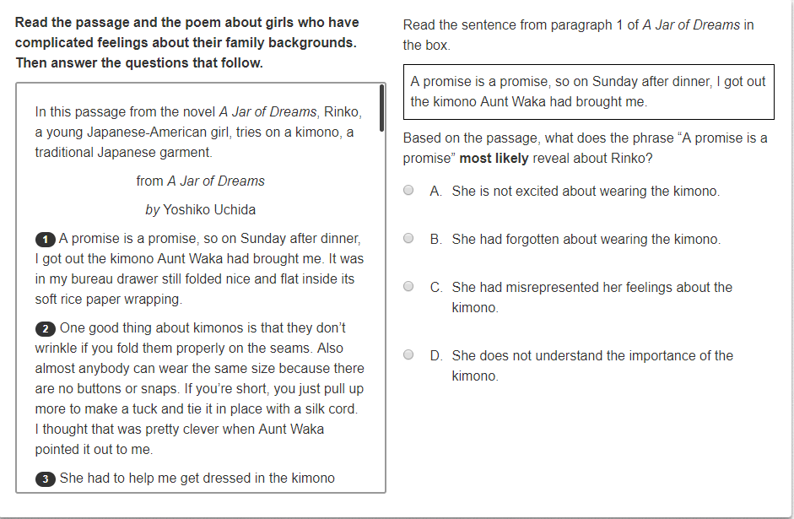
Grade 6 Selected Response
Notes:
Welcome back - All participants should have completed (answered) this passage set before you resume the webinar.
Let’s walk through the Selected Responses and see how you did on this set:
Correct Answer: A
RICAS Alignment: RL.6.4 Determine the meaning of words and phrases as they are used in a text, including figurative and connotative meanings; analyze the impact of a specific word choice on meaning and tone.
Students needed to determine how the phrase "a promise is a promise" reveals aspects of Rinko in this passage.

Slide 10
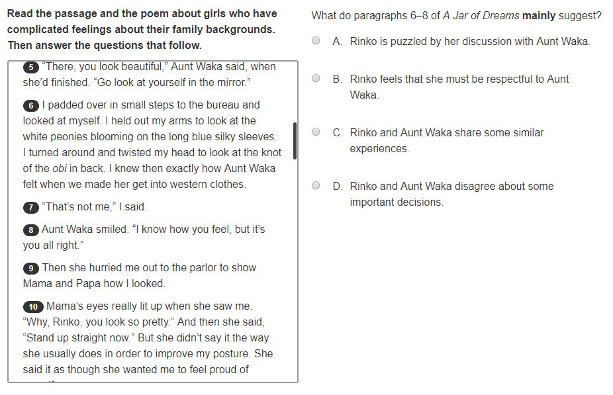
Grade 6 Selected Response
Notes:
Correct Answer: C
RICAS Alignment: RL6.5 Analyze how a particular sentence, chapter, scene, or stanza (in this case paragraphs) fits into the overall structure of a text and contributes to the development of the theme, setting, or plot.
Students needed to analyze how these paragraphs from the passage contribute to the development of the plot and Rinko's understanding of/relationship with her aunt.

Slide 11
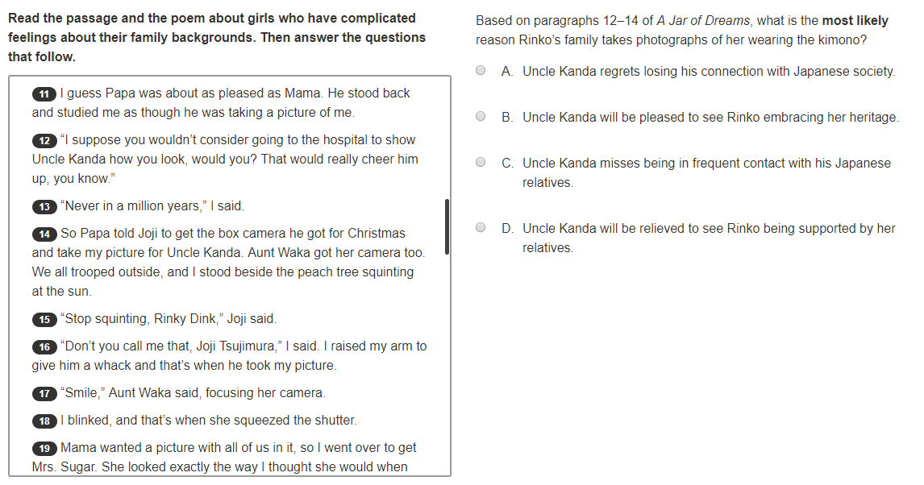
Grade 6 Selected Response
Notes:
Correct Answer: B
RICAS Alignment: RL.6.1 Cite textual evidence to support analysis of what the text says explicitly as well as inferences drawn from the text.
Students needed to make an inference about why the family is taking a photograph of Rinko wearing the kimono.
If teachers want to probe a bit more and make it a teachable moment they could provide a follow-up question and ask your students is Which sentence really helped you make that inference? P12 “That would really cheer him up.”

Slide 12
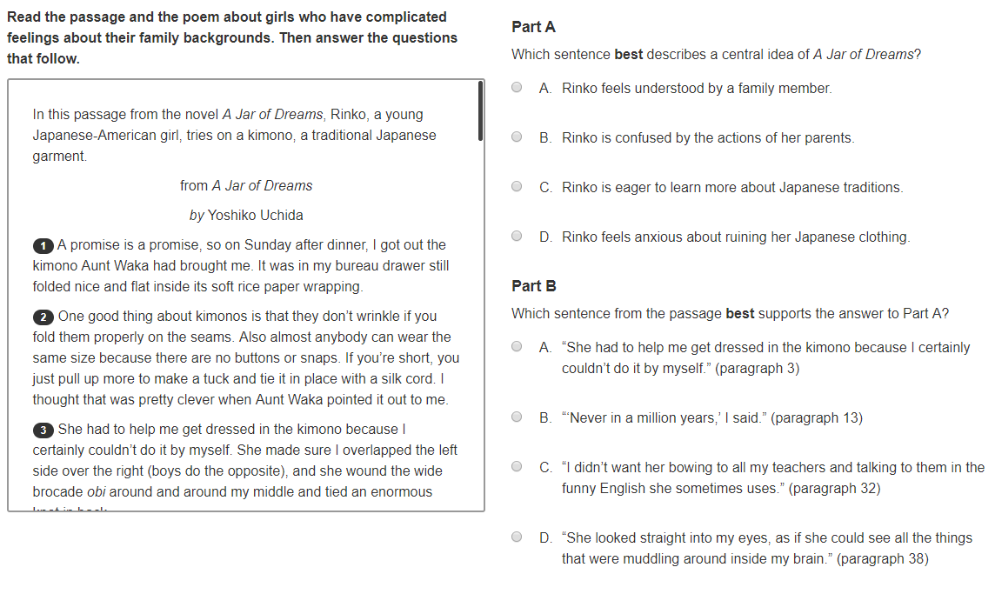
Grade 6 Selected Response
Notes:
Correct Answers: A,D
RICAS Alignment: RL.6.2 Determine a theme or central idea of a text and how it is conveyed through particular details; provide a summary of the text distinct from personal opinions or judgments.
Students needed to identify the central idea of the passage and also choose supporting evidence.
In the past we would have coding it to both standard RL.6.2 AND RL.6.1
Students need to get Part A correct in order to score the point in Part B.

Slide 13
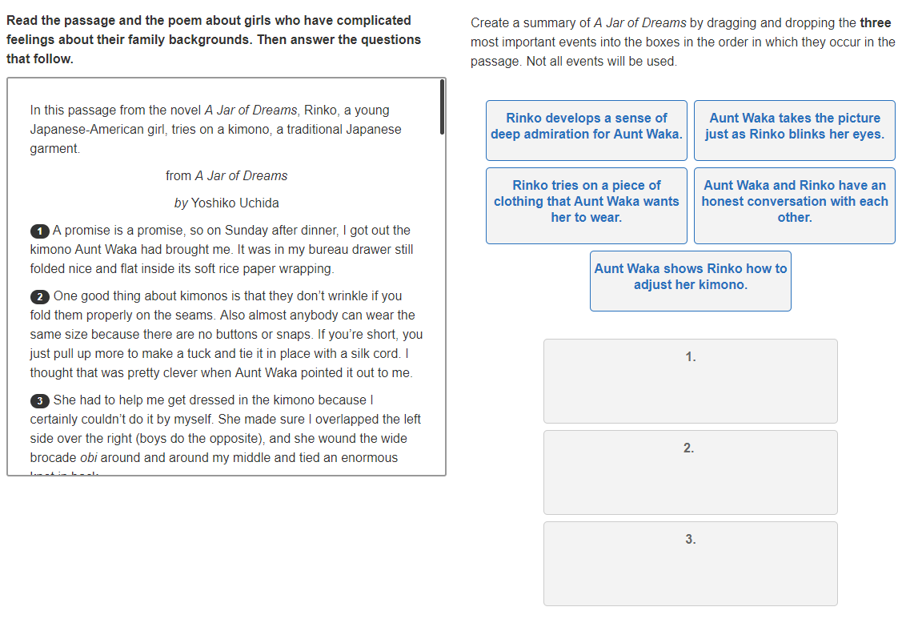
Grade 6 Selected Response
Notes:
Correct Answers:
Rinko tries on a piece….
Aunt Waka and Rinko have an honest …
Rinko develops a sense ….
RICAS Alignment: RL.6.2 Determine a theme or central idea of a text and how it is conveyed through particular details; provide a summary of the text distinct from personal opinions or judgments.
Students needed to create a summary of the passage.
Scoring All three in the correct order to score 2 points
2 of the three correct responses with at least one in the correct spot
If all three correct choices are selected but none are in the correct spot 0 points are given

Slide 14
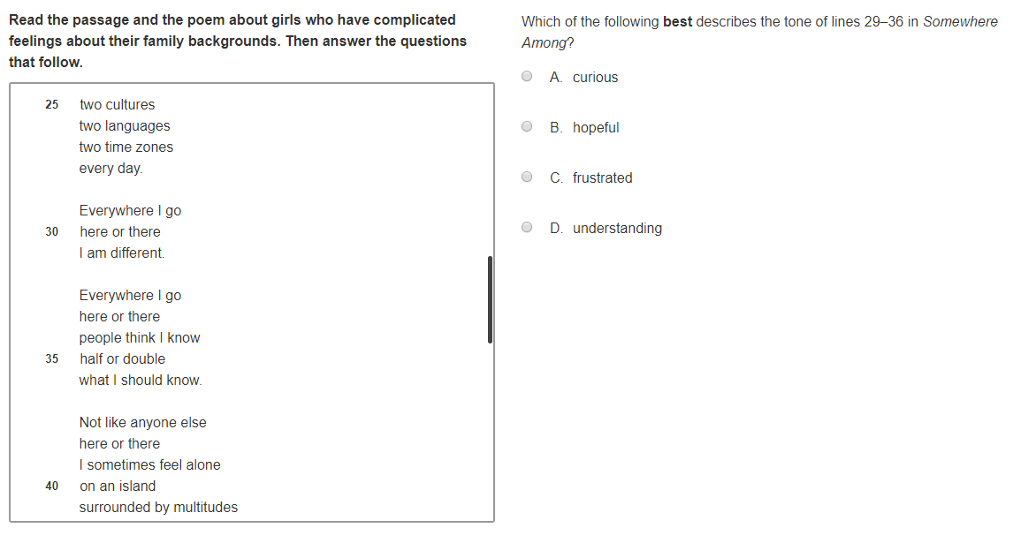
Grade 6 Selected Response
Notes:
Correct Answer: C
RICAS Alignment: RL.6.4 Determine the meaning of words and phrases as they are used in a text, including figurative and connotative meanings; analyze the impact of a specific word choice on meaning and tone.
Students will needed to determine the tone of the poem in this particular section.

Slide 15
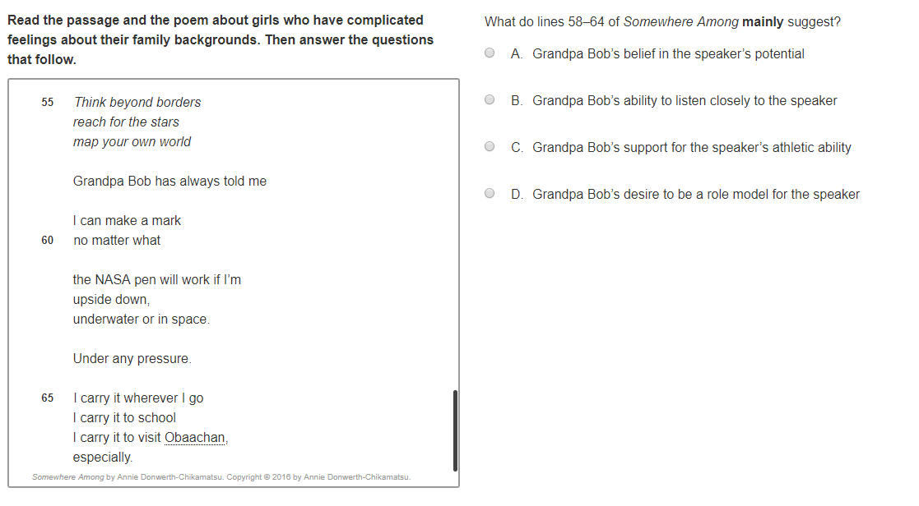
Grade 6 Selected Response
Notes:
Correct Answer: A
RICAS Alignment: RL.6.5 Analyze how a particular sentence, chapter, scene, or stanza fits into the overall structure of a text and contributes to the development of the theme, setting, or plot.
Students needed to analyze how the characters in the poem contribute to the development of the plot

Slide 16
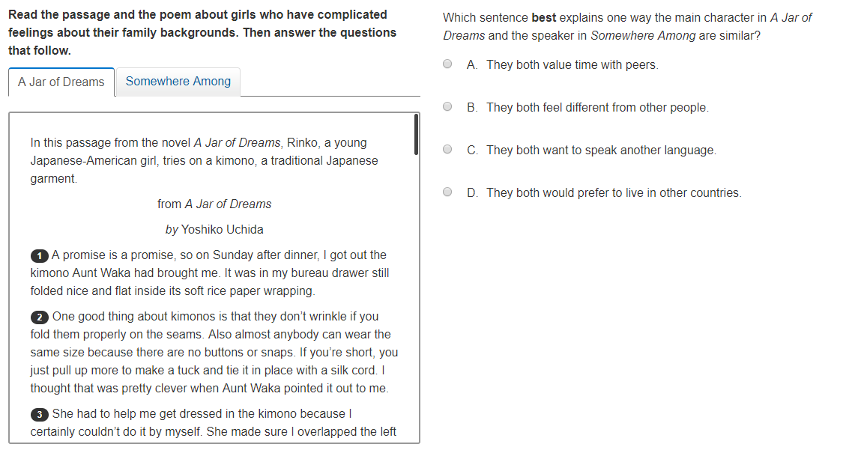
Grade 6 Selected Response
Notes:
Correct Answer: B
RICAS Alignment: RL.6.3 Describe how the plot of a particular story, poem or drama unfolds in a series of episodes as well as how the characters respond or change as the plot moves toward a resolution.
Students needed to analyze how characters in the passage and the poem as similar.

Slide 17
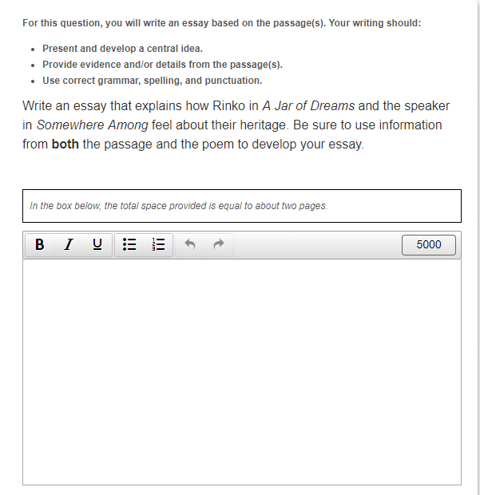
Grade 6 Essay
Notes:
RICAS Alignment:
W.6.2Write informative/explanatory texts to examine a topic and convey ideas, concepts, and information through the selection, organization, and analysis of relevant content.
W.6.4 Produce clear and coherent writing in which the development, organization, and style are appropriate to task, purpose, and audience
L.6.1, L.6.2, L.6.3 This encompasses Conventions of Standard English & Knowledge of Language
You have crafted an outline and/or list of bullets points along with evidence you or your students would use to answer this question.
Let’s take a look at some student work that has been released.

Slide 18
Calibration: Student Responses
INDEPENDENTLY…
  Read Student Responses A, B, and C
  Rate the 3 responses: HIGH, MIDDLE, LOW
Is the question asked in the prompt being answered?
What is the quality and development of the central idea of the response?
What is the quality of the evidence and/or details?
How well is this response organized?
How well did the student express his/her ideas?
Notes:
We would ask the facilitator to pass out Student Responses labeled: A, B, and C
Independently read the 3 student responses. Think about the writing (not the grammar/conventions) found within each response.
As you think about the quality of writing, ask yourself
-->Is the students answering the question asked?
-->What is the quality and development of the central idea of the response?
-->What is the quality of the evidence and/or details? This includes the selection and explanation of the evidence and/or details provided.
Also consider the organization of the response as well as the expression of ideas. So
-->How well is this response organized?
-->How well did the student express his/her ideas?
Then rate the 3 responses as HIGH, MIDDLE and LOW
Feel free to take notes about what the student is doing well within each response, capturing the positive aspects of each response. This will be helpful as you work through the set and articulate your thoughts to others.
Hint to complete this task- refer back to the texts and prompt as needed.
After completion of this independent work resume the webinar.

Slide 19
Calibration: Student Responses
Small Group Work…
  Share your ratings with colleagues
  Discuss any differences
  Come to consensus on the group rating
  Articulate as a group HOW and WHY you all assigned the rating of HIGH, MIDDLE, LOW to each response
Notes:
Welcome back - We hope your conversations were fruitful and that you were able to record notes as you read through the 3 responses.
Now in groups of 3-4, share your ratings of HIGH, MIDDLE, LOW with your colleagues. Be sure to discuss any differences and come to a consensus. As a group, articulate why your group assigned the rating of high, middle or low to each piece of student work.

Slide 20
Calibrating Student Responses
INDEPENDENTLY…
  Read Student Responses D and E
  Rate the two new responses in relation to previous three responses
  Rank them from 1-5, 1 being the highest and 5 being the lowest
Keep in mind the qualities of good writing:
    Answering the question asked
    Development of central idea
    Evidence and/or details selected
    Organization
    Expression of ideas
Notes:
Independently read two additional responses labeled D and E.
Where do these 2 new responses "fit“ in relation to the previous 3 responses (A, B, C)? Be sure to independently place all five responses in order from highest to lowest.
1 being the best response and 5 being the lowest.
Once your independent work is complete resume the webinar.

Slide 21
Calibrating Student Responses
Small Group Work…
  Share rating with colleagues
  Discuss & come to consensus on the progression of all papers from highest to lowest
  Articulate WHY your group ranked them as they did
Large Group Discussion to sum up small group discussions
Notes:
Welcome back...
In small groups,
Share your ratings, including why each response was ranked in that particular order. Discuss all of the responses and come to consensus on the progression of the papers within your small group. Be sure to articulate why your group assigned the numbers 1-5 to each response, so that your group can report out.
Once each group has finished their discussion, provide each small group time to share out their rank order and sum up their discussion to the larger group. Do not be surprised if within the larger group you have some differences between order. It is important to discuss the differences as responses which are "neighbors" (a 2 vs 3) is a different conversation than if one group scored the same response a 1 and another scored it a 4.
Pause the webinar while you are having your small group discussions and your reporting out to the larger group.

Slide 22
Answer Key
Ranking student responses -1 being the highest and
5 being the lowest
Student B
Student A
Student D
Student C
Student E
Notes:
Having worked with many educators across the state, we know that some of you won’t be happy until you get an answer key as to how the student responses were ranked.
How does this information jive with the conversations you have had in your small and larger groups? Do you agree? Disagree? Do you have any discrepant scores or non-neighbors (perhaps a 1 and a 4 for the same response)?
Please take a few minutes to compare your ranking with the ranking we provided. Feel free to pause the webinar if your participants need to discuss the results.

Slide 23
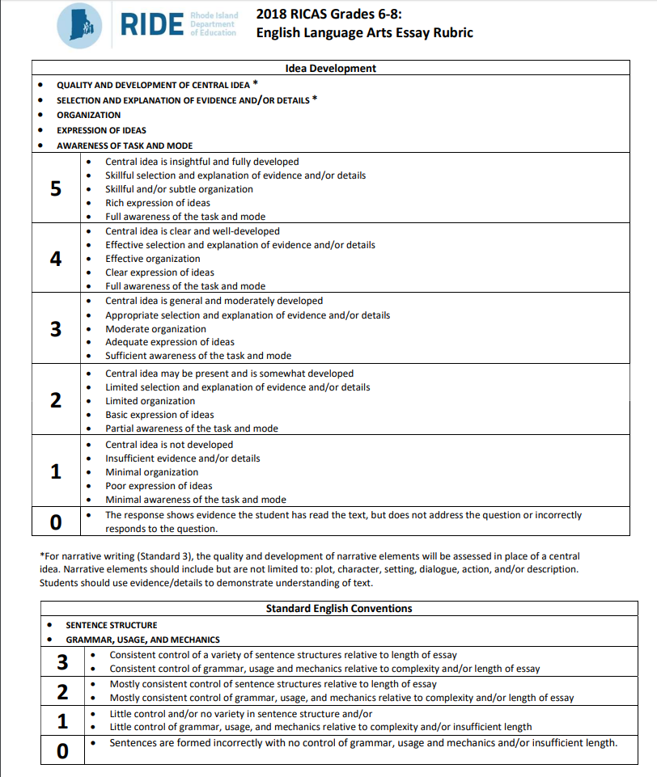
Understanding RICAS Rubric Expectations
Notes:
In all of this work we have asked you to consider the qualities of a good piece of writing without considering the Conventions. Some of you may have also been asking why you did not have a copy of the RICAS rubric in front of you during this time.
We did this purposefully as we wanted you to consider all the qualities of good writing and have more meaningful discussions around each of them.
Development of central idea
Evidence and/or details selected
Organization
Expression of ideas
Keeping this in mind, let's look at the RICAS rubric. You will note that there are two constructs measured/scored: Idea Development and Standard English Conventions.
As we continue with this calibration session, our focus will remain on the idea development within the RICAS rubric.

Slide 24
Calibration: Rubric Analysis
INDEPENDENTLY…
  Review 2018 RICAS Grade 6-8: English Language Arts Essay Rubric
  Highlight words that signal change between score points
Notes:
Let's dive deeper into the Idea Development portion of the RICAS Idea Development portion of the RICAS Grade 6-8 English Language Arts Essay Rubric.
Invite everyone to take some time to highlight, underline, etc., words that signal a change between score points.
After participants have had an opportunity to independently review the Rubric, encourage everyone to discuss their observations, including word choice and score point distinctions. Are they similar or very different than other rubrics you are using in your classroom or have encountered in education?

Slide 25
Calibration: Scoring Student Work
INDEPENDENTLY…
  Assign an Idea Development score to each paper based upon Rubric expectations
Small Group Work…
  Discuss scores & come to consensus for assigned score
Notes:
We will ask that each participant independently work to assign a score to each of the 5 responses using only the idea development part of the rubric.
You already have some of the work completed as you have ranked the 5 responses. Now you have to determine which one or ones belong in which score points.
Cautionary Notes:
Some folks have said this is easy. There are 5 responses and 6 score points when you include the score point of zero.
Heads up: we did not include any score point zero responses in this calibration exercise.
So you might say, ok, that is even easier now that there are 5 score points and 5 responses.
However, we would not make it that easy as there would be no rich discussion opportunities.
That being said, we will share with you that all 5 score points ARE NOT represented in these 5 responses.
Other than that piece of information, we will ask that you independently assign scores to the set of 5 responses based on the RICAS rubric.
Then gather, again, as a small group to discuss scores and come to consensus before you resume this webinar.
Have fun.

Slide 26
Calibration: Annotations
INDEPENDENTLY:
  Read Annotations for 5 student response papers
  Ask yourself:
    Did the annotations help your understanding of the score assigned?
    Did the annotations highlight a new interpretation for you of the student response?
    Did the annotation help clarify language of the rubric?
    What might you add to the annotation(s)?
Notes:
Now that you have scores for all five responses.
We will ask the facilitator to pass out the annotations.
Read the annotations independently and ask yourself:
Did the annotations help your understanding of the score assigned?
Did the annotations highlight a new interpretation for you of the student response?
Did the annotation help clarify language of the rubric?
Think about the independent notes and group notes that were taken earlier in the session.
Is there anything that you feel is missing from the annotation that would provide clarity to others?

Slide 27
Calibration: Take Away Discussion
Scoring Reflection:
  Articulate characteristics found within Score Point 4 response?
  Identify differences between Score Point 3 and 4? Score point 3 and 2?
  If you had discrepant scores among scorers, how were they discrepant? Was it due to interpretation of rubric language? Student expectations differences?
Implications for Instruction:
  How do students prepare to understand the expectations of the standard?
  How do we support students in answering the essay questions?
      Would a Graphic Organizer be appropriate?
      Would additional experiences with multiple texts be helpful?
Notes:
Articulate characteristics found within Score Point 3 responses?
- What is it that a student does to earn a score point 3? Evidence? Ideas? Focus? Clarity?
Identify differences between Score Point 3 and 4?
How are the student responses different between Score 3 and 4? Elaboration? Sophistication of response? Evidence to support? Clarity/ Cohesion?
Identify differences between Score point 3 and 2?
-How are the student responses different between Score 3 and 2? Control of response? Evidence? Development of response/ideas? Evidence included?
If you had discrepant scores, how were they discrepant? Interpretation of Rubric language? Student expectations differences? Differences in interpretation of appropriate response? Interpretation of texts?
IMPORTANT NOTE: If your group on a whole scored the student responses lower than the score they received on RICAS. That is fine as you have higher expectations for student writing than the on demand RICAS state assessment. However, if it was the reverse and you scored the student responses higher than the score they received on RICAS, you may need to spend some time on reviewing district and/or school expectations for writing. As it may be that you are not rigorous enough in your expectations for student writing.

Slide 28
The Calibration Process
Ultimate Benefit:
Deepens collective understanding of standard & expectations
Extensions:
  Revise/Review current LEA/school rubrics
  Use anchor responses for instruction with students:
    Shows students how other peers have responded to Essays
    Students can analyze/evaluate sample responses critiquing each writer’s craft & applying to own peer feedback
  Review student data to guide current instruction/curriculum
Notes:
Notes:
Perhaps the calibration process of the RICAS released items provides an opportunity to revise current rubric to reflect more accurately a student expectations or use RICAS Rubric instead.
Calibration provides a professional learning opportunity for educators, enabling them to deepen and solidify their understanding of expectations for student work and of the standards upon which they are based.

Slide 29
Resources
RICAS Resource Center
  Computer-based RICAS Released Items
  Answer key/scoring rubric including Reporting Categories, Standards, and Item Descriptions
  Student Work link- This will take users to the Massachusetts Department of Education website.
RIDE Item Analysis Resources
  Printable version of Paper-based RICAS Released Items
  Item analysis by subject and grade level

Slide 30
Literacy Supports on RIDE website
RICAS ELA Test Design
RICAS: Released Items & Student Samples
RICAS: Student Score Report/ Item Analysis & Subscore
RICAS Graphic Organizers
Writing Calibration Tool – Turn Key Protocol
  Addresses :
          BOTH Holistic & Analytic Rubrics
          If you have Anchors sets and if you do not have Anchor sets

Slide 31
Questions
Please direct all correspondence to:
assessment@ride.ri.gov
In the subject line of the inquiry include:
RICAS: ELA/Literacy Calibration

