Slide 1
Training Guidelines
Please mute your mic, you can unmute it at the end of the presentation to ask questions
Use chat to make questions during the presentation, we will address them when convenient
Sessions will be recorded and posted on the UCOA Website
START RECORDING!

Slide 2
UCOA DASHBOARDS UCOA Training Series Session 5
Rhode Island Department of Education
8/25/22

Slide 3
UCOA Dashboards Initiative
More than 10 years since UCOA implementation and still potential hasn’t been realized
We value the effort of submitting the data and want to provide useful tools to analyze the data
Step towards increasing the accessibility and use of UCOA data
Continue improving the quality and timeliness of the UCOA data
We view LEAs as one of the primary users of these dashboards. Please let us know what information would be useful

Slide 4
Three interactive Tools with UCOA Data
1. UCOA Dashboards
Released November 2021 recently updated
2. LEA Financial Profiles
Released August 2022
3.LEA Budgets
To be released soon

Slide 5
UCOA Dashboard
Analyze historical expenditures at different levels of aggregation (district and school level) and detail (parent, child and grandchild)
Compare expenditures/revenues of different districts and schools
Analyze expenditures by individual segments (function, object, subject, etc.) and combined expenditure classifications (e.g. program and object)
Answer specific questions such as:
“How much we spent for instructional materials and textbooks for Math at the high school?”
or
“How much did we spend on Salaries and Benefits for Math Teachers in our Middle Schools?”

Slide 6
LIVE DEMO
https://tinyurl.com/UCOADashboard

Slide 7
LEA Financial Profiles
Part of the Fiscal Accountability report submitted to the General Assembly in August 2022 as required by State Law
Four-page report that includes high level information about the characteristics of every LEA (including a set of outcome measures) and an in-depth analysis of the finances.
Developed to answer three types of questions:
1) What are the sources of revenue of my LEA and how are they spent?
2) How have the revenues and expenditures of my LEA changed over time?
3) How do the revenues and expenditures of my district compare to similar LEAs?
Plan to meet with LEA representatives to review the profiles and develop criteria and priorities to improve cost controls, efficiencies, and program effectiveness.

Slide 8
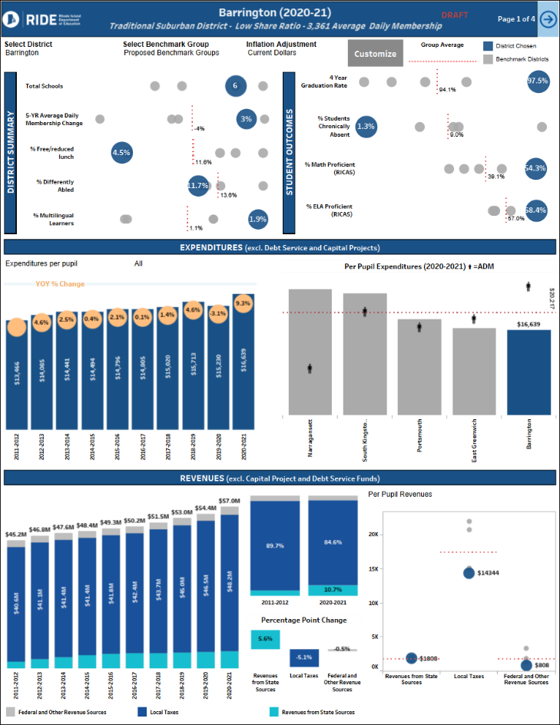
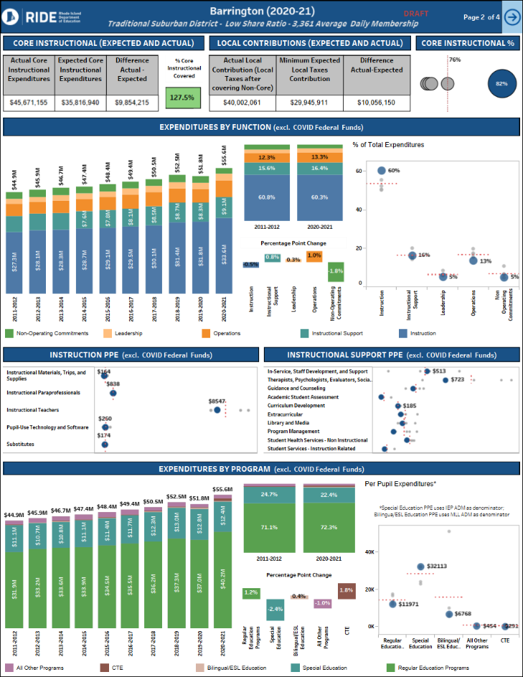
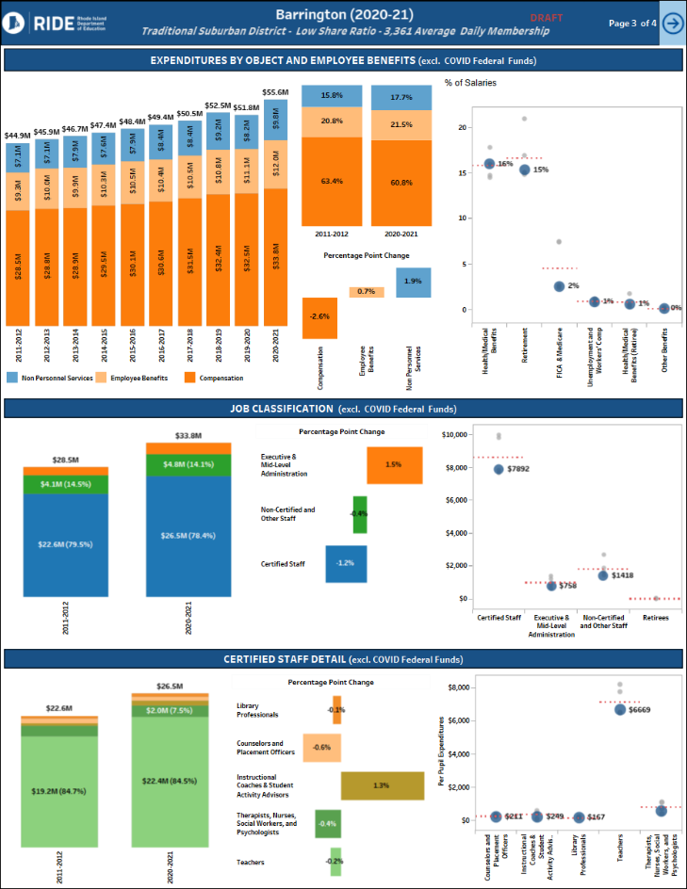
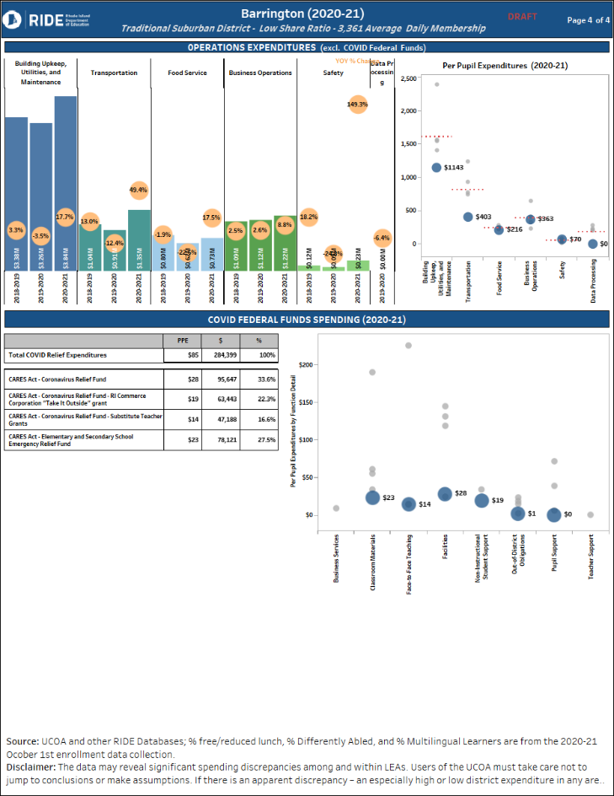
LIVE DEMO
https://tinyurl.com/UCOAFinancialProfiles

Slide 9
LEA Budgets
Required submission per R.I. Gen. Laws § 16-2-9.4:
“(…) each local education agency shall submit a "budget-only" file that conforms with UCOA requirements to the department of elementary and secondary education within 30 days of the city/town adoption of the budget.”
Starting this year we are using the data for:
New Budget section in our website:
Who has submitted/not submitted
Easy to view/understand/download district budgets
Strategic Planning System
Ties budget to initiatives and results
Can customize for your district if you want to publish in your website

Slide 10
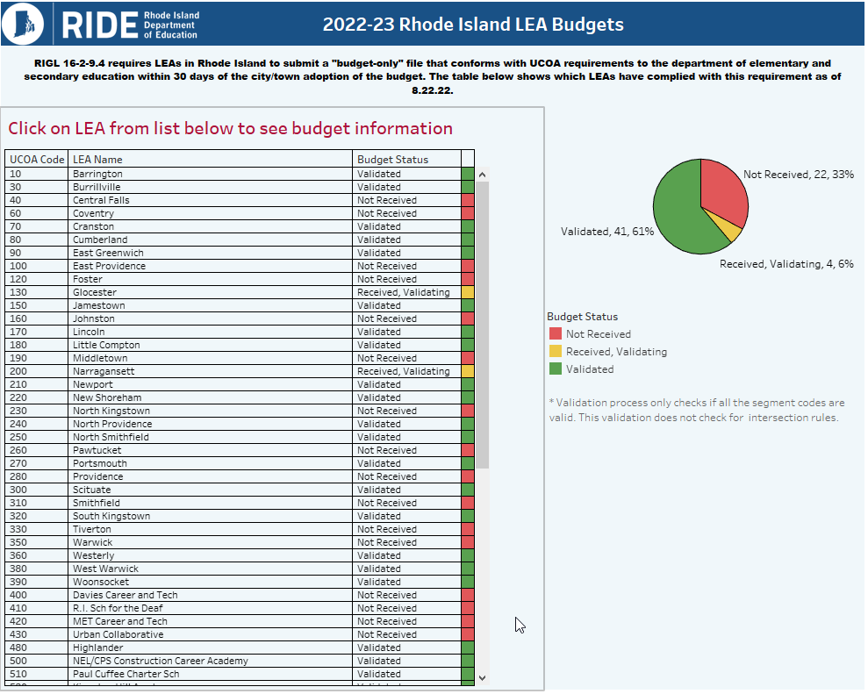
LIVE DEMO
https://tinyurl.com/UCOABudgets

Slide 11
Next Steps
Submit UCOA files due on time
Contact us if you see any issues with the visualizations
Feedback is more than welcome, we hope that these tools are useful
RIDE will continue analyzing UCOA Data:
Cost Effectiveness and Return on Investment
School Level Analyses
Resource Equity Analyses
Financial Health Analyses
Variance Analyses (actual vs budget)
Any other topic of interest?

Slide 12
Questions?
Santiago.Guerrero@ride.ri.gov
Juan.Taveras@ride.ri.gov

