Slide 1
Common Core State Standards and Next Generation Science Standards for Diversity and Equity
Education Policy Breakfast Series
The Common Core Standards:
Part III: Desired Outcomes and Potential Consequences
Okhee Lee
New York University
Steinhardt School

Slide 2
Topics
Context: National and New York
Increasing diversity in demographics
Emerging educational policies for standards and assessments
National Initiatives
Next Generation Science Standards (NGSS) Diversity and Equity
Understanding Language Initiative
Promote Desired Outcomes (and Avoid Negative Consequences)
Notes:
On the one hand, changing demographics. On the other hand, emerging national initiatives for standards and assessments
These initiatives are designed to promote desired outcomes for increasing student diversity to meet standards and assessments

Slide 3
Student Demographics: National Context
45% of the U.S. population under 19 years old are racial minorities (2010 U.S. Census)
22% of children live in poverty, the highest rate since the American Community Survey began in 2001 (2010 U.S. Census)
48% of students were eligible for free or reduced price lunch in 2010 (National Center for Education Statistics)
Notes:
“Under 19 years old” indicates the school-age population.
It is projected that the year 2022, 10 years from now, will be the turning point when minorities collectively will become the majority in terms of percentage of the population but are likely to remain minorities in terms of status. After that point, there is no turning back.

Slide 4
Student Demographics: National Context
13% of children and youth ages 3-21 receive special education services under Individuals with Disabilities Education Act (IDEA) in 2009
21% of school age children speak a language other than English as their primary language at home in 2007
Limited English Proficient (LEP) students (the federal term) have more than doubled from 5% in 1993 to 11% in 2007
(National Center for Education Statistics)
Notes:
FRL source: http://nces.ed.gov/pubs2012/pesschools10/tables/table_07.asp

Slide 5
Student Demographics: New York City
16% received special education services in 2010
41% reported speaking a language other than English as the primary language at home in 2010
14% of the student population were English language learners in 2010

Slide 6
Educational Policies: National Context and New York State
Common Core State Standards (CCSS) for English Language Arts and Math – 45 states and 3 territories including D.C.
New York State “Common Core Learning Standards (CCLS)”
Comprehensive Assessment Consortia (PARCC and Smarter Balanced) to measure CCSS
New York State belongs to PARCC
Next Generation Science Standards (NGSS)
New York State is one of the 26 Lead State Partners
Notes:
Review of Ed Policy Breakfast 1 on CCSS
Review of Ed Policy Breakfast 2 on PARCC and CCSS (watch videos)
Science standards are released in the mix of CCSS and Comprehensive Assessments
I would like to highlight synergy across these subject areas to meet the needs of diverse student groups
Standards are out, implementation and assessment are key – I would like to speak to teachers and future teachers (my own students)

Slide 7
Next Generation Science Standards (NGSS): Diversity and Equity

Slide 8
Next Generation Science Standards (NGSS)
Achieve, Inc. is overseeing the development
The 41 writing team members consist of classroom teachers, state and district supervisors, faculty from higher education institutions, and representatives from the private sector
There were two rounds of public release of drafts for feedback – May 2012 and January 2013
The final NGSS were released on April 9, 2013 (and will continue until late April)
http://www.nextgenscience.org/

Slide 9
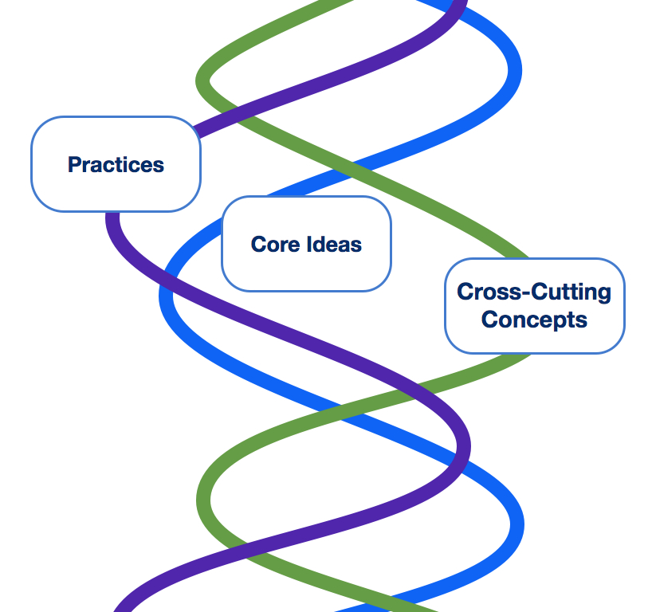
Three Dimensions Intertwined
Science and engineering practices
Crosscutting concepts
Disciplinary core ideas
Notes:
Explain a little more later

Slide 10
NGSS Diversity and Equity: “All Standards, All Students”
Task 1. Bias Reviews of Standards
Task 2. Chapter (called “Appendix D)
Task 3. Seven Case Studies
Task 4. Diversity and Equity Theme in Appendices
Notes:
“All Standards, All Students” – how to make NGSS accessible to all students
Some of the tasks have been released; others are “coming attractions”
“Gag order” up to this point

Slide 11
NGSS Diversity and Equity Team
Okhee Lee, team leader
Emily Miller, ESOL
Rita Januszyk, gifted and talented education
Bernadine Okoro, alternative education
Betsy O’Day, special education
Netosh Jones, African American students
Jennifer Gutierrez, district supervisor
Notes:
representation of diversity on the design team
talented and dedicated classroom teachers who represent various grade levels, various geographic areas of the nation, urban/rural/suburban, etc.

Slide 12
Task 1: Bias Reviews of Standards
Diversity and equity
- To avoid bias and stereotypes
- To represent diverse groups of students
- To use inclusive language
Consistency of language
- To enhance clear and common understanding,
especially scientific terms
Clarity of language
- To avoid unnecessarily difficult language
- To remove ambiguous words and phrases
Notes:
Diversity and equity
- To avoid bias and stereotypes – e.g., “smell of baking cookies”
- To represent diverse groups of students – “local contexts,” “real world problems,” low cost materials
- To use inclusive language – scientists or engineers from diverse backgrounds
Consistency of language
- To enhance clear and common understanding,
especially scientific terms – e.g., “draw on” evidence, “figure out”
Clarity of language
- To avoid unnecessarily difficult language – sentence structure
- To remove unnecessary and redundant words and phrases – e.g., “remains”
- avoid use of pronouns – e.g., “it” “they”

Slide 13
Task 2: Chapter (Appendix D)
Section 1: NGSS Learning Opportunities and
Demands for Student Diversity
Section 2: Implementation of Effective Strategies in
- Science classroom
- Home and community
- School resources
Section 3: Context
- Demographics
- Science achievement
- Educational policy
Notes:
The chapter focuses on issues of student diversity and equity in relation to NGSS specifically as NGSS presents both learning opportunities and challenges to all students, particularly non-dominant student groups.

Slide 14
Task 2: Chapter (Appendix D)
Four Accountability Groups
Economically disadvantaged students
Students from major racial and ethnic groups
Students with disabilities
Students with limited English proficiency
Three Additional Groups
Gender
Students in alternative education programs
Gifted and talented students
Notes:
Four NCLB or ESEA accountability groups
Seven demographic groups of students in science education – This is noteworthy because research for each student group tends to exist independently from the others.

Slide 15
Task 3: Seven Case Studies
Economically disadvantaged – 9th grade chemistry
Racial and ethnic groups – 8th grade life science
Disabilities – 6th grade space science
English language learners – 2nd grade earth science
Gender – 3rd grade engineering
Alternative education – 10th and 11th grade chemistry
Gifted and talented students – 4th grade life science
Notes:
The case studies are written by the team members in their own classrooms.
Reviewed by the NGSS design team members and outside reviewers

Slide 16
Task 3: Seven Case Studies
Vignette Highlighting:
- NGSS connections
- CCSS ELA and math connections
- Effective classroom strategies
Research-Based Classroom Strategies
Context:
- Demographics
- Science achievement
- Educational policy

Slide 17
Task 4: Diversity and Equity Theme in Appendices
Front Matter
Appendix C: College and Career Readiness
Appendix D: All Standards, All Students (of course)
Appendix F: Science and Engineering Practices
Appendix G: Crosscutting Concepts
Appendix I: Engineering Design, Technology, and the
Applications of Science

Slide 18
Understanding Language Initiative
Engage in a healthy public dialogue around what the CCSS and NGSS imply for English language learners (ELLs)
Develop exemplars of what CCSS and NGSS-aligned instruction looks like
Develop a vibrant, inquisitive, engaging online community
http://ell.stanford.edu
Notes:
“Understanding Language” project at Stanford University
Educators in language learning and second language acquisition become concerned about lack of consideration of ELLs across CCSS for ELA and for math. They have initiated a project involving experts in second language acquisition and content areas of ELA, math, and science to address the question: “What are language demands and opportunities as ELLs engage in CCSS in ELA, math, and science?”
For science, Helen Quinn, Chair of the Science Framework document, and I are involved in the project
One member of the project describes it as “a magical moment” where language and content people come together for ELLs

Slide 19
The New Standards . . . from Content Perspective
raise the bar for content
raise the bar for language
call for a high level of classroom discourse across all content areas for all students, including English language learners
Notes:
Rigorous content
Language intensive
Discourse rich classroom

Slide 20
ELA and Literacy Standards
Student Portraits 1. Demonstrate independence 2. Build strong content knowledge 3. Respond to the varying demands of audience, task, purpose, and discipline 4. Comprehend as well as critique 5. Value evidence 6. Use technology and digital media strategically and capably 7. Understand other perspectives and cultures | Key Features Reading: Text complexity and the growth of comprehension Writing: Text types, responding to reading, and research Speaking & Listening: Flexible communication & collaboration Language: Conventions, effective use, and vocabulary
Notes:
Full title of the CCSS for ELA and literacy: “English Language Arts & Literacy in History/Social Studies, Science, and Technical Subjects”

Slide 21
Math Standards
Mathematical Practices 1. Make sense of problems and persevere in solving them 2. Reason abstractly and quantitatively 3. Construct viable arguments and critique the reasoning of others 4. Model with mathematics 5. Use appropriate tools strategically 6. Attend to precision 7. Look for and make use of structure 8. Look for and express regularity in repeated reasoning | Core Ideas K-5 Counting & Cardinality (K) Operations & Algebraic Thinking Number & Operations Fractions (3) Measurement & Data Geometry 6-8 Ratios & Proportional Relationships Number System Expressions & Equations Functions (8) Geometry Statistics & Probability 9-12 Number & Quantity Algebra Functions Modeling Geometry Statistics & Probability

Slide 22
Science Standards
Science & Engineering Practices 1. Ask questions (for science) and define problems (for engineering) 2. Develop and use models 3. Plan and carry out investigations 4. Analyze and interpret data 5. Use mathematics and computational thinking 6. Construct explanations (for science) and design solutions (for engineering) 7. Engage in argument from evidence 8. Obtain, evaluate, and communicate information | Crosscutting Concepts 1. Patterns 2. Cause and effect 3. Scale, proportion and quantity 4. Systems and system models 5. Energy and matter 6. Structure and function 7. Stability and change Core Ideas 1. Physical Sciences 2. Life Sciences 3. Earth and Space Sciences 4. Engineering, Technology and Applications of Science

Slide 23
MATH
SCIENCE
M1. Make sense of
S2. Develop
and use models
S1. Ask questions &
problems & persevere in solving them
define problems
S5. Use mathematics & computational thinking
S3. Plan & carry out
M6. Attend to precision
investigations
M4. Model with mathematics
S4. Analyze & interpret
M7. Look for & make use of structure
data
M8. Look for & express
E2. Build strong content knowledge
E4. Comprehend as well as critique
E5. Value evidence
M2. Reason abstractly & quantitatively
M3. Construct viable argument & critique reasoning of others
S7. Engage in argument from evidence
S6. Construct explanations & design solutions
S8. Obtain, evaluate & communicate information
E6. Use technology & digital media
M5. Use appropriate tools strategically
regularity in repeated reasoning
E1.Demonstrate independence
E3. Respond to the varying demands of audience, talk, purpose, & discipline
ELA
E7. Come to understand other perspectives & cultures
Source: Working Draft, 12-6-11 by Tina Cheuk, ell.stanford.edu
Notes:
When you combine student portraits and practices from the three content areas, you get this figure

Slide 24
The New Standards . . . from Language Perspective
raise the bar for language
raise the bar for content
call for a high level of classroom discourse across all content areas for all students, including English language learners
Notes:
Language intensive

Slide 25
Old Paradigm
Content
Language
Vocabulary
Grammar
Native-like fluency
Notes:
The old paradigm had a simple view of the intersection of content and language, putting the emphasis mostly on vocabulary and grammar.

Slide 26
New Paradigm
Discourse
Text (complex text)
Explanation
Argumentation
Purpose
Text structure
Sentence structure
Vocabulary
Content
Language
Notes:
The new paradigm raises the level of vocabulary but also adds high complex functions of language. The overlap is greatly increased.

Slide 27
New Paradigm
Math
Science
Discourse
Text (complex text)
Explanation
Argumentation
Purpose
Text structure
Sentence structure
Vocabulary
Discourse
Text (complex text)
Explanation
Argumentation
Purpose
Text structure
Sentence structure
Vocabulary
Content
Discourse
Text (complex text)
Explanation
Argumentation
Purpose
Text structure
Sentence structure
Vocabulary
Language Arts
Notes:
The overlap is greatly increased across the three content areas

Slide 28
Promote Desired Outcomes (and Avoid Negative Consequences)
High academic standards, to be followed by resources and opportunities for all students
NGSS Diversity and Equity
- State adoption
- State implementation addressing diversity and equity
- Implications for Common Core for ELA and math
Understanding Language Initiative
- English language proficiency/development standards aligned with CCSS and NGSS
- Implications for other diverse student groups
Collaboration among content and diversity educators

Slide 29
Thank you!

