Slide 1
RICAS Mathematics: Calibrating Expectations
Using Existing Student Work Samples
Winter 2019
(updated 1/26/22)
Notes:
Welcome to the RICAS Mathematics module, Calibrating Expectations Using Existing Student Work Samples.

Slide 2
Session Goal
Use existing samples of student work from RICAS released items to calibrate expectations for student performance in mathematics.
Notes:
Our goal for this session is to provide a structure for calibrating expectations for student performance on the RICAS mathematics assessment. To help us accomplish this goal, we will use a fifth grade item released from the Spring of 2018 administration.
There will be times during the session when you will be asked to pause the presentation and work individually or with your small group. The total time to work through the module can vary, but we advise you to set aside a minimum of two hours to allow for deep and thoughtful conversations.

Slide 3
Purpose of Calibration
Build CONSISTENCY in:
evaluating evidence found in student work
interpreting a Scoring Guide
aligning expectations for student work to the rigor of the standards
Notes:
Why calibrate? Just as manufacturers calibrate their instruments to ensure the production of reliable, high-quality products, educators should calibrate their expectations for student work to ensure consistency, reliability, and fairness. A given piece of student work should receive the same score from any reviewer. This is dependent on there being a common agreement in how to evaluate the evidence in a piece of work, how to interpret the scoring guide or rubric, and how to interpret the required rigor of the standards. Consistency is the key, thus the need for calibration.

Slide 4
Preparation for a Successful RICAS Mathematics
Released Item Calibration Session
The session facilitator(s):
makes copies of the task and the standard it assesses
makes copies of the Scoring Guide
copies versions of student work samples for each participant that do not show scores
creates and copies a document revealing the official scores for each piece of student work for each participant
creates a Master Scoring Sheet
Notes:
In preparation for a calibration session, your facilitator(s) had some basic tasks to complete. They needed to:
Identify the task that will be used for the session and make a blank copy for each participant.
Make copies of the standard(s) to which the task is written.
Create packets of student work for each participant. They removed the scores from each piece and arranged them in random order. Participants will be asked to rank order and score papers on their own so the random ordering and lack of discernable scores are important. We have chosen to use an alphabetical code for each piece of work. The codes have no relation to the actual scores given to each piece of work.
Create and copy an answer key document for each participant.
Create a Master Scoring Sheet which will enable the collection of the initial scores given by each participant, the consensus score that the group arrives at, the official scores, and any notes or action steps that result from group conversations.

Slide 5
Steps for a Successful RICAS Mathematics
Released Item Calibration Session
Individually:
Read the standard to which the task is written.
Read and work the task.
Take note of your expectations for student performance and anticipate alternate student strategies and possible misconceptions.
Review the Scoring Guide and the point distribution for the task.
Rank order the pieces of student work from highest to lowest and assign a score.
As a small group:
Record individual scores on the Master Scoring Sheet.
Discuss and determine final scores based on evidence from the student work and Scoring Guide language.
Compare the group’s final scores with the official scores.
Discuss any discrepancies between the group’s scores and the official scores.
Discuss possible adjustments to curriculum, instruction, and assessment to align with expectations.
Notes:
Here we have an overview of the steps for a RICAS released item calibration session. Given that there are limited work samples for current RICAS released items, these steps may differ in scope from what you may have seen in other calibration protocols where there is a greater quantity of student work samples.
The session begins with individual time in which participants process the requirements of the task and their own expectations for performance. This is followed by periods of group discussion with the ultimate goal of establishing a communal understanding of expectations.
Let’s walk through each step together. As we do so, you will be prompted when to pause the recording to allow for work time.

Slide 6
Read the Standard
5.MD.A.01 - Convert among different-sized standard measurement units within a given measurement system (e.g., convert 5 cm to 0.05 m), and use these conversions in solving multi-step, real world problems.
Notes:
Every calibration session should begin with a full understanding of the standard(s) which is being assessed. Generally speaking, participants read the standard on their own. The facilitator may choose to have a brief discussion about the rigor of the standard before moving on.
Pause the presentation at this time to review and discuss the standard.

Slide 7
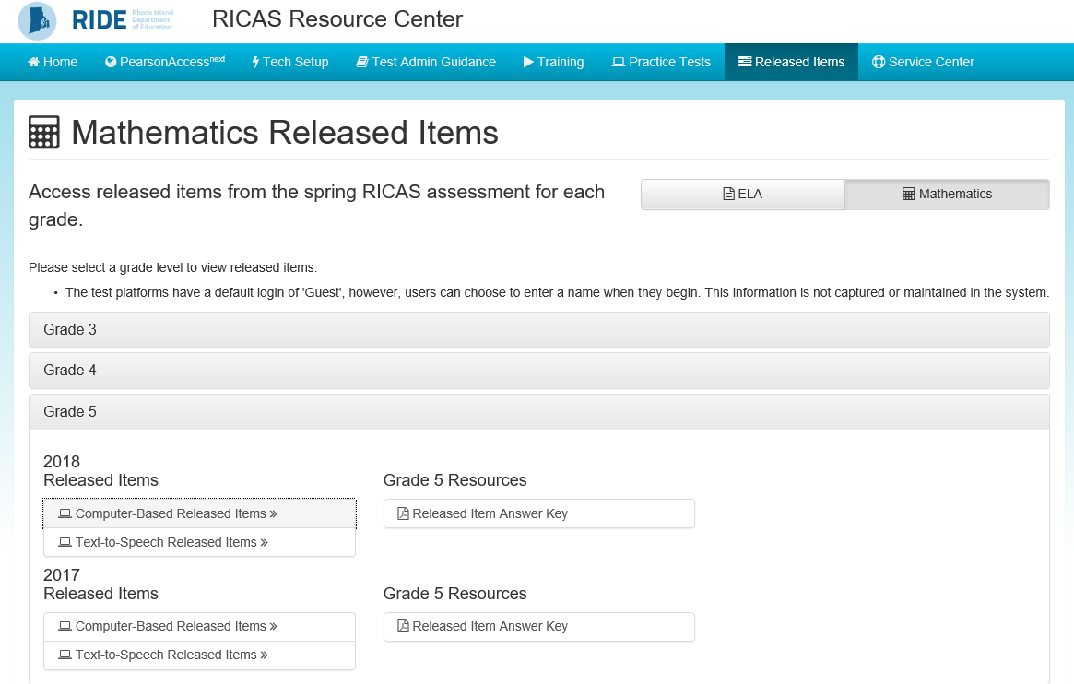
Read and Work the Task
Notes:
Resume the presentation.
As previously mentioned, the task for this calibration session is from the Spring 2018 released items. If you choose to access the item electronically, please Google the RICAS Resource Center. Once you arrive at the home page, click on the “Released Item” tab at the top right-hand side of the window’s banner. After doing so, you will arrive at the Released Items page. On that page, off to the right, there are tabs for ELA and Mathematics. After clicking “Mathematics” you will arrive at the page displayed on this screen.
I have clicked on the Grade 5 tab, and as you can see, it provides access to the released items for 2018 and 2017. Please click on the Computer-Based Released Items tab for 2018.
http://ricas.pearsonsupport.com/released-items/math/
Pause the presentation here if needed.

Slide 8
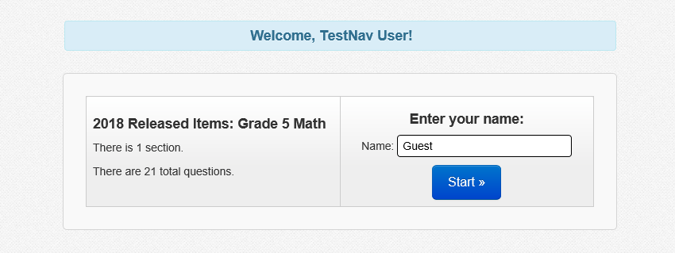
Read and Work the Task
Notes:
Resume the presentation as needed.
After clicking on that tab you should arrive at the TestNav 8 screen which is the entry page for the collection of grade 5 Computer-based Released Items from Spring 2018. This collection of items is a mini test called an ePAT (electronic practice assessment tool). Page through the ePAT screens until you get to the fifth item. (Note: This was item #7 on the live assessment)
Pause the presentation here as needed.

Slide 9
Read and Work the Task
This question has three parts.
Ben walked a distance of 1.2 kilometers. Alice walked a distance of 0.85 kilometer. Walter walked a distance of 50 meters.
Part A
What is the distance, in meters, that Ben walked? Show or explain how you got your answer.
Enter your answer and your work or explanation in the space provided.
Part B
How many more meters did Ben walk than Alice walked? Show or explain how you got your answer.
Enter your answer and your work or explanation in the space provided.
Part C
What is the total distance, in kilometers, that Ben, Alice, and Walter walked? Show or explain how you got your answer.
Enter your answer and your work or explanation in the space provided.
Notes:
Resume the presentation as needed.
Here we see the text of the item minus the answer entry spaces.
Connecting with the task is a vital step in the calibration process. Take some time here to read and work through the task. As you work, think of and make notes on alternate strategies students may employ, possible misconceptions they could have, and what your expectations are for performance to demonstrate proficiency.
Pause the presentation here to allow for work time.

Slide 10
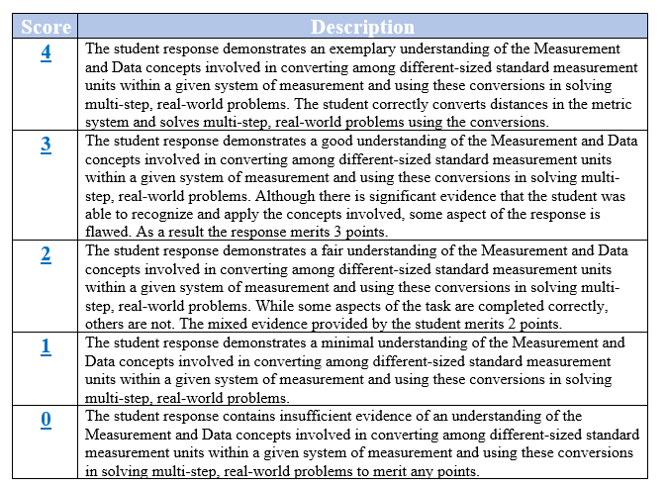
Review the Scoring Guide
Notes:
Resume the presentation.
Now that you have worked the task and thought about alternate strategies, possible misconceptions, and your expectations for proficiency, take some time to consider the Scoring Guide.
RICAS Scoring Guides are different in nature from rubrics you may be familiar with from past assessments. They highlight the text of the standard, comment on the degree of understanding (e.g., exemplary, good, fair, or minimal), and make references to the quantity of evidence present (e.g., significant or mixed) in a response. They do not give specific guidance on acceptable answers, strategies, or suggested responses. Analysis of student work and calibrating conversations will give groups a more expansive grounding in expectations.
Pause the presentation here to give time to review and analyze the Scoring Guide.

Slide 11
Scoring the Student Work
Individually, each participant:
uses the Scoring Guide to rank order the pieces of student work from highest to lowest and assigns a score to each
annotates the work with evidence and language from the Scoring Guide to support each score
shares individual scores with the group facilitator who will record them on the Master Scoring Sheet
Notes:
Resume the presentation.
Now it is time to actually dig into the student work samples. Your facilitator has prepared a small packet of work samples from which the assigned scores have been removed.
Each participant will work individually to rank order the pieces of student work from highest to lowest. Use the Scoring Guide and your notes from earlier in the session to assign a score to each piece. When assigning scores, seek out evidence in each piece of work to substantiate your choice. It is helpful to annotate the work as you go so you can refer to it during group discussion.
Once all participants have completed their individual scoring, the facilitator(s) will ask each person to share their numerical scores and he or she will record them on the Master Scoring Sheet. Participants may also choose to record the scores of their groupmates to use as a reference during conversation.
Generally speaking, the facilitator(s) has a paper copy of the Master Scoring Sheet. Of course other alternatives include a digital copy which can be displayed or a poster version. Both of these options may help facilitate group participation and transparent record keeping.
Pause the presentation here to allow time for participants to score student work.

Slide 12
Group Discussion Round I
As a whole group:
establish a set of norms for group discussion
discuss individual scores and arrive at a group consensus for each piece of student work
refer to evidence from student work and notations in the Scoring Guide
record consensus score and notes in the Master Scoring Sheet
Notes:
Resume the presentation.
Now the fun begins! The most beneficial aspect of the calibration process is the sharing of ideas and arriving at consensus. These conversations can be passionate and sometimes challenging. It is important to acknowledge this fact up front and to have a set of norms to keep conversations on track and professional. Possible norms to consider include:
Active listening
Equity of voice
Respectful all opinions
Safety to share
Link back to the evidence, avoid assumptions
Once a set of norms has been established, discussion can begin. Upon arriving at a consensus score, the facilitator will record it in the Master Scoring Sheet along with any pertinent notes from the conversation.
Pause the presentation here to have a group discussion

Slide 13
Group Discussion Round II
Facilitator distributes to each participant the official scores attributed to each piece of student work.
The group discusses any discrepancies between the group and official scores.
Collaboratively, the group crafts additional annotations for the pieces of student work in order to highlight evidence of performance and guidance for expectations.
The group augments the Scoring Guide by providing additional notes to better inform expectations at each performance level.
The group formulates a series of next steps (e.g., analyzing standards to attain a common understanding of required rigor, adjusting curriculum and instruction/assessment practices to standards’ analysis, revising in-class rubrics).
Notes:
Resume the presentation.
As a result of that first round of conversation, your group should have begun to shape a set of common expectations for demonstrating proficiency on the task. There may still be some questions in everyone’s minds, but this is normal given the abbreviated number of student samples and the absence of a traditional task-specific rubric.
Some of these questions may be addressed when the group reviews the official scores.
As the facilitator shares the official scores of each piece of student work, group members should take some time to process them in light of the evidence the group highlighted and language in the Scoring Guide. This is especially important since there are no annotations provided to concretely illuminate the assignation of a score. There may be discrepancies between the group consensus score and the official scores. Talk these through and think of annotations that can be made on each piece of student work and the Scoring Guide to better define parameters for performance.
Think about whether your expectations for performance were higher or lower than those illustrated by the official scores? If they were high, are there some things that you still want your students to aspire to during instruction, but have come to understand that sometimes more leeway is given in high stake assessments? If your expectations were low, are there changes that need to made during instruction to better help your students achieve proficiency?
As a group, formulate a series of next steps. These may include re-examining standards to attain a common understanding of the required rigor or making adjustments to instructional practices or materials. To gain more practice in interpreting the Scoring Guide and refining common expectations, you may consider administering the task to your students. This will provide you with a larger sample of student work and more opportunity to discuss exactly what characterizes each level of performance for this standard. The actions you decide to take should meet your particular needs.
Pause the presentation to allow time for discussion.

Slide 14
Resources
RICAS Resource Center
Computer-based RICAS Released Items
Student Work link - provides access to student samples housed on the Massachusetts Department of Education website
Released Item Answer Key - provides Scoring Guide for constructed response items. (Note: Item numbers correspond to the original Computer-based administration numbers and not the ePAT numbers.)
RICAS Released Items and Practice Tests
Printable version of Paper-based RICAS Released Items
Access to RICAS Digital Item Library
RICAS Mathematics Test Design and Supporting Resources
Notes:
Resume the presentation.
Welcome back and thank you for joining the RICAS Mathematics module Calibrating Expectations Using Existing Student Work Samples.
We hope this calibration session has provided you with an opportunity and a structure to gain a common understanding of expectations for performance on RICAS.
Please use the resources displayed on this page to help you conduct a calibration session for other RICAS mathematics released items.

Slide 15
Questions
Please direct all correspondence to:
assessment@ride.ri.gov
In the subject line of the inquiry include:
RICAS: Mathematics Calibration
Notes:
Should you have any questions, please contact us at the address displayed on the screen.

