Slide 1


RIDE School Construction Projects – MBE Participation
January 31, 2020
Presented by:
RI Department of Administration
Office of Diversity, Equity and Opportunity

Slide 2
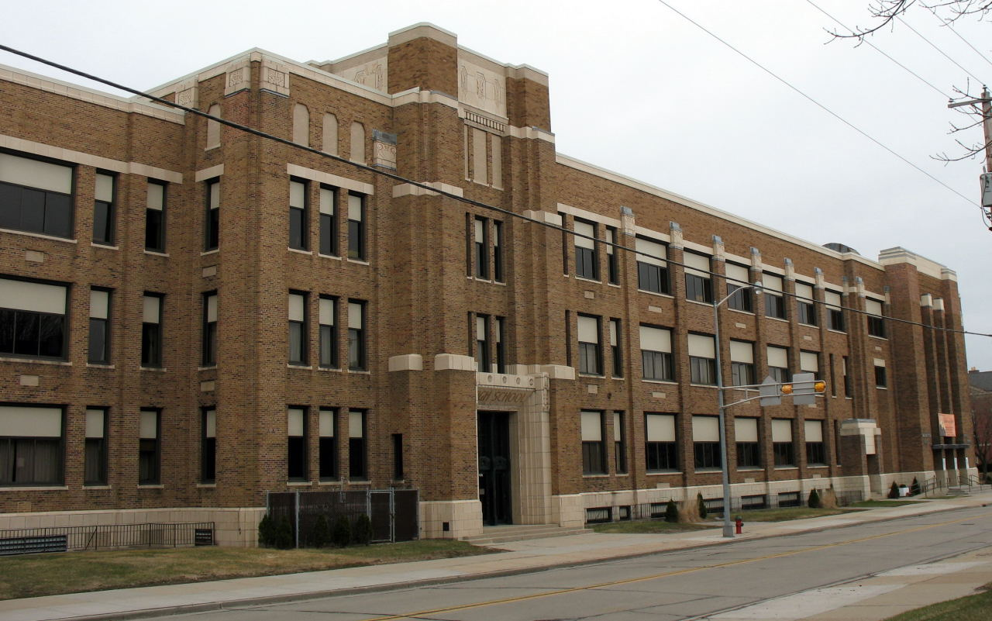
Necessity of School Construction
In September 2017, the Rhode Island Department of Education School Building Authority issues the Schoolhouses report which identifies more than $2.2 billion in school building deficiency costs
On September 13, 2017 Governor Raimondo signed Executive Order 17-09 creating the RI School Building Task Force to address needs outlined in Schoolhouses report
On November 6, 2018, Rhode Island voters approved the Statewide School Construction Bond

Slide 3

Statewide School Construction Bond
School Building Authority Capital Fund (“SBA Capital Fund”) creates funding mechanism designed to provide upfront funding for projects
School Housing Aid, governed by RIGL 16-7, Sections 35 – 47, provides for a minimum35% state share ratio for Housing Aid set by law
Minimum 10% MBE participation requirement on all state funded school construction projects

Slide 4
MBE / WBE PROGRAM
Governed by RIGL § 37-14.1
Minority Business Enterprises shall be awarded a minimum of ten percent of the dollar value of all state purchasing, including, but not limited to, the procurement of goods, services, construction projects, or contracts funded in whole or in part by state funds, or funds which, in accordance with a federal grant or otherwise, the state expends or administers or in which the state is a signatory to the construction contract

Slide 5

MBE Participation Requirement Applicability
MBE requirement applicable to entire project
  Design
  Owner’s Project Manager
  Construction Manager / General Contractor

Slide 6

MBE Program Training
LEAs should meet with ODEO/MBECO early on during the development of a project in order to provide an overview of project details, to gain an understanding of the MBE program, and to ensure the incorporation of MBE requirements and pertinent language in all applicable documents.

Slide 7
Suggested Solicitation Language
In accordance with RI Gen. Law § 37-14.1-1, it is the policy of the State of Rhode Island to support the fullest possible participation of firms owned and controlled by minorities (MBEs) and women (WBEs). Pursuant to §§ 37-14.1-2 and 37-14.1-6, MBEs and WBEs shall be included in all state purchasing, including, but not limited to, the procurement of goods, services, construction projects, or contracts funded in whole or in part with state funds, or funds which, in accordance with a federal grant or otherwise, the state expends or administers. MBEs and WBEs shall be awarded a minimum of ten percent (10%) of the dollar value of the entire procurement or project. MBE participation credit shall only be granted for firms duly certified as MBEs or WBEs by the State of Rhode Island, Department of Administration, Office of Diversity, Equity and Opportunity, MBE Compliance Office (MBECO). The current directory of firms certified as MBEs or WBEs may be accessed at http://odeo.ri.gov/offices/mbeco/mbe-wbe.php or by contacting Dorinda Keene at the MBECO at (401) 574-8670 or via email at Dorinda.Keene@doa.ri.gov

Slide 8

Strategies for Increasing MBE Participation
Break up projects and/or scopes of work into smaller, economically feasible contracts in order to facilitate MBE participation.
Select portions of work to be performed by MBEs in order to increase likelihood of meeting MBE participation requirements.
Recognize opportunities for sub-tier participation and participation for the supply of goods.
Require 1st tier subcontractors to make a good faith effort to include MBE participation on their scopes, and set MBE goals accordingly.
Utilize the resources of the MBECO and SDO to assist in outreach and bid matching.

Slide 9
MBE/WBE Certification Criteria
Business must be owned and controlled, both administratively and operationally, at least 51% by socially and economically disadvantaged minorities or women.
Business, inclusive of all affiliate firms, must meet small business size standard criteria.
If operating in a licensed industry, both the business and the socially and economically disadvantaged owner must possess the applicable Rhode Island license.
Business must be an on-going business concern and be in operation for a minimum of six (6) months.
Businesses located outside of Rhode Island must seek certification in home state prior to seeking certification in Rhode Island.

Slide 10
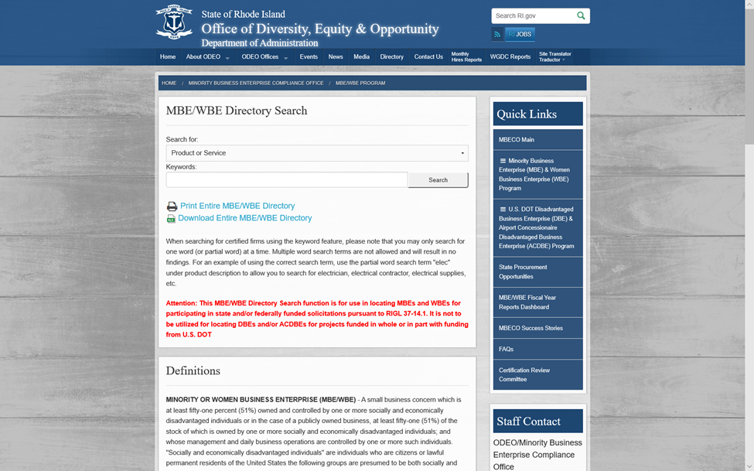
Where Can I Find MBE/WBE Firms?
ODEO/MBECO is the sole certification authority for MBE and WBE certification.
The current directory of certified MBE and WBE firms is available on the ODEO website at http://odeo.ri.gov/offices/mbeco/mbe-wbe.php

Slide 11
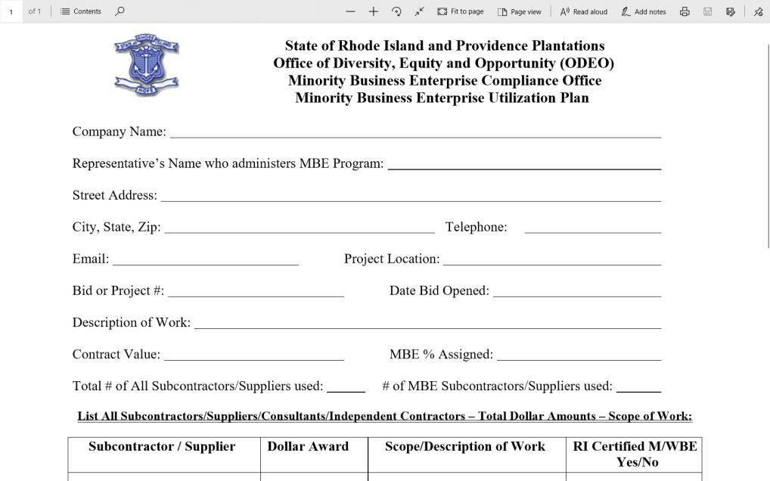
Contract and Reporting Requirements
An MBE Utilization Plan must be submitted to ODEO/MBECO for review and approval prior to commencement of work. Plan forms are available on the ODEO website at http://odeo.ri.gov/offices/mbeco/mbe-wbe.php#section4
MBE/WBE firms must be certified by ODEO/MBECO at the time of submission of an MBE Utilization Plan
During the course of the project, periodic reporting, including the submission of subcontracts, invoices and cancelled checks for payment to MBEs is required. The MBE Project Reporting Form is available on the ODEO website at http://odeo.ri.gov/offices/mbeco/mbe-wbe.php#section4

Slide 12

Good Faith Efforts
Vendors are required to actively and aggressively seek MBE participation for all available opportunities for participation.
Specific regulations and guidance regarding whether a vendor, consultant, or prime contractor has made a “Good Faith Effort” to fulfill the pertinent MBE/WBE participation requirements are available on the ODEO website at http://odeo.ri.gov/offices/mbeco/mbe-wbe.php#section3

Slide 13

Waiver Requests
If a bidder, vendor, or contractor is unable to comply with the MBE participation requirement for state funded contracts and projects, a request for a waiver or partial waiver of the participation requirement may be submitted to the ODEO/MBECO for review and approval.
  No waiver of the MBE participation requirement shall be granted without written documentation of good faith efforts to achieve same.
  Waiver requests should be submitted for approval prior to the release of contracts and/or commencement of work on a contract.
  No request for a waiver of the MBE participation requirement will be entertained after the contract or project has been, or is substantially completed.

Slide 14

Substitution of MBEs/WBEs
Substitution of MBE/WBEs as identified in approved MBE/WBE plans will only be allowed for cause as per regulations.
Substitutions must be approved, in writing, by ODEO/MBECO prior to commencement of work.
Under no circumstances will substitution be allowed for convenience.
The rules regarding the substitution of MBE/WBEs are available on the ODEO website located at http://odeo.ri.gov/offices/mbeco/mbe-wbe.php#section3

Slide 15

Project Close-Out Documentation
LEAs will be required to provide project close-out documents to ODEO in order to receive final verification of compliance with RIGL 37-14.1.
Fulfillment of the MBE participation requirement is one criterion for School Housing Aid.

Slide 16
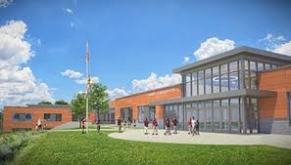
Contacts
Dorinda L. Keene
Assistant Administrator - MBE
Office of Diversity, Equity & Opportunity
MBE Compliance Office
One Capital Hill, 3rd Floor
Providence, RI 02908
(401) 574-8670
Dorinda.Keene@doa.ri.gov
Jean M. Heiss
Programming Service Officer
Office of Diversity, Equity & Opportunity
MBE Compliance Office
One Capital Hill, 3rd Floor
Providence, RI 02908
(401) 574-8356
Jean.M.Heiss@doa.ri.gov
Elvys Ruiz
Chief Program Development
Office of Diversity, Equity & Opportunity
Supplier Diversity Office
One Capital Hill, 3rd Floor
Providence, RI 02908
(401) 574-8253
Elvys.Ruiz@doa.ri.gov

Slide 17

QUESTIONS?

